Slide 1
How to Setup Automatic Sync between Mobile devices and Servers
Under 3 hours

Slide 2
Starter Configuration

Slide 3
Where to Start
Make sure you have Android Studio
Make sure you have an image lvl 19+
You can clone the final version and follow the steps using git
https://github.com/ldoguin/couchbase-mobile-android-workshop
Notes:
Explain that “get sync for free” means you have to write syncing function, so not entirely free

Slide 4
What we are going to do?
A simple app
Showing a list of items
And the details of said items
These items will be stored in a local database
The local database will be synchronized to a remote Database
Notes:
Explain that “get sync for free” means you have to write syncing function, so not entirely free

Slide 5
Working with Couchbase Mobile
An introduction to concepts and practices

Slide 6
The Couchbase Mobile stack
Couchbase Lite: a lightweight native document database for the device
SyncGateway: handles synchronisation, including content auth and validation
Couchbase Server: could also be CouchDB or another compatible database

Slide 7
Couchbase Lite
Native API for:
iOS
Android
Windows Phone
REST API:
Used with Phonegap, Titanium (with a wrapper) and so on
Document database using CouchbDB-like model:
Native JSON storage
Uses map-reduce to create indexes (called views)
Work locally with Couchbase Lite and get sync for free
Notes:
Explain that “get sync for free” means you have to write syncing function, so not entirely free

Slide 8
Sync Gateway
Lives in the data center or cloud environment
Uses a Couchbase Server bucket to persist data from Couchbase Lite devices
HTTP listener that provides a passive replication end point
Notes:
Explain that “get sync for free” means you have to write syncing function, so not entirely free

Slide 9
Couchbase Server
Couchbase Server 2.0 or newer
Requires a dedicated bucket
CPU: SyncGateway uses Couchbase views
Notes:
Explain that “get sync for free” means you have to write syncing function, so not entirely free

Slide 10
How to Follow the Workshop

Slide 11
One Step One Tag
To follow the workshop easily
git clone https://github.com/ldoguin/couchbase-mobile-android-workshop
Follow the git checkout stepX to move the code directly to the right step

Slide 12
git checkout step0

Slide 13
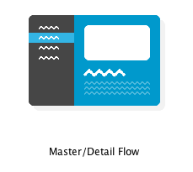
The Master/Detail Flow wizard
Create a new project with sdk 19 or above
Select the Master/Detail Flow Wizard

Slide 14
Congrats!
You are now ready for the next step
That was easy huh?

Slide 15
Git checkout step1

Slide 16
The Presentation POJO
Replace the DummyItem and DummyContent by a PresentationItem and PresentationContent
A Presentation represents a talk with a title, an abstract, a date.

Slide 17
Git checkout step2

Slide 18
Store Presentation in Couchbase Lite
Get a Couchbase Lite instance
Store Presentation objects in Couchbase Lite
Unit test this

Slide 19
Couchbase Lite concepts
Manager
Your single point of entry into Couchbase Lite
One manager for each app
Multiple databases per manager
Database
Broadly equivalent to a Couchbase Server bucket
Usually one database per app
Databases are independent: if you’re writing a multi-user app, consider one database per user
Notes:
Explain that “get sync for free” means you have to write syncing function, so not entirely free

Slide 20
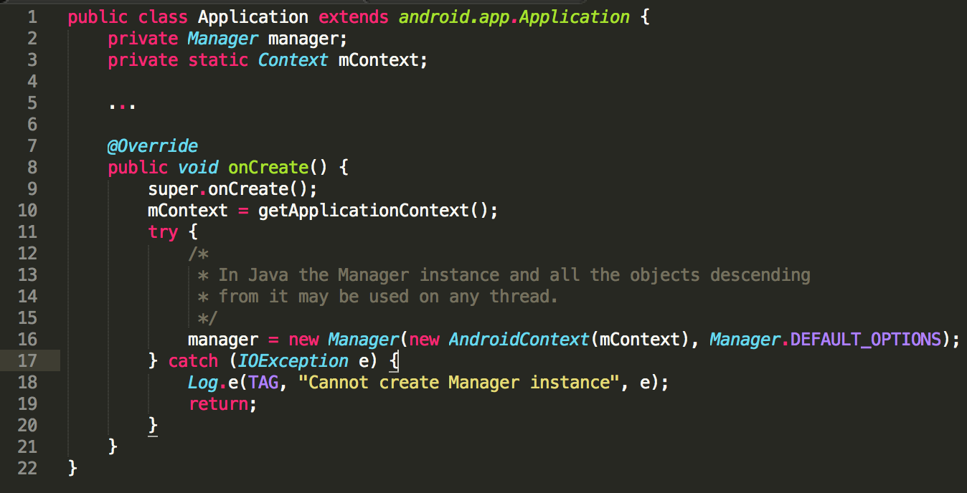
Creating a Manager
Notes:
Explain that “get sync for free” means you have to write syncing function, so not entirely free

Slide 21
Database concepts
Document: JSON documents, each with a unique ID
View: an index created by a map-reduce script
Filter function: filter which documents are pushed to SyncGateway
Replication: set up push, pull or bi-directional replication with SyncGateway
Notes:
Explain that “get sync for free” means you have to write syncing function, so not entirely free

Slide 22
Couchbase Lite the Local Database
Start by the following unit test:
public class ApplicationTest extends ApplicationTestCase<Application> {
private Database database;
public ApplicationTest() throws CouchbaseLiteException {
super(Application.class);
}
@Override
public void setUp() throws Exception {
super.setUp();
createApplication();
database = getApplication().getDatabase();
}

Slide 23
Couchbase Lite the Local Database
public void testDatabase() throws CouchbaseLiteException {
// This will create a document using the given id
// Be careful, despite the fact that we use a getter, the document is not yet persisted
Document document = database.getDocument("myDocumentId");
assertNull(database.getExistingLocalDocument(document.getId()));
Map<String, Object> properties = new HashMap<>();
properties.put("title", "doc title");
// The call to putProperties will create a new local revision of the document, thus
// persisting it.
document.putProperties(properties);
assertNotNull(database.getExistingDocument(document.getId()));
}

Slide 24
Couchbase Lite the Local Database
public void testPresentation() throws Exception {
// Start by creating a presentation document
Presentation.createPresentation(database,"Doc1 Title","Abstract");
// Create another presentation through the save method
Presentation pres2 = new Presentation(database);
pres2.setTitle("Doc2 Title");
pres2.setPresentationAbstract("presentationAbstract");
pres2.save();
// use a specific database query that returns all the documents
QueryEnumerator qe = database.createAllDocumentsQuery().run();
// Make sure we see our previously created document
Boolean foundDoc1 = false;
Boolean foundDoc2 = false;
while (qe.hasNext()) {
QueryRow qr = qe.next();
Document doc = qr.getDocument();
Presentation presentation = Presentation.from(doc);
if (presentation.getTitle().equals("Doc1 Title")) {
foundDoc1 = true;
} else if (presentation.getTitle().equals("Doc2 Title")) {
foundDoc2 = true;
}
}
assertTrue(foundDoc1);
assertTrue(foundDoc2);
}

Slide 25
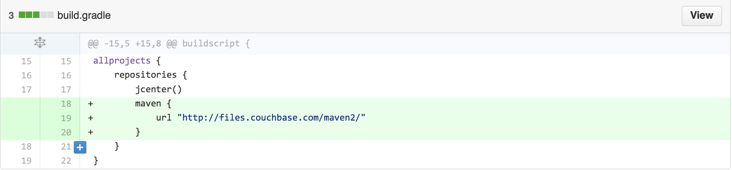
Compilation issues?

Slide 26
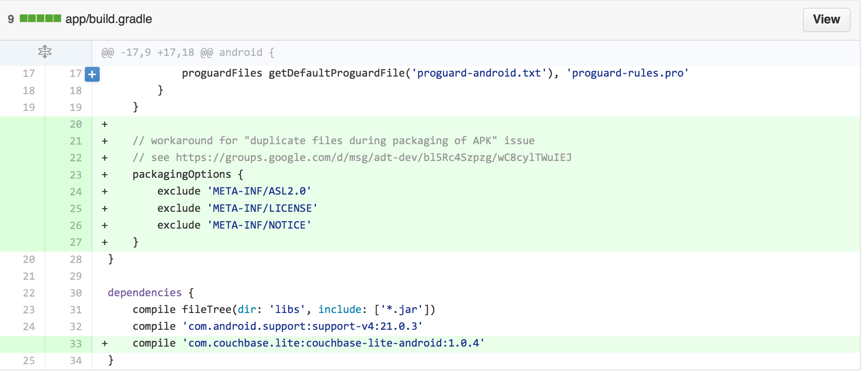
Compilation issues?

Slide 27
This requires to:
Create a new Application class to manage the Database
Add create/save methods to the Presentation

Slide 28
Git checkout step3

Slide 29
Query the Presentation Objects
Query all the Presentation Object
Feed them to a view adapter that will be automatically updated once there is a change.

Slide 30
Basics of querying
First you need to create a view
Views are:
persistent indexes of your documents
generated by map (and optionally reduce) queries that you write
use the native language of the platform (Java in our case)

Slide 31
Querying the view
Queries return an iterable of QueryRow objects
You can check if the query is stale and then optionally run the query again to update it
Three types of query:
Standard
All-docs
LiveQuery

Slide 32

Query: most recent 20 blog posts

Slide 33
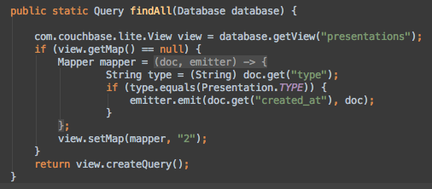
Our query: return all the presentations

Slide 34
LiveQuery: creating reactive interfaces
A LiveQuery lets us build a UI that updates automatically
Links the Model to the View
Feed lists with an appropriate adapter class

Slide 35
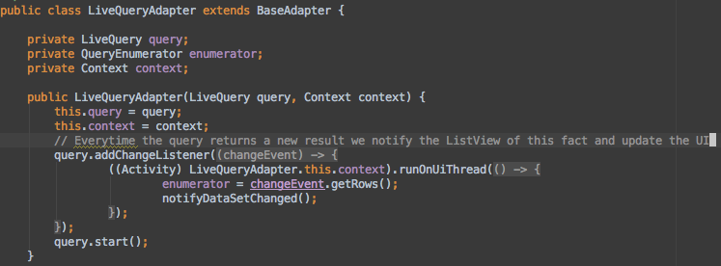
LiveQueryAdapter.java

Slide 36
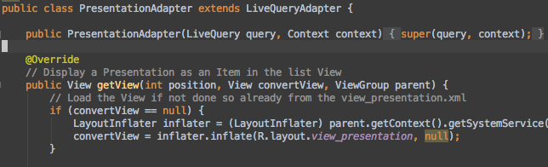
PresentationAdapter.java

Slide 37
Build an Index and a LiveQueryAdapter
Add create/save methods to the Presentation

Slide 38
Build an Index and a LiveQueryAdapter
public LiveQueryAdapter(LiveQuery query, Context context) {
this.query = query;
this.context = context;
// Everytime the query returns a new result we notify the ListView of this fact and update the UI
query.addChangeListener(new LiveQuery.ChangeListener() {
@Override
public void changed(final LiveQuery.ChangeEvent changeEvent) {
((Activity) LiveQueryAdapter.this.context).runOnUiThread(new Runnable() {
@Override
public void run() {
enumerator = changeEvent.getRows();
notifyDataSetChanged();
}
});
}
});
query.start();
}

Slide 39
Git checkout step4

Slide 40
Setting Up the Sync Gateway
Start by Reading ConfigureSyncGateway.md

Slide 41
Git checkout step5

Slide 42
Setup the Push/Pull Replication
private void setupSync() throws MalformedURLException {
URL url = new URL(SYNC_URL_HTTP);
pull = database.createPullReplication(url);
push = database.createPushReplication(url);
pull.setContinuous(true);
push.setContinuous(true);
pull.start();
push.start();
}

Slide 43
Git checkout step6

