Slide 1
HOW TO SETUP AUTOMATIC SYNC BETWEEN MOBILE DEVICES AND SERVER
Laurent Doguin, Dev Advocate
Couchbase
@ldoguin
Notes:
Hi Everyone.
I’m Wayne Carter.
I’m the Chief Architect of Mobile at Couchbase where I head up their mobile products.
Today I’ll give you an introduction to Couchbase Mobile and talk about building apps that always work.

Slide 2
WORKSHOP SETUP

Slide 3
What we are going to do?
Learn about Couchbase Mobile
A simple app
Showing a list of items
And the details of said items
These items will be stored in a local database
The local database will be synchronized to a remote Database
Notes:
Explain that “get sync for free” means you have to write syncing function, so not entirely free

Slide 4
Where to Start
Make sure you have Android Studio
Make sure you have an image lvl 19+
You can clone the final version and follow the steps using git
https://github.com/ldoguin/couchbase-mobile-android-workshop
Notes:
Explain that “get sync for free” means you have to write syncing function, so not entirely free

Slide 5
WhySync
Notes:
Thanks Ali.
So, why is sync so important?

Slide 6
Today’s Mobile Apps
No Internet
Try again later.
please wait…
Notes:
Let’s start with the typical deployment topology of today’s mobile apps.
Most mobile applications today use a remote data strategy that relies on data that exists in the cloud and to get to this data the applications require a network connection.
If the network is available things typically work as expected
[FWD]
But if the network is slow the application is slow. This is why we have UI components like activity indicators.
[FWD]
And if the network is unavailable then the application doesn’t work…so try back later.

Slide 7
The Problem
Remote Data
Notes:
So the core problem we face is the location of our data.
When the data isn’t located on our device, there will always be situations where it isn’t available.
And when the data isn't available the app won’t work.

Slide 8
The Solution
Local Data + Sync
Notes:
So what we need is data locally on the device and a mechanism to keep the local data in sync w/ the remote data.
Synchronization does that for us.

Slide 9
What does this mean for apps?
Notes:
So what does this mean for apps?

Slide 10
Always Work
Notes:
Apps will always work.

Slide 11
Always Fast
Notes:
Apps will always be fast.

Slide 12
Notes:
And users will absolutely love them because of it.

Slide 13
CouchbaseMobile
Notes:
Now let’s take a look at Couchbase Mobile.

Slide 14
Couchbase Lite
Embedded NoSQL Database
Sync Gateway
Secure Synchronization
Couchbase Server
Cloud NoSQL Database
Notes:
Couchbase Mobile includes:
Couchbase Lite: An embedded NoSQL Database that runs locally on the device.
Sync Gateway: An internet facing cloud component that securely syncs data between the device and cloud.
Couchbase Server: Our highly scalable, high performance, NoSQL Database that runs in the cloud.

Slide 15
YearOne
Notes:
We’ve done some really amazing things w/ Couchbase Mobile over the past year.

Slide 16
Couchbase Mobile Innovation
Couchbase Lite
Unity
Sync Gateway
Web Hooks
View Query
Couchbase Lite
iOS
Android
OS X
Linux
Windows
Sync Gateway
Multi-Master Sync
Authentication
Read/Write Access
REST
Couchbase Lite
Unity (beta)
1.1
Couchbase Lite
Microsoft .NET
Xamarin
Mono
Couchbase Lite
Forest DB (alpha)
1.0.4
1.0.3
1.0.2
1.0.1
1.0
May
Jun
Jul
Aug
Sep
Oct
Nov
Dec
Jan
Mar
Feb
Apr
May
2014
2015
Notes:
It all started exactly one year ago w/ the release of Couchbase Mobile 1.0.
For devices, we had support for iOS, Android, OS X, Linux, and Windows.
And we had Sync Gateway, for secure multi-master synchronization over the internet.
In the fall, we released our .NET support for the Microsoft, Xamarin, and Mono runtimes
And we added some great experimental features like integration w/ Forest DB.
In the spring, we released Unity support.
And now in our 6th release, we have even more great features that I’ll talk about in more detail later.

Slide 17
The most complete NoSQL database solution
Notes:
We built the most complete NoSQL database solution on the market...

Slide 18
to power
mobile
tablet
wearable
desktop
laptop
IoT
web
apps
games
Notes:
…to power
Mobile
Tablet
Wearable
Desktop
Laptop
IoT
and Web
…Apps...and Games

Slide 19
Notes:
That users will absolutely love.

Slide 20
MarketLandscape
Notes:
So taking a step back, let’s quickly talk about the mobile database market and when this online-first to offline-first trend began.

Slide 21
Online-First to Offline-First
REST
Offline-first and
need for sync
Shift to
Local Data
The iPhone
Enterprise Sync
1998
2007
2010
Today
Notes:
The beginning of time in mobile as we know it today was 2007, with the release of the first iPhone.
From 2007 through today, the primary way to power mobile apps is via REST.
And while REST allows developers to take this proven architectural approach and apply it to mobile platforms, it also means that mobile apps (like web apps), will only work when you have a network connection.
Then we got to 2010, where there was a shift in sync capabilities that would move data to and from other endpoints, like the cloud.
For the record, this wasn’t a new approach but more of a reemergence of the enterprise sync technologies of the late 90s.
Back then, you would see companies like Siebel, Oracle, SAP and others use local data and sync technology to enable remote sales forces on their laptops. And there are a lot of other examples.
But then that sync kind of died off with the shift to web apps and the promise of ubiquitous wireless networks.
So going back to today, there’s now the shift towards an offline-first enterprise. Mobile apps have to work with and without a network connection.

Slide 22


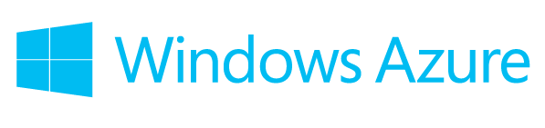
Mobile Sync Offerings
Notes:
In addition to Couchbase Mobile, over the past year and a half, all the major cloud providers including Amazon, Google, and Microsoft have added some form of sync and offline capability to their mobile offerings.
The point is that the major players in the market all have sync built-in.
So with that, let’s bring Wayne back up who can tell us why sync is so important.

Slide 23
CouchbaseMobile
Notes:
Now let’s take a look at Couchbase Mobile.

Slide 24
Couchbase Lite
Embedded NoSQL Database
Sync Gateway
Secure Synchronization
Couchbase Server
Cloud NoSQL Database
Notes:
Couchbase Mobile includes:
Couchbase Lite: An embedded NoSQL Database that runs locally on the device.
Sync Gateway: An internet facing cloud component that securely syncs data between the device and cloud.
Couchbase Server: Our highly scalable, high performance, NoSQL Database that runs in the cloud.

Slide 25
Couchbase Lite
Embedded NoSQL Database
Notes:
Ok...let’s dive a little deeper into each component starting w/ Couchbase Lite our embedded NoSQL database.

Slide 26
Full-Featured
Notes:
It has all of the features of our server database plus some additional features around revision handling and conflict resolution.

Slide 27
Lightweight
500kb
Notes:
It’s super light. Weighing in at just 500kb on most platforms.

Slide 28
Cross Platform
Notes:
We’re very focused on cross platform portability.
And we’ve built from the ground up native for each platform.
We currently have support for a bunch of different platforms.

Slide 29



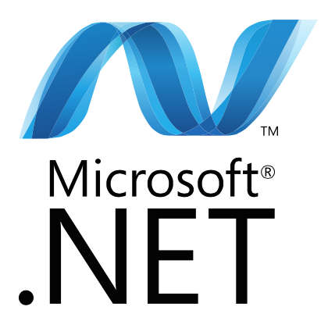


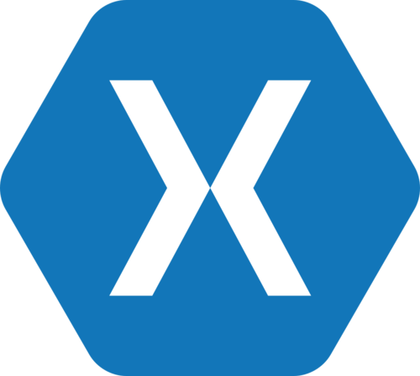
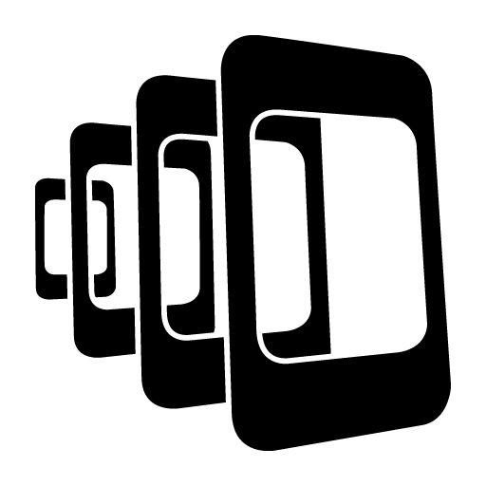

Notes:
We have an Objective-C version for all the Apple technologies. This includes:
- iOS
- OS X
Our Java version supports any platform that can run a J2SE compliant JVM. So:
- Android
- Linux
- Windows
- And a ton more.
And our C# version supports all the .NET runtimes. That’s:
- Microsoft
- Mono
- Unity
- Xamarin

Slide 30
Secure
Notes:
It’s secure.
I have a whole section on security so I’ll cover this in more detail in a minute.

Slide 31
JSON
Notes:
It has an awesome flexible JSON data model…just like the server.
So one modeling language throughout w/ no transforms.

Slide 32
Sync Gateway
Secure Synchronization
Notes:
Sync Gateway is a cloud component that sits on the boundary of your public and private cloud.
It resolves application level replication and security concerns allowing you to securely synchronize data over the internet.

Slide 33
Authentication
Notes:
For User Auth we support pluggable authentication.
Out of the box we have support for popular public login providers like Facebook or you can write your own custom provider.
You can restrict access to the system to authenticated users and optionally allow unauthenticated guest users.

Slide 34
Data Read Access
Notes:
For Data Read/Write Access there’s fine-grained control for granting data access for individual users and roles.
Read-side permissions are at the document level.

Slide 35
Data Write Access
Notes:
Write-side permissions are separate from read-side permissions and are down to the field level.

Slide 36
Couchbase Server
Cloud NoSQL Database
Notes:
And backing all of this you have Couchbase Server in the cloud.

Slide 37
Highly Scalable
Notes:
It’s highly scalable.
You can start w/ a few nodes and scale that out adding additional nodes as you need capacity.

Slide 38
High Performance
Notes:
Reading and writing data is always super fast.

Slide 39
Always On
Notes:
Data is always available all the time.

Slide 40
JSON
Notes:
And again it has the awesome flexible JSON data model…just like mobile.

Slide 41
ChangeEvents
Notes:
We’ve made it really easy to find out when data changes in our database.
Let’s look at how change events work.

Slide 42
Data Center

Slide 43
Database.Change
Document.Change
Query.Change
OnDocumentChanged
OnDatabaseChanged
Notes:
Scope

Slide 44
Sync Gateway: OnDocumentChanged
"event_handlers": {
"document_changed": [
{
"handler": "webhook",
"url": "http[s]://[user:pass@]www.domain.com/changehandler"},
"filter": `function(doc) {
return (doc.type == "article");
}`
}
]
}

Slide 45
Sync Gateway: OnDatabaseChanged
"event_handlers": {
"document_changed": [
{
"handler": "webhook",
"url": "http[s]://[user:pass@]www.domain.com/changehandler”}
}
]
}

Slide 46
DeploymentTopology

Slide 47
Star
Tree
Mesh

Slide 48
Star
Data Center
LBR
<html/>
Web Server

Slide 49
Tree
Retail Store
Data Center
LBR
<html/>
Web Server

Slide 50
Mesh
Retail Store
Data Center
LBR
<html/>
Web Server

Slide 51
Security

Slide 52
User Authentication
Data Read/Write Access
Data Transport on the Wire
Data Storage on the Device
Data Storage in the Cloud
Notes:
There are five key security concerns during data synchronization and decentralized storage on device:
1) User Authentication
2) Data Read/Write Access
3) Data Transport on the Wire
4) Data Storage on Device
5) Data Storage in the Cloud
Let’s look at how Couchbase Mobile resolves each of these concerns.

Slide 53
Data Center

Slide 54
User Authentication
Notes:
For User Auth we support pluggable authentication.
Out of the box we have support for popular public login providers or you can write your own custom provider.
You can also restrict access to the system to successfully authenticated users or optionally allow anonymous users.

Slide 55
Read/Write Access
Notes:
For Data Read/Write Access there are fine-grained policy tools that allow controlling data access for individual users and roles.
Read-side permissions are at the document level.
Write-side permissions are down to the field level.

Slide 56
Transport on the Wire
Notes:
Data Transport on the Wire, for data in motion, is over TLS.

Slide 57
Storage on the Device
Notes:
Data Storage on Device, for data at rest on device, uses the device’s built in File System Encryption.
And soon we will also support:
- Data Level Encryption (on top of File System Encryption): If you provide us w/ a set of encryption keys we’ll encrypt and decrypt data as you read and write it to and from the database.
- Data Lease Policies: If you configure these policies and the device doesn’t re-lease the data it will be automatically deleted when its lease expires.

Slide 58
Storage in the Cloud
Notes:
For data at rest in the cloud, you can secure Couchbase Server in a secure cloud and optionally configure it’s database nodes to use File System Encryption.

Slide 59
User Authentication
Data Read/Write Access
Data Transport on the Wire
Data Storage on the Device
Data Storage in the Cloud
Notes:
With Couchbase Mobile we have:
1) Support for out-of-the-box and custom authentication providers
2) Granular data read/write access policies
3) Secure transport on the wire
4) Secure storage on device
5) Secure storage in the cloud

Slide 60
How to Follow the Workshop

Slide 61
One Step = One Tag
To follow the workshop easily
git clone https://github.com/ldoguin/couchbase-mobile-android-workshop
Follow the git checkout stepX to move the code directly to the right step
You can use git reset --hard to make sure you can follow the next step

Slide 62
git checkout step0

Slide 63
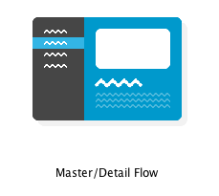
The Master/Detail Flow wizard
Create a new project with sdk 19 or above
Select the Master/Detail Flow Wizard

Slide 64
Congrats!
You are now ready for the next step
That was easy huh?

Slide 65
Git checkout step1

Slide 66
The Presentation POJO
Replace the DummyItem and DummyContent by a PresentationItem and PresentationContent
A Presentation represents a talk with a title, an abstract, a date.

Slide 67
Git checkout step2

Slide 68
Store Presentation in Couchbase Lite
Get a Couchbase Lite instance
Store Presentation objects in Couchbase Lite
Unit test this

Slide 69
Couchbase Lite concepts
Manager
Your single point of entry into Couchbase Lite
One manager for each app
Multiple databases per manager
Database
Broadly equivalent to a Couchbase Server bucket
Usually one database per app
Databases are independent: if you’re writing a multi-user app, consider one database per user
Notes:
Explain that “get sync for free” means you have to write syncing function, so not entirely free

Slide 70
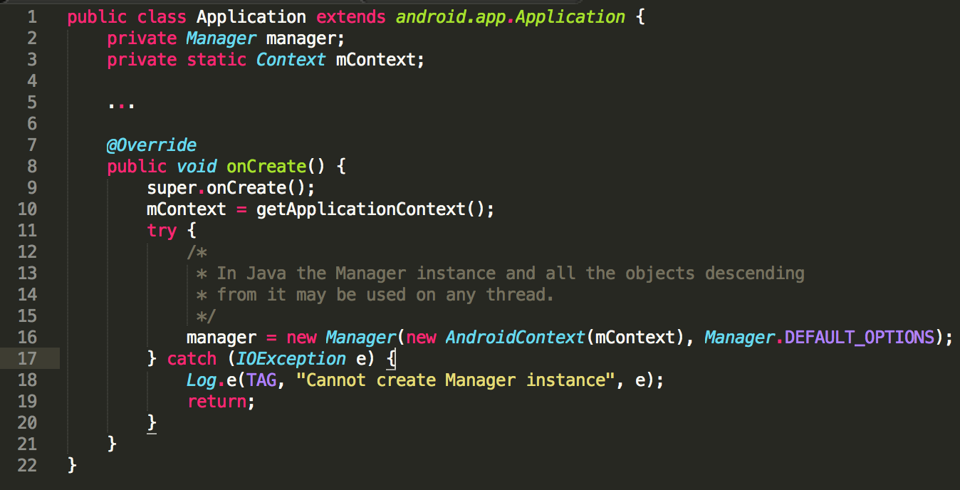
Creating a Manager
Notes:
Explain that “get sync for free” means you have to write syncing function, so not entirely free

Slide 71
Database concepts
Document: JSON documents, each with a unique ID
View: an index created by a map-reduce script
Filter function: filter which documents are pushed to SyncGateway
Replication: set up push, pull or bi-directional replication with SyncGateway
Notes:
Explain that “get sync for free” means you have to write syncing function, so not entirely free

Slide 72
Couchbase Lite the Local Database
Start by the following unit test:
public class ApplicationTest extends ApplicationTestCase<Application> {
private Database database;
public ApplicationTest() throws CouchbaseLiteException {
super(Application.class);
}
@Override
public void setUp() throws Exception {
super.setUp();
createApplication();
database = getApplication().getDatabase();
}

Slide 73
Couchbase Lite the Local Database
public vid testDatabase() throws CouchbaseLiteException {
// This will create a document using the given id
// Be careful, despite the fact that we use a getter, the document is not yet persisted
Document document = database.getDocument("myDocumentId");
assertNull(database.getExistingLocalDocument(document.getId()));
Map<String, Object> properties = new HashMap<>();
properties.put("title", "doc title");
// The call to putProperties will create a new local revision of the document, thus
// persisting it.
document.putProperties(properties);
assertNotNull(database.getExistingDocument(document.getId()));
}

Slide 74
Couchbase Lite the Local Database
public void testPresentation() throws Exception {
// Start by creating a presentation document
Presentation.createPresentation(database,"Doc1 Title","Abstract");
// Create another presentation through the save method
Presentation pres2 = new Presentation(database);
pres2.setTitle("Doc2 Title");
pres2.setPresentationAbstract("presentationAbstract");
pres2.save();
// use a specific database query that returns all the documents
QueryEnumerator qe = database.createAllDocumentsQuery().run();
// Make sure we see our previously created document
Boolean foundDoc1 = false;
Boolean foundDoc2 = false;
while (qe.hasNext()) {
QueryRow qr = qe.next();
Document doc = qr.getDocument();
Presentation presentation = Presentation.from(doc);
if (presentation.getTitle().equals("Doc1 Title")) {
foundDoc1 = true;
} else if (presentation.getTitle().equals("Doc2 Title")) {
foundDoc2 = true;
}
}
assertTrue(foundDoc1);
assertTrue(foundDoc2);
}

Slide 75
This requires to:
Fix the compilation issues
Create a new Application class to manage the Database
Add create/save methods to the Presentation

Slide 76
Compilation issues?
allprojects {
repositories {
jcenter()
maven {
url "http://files.couchbase.com/maven2/"
}
}
}
dependencies {
compile fileTree(dir: 'libs', include: ['*.jar'])
compile 'com.android.support:support-v4:21.0.3'
compile 'com.couchbase.lite:couchbase-lite-android:1.0.4'
}

Slide 77
Compilation issues?
// workaround for "duplicate files during packaging of APK" issue
// see https://groups.google.com/d/msg/adt-dev/bl5Rc4Szpzg/wC8cylTWuIEJ
packagingOptions {
exclude 'META-INF/ASL2.0'
exclude 'META-INF/LICENSE'
exclude 'META-INF/NOTICE'
}

Slide 78
Git checkout step3

Slide 79
Query the Presentation Objects
Query all the Presentation Object
Feed them to a view adapter that will be automatically updated once there is a change.

Slide 80
Basics of querying
First you need to create a view
Views are:
persistent indexes of your documents
generated by map (and optionally reduce) queries that you write
use the native language of the platform (Java in our case)

Slide 81
Querying the view
Queries return an iterable of QueryRow objects
You can check if the query is stale and then optionally run the query again to update it
Three types of query:
Standard
All-docs
LiveQuery

Slide 82

Query: most recent 20 blog posts

Slide 83
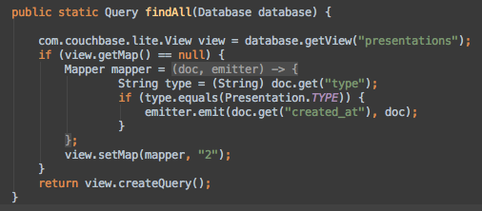
Our query: return all the presentations

Slide 84
LiveQuery: creating reactive interfaces
A LiveQuery lets us build a UI that updates automatically
Links the Model to the View
Feed lists with an appropriate adapter class

Slide 85
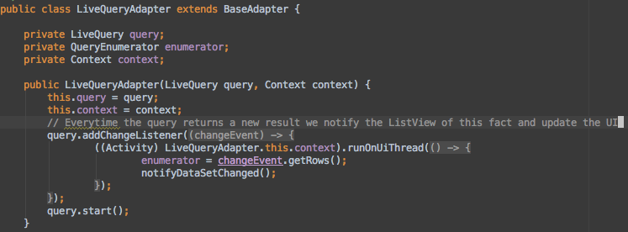
LiveQueryAdapter.java

Slide 86
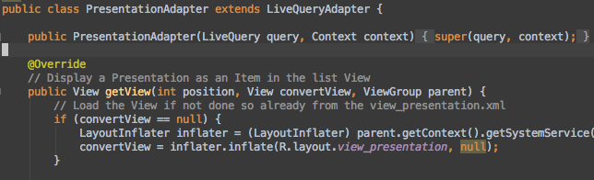
PresentationAdapter.java

Slide 87
Build an Index and a LiveQueryAdapter
Add create/save methods to the Presentation

Slide 88
Build an Index and a LiveQueryAdapter
public LiveQueryAdapter(LiveQuery query, Context context) {
this.query = query;
this.context = context;
// Everytime the query returns a new result we notify the ListView of this fact and update the UI
query.addChangeListener(new LiveQuery.ChangeListener() {
@Override
public void changed(final LiveQuery.ChangeEvent changeEvent) {
((Activity) LiveQueryAdapter.this.context).runOnUiThread(new Runnable() {
@Override
public void run() {
enumerator = changeEvent.getRows();
notifyDataSetChanged();
}
});
}
});
query.start();
}

Slide 89
Git checkout step4

Slide 90
Setting Up the Sync Gateway
No code to add on the app, move to next tag with git checkout step5
Instructions are in ConfigureSyncGateway.md

Slide 91
Git checkout step5

Slide 92
Setup the Push/Pull Replication
private void setupSync() throws MalformedURLException {
URL url = new URL(SYNC_URL_HTTP);
pull = database.createPullReplication(url);
push = database.createPushReplication(url);
pull.setContinuous(true);
push.setContinuous(true);
pull.start();
push.start();
}

Slide 93
Git checkout step6

