Slide 1
Wiselent
Team Members
Lin Dong
Shen Dong
Where Wiselent met Agora

Slide 2
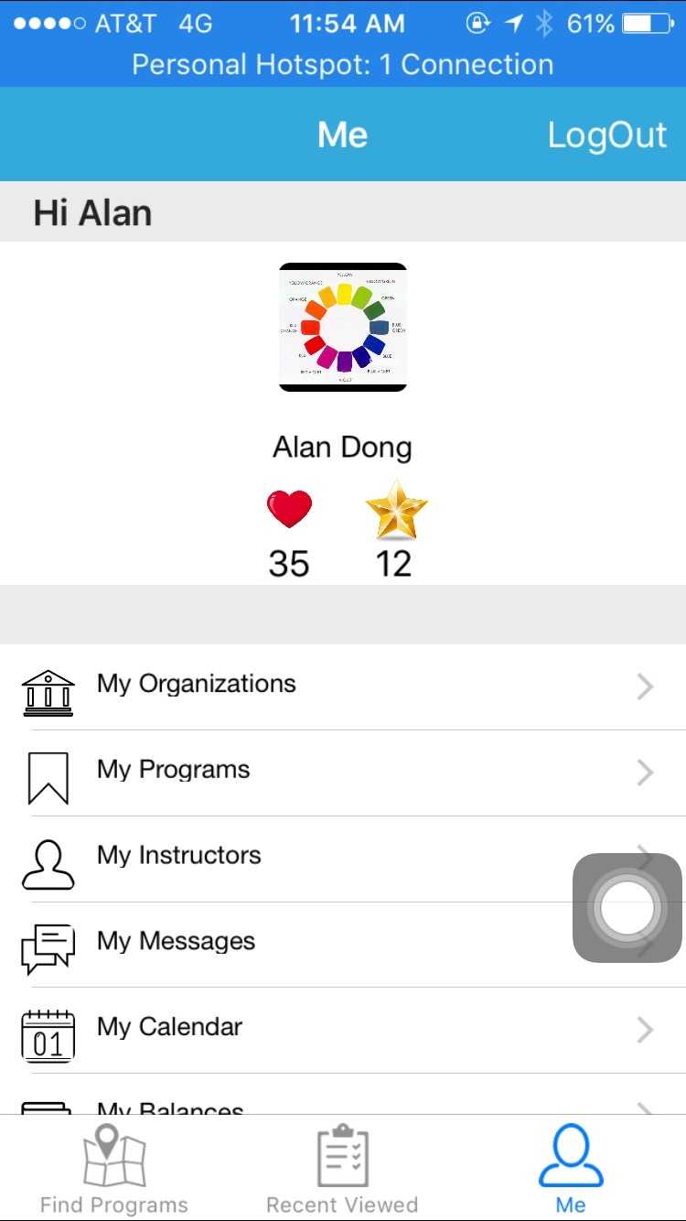
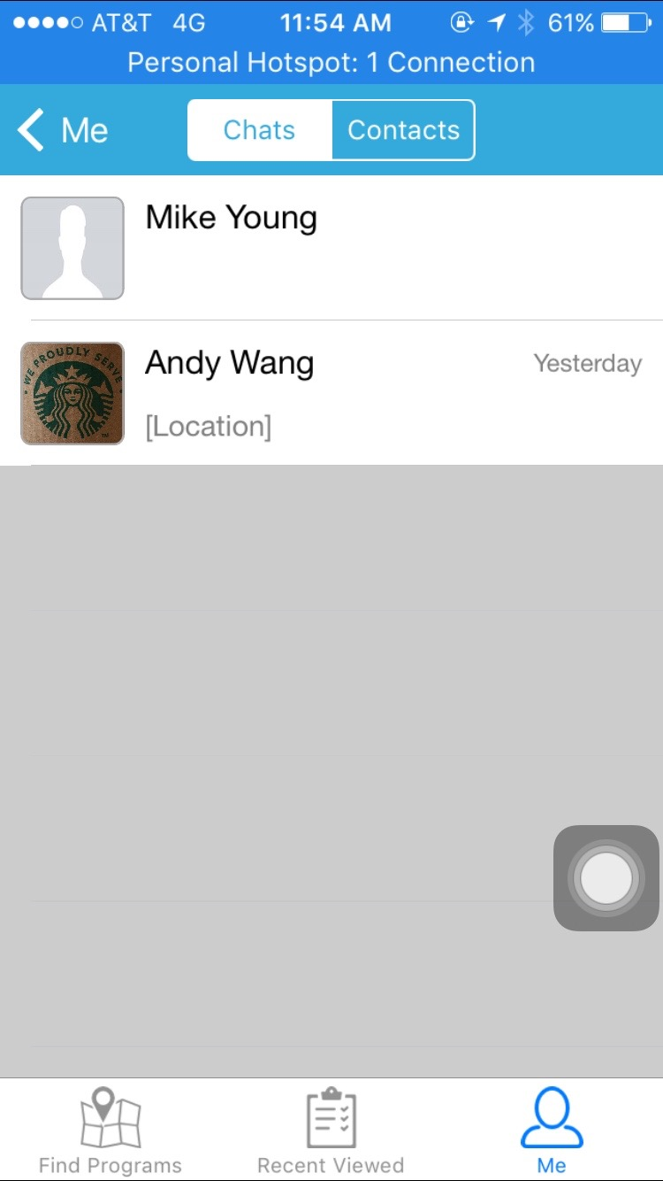
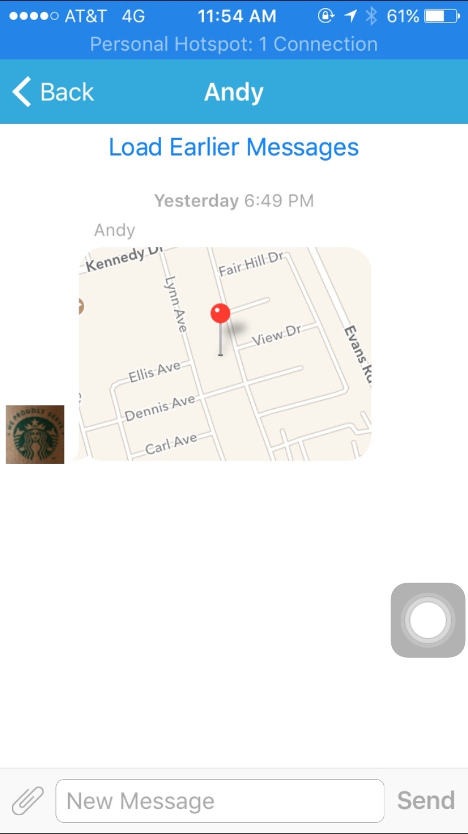
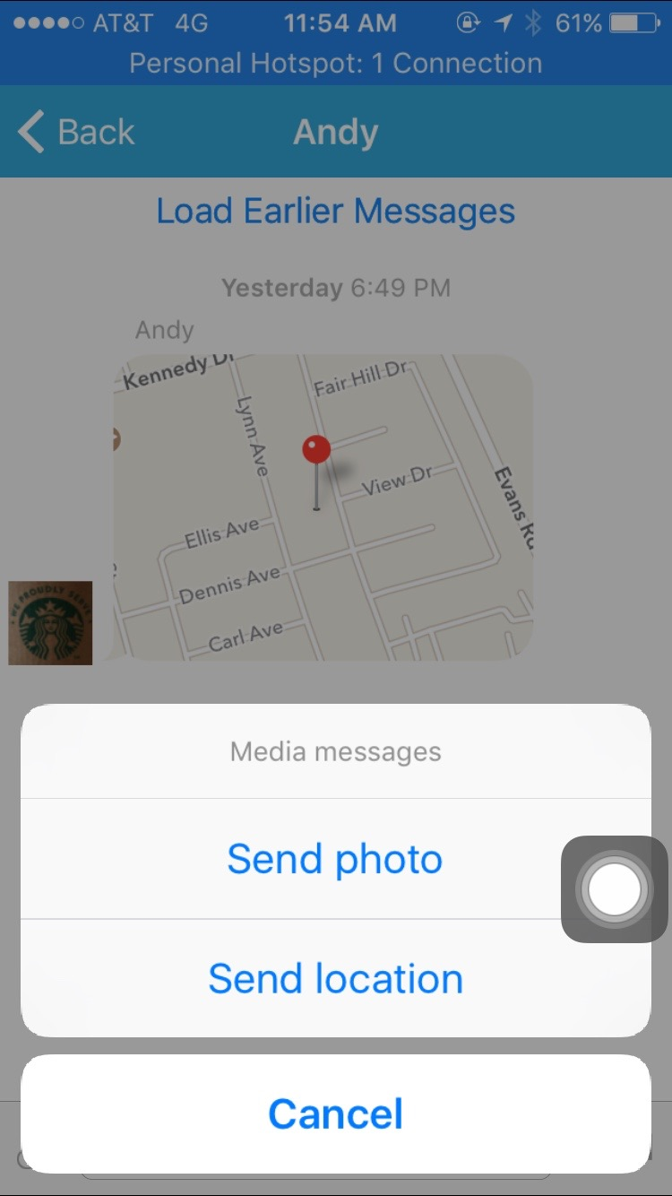
Before

Slide 3
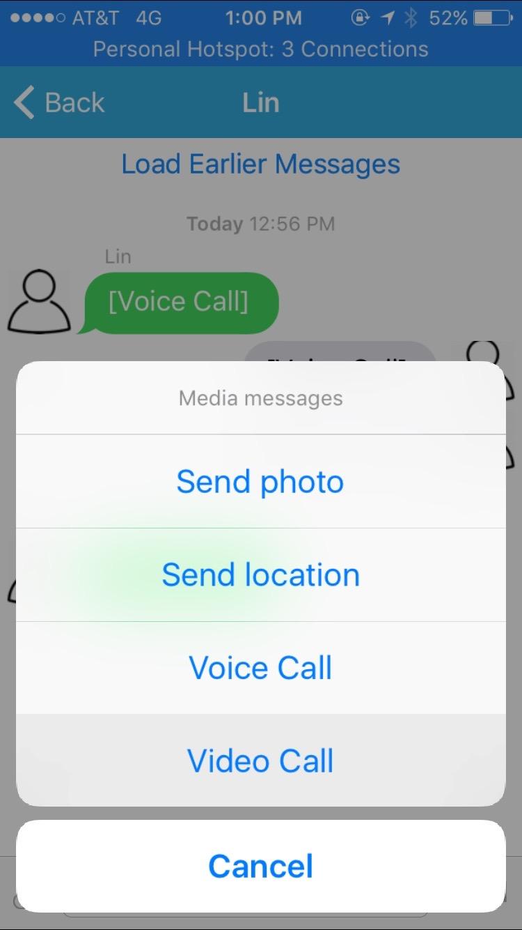
Enhanced Msg System
Old
New

Slide 4




Wislent + iOS SDK = Wiselent 2.0

Slide 5
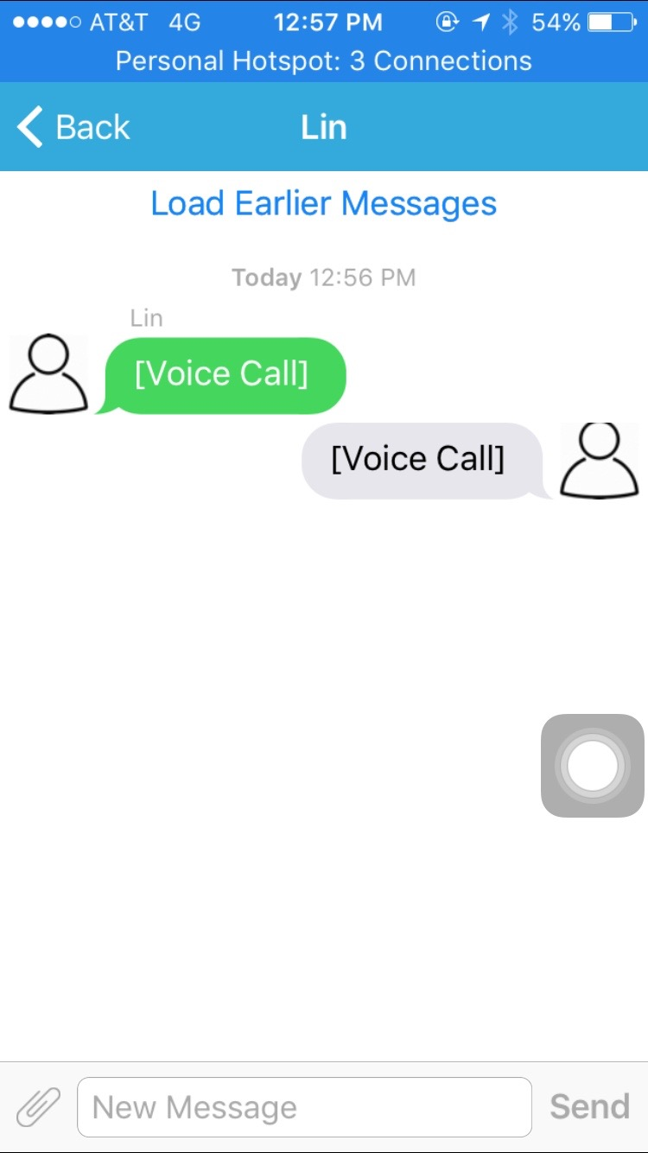
After

Slide 6
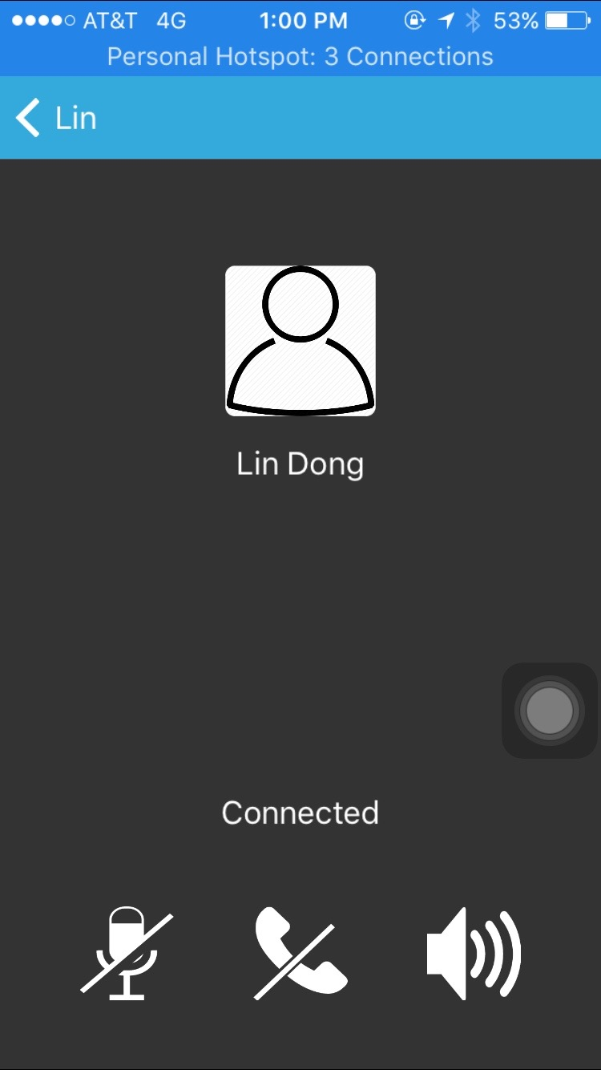
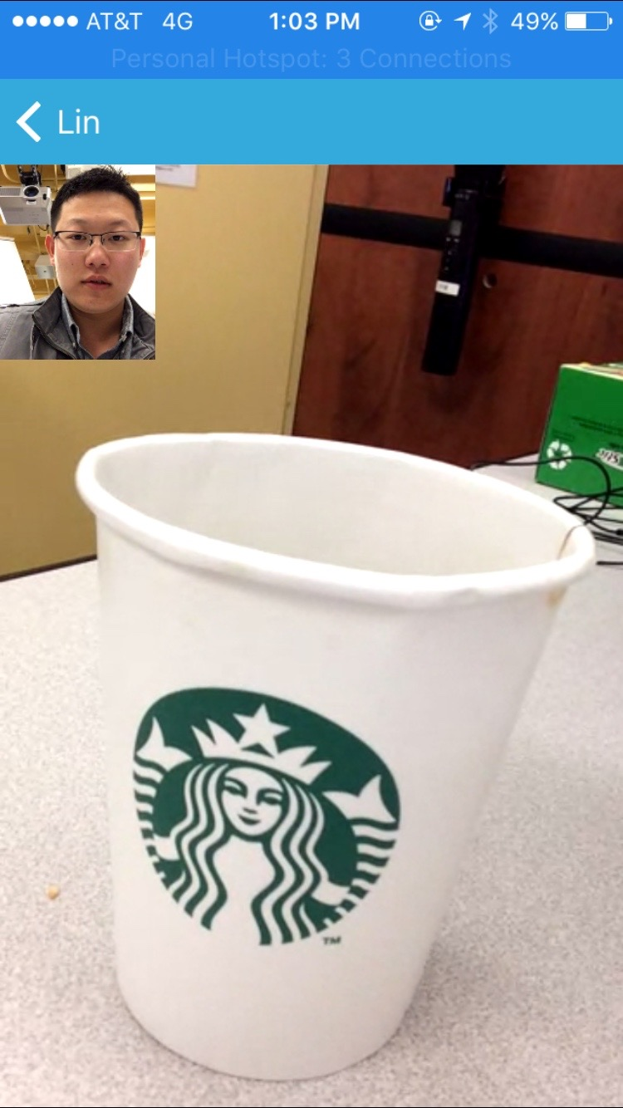
More

Slide 7
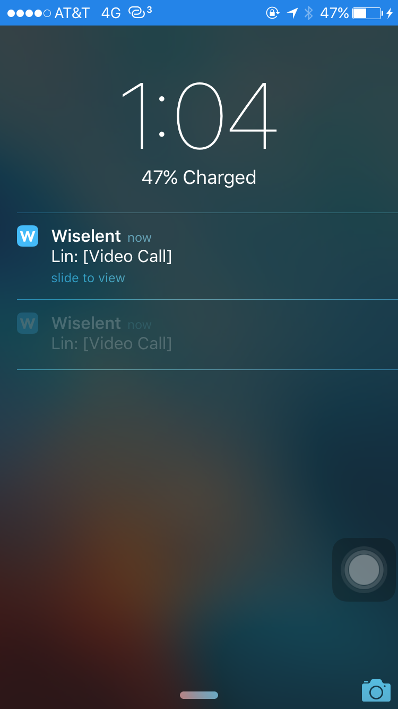
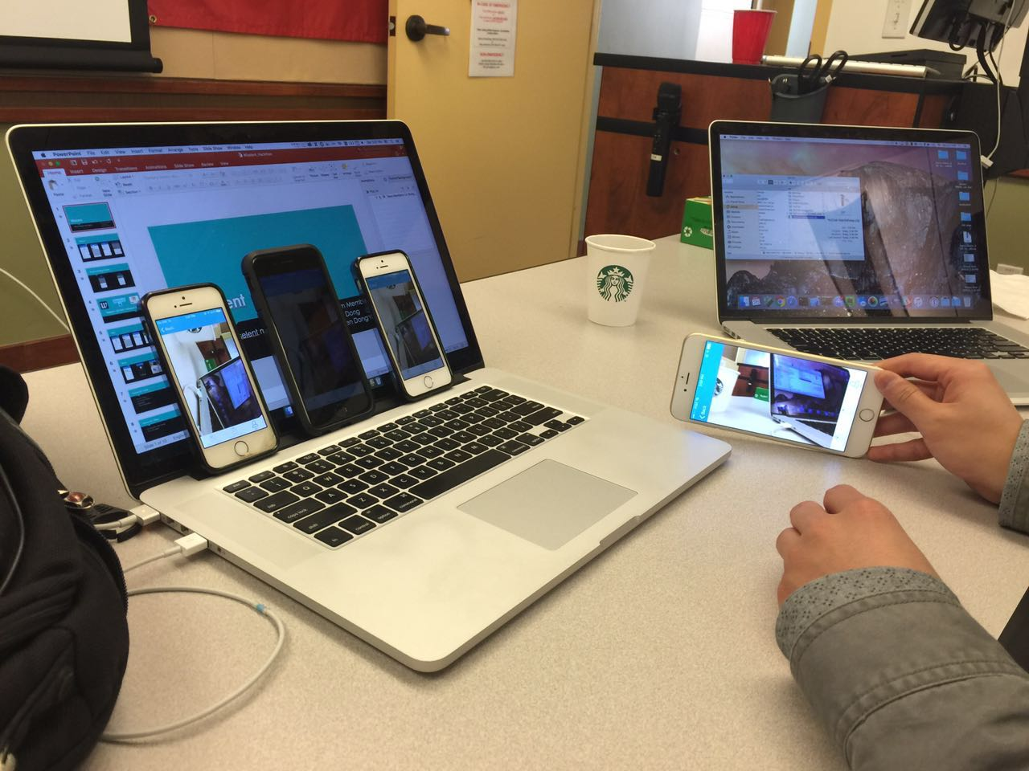
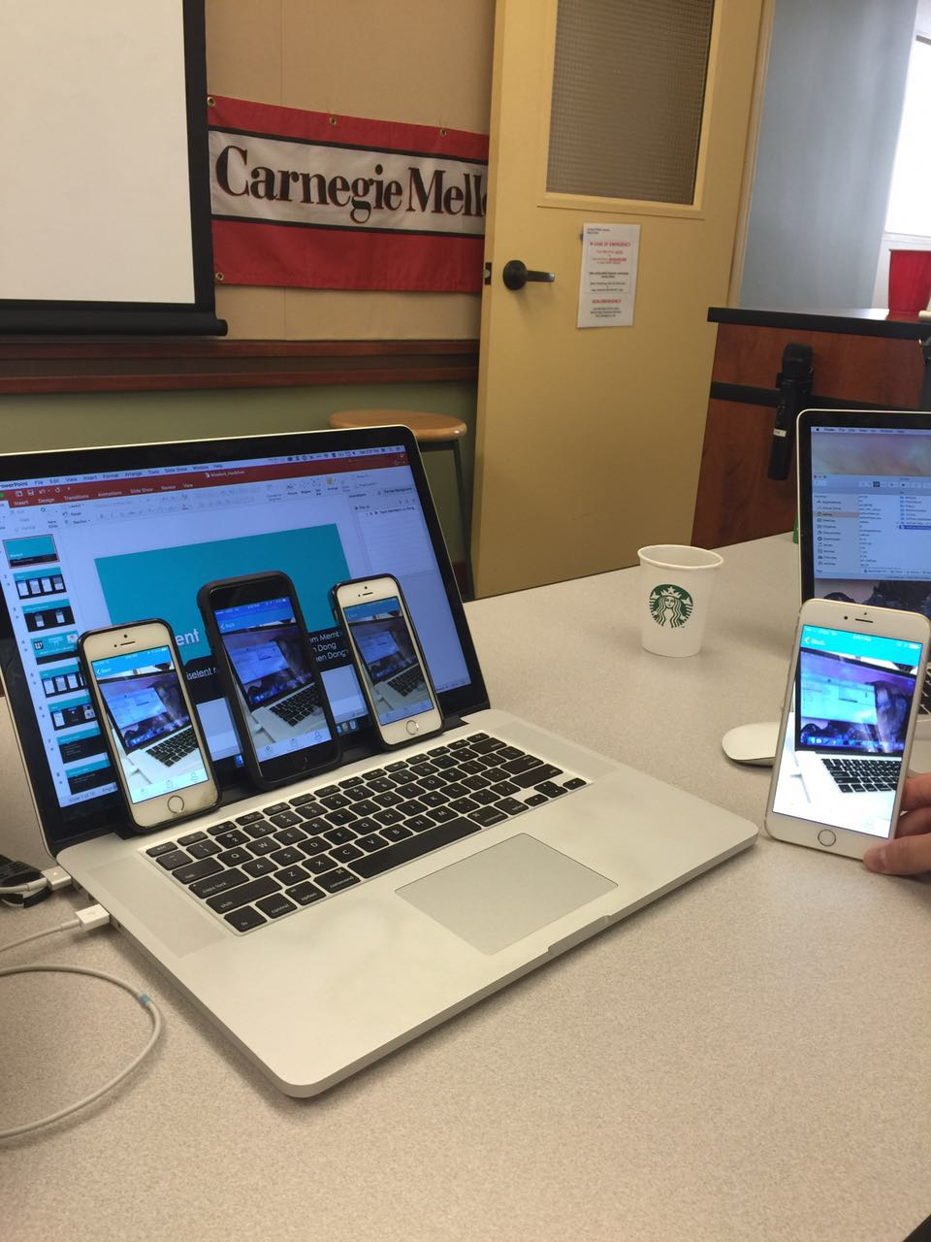
Even more

Slide 8
Feature List – Audio
Mute Voice
Un-mute Voice
Speaker
Mute Speaker

Slide 9
Feature List – Video
Front/back cam swap
Turn off video
Broadcast 1 to many

Slide 10
Demo

Slide 11
Thank you
Lin & Shen
3/26/2016

