Slide 1

ACME
Merchant Performance Review
Post authorization · Strategic · 2025-07 – 2026-06
Prepared by Riskified Customer Success

Slide 2
Executive Summary
Submission Volume
4,876
▲ +6.4% since start
Approval Rate
98.15%
▲ +1.3% since start
Accepted Chargeback Rate
0.12%
▼ -8.9% since start
Effective Fraud Rate
1.80%
▼ -4.9% since start
• Submission volume grew +6.4% by count and +6.0% by value over the review period, with a seasonal peak in December 2025.
• Approval rate improved +1.3% (count) and +1.4% (value), reaching near-period-high levels of 98.15% and 97.33% respectively by June 2026.
• Accepted chargeback rate declined meaningfully — down 8.9% by count and 18.8% by value — reflecting a healthier approved-order mix.
• Effective fraud rate trended in the right direction, falling 4.9% by count and 5.0% by value despite a noted high-fraud episode in January 2026.
• Overall, ACME's key risk and approval metrics moved favorably across the period, ending June 2026 at or near their best levels.

Slide 3
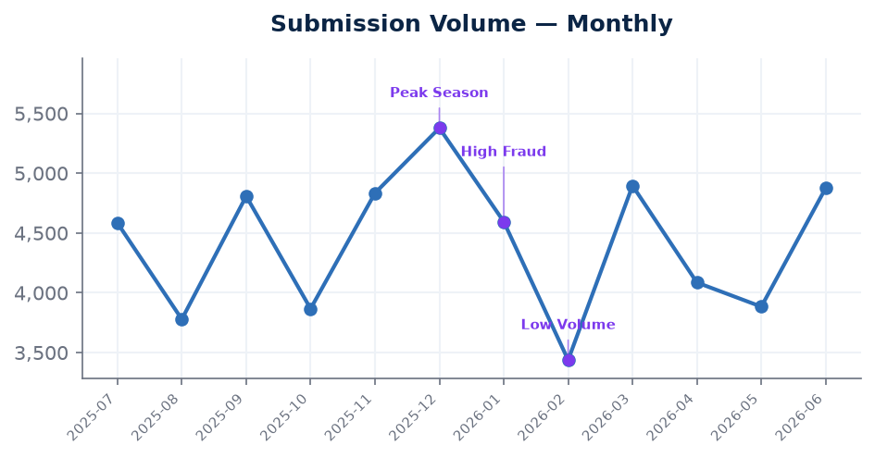
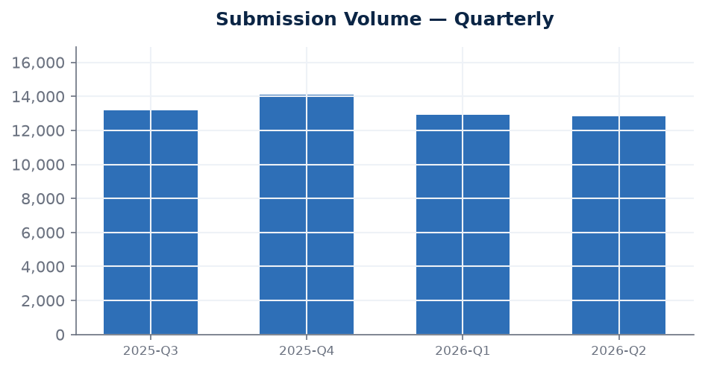
Submission Volume
transaction volume
Latest
4,876
2026-06
Change since start
+6.4%
vs first month
Latest quarter
12,846
2026-Q2
Submitted value
$4,304,316
2026-06
Submission volume grew from 4,584 transactions ($4,061,436) in July 2025 to 4,876 transactions ($4,304,316) in June 2026, representing increases of +6.4% and +6.0% respectively. The count-based peak of 5,378 in December 2025 coincides with the noted Peak Season event, while the trough of 3,438 in February 2026 coincides with the Low Volume event flagged for that month. The overall upward trajectory across the period is a positive indicator of business growth.

Slide 4
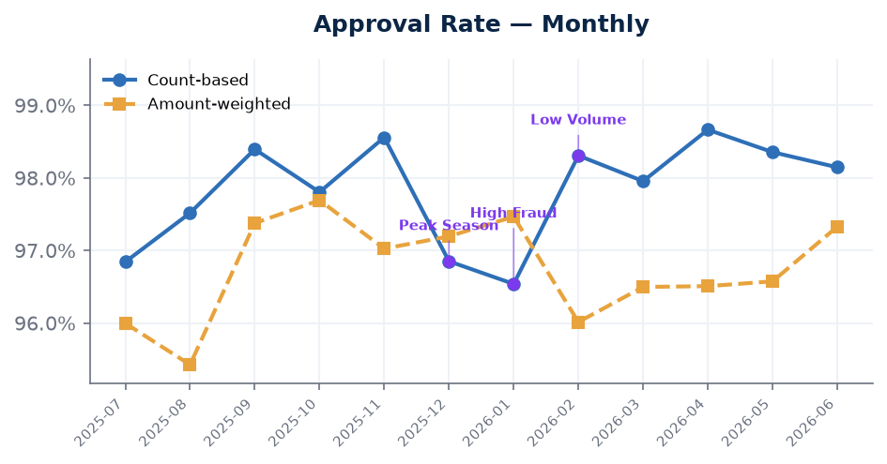
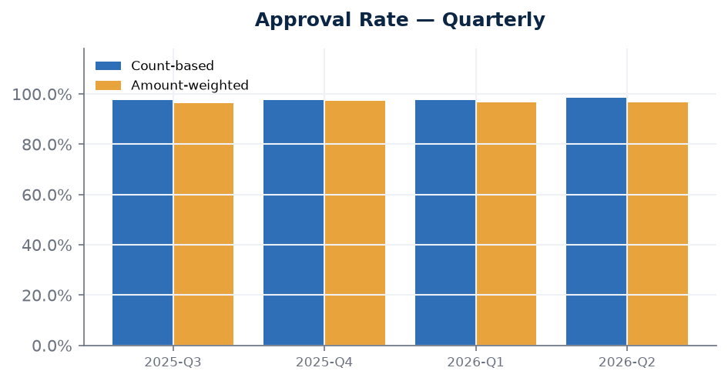
Approval Rate
higher is better
Latest
98.15%
2026-06
Change since start
+1.3%
vs first month
Latest quarter
98.37%
2026-Q2
Amount-weighted latest
97.33%
2026-06
Approval rate improved steadily over the review period, rising from 96.84% to 98.15% on a count basis (+1.3%) and from 96.00% to 97.33% on a value-weighted basis (+1.4%). The period low of 96.54% in January 2026 coincides with the High Fraud event, which is consistent with a more challenging order mix during that month. By April 2026, the count-based rate reached its period high of 98.66%, and June 2026 levels remain close to that peak, suggesting a sustained positive trend.

Slide 5
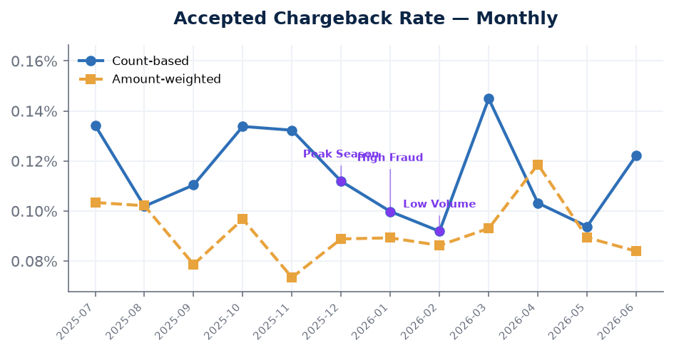
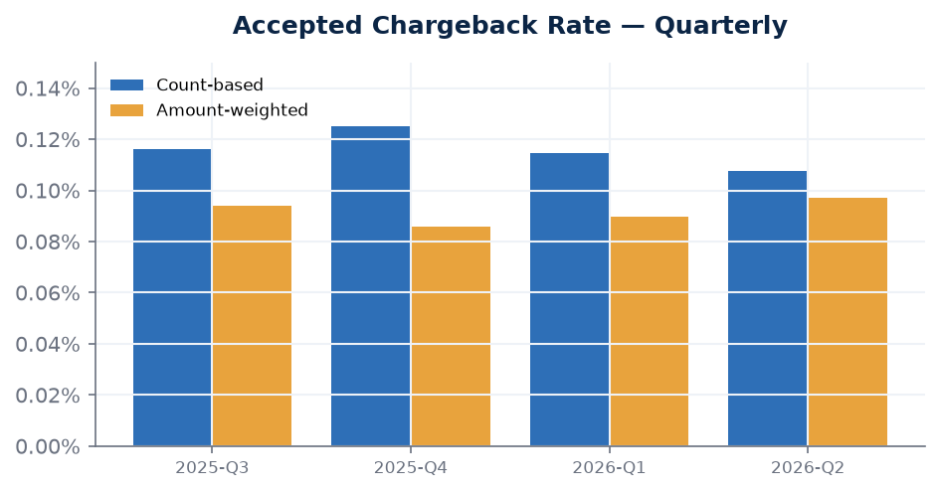
Accepted Chargeback Rate
lower is better
Latest
0.12%
2026-06
Change since start
-8.9%
vs first month
Latest quarter
0.11%
2026-Q2
Amount-weighted latest
0.08%
2026-06
The accepted chargeback rate declined from 0.13% to 0.12% by count (−8.9%) and from 0.10% to 0.08% by value (−18.8%), with the value-weighted improvement being particularly notable. The February 2026 period best of 0.09% (count-based) coincides with the Low Volume event, which may indicate a shift in order mix during that month. The overall downward direction across both views is a favorable outcome, suggesting the approved portfolio is carrying lower chargeback exposure over time.

Slide 6
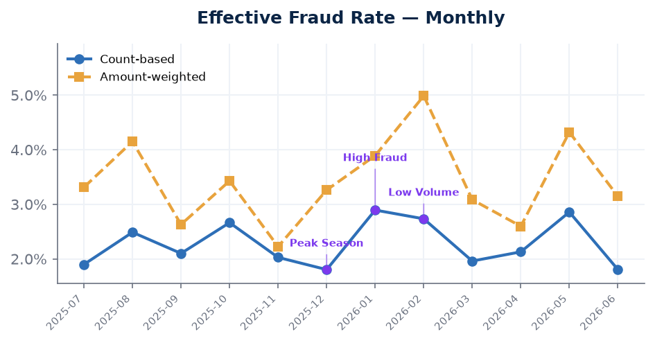
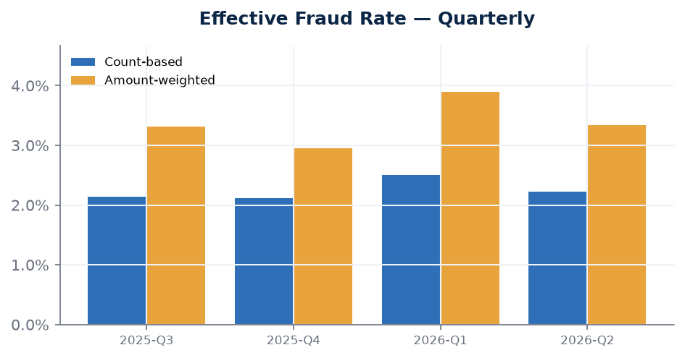
Effective Fraud Rate
lower is better
Latest
1.80%
2026-06
Change since start
-4.9%
vs first month
Latest quarter
2.23%
2026-Q2
Amount-weighted latest
3.15%
2026-06
The effective fraud rate improved from 1.90% to 1.80% by count (−4.9%) and from 3.31% to 3.15% by value (−5.0%) over the review period. The count-based period high of 2.89% in January 2026 coincides with the High Fraud event, which is consistent with elevated fraudulent activity during that window. Despite that spike, the rate recovered and the period closed at its count-based low of 1.80% — matching the December 2025 worst-label figure — suggesting the portfolio returned to a more favorable fraud profile by June 2026.

Slide 7
Notes & Methodology
• Count-based view: KPIs by transaction volume (number of orders).
• Amount-weighted view: KPIs weighted by submitted order value (Submission Volume is shown in dollars).
• Charts annotate notable evidence events from the period.

