Slide 1

Cyberdyne Systems
Merchant Performance Review
Pre authorization · Strategic · 2025-07 – 2026-06
Prepared by Riskified Customer Success

Slide 2
Executive Summary
Submission Volume
2,961
▲ +6.5% since start
Approval Rate
98.05%
▲ +1.4% since start
Accepted Chargeback Rate
0.21%
▼ -1.8% since start
Effective Fraud Rate
3.48%
▼ -3.3% since start
• Submission volume grew +6.5% by transaction count over the review period, though submitted value edged down -1.1%, reflecting a shift toward lower-value orders.
• Count-based approval rate improved +1.4% to 98.05%, a strong result, though amount-weighted approval rate dipped -0.4%, suggesting higher-value transactions faced relatively more declines.
• Accepted chargeback rate held flat at 0.21% on a count basis, but the amount-weighted view rose +16.3%, coinciding with a Chargeback Spike event in 2026-05 that warrants monitoring.
• Effective fraud rate improved -3.3% by transaction count, yet the amount-weighted rate climbed +41.6%, indicating that fraudulent activity is increasingly concentrated in higher-value orders.
• Two High Fraud events (2025-10, 2026-03) and a Chargeback Spike (2026-05) punctuate the period and are consistent with the divergence seen between count- and amount-weighted fraud metrics.

Slide 3
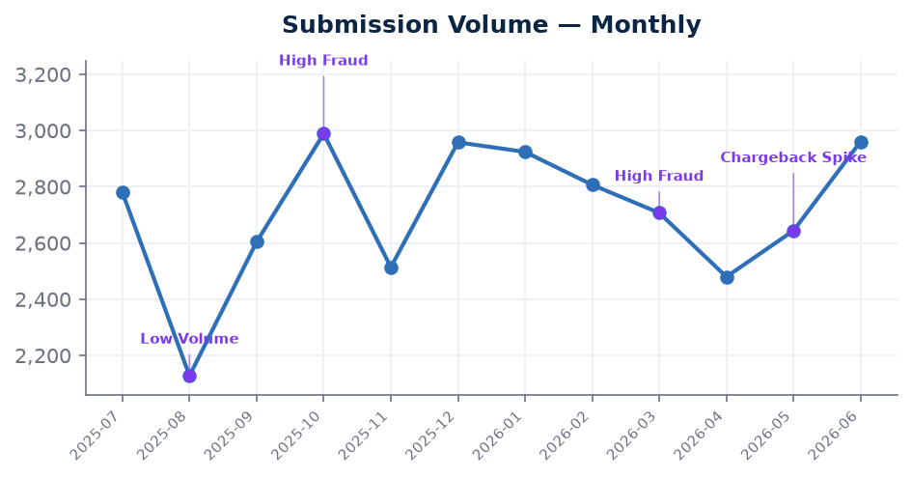
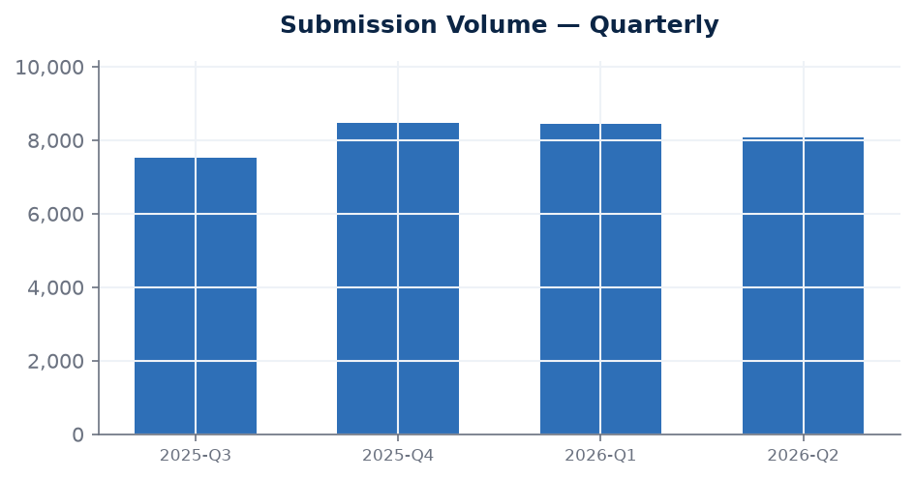
Submission Volume
transaction volume
Latest
2,961
2026-06
Change since start
+6.5%
vs first month
Latest quarter
8,085
2026-Q2
Submitted value
$2,836,579
2026-06
Transaction count grew +6.5% from 2,780 in 2025-07 to 2,961 in 2026-06, with a peak of 2,989 in 2025-10 and a notable trough of 2,128 in 2025-08, which coincides with a Low Volume event recorded that month. Submitted value, however, moved in the opposite direction, declining -1.1% from $2,867,208 to $2,836,579, suggesting the incremental volume growth is concentrated in relatively lower-value transactions. This divergence between count and value trends is worth tracking to understand any evolving shifts in order mix.

Slide 4
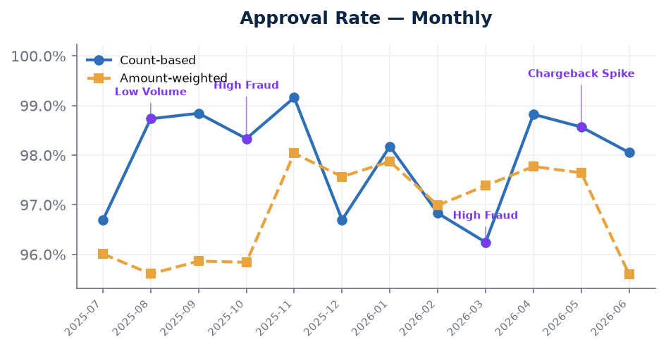
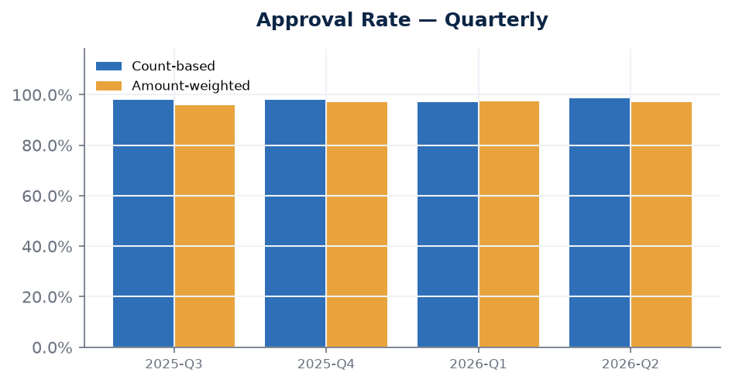
Approval Rate
higher is better
Latest
98.05%
2026-06
Change since start
+1.4%
vs first month
Latest quarter
98.46%
2026-Q2
Amount-weighted latest
95.60%
2026-06
Count-based approval rate improved +1.4% over the period, rising from 96.69% in 2025-07 to 98.05% in 2026-06, with a high of 99.16% reached in 2025-11. The low point of 96.24% in 2026-03 coincides with a High Fraud event that month, which is consistent with a more cautious decisioning environment during elevated fraud activity. The amount-weighted approval rate tells a more nuanced story, declining -0.4% from 96.01% to 95.60%, suggesting that higher-value transactions are being approved at a modestly lower rate than the broader transaction population.

Slide 5
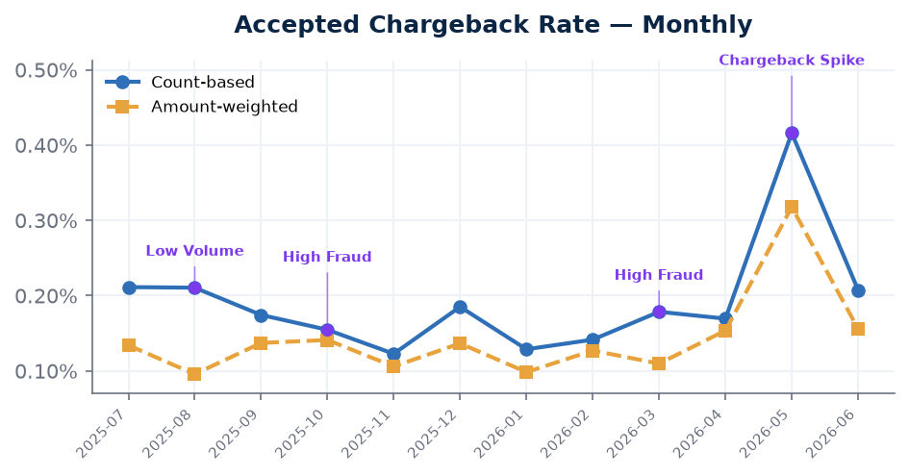
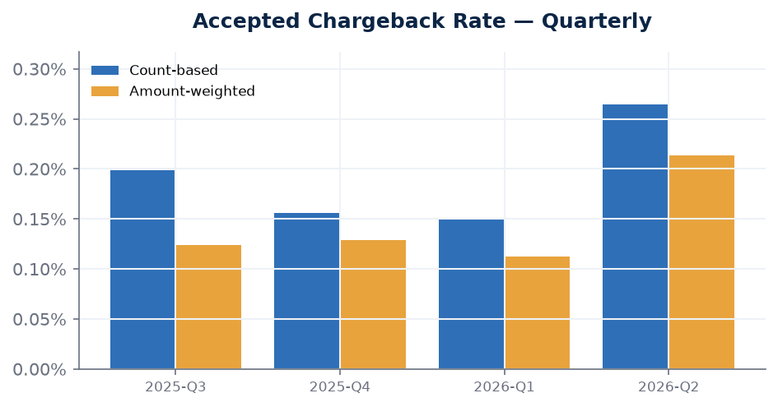
Accepted Chargeback Rate
lower is better
Latest
0.21%
2026-06
Change since start
-1.8%
vs first month
Latest quarter
0.26%
2026-Q2
Amount-weighted latest
0.16%
2026-06
On a count basis, the accepted chargeback rate remained stable at 0.21% from the start to the end of the period, reflecting a -1.8% improvement overall. However, the amount-weighted rate increased +16.3%, moving from 0.13% to 0.16%, which may indicate that chargebacks are occurring on higher-value transactions with greater frequency. The 2026-05 Chargeback Spike event coincides with the worst count-based reading of 0.42% that month, and continued vigilance around high-value order chargebacks is advisable going forward.

Slide 6
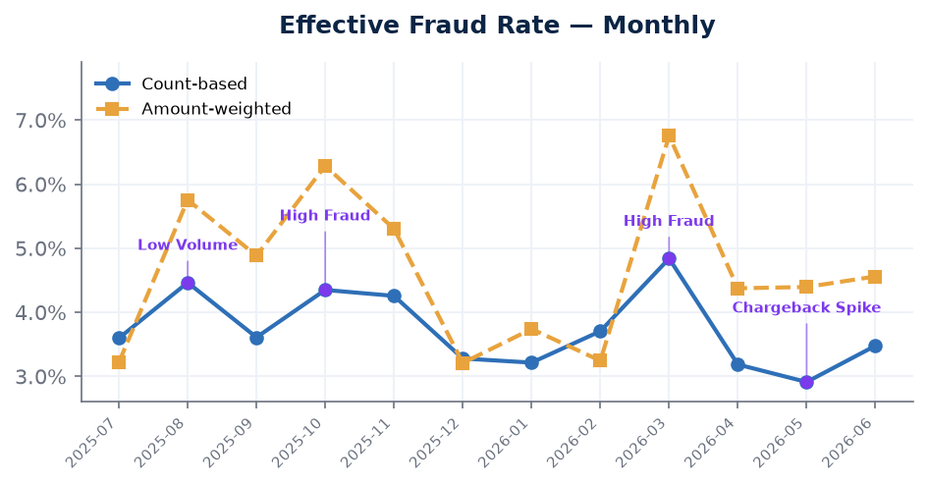
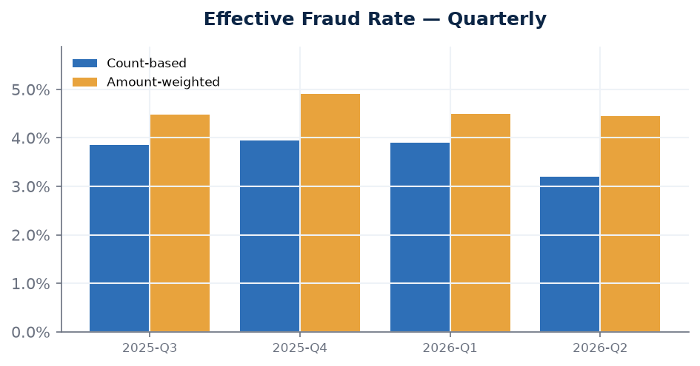
Effective Fraud Rate
lower is better
Latest
3.48%
2026-06
Change since start
-3.3%
vs first month
Latest quarter
3.20%
2026-Q2
Amount-weighted latest
4.56%
2026-06
The count-based effective fraud rate improved -3.3% over the review period, declining from 3.60% to 3.48%, with the best result of 2.91% recorded in 2026-05. Despite this positive trend at the transaction level, the amount-weighted effective fraud rate rose sharply by +41.6%, from 3.22% to 4.56%, suggesting that fraud attempts are increasingly concentrated among higher-value orders. The High Fraud events in 2025-10 and 2026-03 coincide with periods of elevated pressure and are consistent with the volatility observed in the amount-weighted metric across the period.

Slide 7
Notes & Methodology
• Count-based view: KPIs by transaction volume (number of orders).
• Amount-weighted view: KPIs weighted by submitted order value (Submission Volume is shown in dollars).
• Charts annotate notable evidence events from the period.

