Slide 1

Vandelay Industries
Merchant Performance Review
Post authorization · Enterprise · 2025-07 – 2026-06
Prepared by Riskified Customer Success

Slide 2
Executive Summary
Submission Volume
5,185
▼ -9.6% since start
Approval Rate
98.82%
▲ +0.3% since start
Accepted Chargeback Rate
0.11%
▲ +17.1% since start
Effective Fraud Rate
2.08%
▲ +13.8% since start
• Submission volume declined 9.6% over the review period, with a notable dip in 2026-05 coinciding with a Low Volume event.
• Approval rate improved modestly by +0.3 percentage points, reaching its period-best of 98.82% in 2026-06.
• Accepted Chargeback Rate edged up 17.1% on a count basis, moving from 0.10% to 0.11%, warranting continued monitoring.
• Effective Fraud Rate worsened by 13.8% over the period, rising to 2.08% in 2026-06, with elevated readings coinciding with a High Fraud event in 2025-11.
• Overall, approval performance is trending positively while fraud-related metrics signal an area of focus heading into the next period.

Slide 3
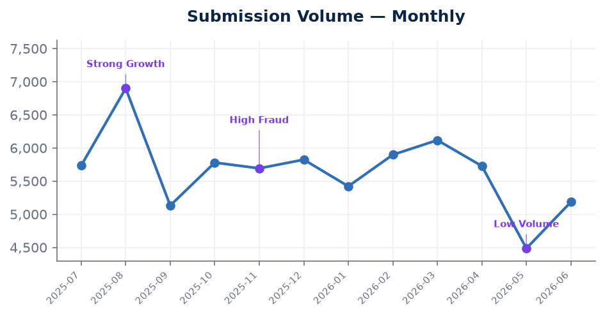
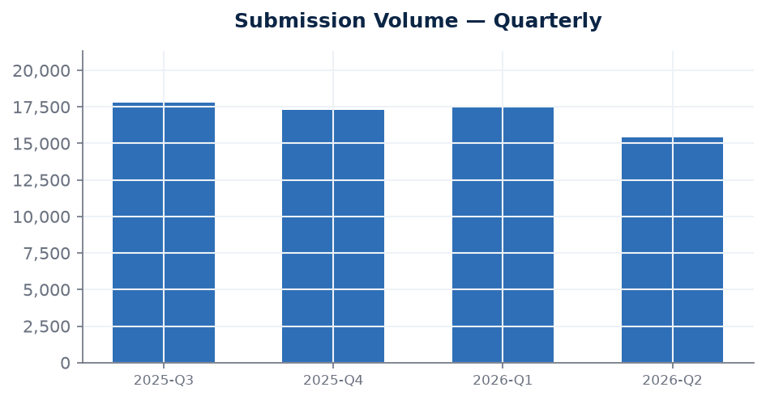
Submission Volume
transaction volume
Latest
5,185
2026-06
Change since start
-9.6%
vs first month
Latest quarter
15,398
2026-Q2
Submission volume opened at 5,735 transactions in 2025-07 and closed at 5,185 in 2026-06, reflecting a 9.6% decline over the review period. The period peak of 6,900 was reached in 2025-08, coinciding with a Strong Growth event, while the trough of 4,485 in 2026-05 coincides with a noted Low Volume event. The overall trend is broadly flat with identifiable peaks and troughs, suggesting volume is sensitive to specific business or seasonal drivers worth tracking going forward.

Slide 4
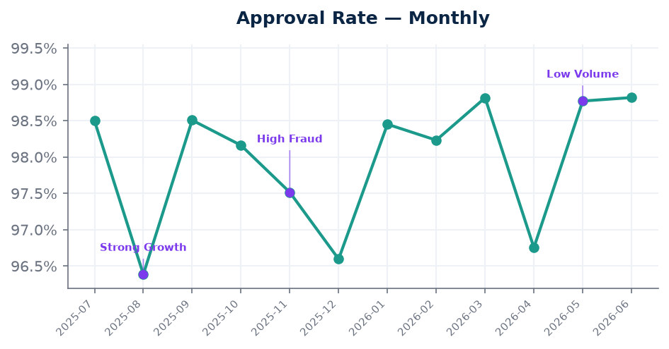
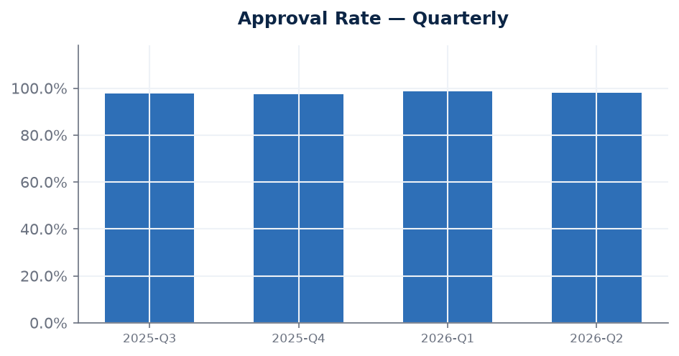
Approval Rate
higher is better
Latest
98.82%
2026-06
Change since start
+0.3%
vs first month
Latest quarter
98.04%
2026-Q2
Approval rate showed a positive trajectory over the review period, improving by +0.3 percentage points from 98.50% in 2025-07 to a period-best of 98.82% in 2026-06. The period low of 96.39% occurred in 2025-08, which coincides with the Strong Growth event, suggesting that the surge in submission volume that month may have introduced a more varied order mix. The recovery and sustained improvement since then is an encouraging sign for the health of Vandelay Industries' approved transaction base.

Slide 5
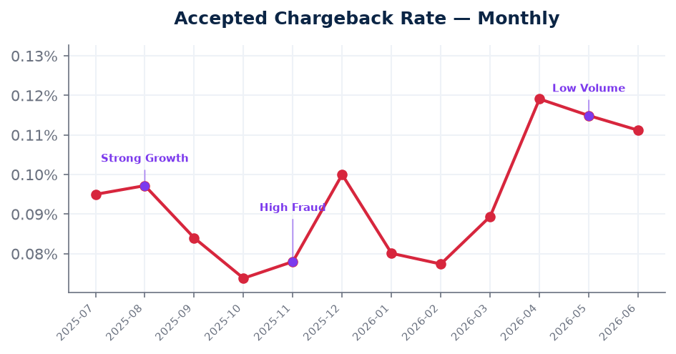
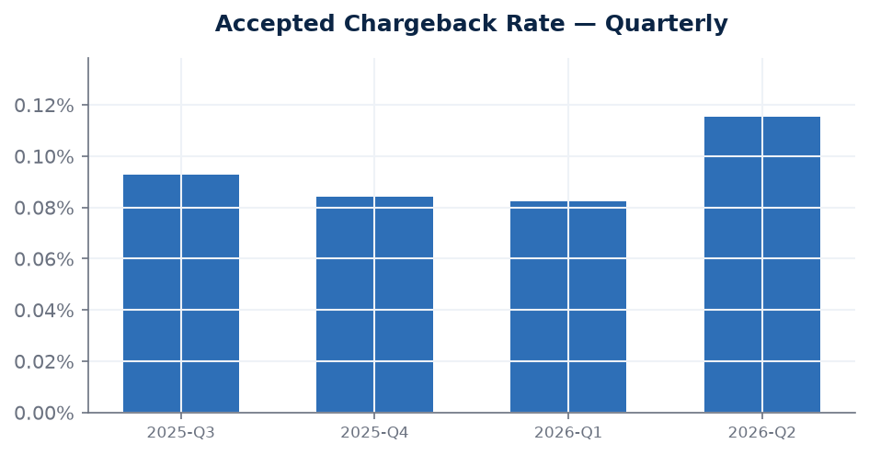
Accepted Chargeback Rate
lower is better
Latest
0.11%
2026-06
Change since start
+17.1%
vs first month
Latest quarter
0.12%
2026-Q2
The Accepted Chargeback Rate increased by 17.1% on a count basis, moving from 0.10% in 2025-07 to 0.11% in 2026-06, indicating a gradual worsening trend over the period. Notably, the period's best reading of 0.12% was recorded in 2026-04, while the lowest rate of 0.07% was seen in 2025-10, pointing to some variability across months. Although the absolute rate remains low, the directional trend warrants close attention to ensure it does not continue to climb in the coming period.

Slide 6
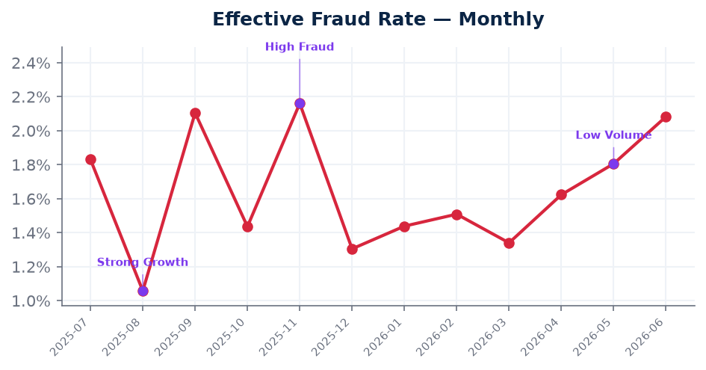
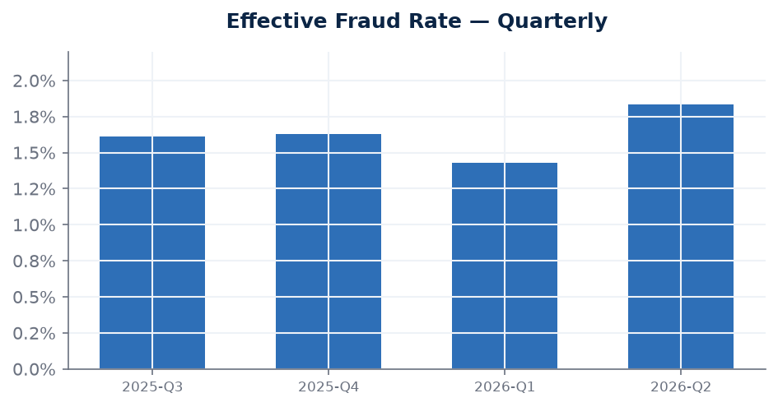
Effective Fraud Rate
lower is better
Latest
2.08%
2026-06
Change since start
+13.8%
vs first month
Latest quarter
1.83%
2026-Q2
The Effective Fraud Rate worsened by 13.8% over the review period, rising from 1.83% in 2025-07 to 2.08% in 2026-06. The period's most elevated reading of 2.16% occurred in 2025-11, which coincides with a High Fraud event, consistent with a broader increase in fraudulent activity at that time. The rate has remained above its opening level since then, suggesting the elevated fraud environment observed mid-period may not have fully subsided. This metric is a priority area to monitor and address collaboratively in the next review cycle.

Slide 7
Notes & Methodology
• This deck uses the count-based (transaction-volume) view.
• Charts annotate notable evidence events from the period.

