Slide 1

#team
BB8
Mahammad Ismayilzada
Jeyhun Orujlu
Samir Musali
Nurlan Masimli

Slide 2
#project
WAThub
study. socialize. share.

Slide 3
#about
create a profile
share what is happening on campus
create group studies
ask questions and get help
exchange books
carpool
direct messaging
vote for posts and comment on them

Slide 4
#whyisitinteresting
unified
social
simple
useful
fast
personal

Slide 5
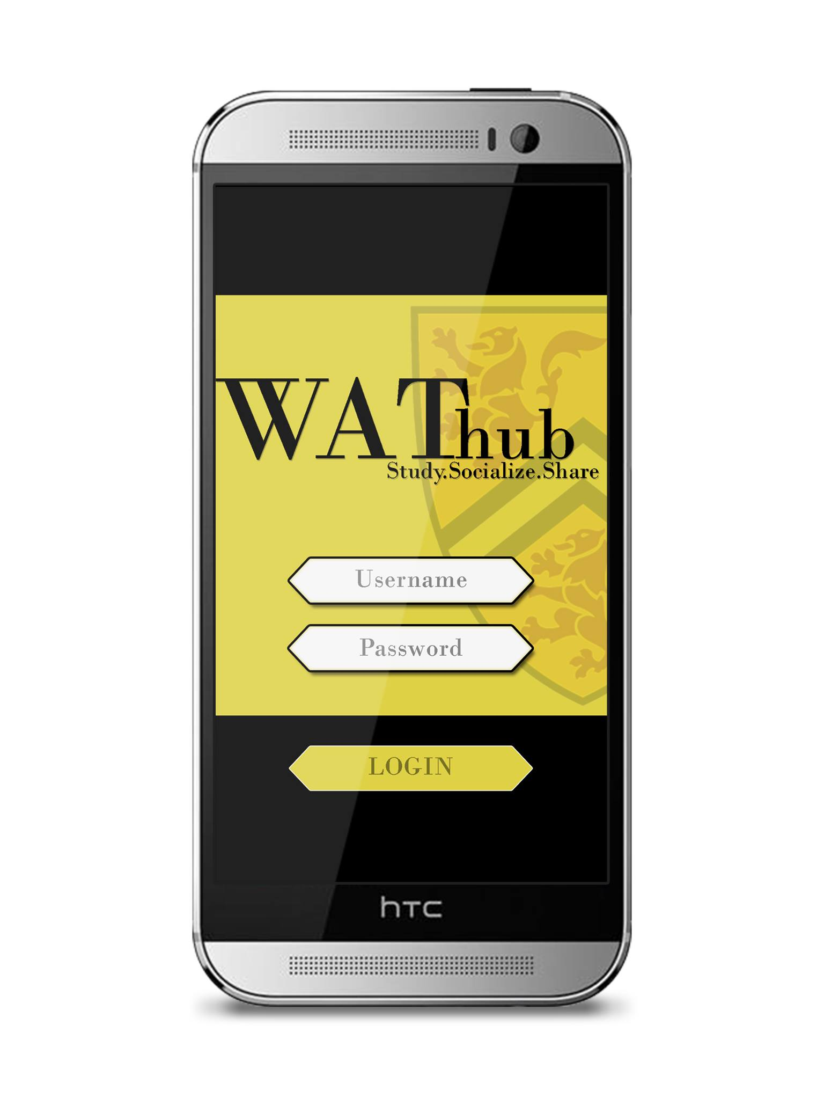
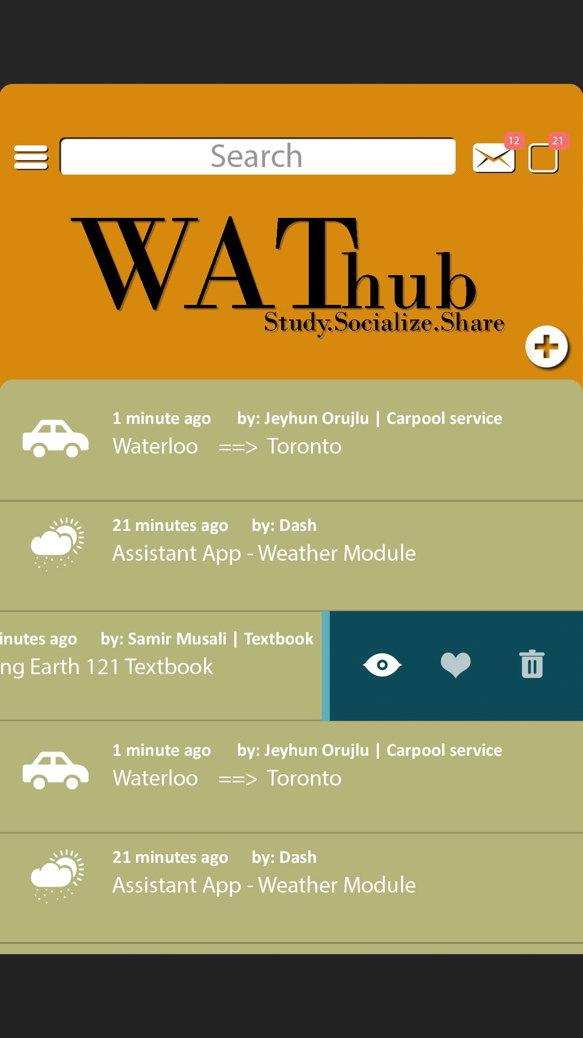
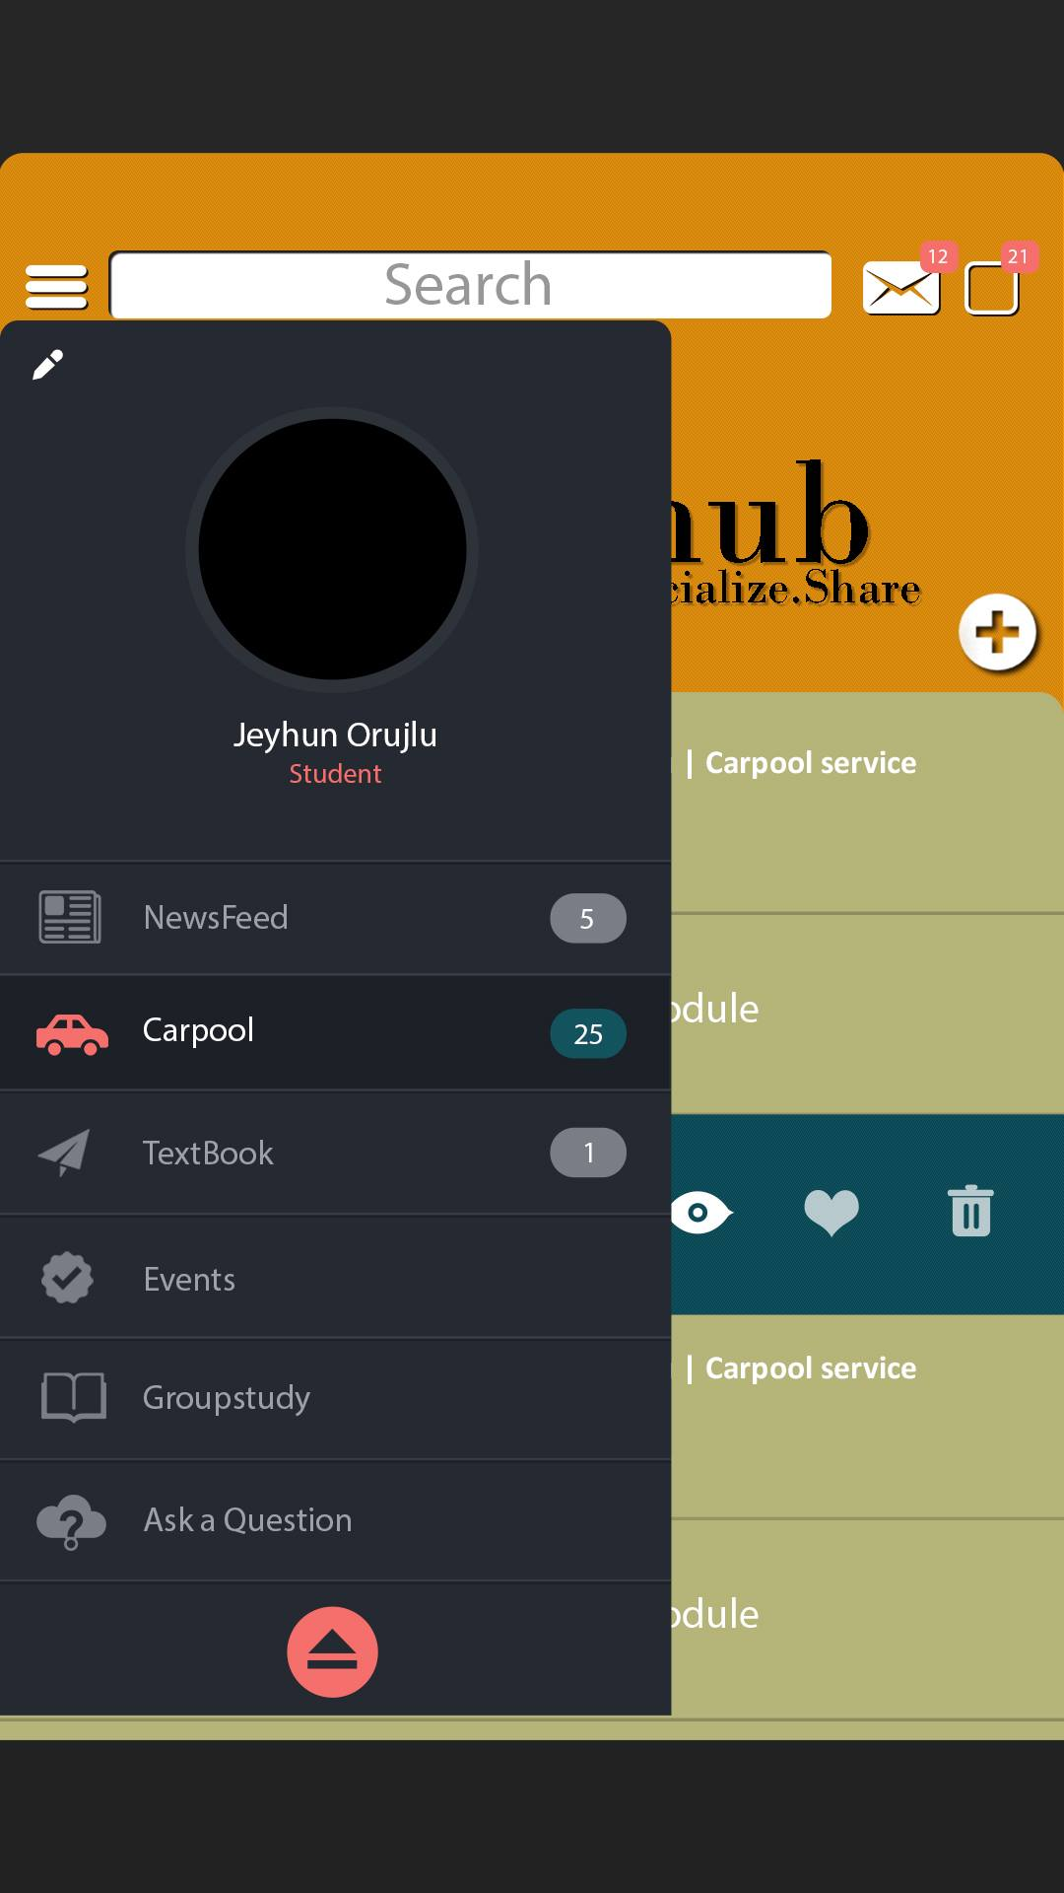
#mockups

Slide 6
#thankyou
WAThub
coming soon...
BB8

