Slide 1
Drug-related deaths vs. Education budget
ETL Project
Pyth@nes:
Antonio Gil.
Jesús Olea.
Luis Daniel Santiago.
Luis Tierra.

Slide 2
Drug addiction epidemic
According to the National center for Health Stiatistics, just in 2017, over 70,000 people died in the United States due to drug related causes, specifically, overdoses.
The drug policy in the United States has been shifting away from prohibition and into the legalization through prevention based in education and health care.
Considering this, we wanted to see in a general basis, if there is a correlation between the budget destined to maintain an education infrastructure per state and the total number of drug related deaths.

Slide 3
Extract
We extracted three databases:
The disclosure of expenditure per state per year.
The total amount of drug-related deaths per state.
Deaths per state that not include cancer, chronic lower respiratory disease, heart disease, stroke or unintentional injury.

Slide 4
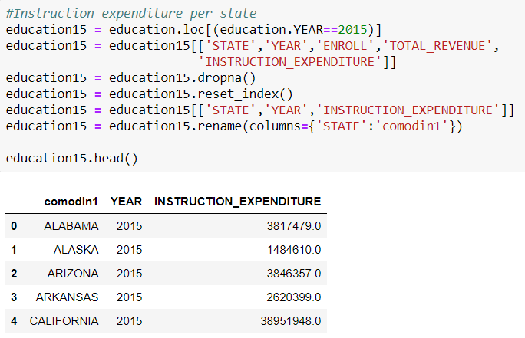
Transform
From the expenditure per year database we selected the Instruction Expenditure.
Instruction expenditure: expenditures for activities related to the interaction between teachers and students, including salaries and benefits for teachers and teacher aides, textbooks, supplies and purchased services.

Slide 5
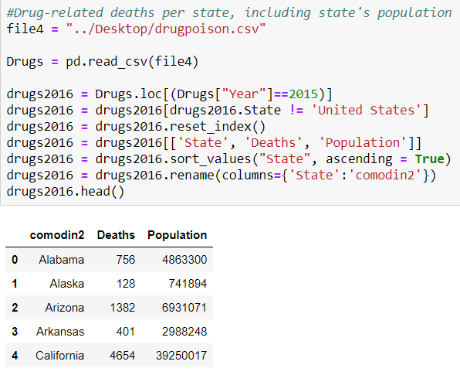
Transform
We extracted only the 2015 data from the drug-related deaths per state database, and also included the state’s population.

Slide 6
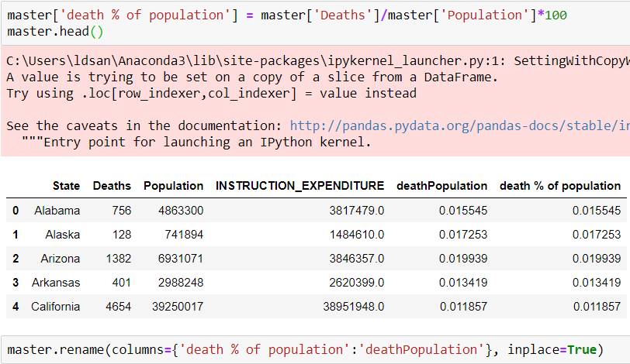
Transform
We combined both dataframes and included an extra column with the percentage of the population that died due to drug-related issue.

Slide 7
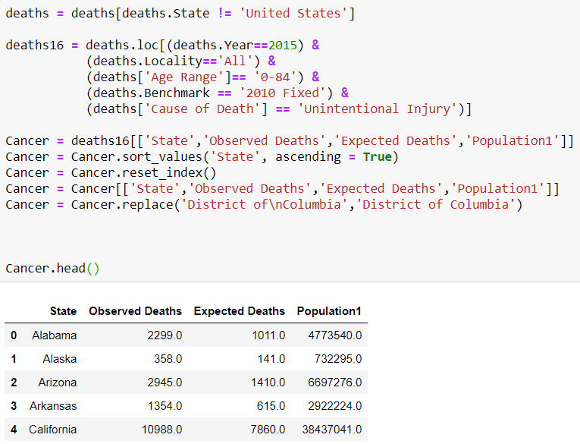
Transform
Deaths per state that not include cancer, chronic lower respiratory disease, heart disease, stroke or unintentional injury.

Slide 8
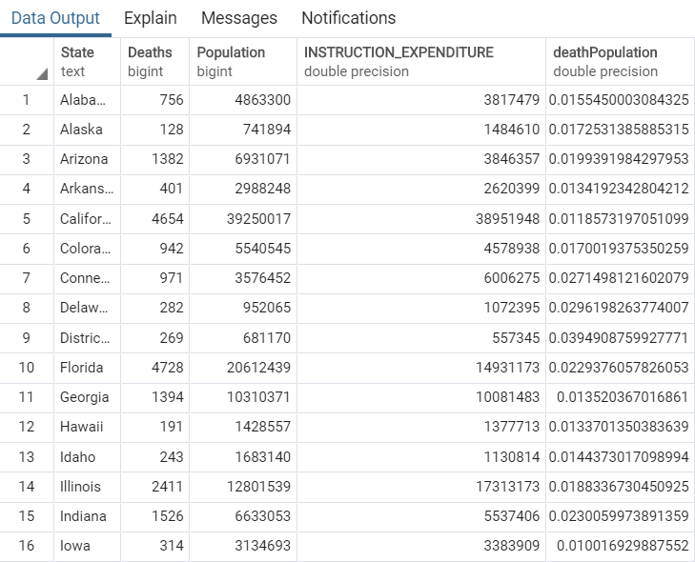
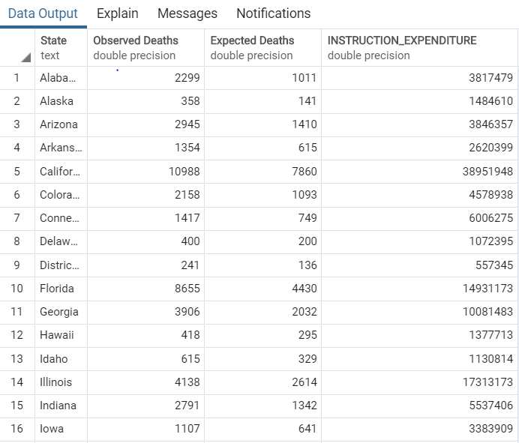
LOAD

