Slide 1
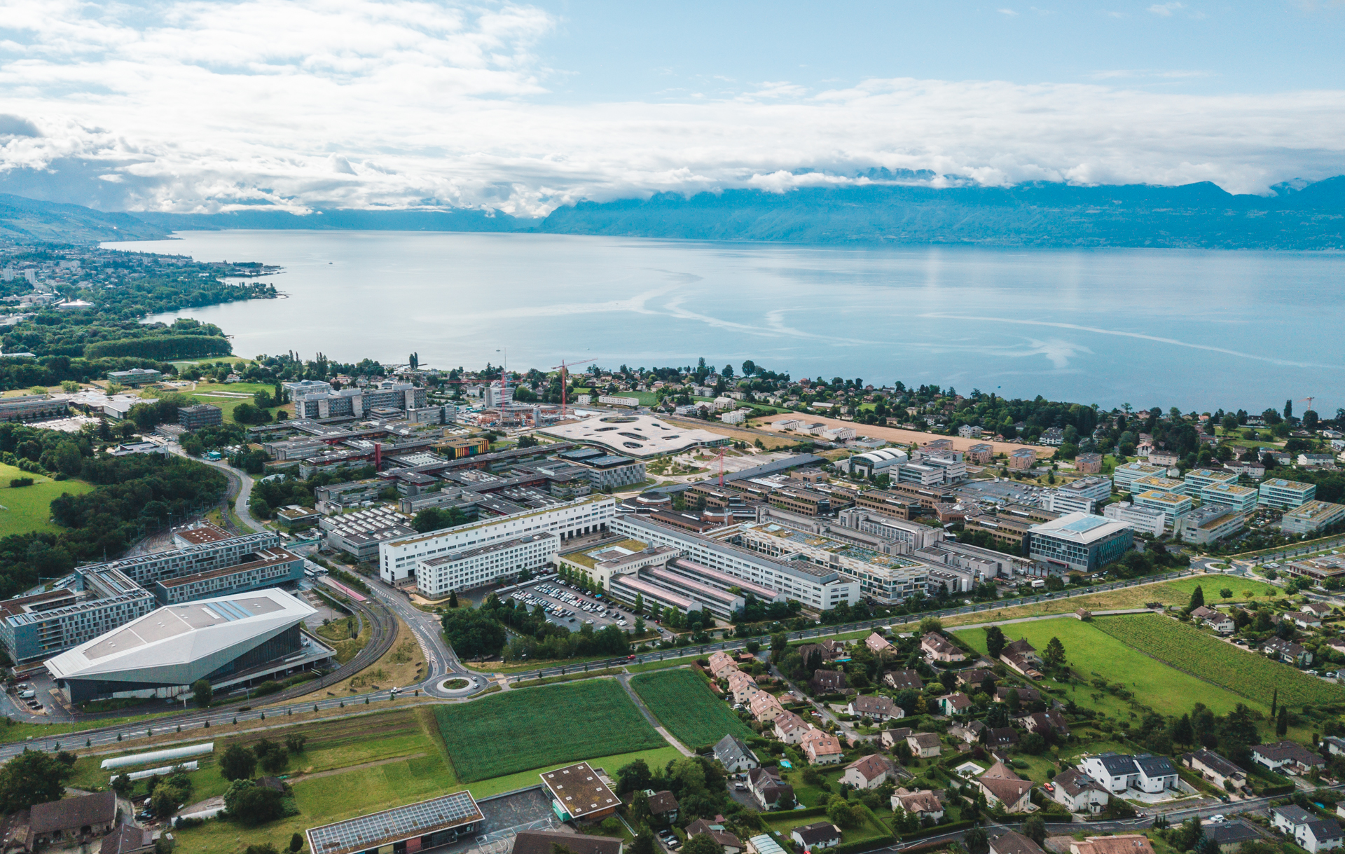

Privacy-preserving inference on DNNs with MHE
Pictures for publication
August 2022

Slide 2
Experiments
We can present 4 experiments:
Cryptonet: Model in clear – data encrypted (usual HE inference)
Cryptonet: Model encrypted – data in clear (model is exported to client. Model owner offers an oblivious decryption service)
NN20: Model encrypted – data encrypted (Poseidon setting with MHE training and distributed protocols)
NN50: Model in clear – data encrypted (usual HE inference with Centralized Bootstrapping)
[1] POSEIDON: Privacy-Preserving Federated Neural Network Learning

Slide 3
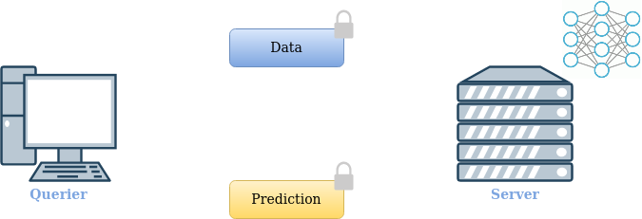
Experiments – Scenario 1
[1] POSEIDON: Privacy-Preserving Federated Neural Network Learning

Slide 4
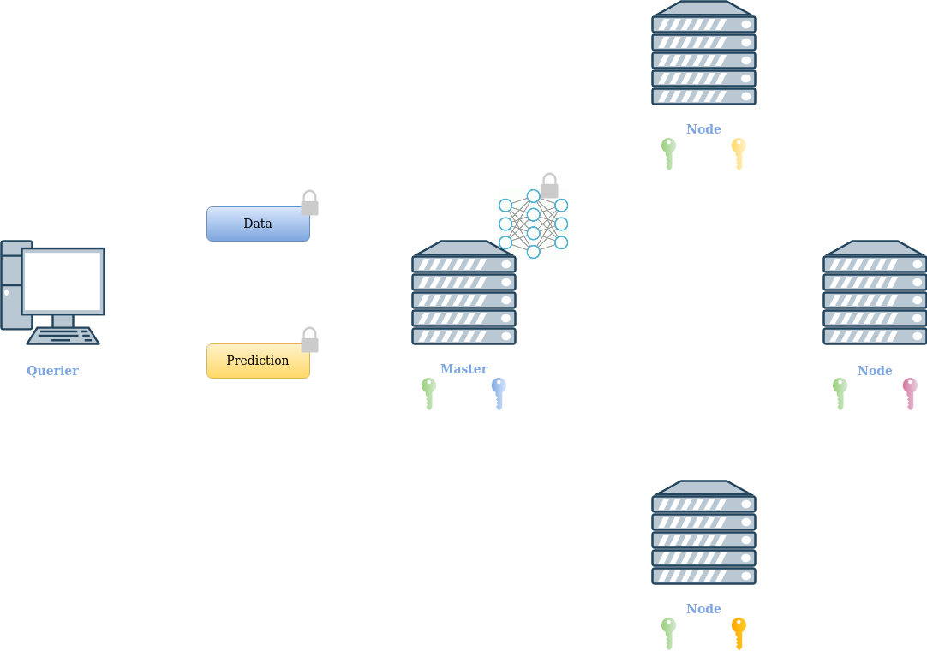
Experiments – Scenario 2
[1] POSEIDON: Privacy-Preserving Federated Neural Network Learning

Slide 5
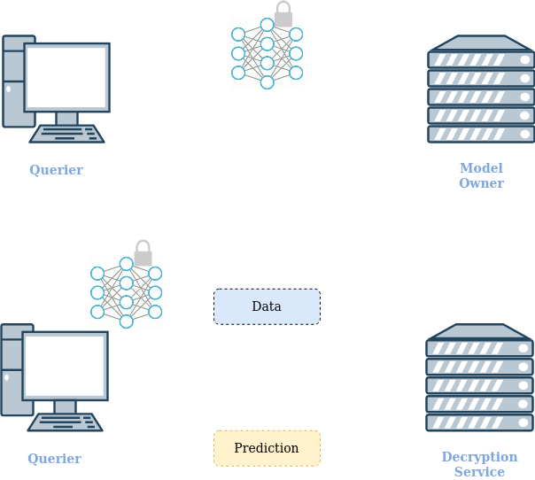
Experiments – Scenario 3
[1] POSEIDON: Privacy-Preserving Federated Neural Network Learning

Slide 6
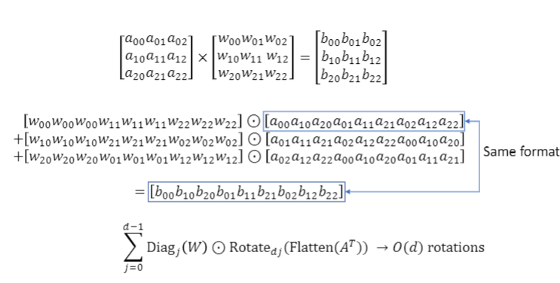
Methods - Matrix Multiplication

Slide 7
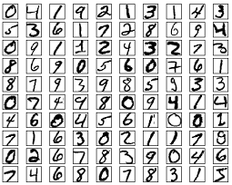
Methods – Input matrix packing
Querier holds batch of N images:
Pre-processing tasks (normalization,padding, etc...)
Images are represented as vectors of size D (row-major ordering)
The NxD matrix is transposed
The NxD matrix is row-flattened
D
D x N
DxN
N
Row-major
T
Flatten
...

Slide 8
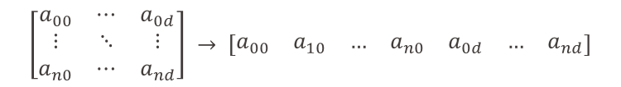
Methods – Input matrix packing – complex trick
Input ciphertext gets packed with complex trick and then replicated for the multiplication (red)
$$\left[\begin{matrix}a_{00} & ⋯ & a_{0d} \\ ⋮ & ⋱ & ⋮ \\ a_{n0} & ⋯ & a_{nd}\end{matrix}\right] → \left[\begin{matrix}a_{00} & a_{10} & … & a_{n0} & a_{0d} & … & a_{nd}\end{matrix}\right]$$
$$↓$$
$$\left[\begin{matrix}a_{00}+{ia}_{01} & … & a_{n0}+ia_{n1} & … & a_{0d−1}+ia_{0d} & … & a_{0d}+ia_{00} & … & a_{nd}+ia_{n0}\end{matrix}\right],$$
Slots
$$\left[\begin{matrix}a_{00}+{ia}_{01} & … & a_{n0}+ia_{n1} & … & a_{0d−1}+ia_{0d} & … & a_{0d}+ia_{00} & … & a_{nd}+ia_{n0}\end{matrix}\right],$$
$$\left[\begin{matrix}a_{00}+{ia}_{01} & … & a_{n0}+ia_{n1} & … & a_{0d−1}+ia_{0d} & … & a_{0d}+i0 & … & a_{nd}+i0 & …0\end{matrix}\right]$$

Slide 9

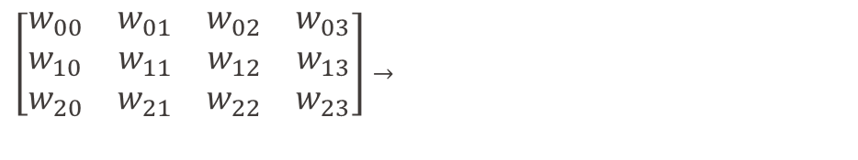



Methods – Weight matrix diagonal packing
Weight matrix gets diagonalized (generalized diagonals for non-square) and the diagonals are then packed together with complex trick. Additionally every element in the diagonal is replicated a number of times equal to the number of rows of the input matrix for multiplication correctness
$$Rows\left(A\right) ×Cols(W)$$
$$Rows(A)$$
${\left[\begin{matrix}w_{00} & w_{01} & w_{02} & w_{03} \\ w_{10} & w_{11} & w_{12} & w_{13} \\ w_{20} & w_{21} & w_{22} & w_{23}\end{matrix}\right] }_{→}$
$$\begin{matrix}{ d}_{0}=\left(\begin{matrix}w_{00}−iw_{10} & ⋯ & w_{03}−iw_{13} & …\end{matrix}\right) \\ d_{1}=\left(\begin{matrix}w_{20}−i0 & ⋯ & w_{23}−i0 & …\end{matrix}\right)\end{matrix}$$
$$(Rows\left(W\right)+1)/2$$

Slide 10
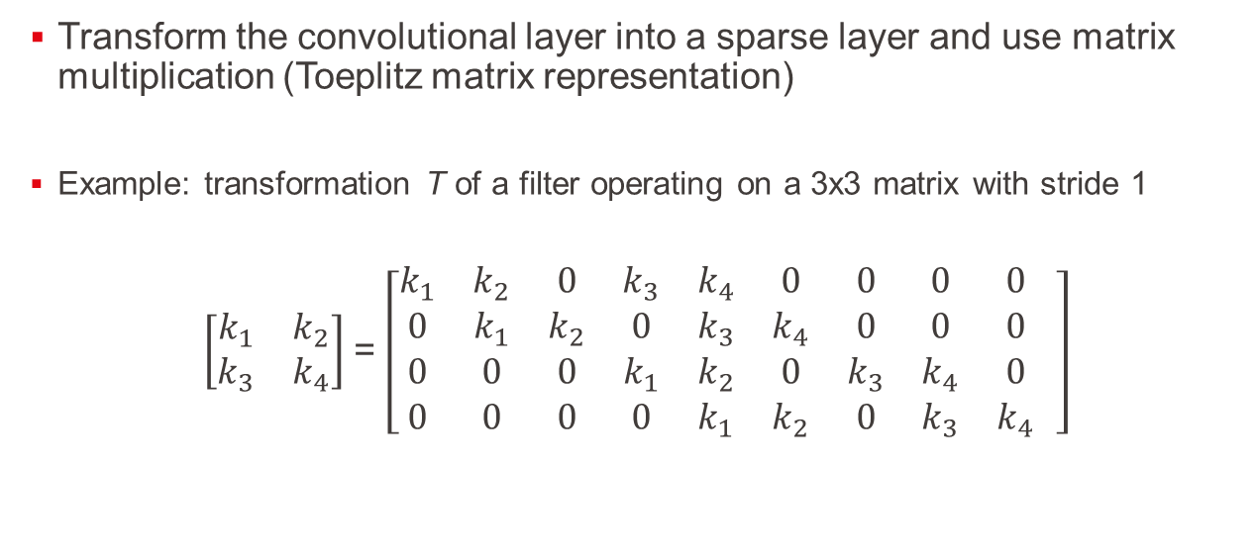
Methods - Convolutional layer «linearization»
Transform the convolutional layer into a sparse layer and use matrix multiplication (Toeplitz matrix representation)
Example: transformation Τ of a filter operating on a 3x3 matrix with stride 1
$\left[\begin{matrix}k_{1} & k_{2} \\ k_{3} & k_{4}\end{matrix}\right]$ = $\left[\begin{matrix}k_{1} & k_{2} & 0 & k_{3} & k_{4} & 0 & 0 & 0 & 0 \\ 0 & k_{1} & k_{2} & 0 & k_{3} & k_{4} & 0 & 0 & 0 \\ 0 & 0 & 0 & k_{1} & k_{2} & 0 & k_{3} & k_{4} & 0 \\ 0 & 0 & 0 & 0 & k_{1} & k_{2} & 0 & k_{3} & k_{4}\end{matrix} \right]$

Slide 11

Methods - Convolutional layer «linearization» cont’d
Generalized for f kernels of KxK size, with M input channels
Benefits:
Can represent any convolution
Self-consistent for subsequent convolutional or linear layers
$$\left[\begin{matrix}T(k_{1}^{({ch}_{1})}) & ⋯ & T(k_{1}^{({ch}_{M})}) \\ ⋮ & ⋱ & ⋮ \\ T(k_{f}^{({ch}_{1})}) & ⋯ & T(k_{f}^{({ch}_{M})})\end{matrix}\right]$$

Slide 12

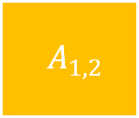

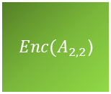
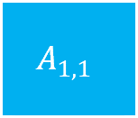

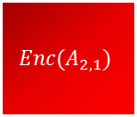
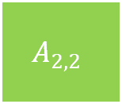
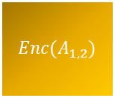
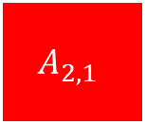
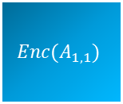
Methods – Block Matrix Arithmetics
$$N x D$$
$$q x s$$
$$q=\frac{N}{2}$$
$$s= \frac{D}{2}$$
A
$$A_{1,1}$$
$$A_{1,2}$$
$${Enc(A}_{1,1})$$
$${Enc(A}_{1,2})$$
$$A_{2,1}$$
$$A_{2,2}$$
$${Enc(A}_{2,1})$$
${Enc(A}_{2,2}$)
Each block (sub-matrix) is encrypted/encoded indipendently
Operations can be carried out on each block using block matrix arithmetics
Benefits:
Smaller ciphertexts/plaintexts
Easily parallelizable
Flexible: block splits can be adjusted to maximize latency or throughput

