Slide 1
An Evaluation of Apollo Powered Descent Guidance
Lloyd David Stroll III

Slide 2
Statement of Purpose

Slide 3
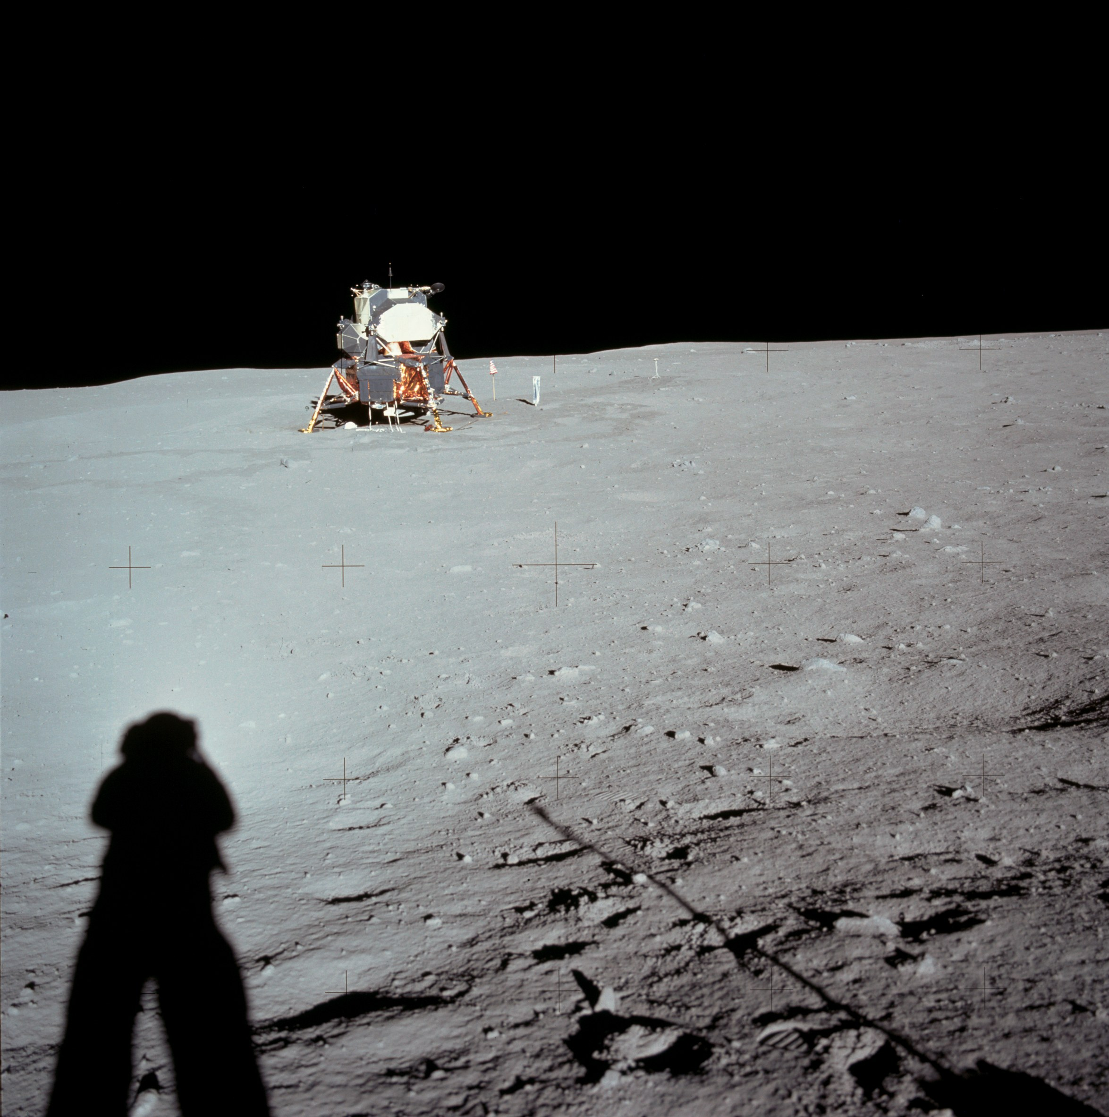
Powered Descent Guidance
Powered descent phase required for any mission in low or no atmosphere
Apollo Powered Descent Guidance (APDG) flown in vacuum only
Simple implementation makes APDG an easy testbed for Adaptive Powered Descent Initiation strategy

Slide 4
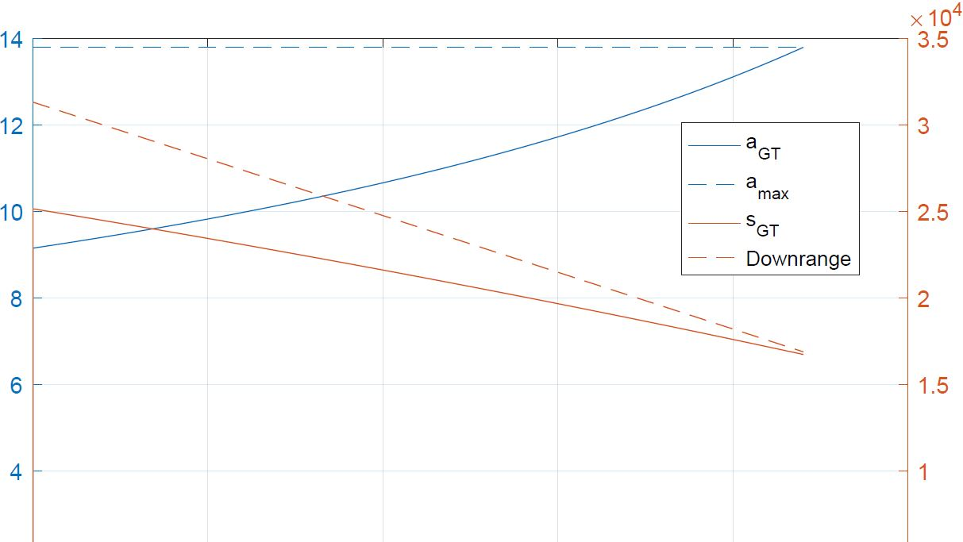
Adaptive Powered Descent Initiation
Most powered descent strategies rely upon time-to-go estimate
Predetermined ignition point is open-loop. Closed-loop strategy might provide better performance and safety
Adaptive PDI helps improve safety and performance automatically

Slide 5
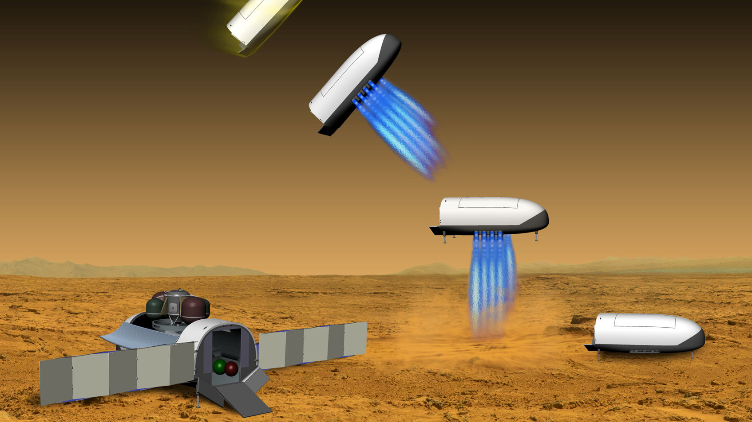
Manned Mars Mission
Manned Mars missions are the focus of current efforts in aerospace, including NASA, SpaceX, and others
Manned Mars missions have high payload mass and large propellant inefficiency penalty
Safety criticality for landing
Vehicle studied is CobraMRV (Cerimele et al)

Slide 6
Literature Review

Slide 7
Apollo Powered Descent Guidance
APDG developed by Cherry 1964 and studied extensively by many.
Studies include programming methods, landing site redesignation (Ploen, Sostaric), robustness (Klumpp), and fuel performance comparisons performed by many.
Fuel performance is not optimal, as demonstrated by D’Souza, Najson, Ross, Lu, and many others.
APDG has been flown in real Apollo missions

Slide 8
Adaptive Powered Descent Initiation
APDG and other powered descent guidance methods rely upon time-to-go estimates, which are often not optimized. D’Souza considered optimizing the time-to-go with a weighted function and realized a better fuel performance, but not completely optimal and did not address ignition timing. Others have explored similar avenues but have used predetermined ignition strategies.
Ceremele et al, designers of the CobraMRV, recommend a strategy similar to the one presented here but do not explore it.
Meditch showed in 1964 that fuel optimal thrust was “bang-bang” style for 1D descent. Leitmann 1959 showed the same for 2D using multiple switches, and Lu has shown that the same is true of 3D.

Slide 9
Methodology

Slide 10
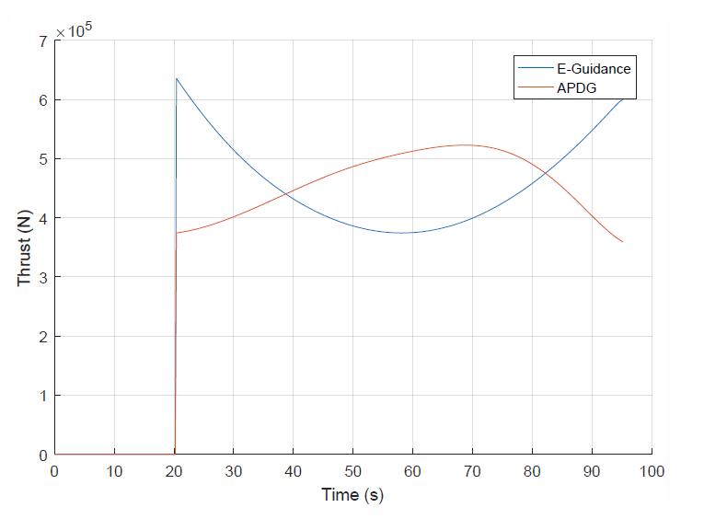
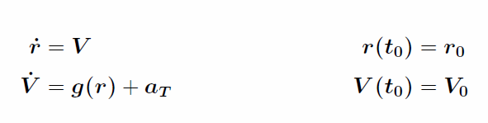
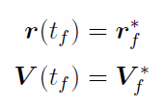

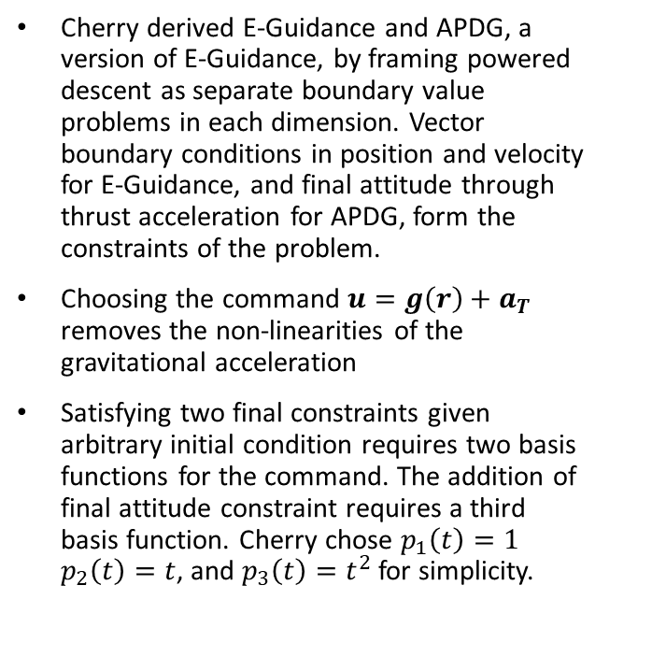


APDG Derivation
Cherry derived E-Guidance and APDG, a version of E-Guidance, by framing powered descent as separate boundary value problems in each dimension. Vector boundary conditions in position and velocity for E-Guidance, and final attitude through thrust acceleration for APDG, form the constraints of the problem.
Choosing the command $u=g\left(r\right)+a_{T}$ removes the non-linearities of the gravitational acceleration
Satisfying two final constraints given arbitrary initial condition requires two basis functions for the command. The addition of final attitude constraint requires a third basis function. Cherry chose $p_{1}\left(t\right)=1$ $p_{2}\left(t\right)=t$, and $p_{3}\left(t\right)=t^{2}$ for simplicity.
E-Guidance:
$u= c_{1}+c_{2}t$
APDG:
$$u=c_{1}+c_{2}t+c_{3}t^{2}$$

Slide 11
Results and Discussion

Slide 12
Future Work

