Slide 1
An Evaluation of Apollo Powered Descent Guidance
Lloyd David Stroll III

Slide 2
Statement of Purpose

Slide 3
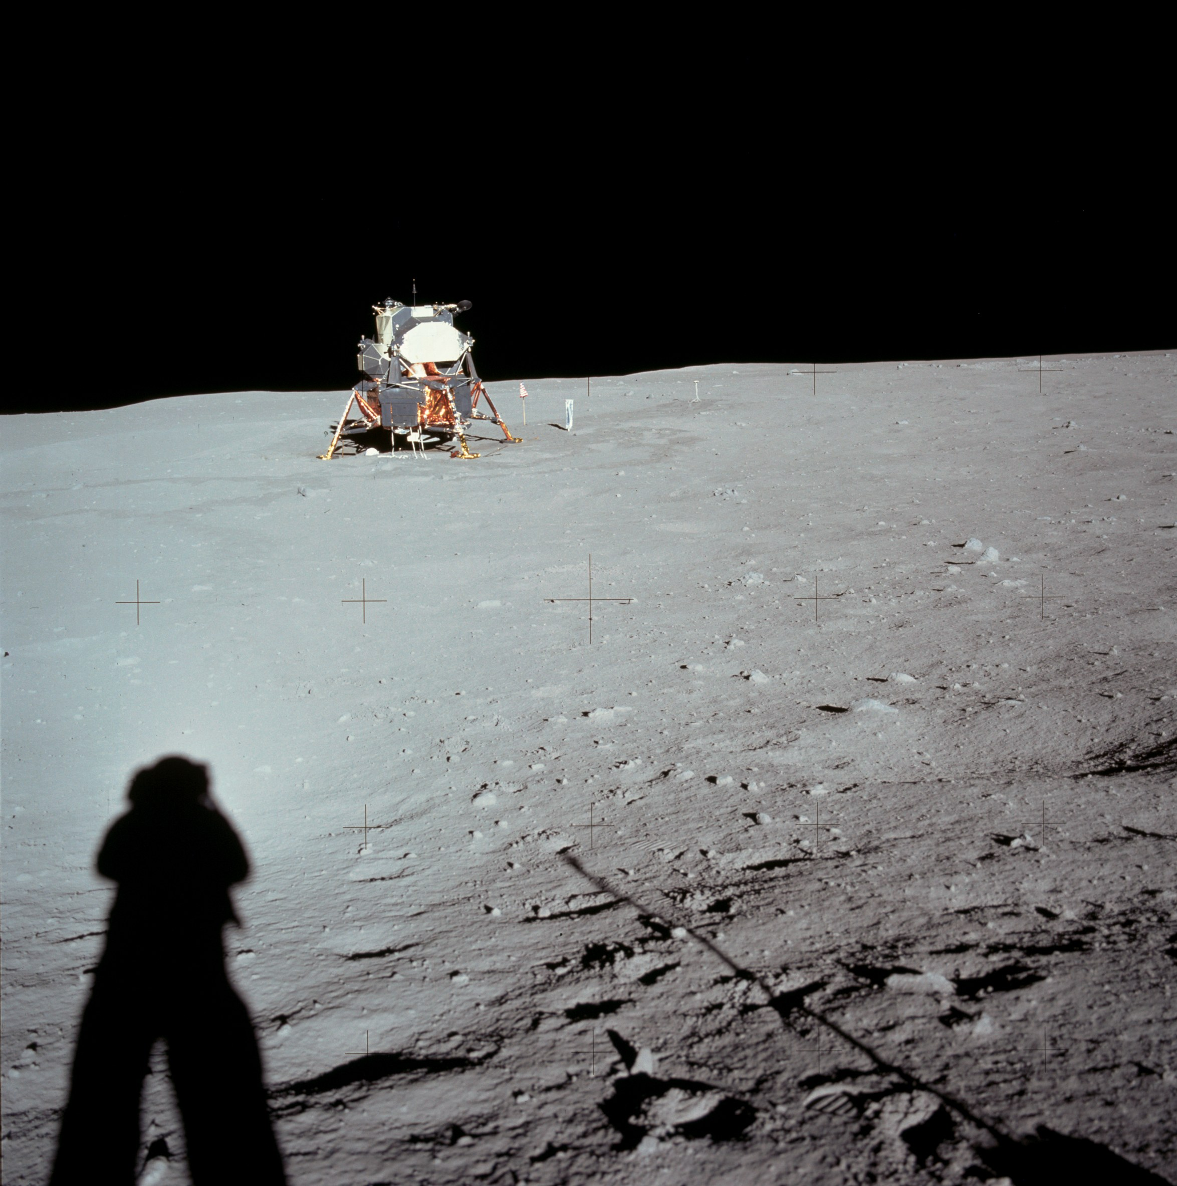
Powered Descent Guidance
Powered descent phase required for any mission in low or no atmosphere
Apollo Powered Descent Guidance (APDG) flown in vacuum only
Simple implementation makes APDG an easy testbed for Adaptive Powered Descent Initiation strategy

Slide 4
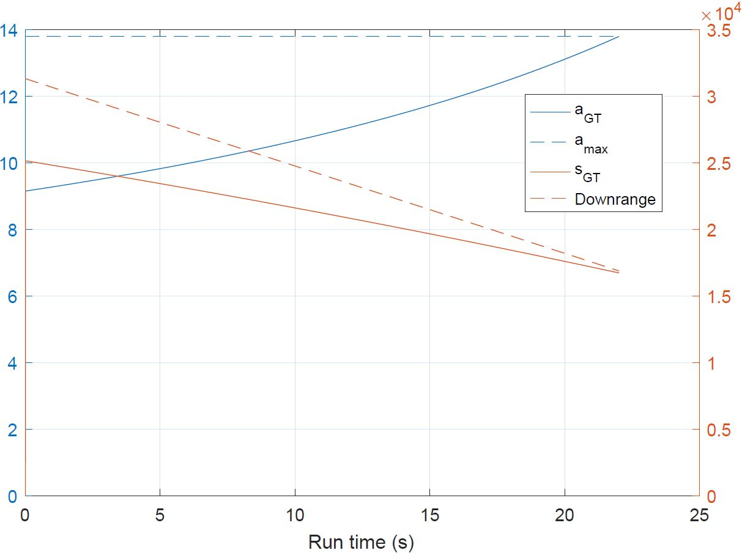
Adaptive Powered Descent Initiation
Most powered descent strategies rely upon time-to-go estimate
Predetermined ignition point is open-loop. Closed-loop strategy might provide better performance and safety
Adaptive PDI helps improve safety and performance automatically

Slide 5
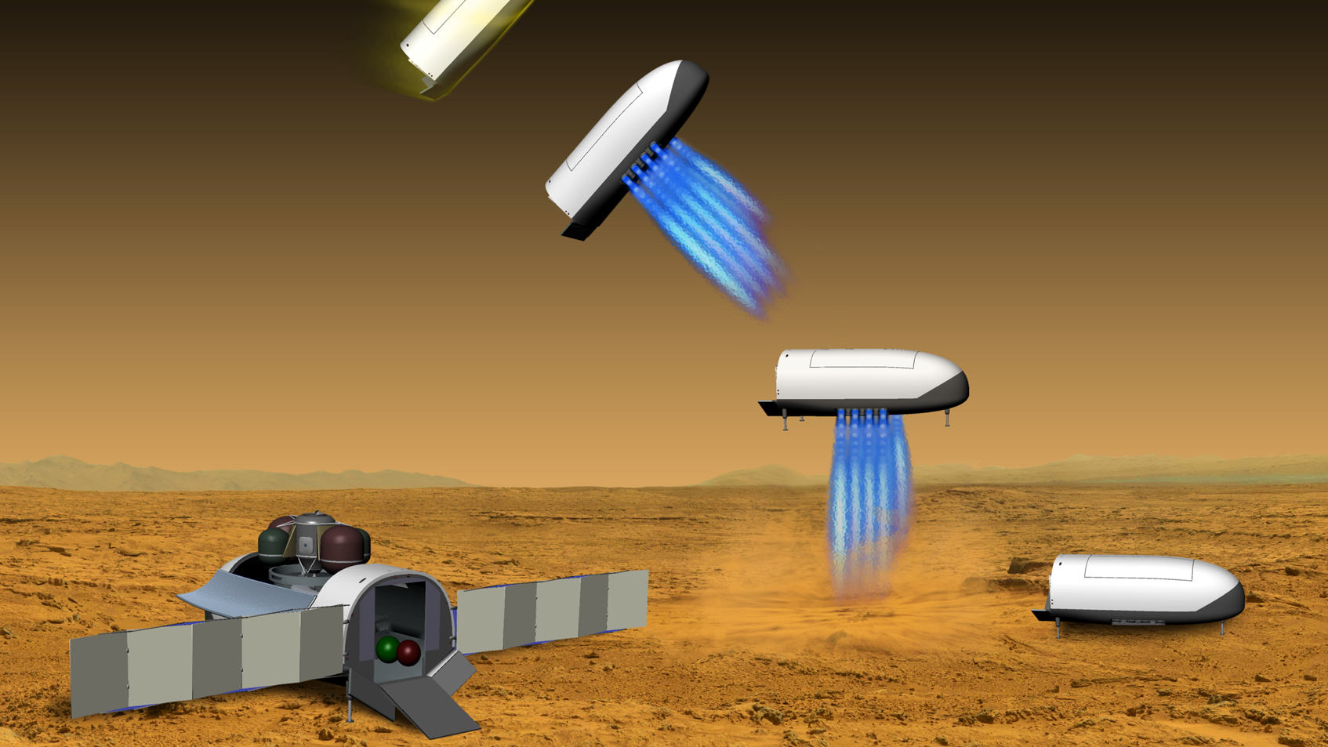
Manned Mars Mission
Manned Mars missions are the focus of current efforts in aerospace, including NASA, SpaceX, and others
Manned Mars missions have high payload mass and large propellant inefficiency penalty
Safety criticality for landing
Thin but significant atmosphere
Vehicle studied is CobraMRV (Cerimele et al)

Slide 6
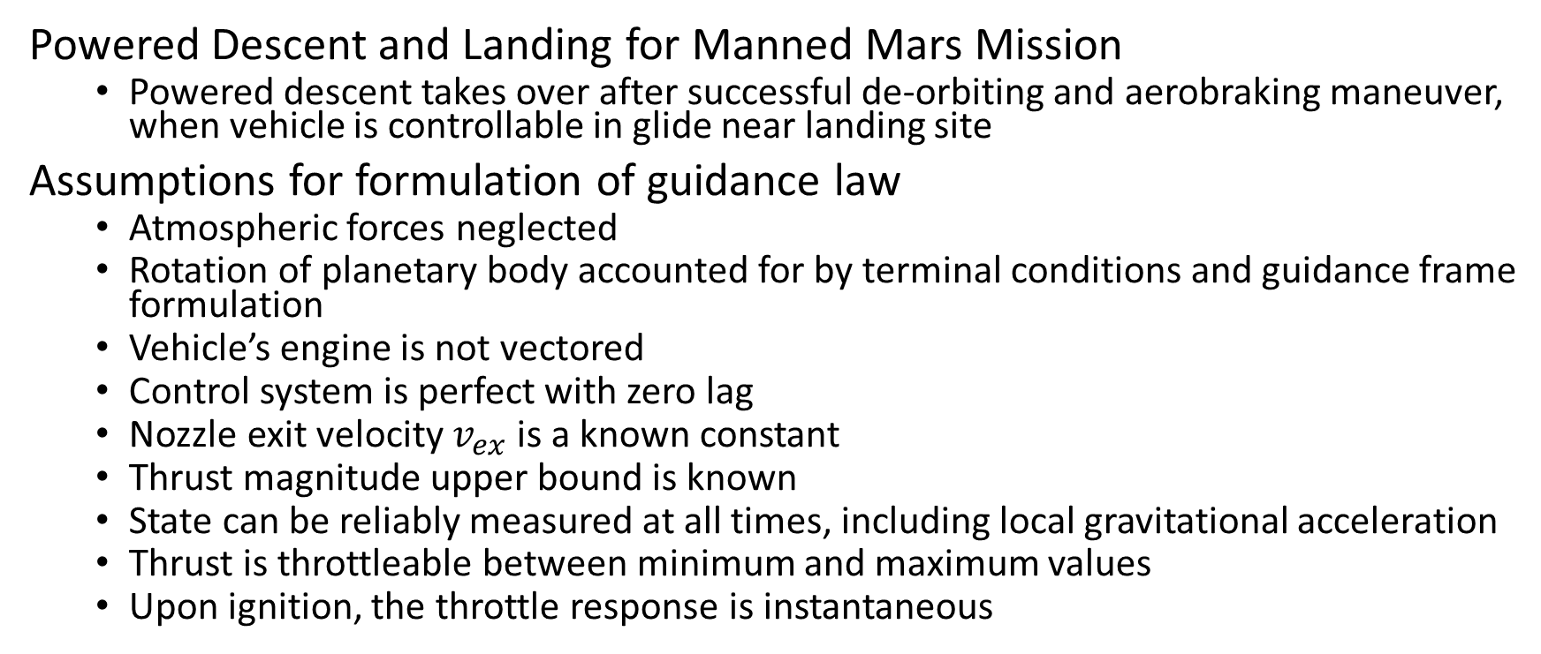
Problem Statement
Powered Descent and Landing for Manned Mars Mission
Powered descent takes over after successful de-orbiting and aerobraking maneuver, when vehicle is controllable in glide near landing site
Assumptions for formulation of guidance law
Atmospheric forces neglected
Rotation of planetary body accounted for by terminal conditions and guidance frame formulation
Vehicle’s engine is not vectored
Control system is perfect with zero lag
Nozzle exit velocity $v_{ex}$ is a known constant
Thrust magnitude upper bound is known
State can be reliably measured at all times, including local gravitational acceleration
Thrust is throttleable between minimum and maximum values
Upon ignition, the throttle response is instantaneous

Slide 7
Literature Review

Slide 8
Apollo Powered Descent Guidance
APDG developed by Cherry 1964 and studied extensively by many.
Studies include programming methods, landing site redesignation (Ploen, Sostaric), robustness (Klumpp), and fuel performance comparisons performed by many.
Fuel performance is not optimal, as demonstrated by D’Souza, Najson, Ross, Lu, and many others.
APDG has been flown in real Apollo missions

Slide 9
Adaptive Powered Descent Initiation
APDG and other powered descent guidance methods rely upon time-to-go estimates, which are often not optimized. D’Souza considered optimizing the time-to-go with a weighted function and realized a better fuel performance, but not completely optimal and did not address ignition timing. Others have explored similar avenues but have used predetermined ignition strategies.
Ceremele et al, designers of the CobraMRV, recommend a strategy similar to the one presented here but do not explore it.
Meditch showed in 1964 that fuel optimal thrust was “bang-bang” style for 1D descent. Leitmann 1959 showed the same for 2D using multiple switches, and Lu has shown that the same is true of 3D.

Slide 10
Methodology

Slide 11
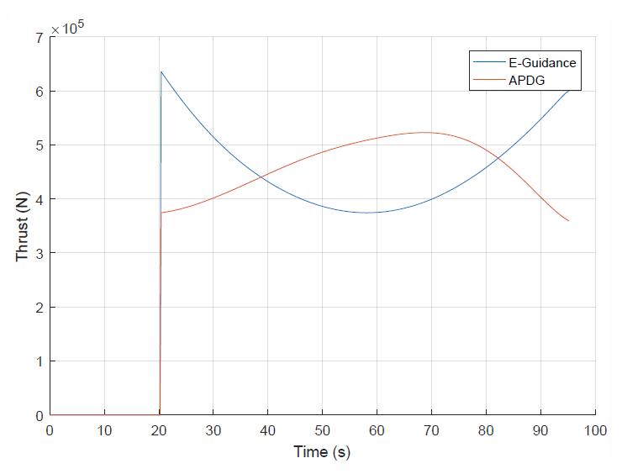
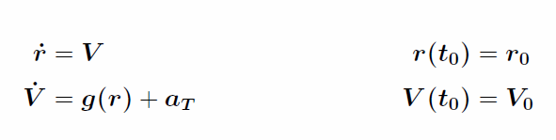
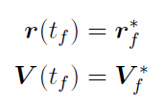

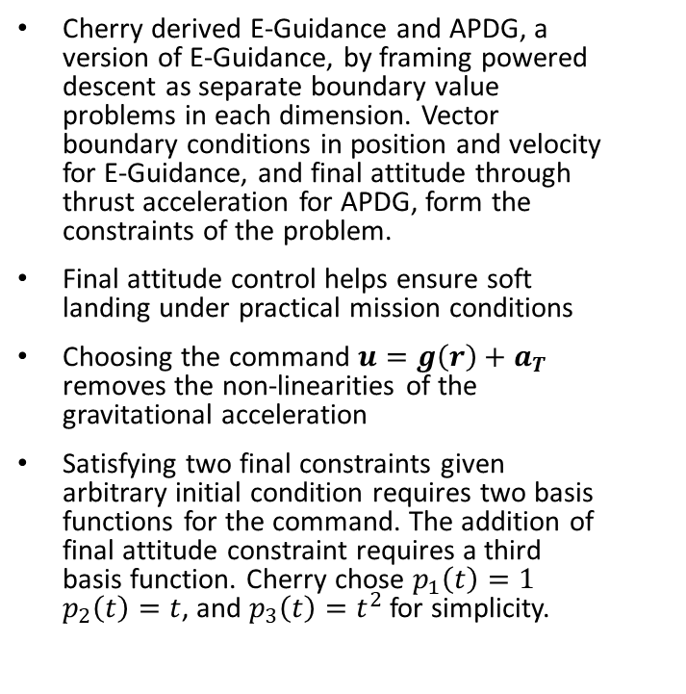


APDG Derivation
Cherry derived E-Guidance and APDG, a version of E-Guidance, by framing powered descent as separate boundary value problems in each dimension. Vector boundary conditions in position and velocity for E-Guidance, and final attitude through thrust acceleration for APDG, form the constraints of the problem.
Final attitude control helps ensure soft landing under practical mission conditions
Choosing the command $u=g\left(r\right)+a_{T}$ removes the non-linearities of the gravitational acceleration
Satisfying two final constraints given arbitrary initial condition requires two basis functions for the command. The addition of final attitude constraint requires a third basis function. Cherry chose $p_{1}\left(t\right)=1$ $p_{2}\left(t\right)=t$, and $p_{3}\left(t\right)=t^{2}$ for simplicity.
E-Guidance:
$u= c_{1}+c_{2}t$
APDG:
$$u=c_{1}+c_{2}t+c_{3}t^{2}$$

Slide 12

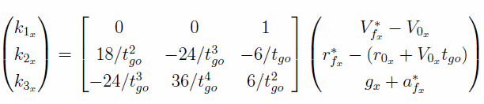

E-Guidance and APDG Implementation
E-Guidance
APDG
The E matrix, the inverted matrix forming the linear system from the equations of motion, gives E-Guidance its name. Each axis of motion is solved independently, resulting in a total of 6 at each guidance update
APDG forms a similar linear system in 3 unknowns per axis, resulting in the above 3 equations for a total of 9 at each guidance update.

Slide 13
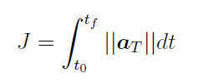
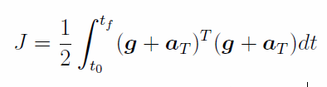
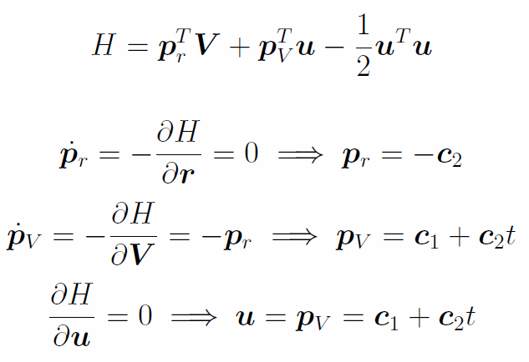


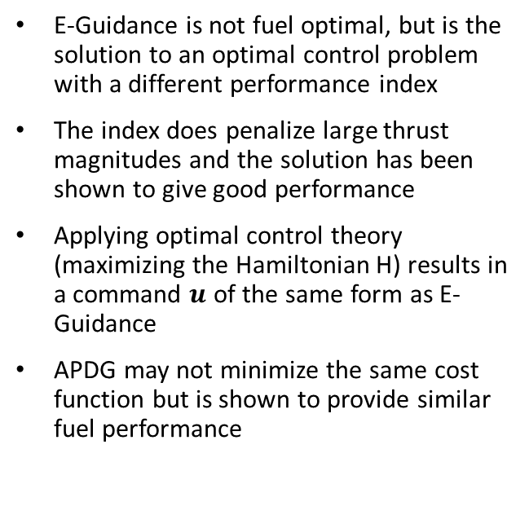
E-Guidance as Optimal Control
E-Guidance is not fuel optimal, but is the solution to an optimal control problem with a different performance index
The index does penalize large thrust magnitudes and the solution has been shown to give good performance
Applying optimal control theory (maximizing the Hamiltonian H) results in a command $u$ of the same form as E-Guidance
APDG may not minimize the same cost function but is shown to provide similar fuel performance
Fuel Optimal:
E-Guidance

Slide 14
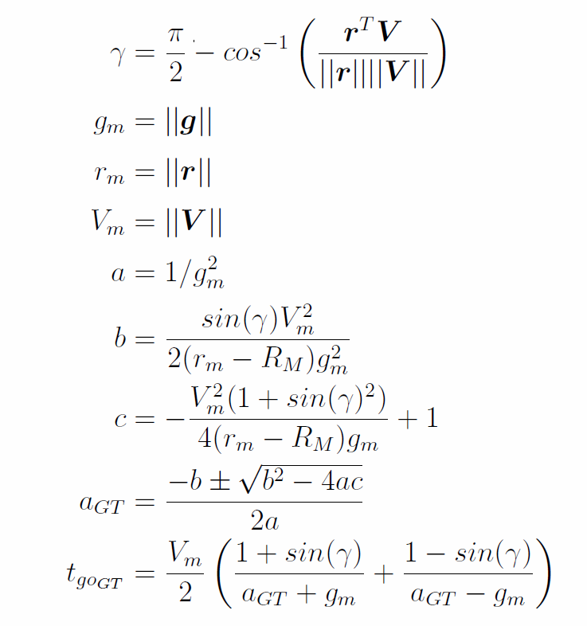
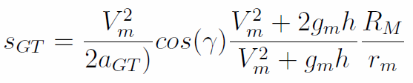
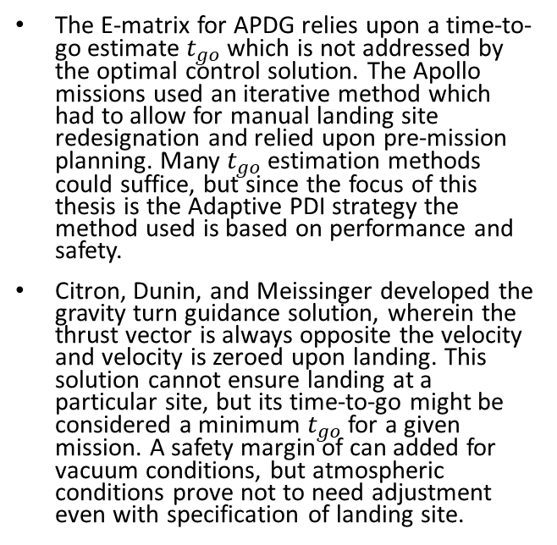
Time-to-go
The E-matrix for APDG relies upon a time-to-go estimate $t_{go}$ which is not addressed by the optimal control solution. The Apollo missions used an iterative method which had to allow for manual landing site redesignation and relied upon pre-mission planning. Many $t_{go}$ estimation methods could suffice, but since the focus of this thesis is the Adaptive PDI strategy the method used is based on performance and safety.
Citron, Dunin, and Meissinger developed the gravity turn guidance solution, wherein the thrust vector is always opposite the velocity and velocity is zeroed upon landing. This solution cannot ensure landing at a particular site, but its time-to-go might be considered a minimum $t_{go}$ for a given mission. A safety margin of can added for vacuum conditions, but atmospheric conditions prove not to need adjustment even with specification of landing site.

Slide 15
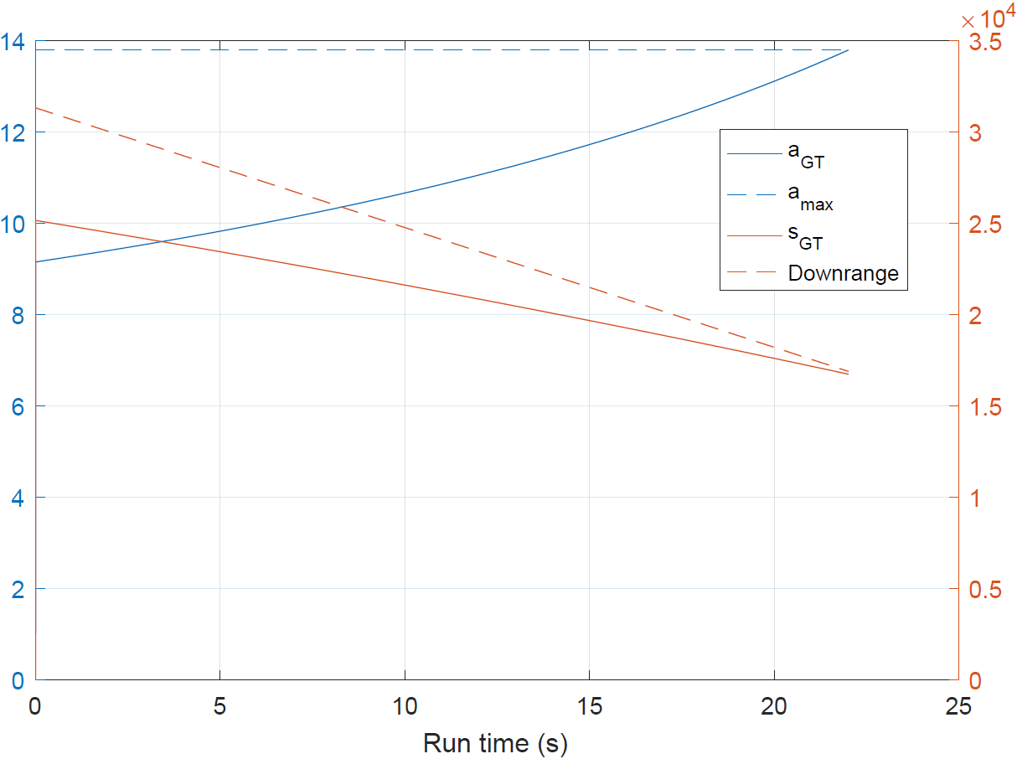
Adaptive Powered Descent Initiation
Few powered descent guidance formulations consider optimized engine ignition time, though most acknowledge the need for ignition criteria. These are typically predetermined altitudes, groundranges, etc
Adaptive PDI uses the gravity turn solution as a threshold value. When required thrust exceeds maximum available thrust, or when groundrange traveled by a gravity turn exceeds ground distance to the landing site, the engine is ignited.
These criteria are shown to be robust

Slide 16
Simulation
Architecture and Implementation

Slide 17
Simulation Architecture
Monte-Carlo: Disperse Conditions
Navigation Module
Simulation
Guidance Computer
Aerodynamic Model
Numerical Integration
No
Landed?
Yes
Yes
Runs completed?
Yes
Record run data
End

Slide 18

Aerodynamic Model
CobraMRV provided by Cerimele et al
“rigid, enclosed, elongated lifting body shape that provides a higher lift-to-drag ratio (L/D) than a typical entry capsule”
Designed for atmospheric entry and powered descent on Mars. Missions require 20 tonnes of cargo to the surface.
Vehicle mass at PDI is 58000 kg. Max thrust is 800 kN, and min is 200 kN.
$C_{L}$ and $C_{D}$ are empirical functions of Mach number and AoA. Reference area $S=62.21 m^{2}$.
Upon ignition, drag and lift are reduced by half due to effects of the exhaust plume.
Optimal AoA is ${55}^{∘}$, which is held until ignition for Adaptive PDI.

Slide 19
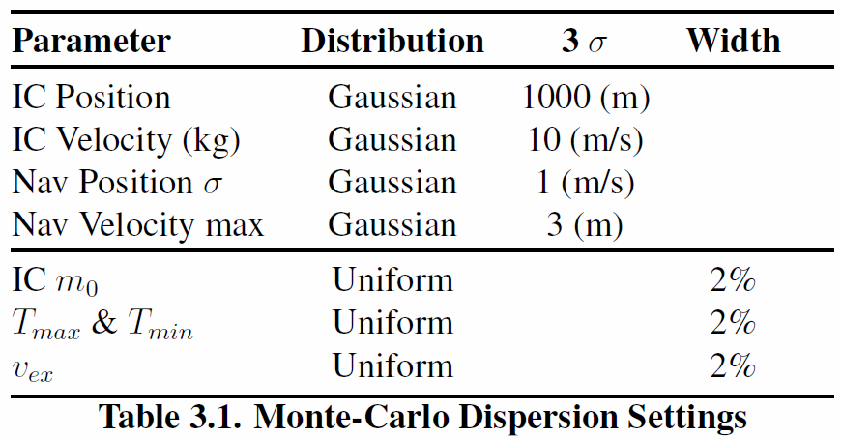
Monte Carlo Testing
Dispersion applied to initial conditions, navigation measurements, rocket parameters (initial mass, thrust bounds, exhaust velocity)
Each run is seeded for reproducibility

Slide 20
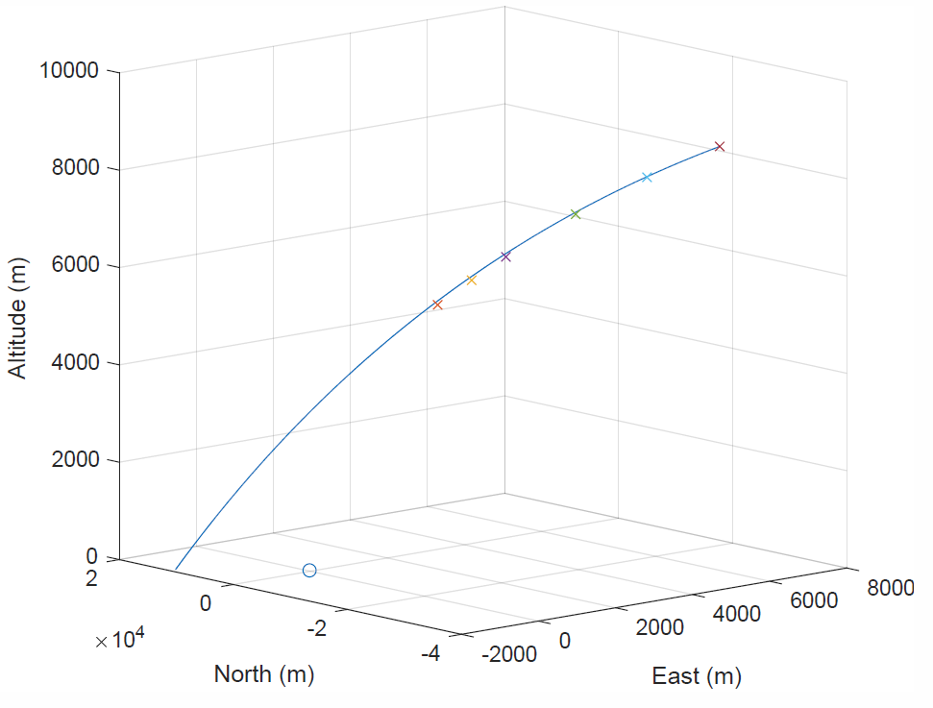
Initial Conditions
Initial trajectory modeled as small angle miss over landing site with overshoot.
Adaptive PDI is compared to predetermined conditions representing CobraMRV gliding at optimal AoA unpowered along initial trajectory

Slide 21
Results and Discussion
APDG is compared to E-Guidance. Adaptive PDI is examined vs. predetermined ignition times, with consideration of performance and safety.

Slide 22
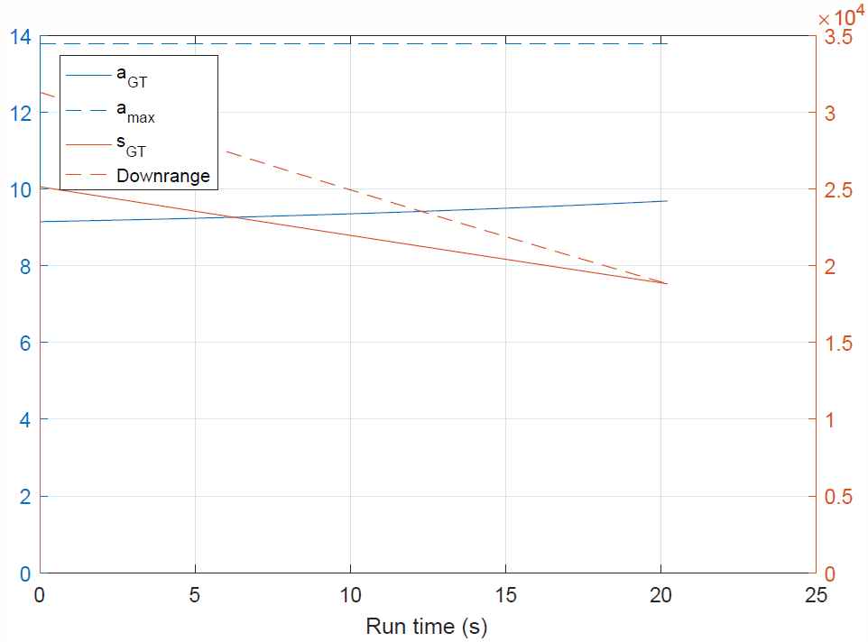
Adaptive PDI Criteria
Vacuum
Atmosphere

Slide 23
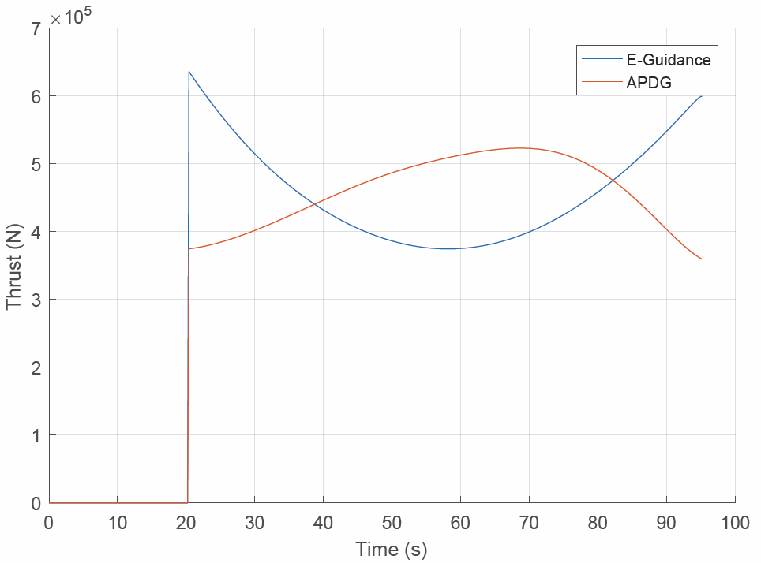
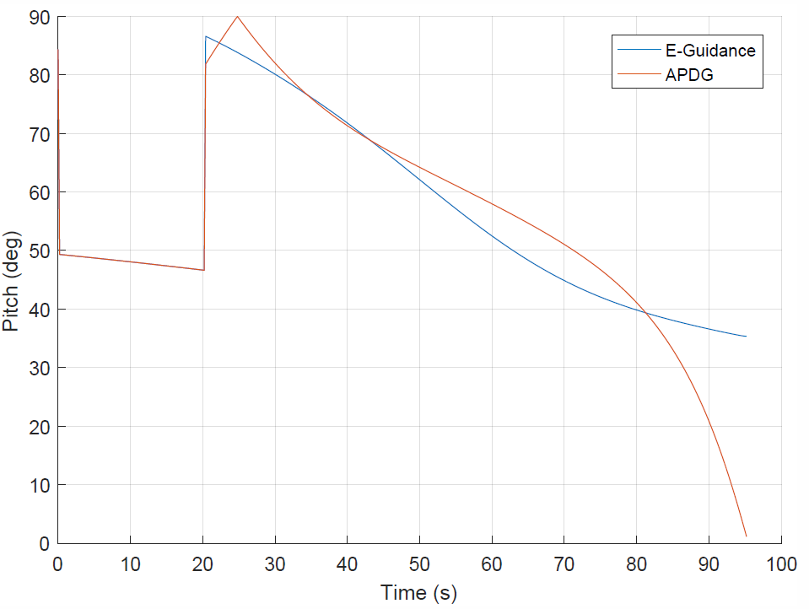
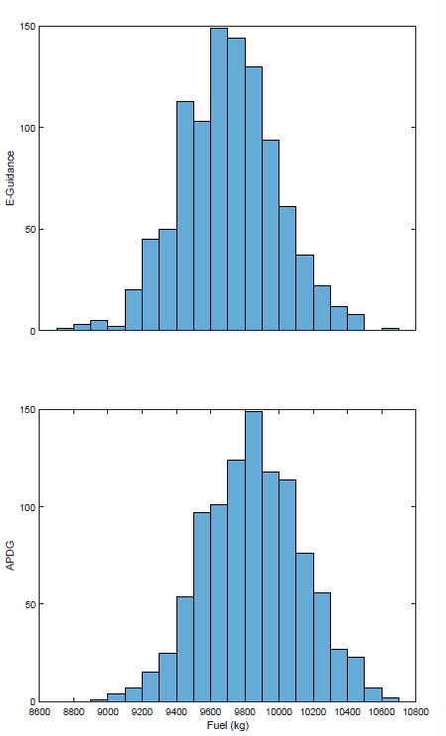
E-Guidance vs. APDG
Thrust
Pitch
Fuel Performance

Slide 24
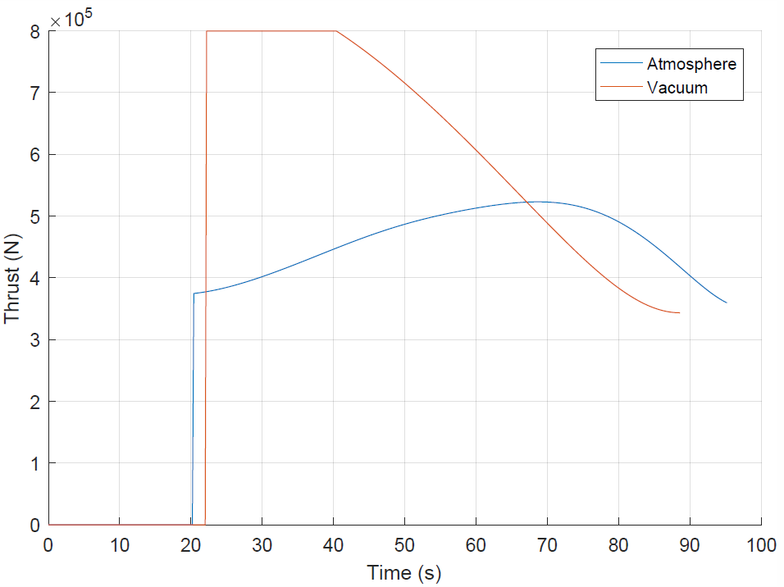
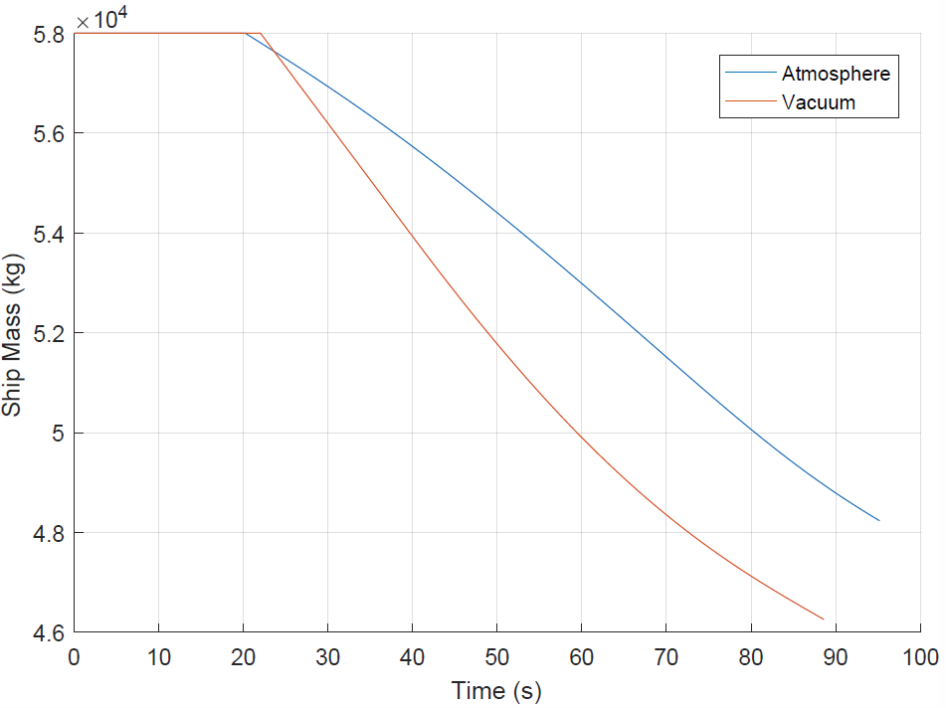
Vacuum vs. Atmosphere
Thrust Magnitude
Vehicle Mass

Slide 25
Future Work

