Slide 1
Image Processing Project - Fingerprint Core point Detection
Shailesh Samudrala
UFID: 61619911

Slide 2
Core Point Detection
Fingerprints consist of certain special regions where the geometry of the ridge structure is very different from that found in other regions
Such regions are called as Singular Points or SPs which can be either core or delta. These regions can be effectively used for fingerprint alignment as they are intrinsic to the fingerprint.
Core points are the points where the innermost ridge loops are the steepest. Delta points are those points from which the three patterns – delta, loop and whorl topologies deviate.

Slide 3
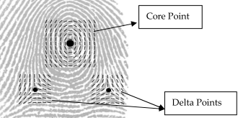
Core Point

Slide 4
Why is it Important?
Fingerprint based identification has been a hotbed for applications in the field of biometric technology.
The core point of fingerprints plays an important role in techniques involving fingerprint identification. It has vast applications and is widely used in fields like fingerprint classification , and fingerprint matching
In many of these applications, there is no need to detect the exact core point of the fingerprint. Detection a Region of interest or ROI around the core point area is sufficient.
Some applications require exact and precise detection of core point.
Accurate core point detection is vital in applications relating to fingerprint classification

Slide 5
Steps leading to Core Point detection
1. Fingerprint Segmentation:
In this process, the background or the non-fingerprint area of the image is separated from the foreground or the fingerprint area of the image.
Eliminating the background area from the image for further processing reduces the number of operations that need to be performed on the fingerprint image, thus increasing the efficiency and execution time of the algorithm

Slide 6
Segmented Image

Slide 7
2. Fingerprint Normalization
Normalization is the process of changing the range of the pixel intensity values
The main purpose of normalization is to reduce the variations in gray-level values along the ridges and valleys.
Normalization is done to reduce the effects of sensor noise and finger pressure difference when taking the fingerprint.
Normalization is a linear pixel-wise operation, it does not change the clarity of the ridge and valley structures of the fingerprint.

Slide 8
Normalized Image

Slide 9


3. Ridge Orientation Estimation
Ridge orientation estimation is a major step towards fingerprint core point detection.
Sobel Operator Gradients:
Local Field Estimation: Vx and Vy

Slide 10


3. Ridge Orientation Estimation
Orientation Field Estimation:

Slide 11

4. Ridge orientation Smoothing
Convert orientation field to continuous vector field. (using sin and cosine trigonometric functions)
Apply low pass filter on resulting vector field.
Obtain a smoothened orientation field as follows:

Slide 12
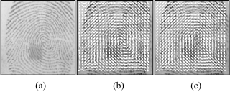
Smoothened Orientation Field
a) Pre-processed image b) Orientation Field Estimation c) Orientation Field Smoothing .

Slide 13
Core Point Detection
Existing Methods:
1. Direction of Curvature (DC)
2. Geometry of Region (GR)
3. Poincare Index Method (PIM)
Other methods:
1. Corner Strength Algorithm
2. Edge map based core point detection

Slide 14
Direction of Curvature (DC)
Method: use orientation field to evaluate difference in direction components for every block in the image.
Core point location is estimated using the difference in direction components.
If difference in both direction components is negative, then that point is the core point.
Advantage: Easy to implement, efficient, easy computation
Disadvantage: Not 100% precise in evaluating core point location.
Usually used to detect Region of Interest (ROI) of fingerprint image

Slide 15

Geometry of Region (GR)
Method:
Compute the smoothed orientation field θ′(i, j).
ε(i, j) = sin(θ′(i, j))
Initialize a label image A which is used to indicate the core point.

Slide 16
Geometry of Region (GR)
Find the maximum value in A and assign its coordinate as the core point.
If the core point still cannot be located, the steps could be re-iterated for a number of times while decreasing the window size

Slide 17
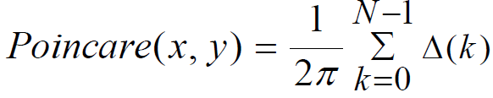
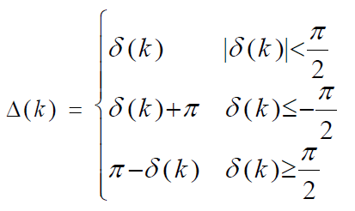
Poincare Index Method
Most popular method
δ (k) =θ (x( k + 1) mod N, y( k + 1) mod N) −θ (xk, yk).

Slide 18
Evaluation
Used Direction of Curvature (DC) method to find core point in my project
Original image:

Slide 19
Segmented Image:

Slide 20
Normalized Image

Slide 21
ROI Extraction

Slide 22
Core Point Detection

Slide 23
Conclusion
The algorithm used is motivated by the following factors: simplicity, ease of computation, and good efficiency.
The algorithm targets applications where detection of the Region of Interest (ROI) or a coarse location of the core-point is sufficient.
Therefore, with the type of application in mind, a simple, robust and efficient algorithm was chosen to implement the problem of core point detection.

Slide 24
Conclusion
Overview of steps taken:
1) Fingerprint image segmentation
2) Fingerprint image normalization
3) Ridge orientation field estimation
4) Ridge orientation field smoothing
5) Detection of ROI and core point using Direction of Curvature (DC) method

Slide 25
THANK YOU!

