Slide 1
Final Project - Cryptography SHA224-HMAC-HKDF
20C14001 – Le Duong Tuan Anh
Tutor: Assoc. Prof. Tran Minh Triet
Dr. Truong Toan Thinh

Slide 2
Agenda
SHA-224
HMAC
HKDF
Conclusion

Slide 3
SHA-224

Slide 4
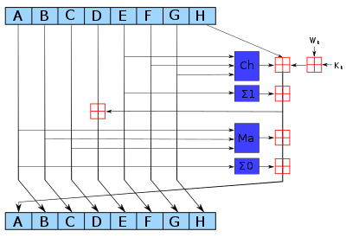
SHA-224
SHA-224 is an iterative one-way hash function, under standard Secure Hash Standard.
Input: less than 2⁶⁴ bits.
Message digest: 224 bits.
Block Size: 512 bits.

Slide 5
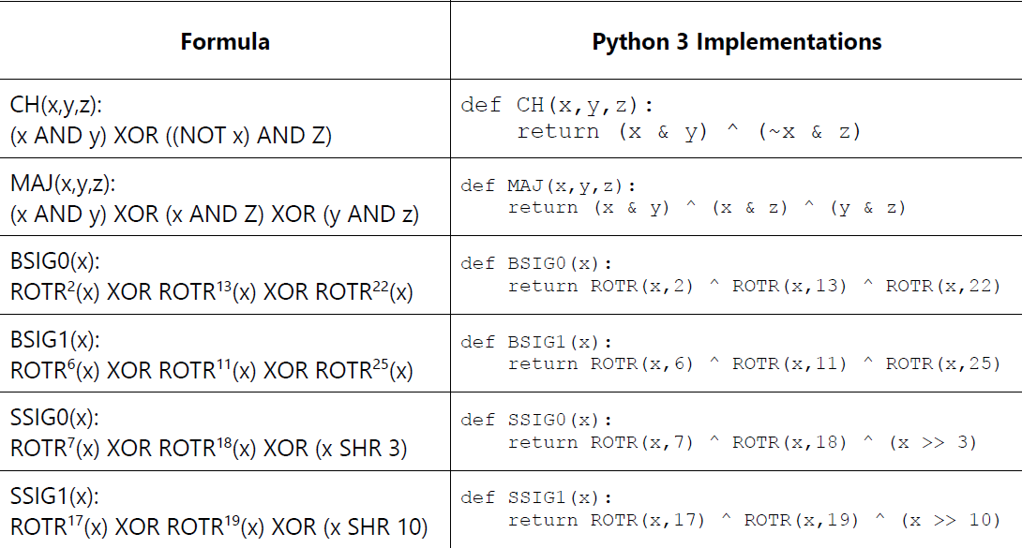
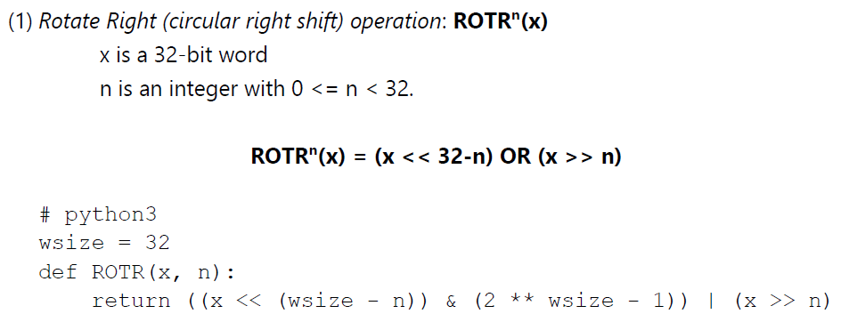
SHA-224 Functions

Slide 6
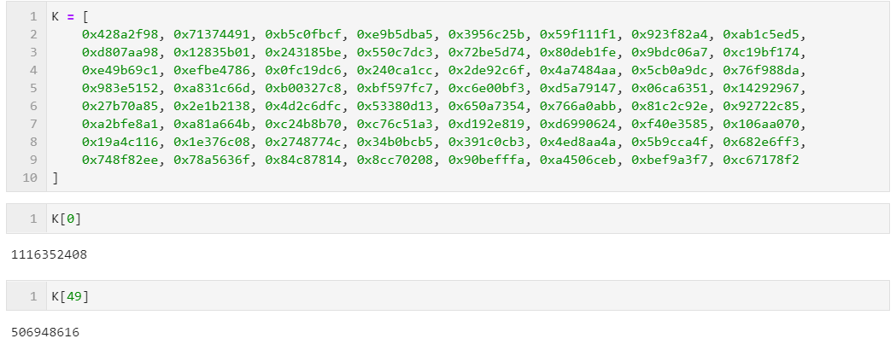
SHA-224 Round Constants (K)
There are 64 32-bit contanst values are used in SHA-224.
Each value (0-63) is the 32 bits of the fractional parts of the cube roots of the first 64 primes (from 2 to 311).

Slide 7
SHA-224 H Initialization Values (H)
There are 8 32-bit contants also for initializated hash value.
Each value represents the first 32 bits of the fractional parts of the square roots of the first 8 primes: 2, 3, 5, 7, 11, 13, 17, 19.

Slide 8
SHA-224 Algorithm - Processing
Input: HCMUS@2021
Binary:
01001000 01000011 01001101 01010101
01010011 01000000 00110010 00110000
00110010 00110001

Slide 9
SHA-224 Algorithm - Processing
Step 1: Padding “1” to the right
01001000 01000011 01001101 01010101
01010011 01000000 00110010 00110000
00110010 00110001 1

Slide 10
SHA-224 Algorithm - Processing
Step 2: Padding K “0”s to the message, where K is the smallest, non-negative solution to the equation
Length of Message + 1 + K = 448 (mod 512)
01001000 01000011 01001101 01010101 01010011 01000000 00110010 00110000 00110010 00110001 10000000 00000000 00000000 00000000 00000000 00000000 00000000 00000000 00000000 00000000 00000000 00000000 00000000 00000000 00000000 00000000 00000000 00000000 00000000 00000000 00000000 00000000 00000000 00000000 00000000 00000000 00000000 00000000 00000000 00000000 00000000 00000000 00000000 00000000 00000000 00000000 00000000 00000000 00000000 00000000 00000000 00000000 00000000 00000000 00000000 00000000

Slide 11
SHA-224 Algorithm - Processing
Step 3: Append 64 bits to the end, where the 64 bits are a big-endian integer representing the length of the original input in binary. The length of original message is 80, which is represented in 64-bit binary as:
00000000 00000000 00000000 00000000 00000000 00000000 00000000 01010000

Slide 12
SHA-224 Algorithm - Processing
Step 3: Append this block to message block, we have length of the message will be a multiple of 512 bits
01001000 01000011 01001101 01010101 01010011 01000000 00110010 00110000 00110010 00110001 10000000 00000000 00000000 00000000 00000000 00000000 00000000 00000000 00000000 00000000 00000000 00000000 00000000 00000000 00000000 00000000 00000000 00000000 00000000 00000000 00000000 00000000 00000000 00000000 00000000 00000000 00000000 00000000 00000000 00000000 00000000 00000000 00000000 00000000 00000000 00000000 00000000 00000000 00000000 00000000 00000000 00000000 00000000 00000000 00000000 00000000 00000000 00000000 00000000 00000000 00000000 00000000 00000000 01010000

Slide 13
SHA-224 Algorithm - Hashing
The length of message now is always devisible by 512.
Firstly, we need to initialize the Hash Values (H) from constants.
H = [ 0xc1059ed8, 0x367cd507, 0x3070dd17, 0xf70e5939,
0xffc00b31, 0x68581511, 0x64f98fa7, 0xbefa4fa4 ]
For all following steps, SHA-224 performs on every 512-bit “chunk” of the message. For every iteration, the computation updates the Hash Value H.
In this example, the message is quite short and can be processed for only 1 iteration.

Slide 14
SHA-224 Algorithm - Hashing
Step 1: Create Message Schedule
The Message Schedule just does the split for chunk data to every 32-bits value.
This is required as all of our functions are calculated on 32-bits.
Message Schedule is stored as array with 64 elements: w[0..63]
01001000010000110100110101010101 01010011010000000011001000110000
00110010001100011000000000000000 00000000000000000000000000000000
00000000000000000000000000000000 00000000000000000000000000000000
…
00000000000000000000000000000000 00000000000000000000000001010000

Slide 15
SHA-224 Algorithm - Hashing
Step 1: For the next 48 values, it is calculated as following formula:
for t in range(16, 64):
w[t] = SSIG1(w[t-2]) + w[t-7] + SSIG0(w[t-15]) + w[t-16])
w[t] = w[t] % 2**wsize
For example, t = 16
SSIG1(w[14]) = 00000000000000000000000000000000
w[9] = 00000000000000000000000000000000
SSIG0(w[1]) = 01100110010000101001001011110010
w[0] = 01001000010000110100110101010101
Sum up all:
w[16] = 10101110100001011110000001000111

Slide 16
SHA-224 Algorithm - Hashing
Step 1: Now we will have following result, including 64 values in our message schedule:
01001000010000110100110101010101 01010011010000000011001000110000
00110010001100011000000000000000 00000000000000000000000000000000
00000000000000000000000000000000 00000000000000000000000000000000
…
00000000000000000000000000000000 00000000000000000000000001010000
10101110100001011110000001000111 10111001100001001001000110111100
01111110001100100000001111101010 11011010110001111010101011010110
01000001100101111111110001011111 00100000000001110000011111010001
00000001101101000010110101010110 00010001101000001001011000001001
…
00000100011110111010000000100100 1101100011001110110000001110011

Slide 17
SHA-224 Algorithm - Hashing
Step 2: Initialize the working variables, from H: a = H[0], b = H[1], c = H[2]...h=H[7]
Step 3: Perform the main hash computation, in 64 times.
for t in range(64):
T1 = (h + BSIG1(e) + CH(e,f,g) + K[t] + w[t]) % 2**wsize
T2 = (BSIG0(a) + MAJ(a,b,c)) % 2**wsize
h = g
g = f
f = e
e = (d + T1) % 2**wsize
d = c
c = b
b = a
a = (T1 + T2) % 2**wsize

Slide 18
SHA-224 Algorithm - Hashing
Step 4: Update the H array, from intermediate hash value:
H[0] = (H[0] + a) % 2**wsize
H[1] = (H[1] + b) % 2**wsize
H[2] = (H[2] + c) % 2**wsize
H[3] = (H[3] + d) % 2**wsize
H[4] = (H[4] + e) % 2**wsize
H[5] = (H[5] + f) % 2**wsize
H[6] = (H[6] + g) % 2**wsize
H[7] = (H[7] + h) % 2**wsize

Slide 19
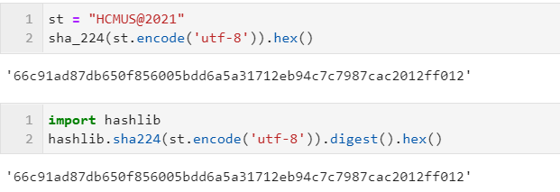
SHA-224 Algorithm - Hashing
After all computations are done for all chunks in the input message. The output is produced from concatenation of H. In SHA-224, this is this is the concatenation of H[0..6] (7 values x 4 bytes = 28 bytes in digest message.
The hashed value for “HCMUS@2021” is:
66c91ad87db650f856005bdd6a5a31712eb94c7c7987cac2012ff012

Slide 20
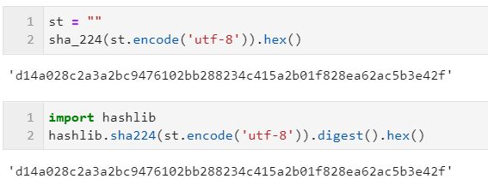
SHA-224 Results – Empty String

Slide 21
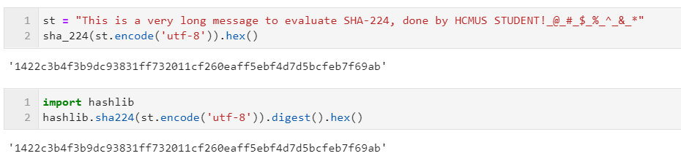
SHA-224 Results – Very long string, processed in 2 chunks

Slide 22
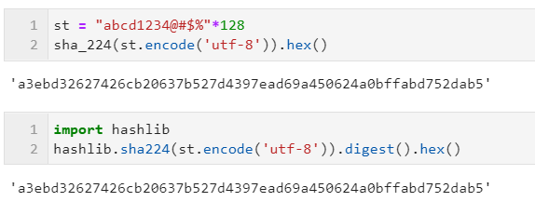
SHA-224 Results – Much longer string, processed in 25 chunks

Slide 23
Keyed-hash Message Authentication Code

Slide 24
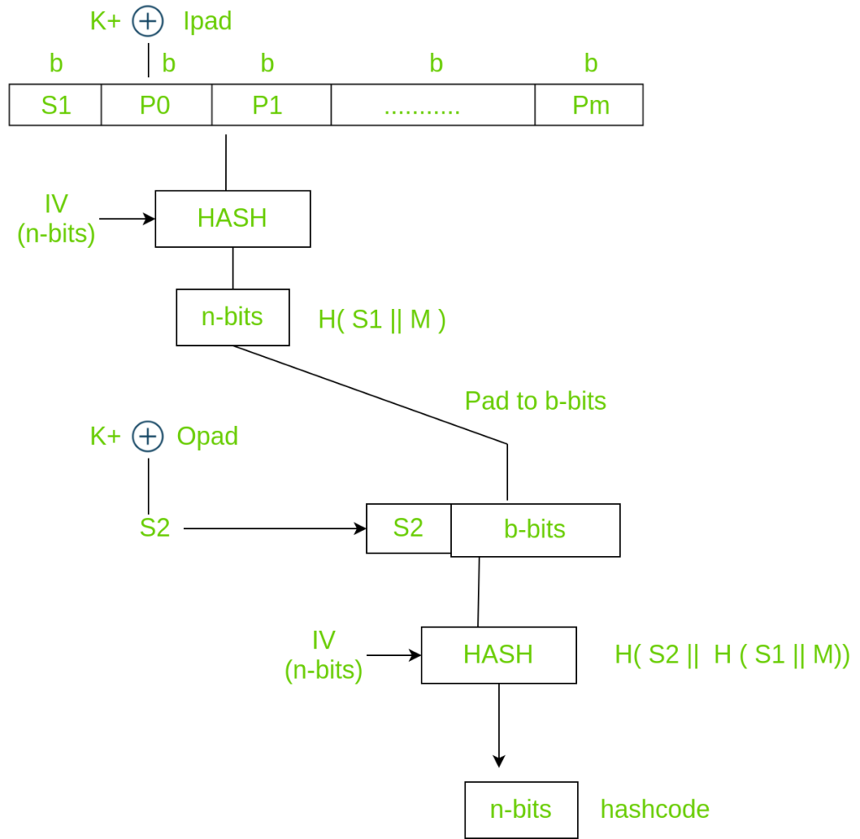
HMAC
Key-Hash Message Authentication Code (HMAC) is a mechanism for message authentication, using cryptographic hash function.
A hash function must be an iterative approved hash function, such as SHA-224, SHA-256.
HMAC provides a way to check the integrity of information, based on a shared secret key. This kind of mechanism are used call as Message Authentication Code (MAC). The “H” just describes the approved Hash function.

Slide 25
HMAC
HMAC includes following things:
Hash function: an approved cryptographic hash function, to map a string to a fixed length string.
Secret key: a cryptographic key that is uniquely associated to some entities.
Message: the message needs to be encrypted.

Slide 26
HMAC Algorithm - Parameters
HMAC includes following things:
B: Block Size, size of input to the approved hash function. In this report, it is 64 bytes, SHA-224.
H: Hash function - SHA-224
K₀: The key, generated from the secret key (K). This key is exact B-byte.
ipad: The inner pad, the byte 0x36, repeated B times.
opad: The outer pad, the byte 0x5c, repeated B times.
The ipad is 0x36 = 0b0110110
The opad is 0x5c = 0b1011100

Slide 27
HMAC Algorithm
The formula of HMAC is described as below:
HMAC(K, text) = H((K₀ XOR opad) + H((K₀ XOR ipad) + text))

Slide 28
HMAC Algorithm
Step 1: Find K₀
This HMAC is based on SHA-224, so Block Size = 64. If the length of K larger than 64, it must be hashed first, by SHA-224. Then padding zero’s to the K is needed if length is less than 64.
B = 64
# hash if K is longer than B
if len(key) > B:
key = sha_224(key)
# pad zero’s if K is less than B
key = key + b'\x00'*(B - len(key))

Slide 29
HMAC Algorithm
Step 2: Generate and apply XOR operation for ipad/opad.
The ipad/opad is first initialized and XOR with the K₀.
ipad = bytes((x ^ 0x36) for x in key)
opad = bytes((x ^ 0x5c) for x in key)

Slide 30
HMAC Algorithm
Step 3: Hash the concatenated value between ipad and text, using SHA-224.
ipad_msg = sha_224(ipad + msg)
Step 4: Generated the HMAC value, by hasing concatenated value between
opad and ipad_msg, using SHA-224.
hmac = sha_224(opad + ipad_msg)

Slide 31
HMAC Algorithm - Example
For example, key = “hcmus”, message = “abcd1234”
B = 64
K = 0x68636d7573
It is not enough, so padding zeros, assigned to K₀
K₀ = 0x68636d757300000000000…0000 // size=B
ipad = 0x3636363636363636363636…363636 // size=B
opad = 0x5c5c5c…5c5c5c5c5c5c5c5c5c5c5c // size=B

Slide 32
HMAC Algorithm - Example
Now XOR the ipad/opad with K₀.
ipad = 0x5e555b43453636363636363636363636363636…3636
opad = 0x343f31292f5c5c5c5c5c5c5c5c5c5c5c5c5c5c…5c5c
The message is:
msg = 0x6162636431323334
The concatenation (red is ipad, the blue is from message)
ipad + msg = 0x5e555b43453636363636…3636366162636431323334

Slide 33
HMAC Algorithm - Example
Hash above number by SHA-224, we get 2-8byte value as below:
ipad_msg = 0x8ba7cac166586688c698ca6ec9b4beaa3d27ac1fdc1f5133807d0a66
Concatenate the opad with above hashed value, we get following string (red is opad, the blue is hashed value):
0x343f31292f5c5c5…5c5c5c8ba7cac166586688c698ca6ec9b4beaa3d27ac1fdc1f5133807d0a66
Hash this string by SHA-224, we get the HMAC value:
2610f96b7e7baf6a841d03c2b88fa79b003754dad906b17d0a16b866

Slide 34
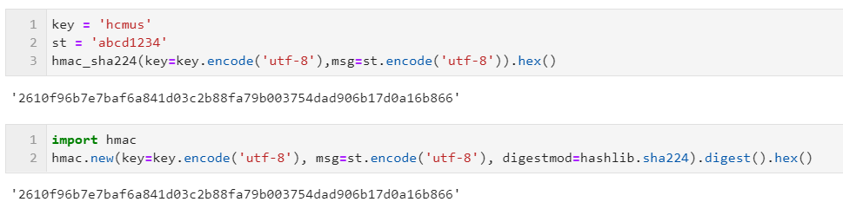
HMAC Results

Slide 35
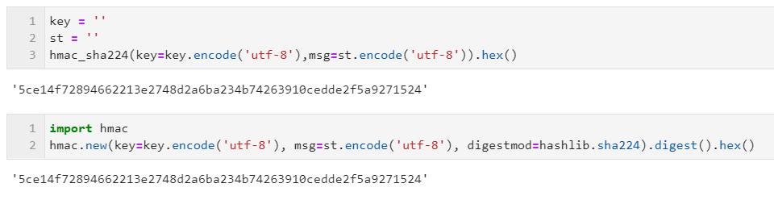
HMAC Empty both key/message

Slide 36
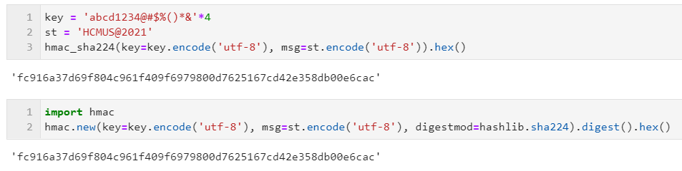
HMAC Long Key (Key = 64)

Slide 37
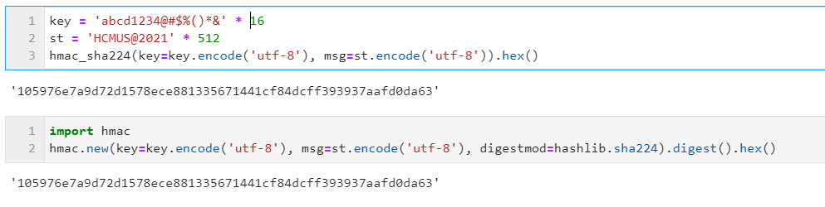
HMAC Long Key (Key > 64)

Slide 38
HMAC-based Extract-and-Expand Key Derivation Function

Slide 39
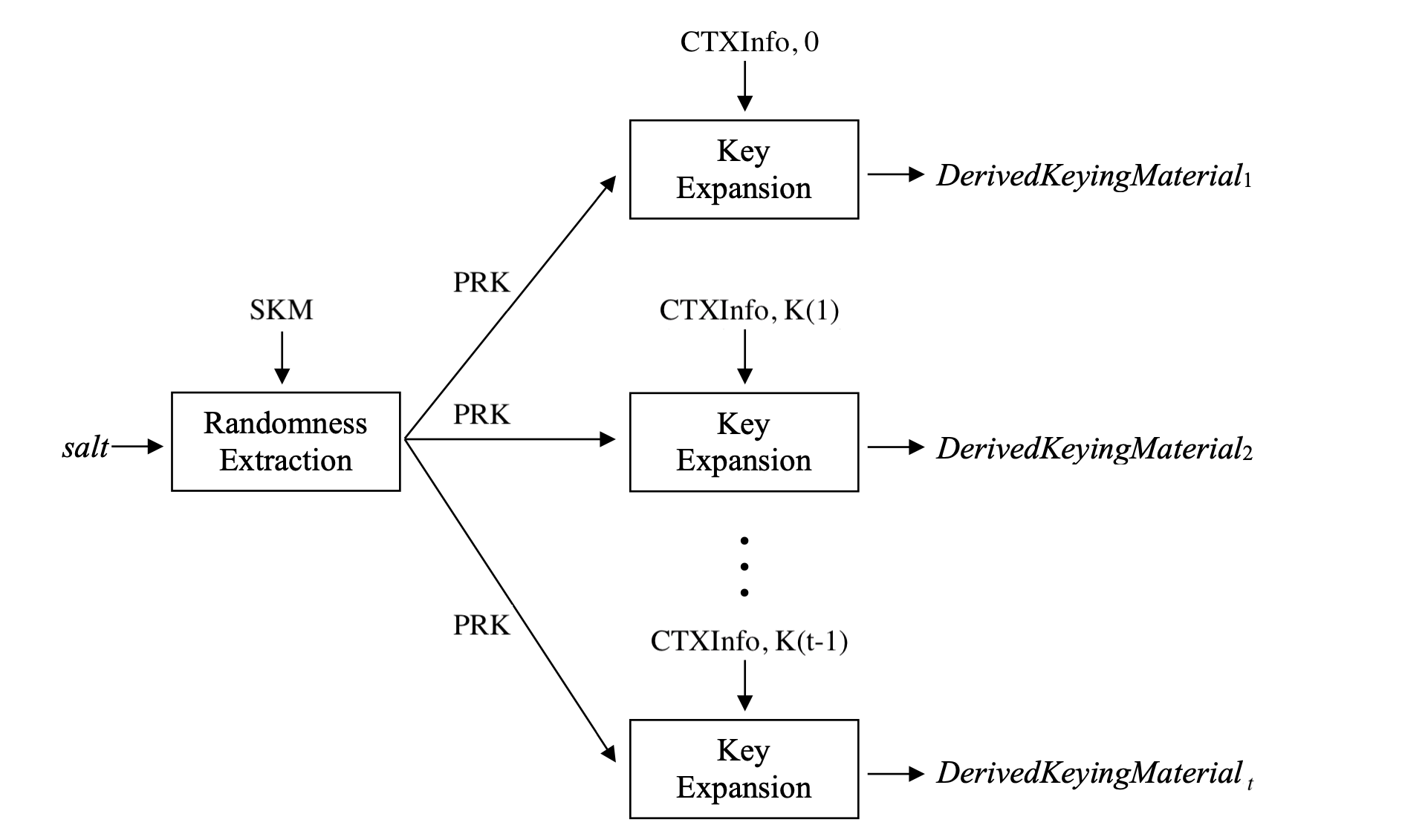
HKDF
HMAC-based Extract-and-Expand Key Derivation Function (HKDF) is a Key Derivation Function, which is used to take some source of initial keying material, derive from it one or more cryptographically strong secret keys, based on HMAC.
HKDF follows the “extract-and-expands” paradigm, consists of 2 modules for each stage:
+ Stage 1 – Extractions: This module takes the input, including keying material, extracts from it to a fixed-length pseudorandom key K. This utilizes the diffusion properties of HMAC.
+ Stage 2 – Expansion: This module expands the key K into several additional pseudorandom keys. Depends on defined length, these keys are used to generate the output of the KDF. The multiple keys are produced deterministically from the initial shared key, so that the same process may produce those same secret keys safely on multiple devices, from the same input.

Slide 40
HKDF Properties
Each stage in HKDF needs different parameters.
Stage 1: Extract
Hash function: HMAC function. In this project, we use HMAC, based on SHA-224.
Salt: Salt value (a non-secret random value). If not set, this is a string of zero.
IKM: Input keying material
Stage 2: Expansion
Hash function: HMAC function. In this project, we use HMAC, based on SHA-224.
PRK: a pseudorandom key. This is usually from step 1.
info: Optional context and application specific information.
L: length of output keying material.

Slide 41
HKDF Algorithms
Stage 1: Extract
hash_length = 28 # Hashlength SHA-224
// If the salt value is not defined, generate the 0’s salt
if len(salt) == 0:
salt = bytes(0x0 * hash_length)
prk = hmac_sha224(
key=salt,
msg=ikm,
)

Slide 42
HKDF Algorithms
Stage 2: Expansion
hash_length = 28 # Hashlength SHA-224
// The length of output keying material must less than 255*H
n = ceil(L/hash_length)
// T = T(1) + T(2) + … + T(n)
t = b""
okm = b""
// T[i] = HMAC(PRK, T[i-1] + info + 0xi
for i in range(n):
t = hmac_sha224(key=prk, msg=(t + info + bytes([1+i])))
okm += t
// Actual result is the first L value of concatenated output.
Result = okm[:L]

Slide 43
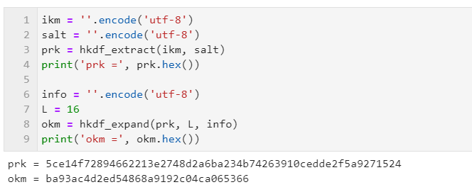
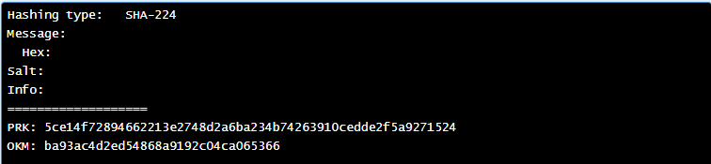
HKDF Results – Empty All Inputs

Slide 44
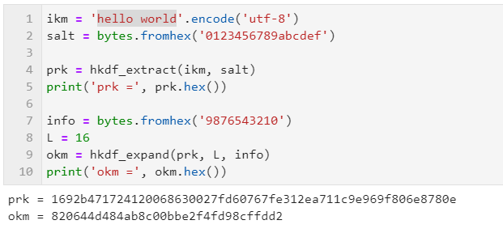
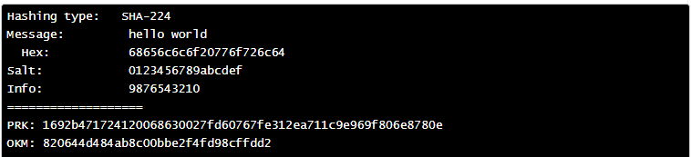
HKDF Results – Dummy Short Inputs

Slide 45
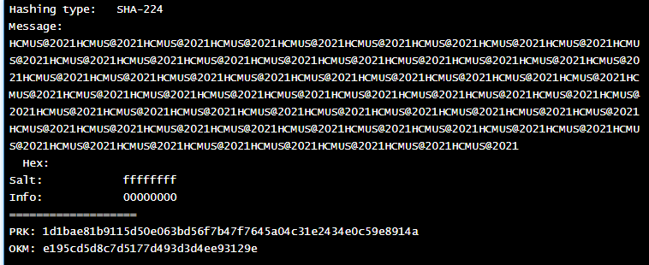
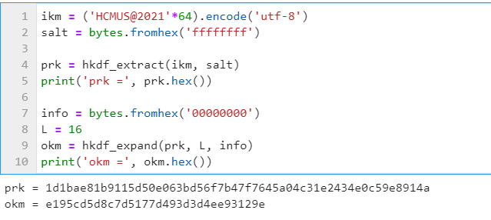
HKDF Results – Long IKM

Slide 46
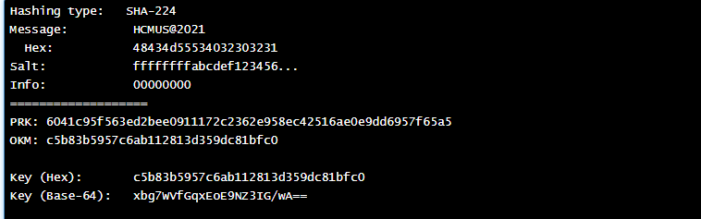
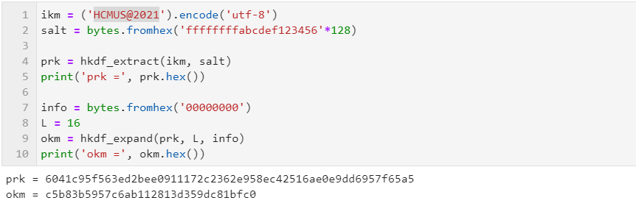
HKDF Results – Long Salt

Slide 47
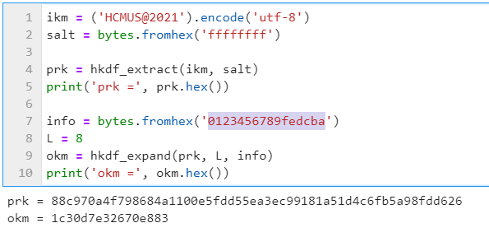
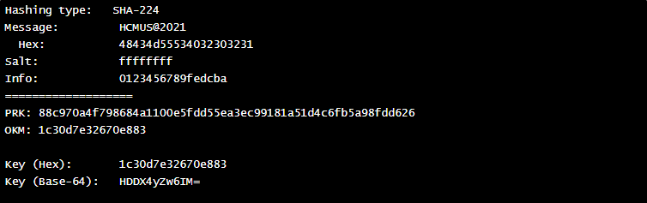
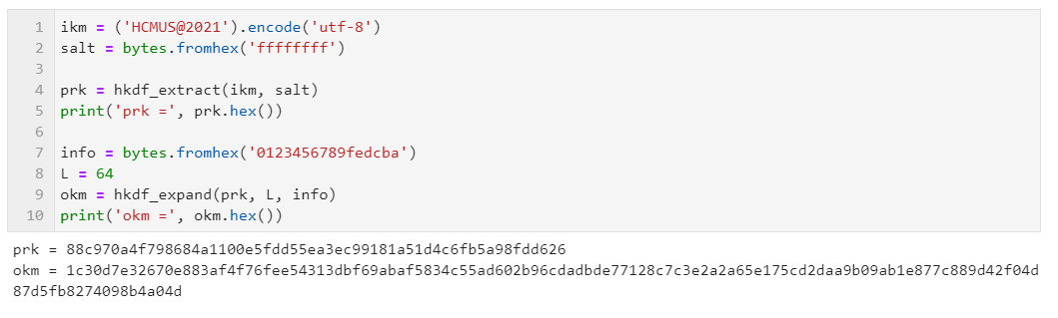
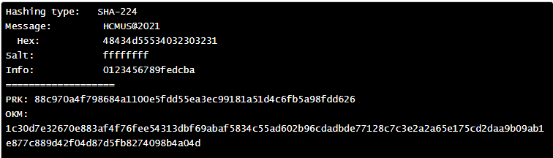
HKDF Results – L=8/64

Slide 48
Conclusion

Slide 49
Conclusion
Comparing with earlier hashing type, SHA-224 is more secure than MD5 and SHA-1, but in term of performance, it is slower.
SHA-2 hashing functions is not much different from SHA-1, so it might be cracked soon.
SHA-3 is recently announced, and this is a good replacement for SHA-2 in the near future.
HMAC uses a symmetric key, which is both used for encryption and decryption. So, the exchange is needed to consider.
If the symmetric key of HMAC is shared between multiple parties, there is a possibility that someone which has the key will make a fraud message.

Slide 50
Thank you

