Slide 1
Final Project Data Mining Course
20C14001 – Le Duong Tuan Anh
Tutor: Dr. Le Thi Nhan

Slide 2
Agenda
Problem Statement
Data Description
Data Understanding
Data Preprocessing
Solution
Conclusion

Slide 3
Problem Statement

Slide 4

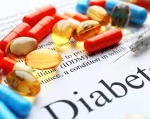
Problem Statement
Dataset: Diabetes prediction with given Pima Indians medical details (Source: the National Institute of Diabetes and Digestive and Kidney Diseases): relationship between some medical details and the result on Diabetes.
The objective: diagnostically predict whether a patient has diabetes, based on certain diagnostic measurements included in the dataset.
The dataset consists of several medical predictor variables and one target variable, Outcome.

Slide 5
Data Description

Slide 6
Data Description
Column | Type | Datatype | Has missing value?
Pregnancies | Interval-scaled | Int64 | No
Glucose | Interval-scaled | Int64 | No
BloodPressure | Interval-scaled | Int64 | No
SkinThickness | Interval-scaled | Int64 | No
Insulin | Interval-scaled | Int64 | No
BMI | Interval-scaled | Float | No
DiabetesPedigreeFunction | Interval-scaled | Float | No
Age | Interval-scaled | Int64 | No
Outcome | Categorical Data Binary (0/1) | Int64 | No
Total instances (records): 768
Total columns: 9
(8 medical attributes +
1 Outcome Class
(has diabetes or not)).

Slide 7
Data Description
Pregnancies: Number of times pregnant
Glucose: Plasma Glucose Concentration.
BloodPressure: Diastolic Blood Pressure.
SkinThickness: Estimate body fat.
Insulin: 2-Hour Serum Insulin.
BMI: Body Mass Index.
DiabetesPedigreeFunction: information about diabetes history in relatives and genetics.
Age: Age (years).
Outcome: 0 = Diabetic, 1 = Not Diabetic

Slide 8
Data Understanding

Slide 9
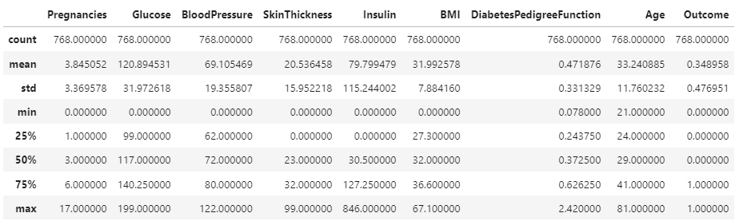
Data Understanding

Slide 10

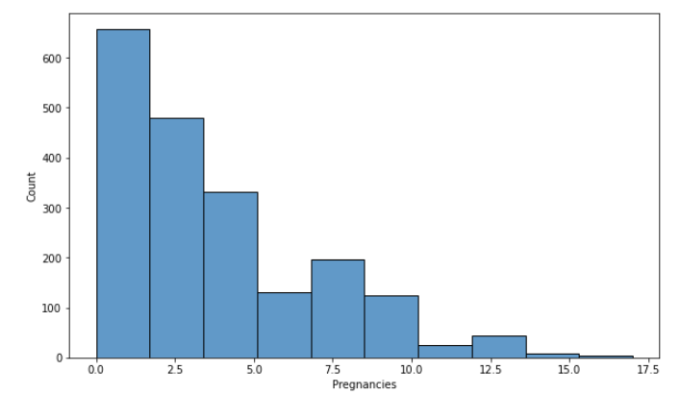
Data Understanding Pregnancies

Slide 11

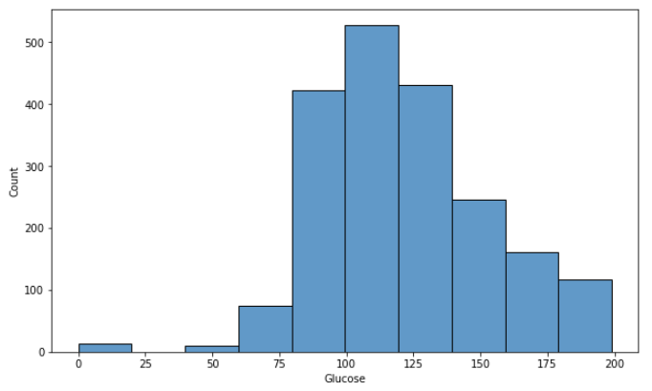
Data Understanding Glucose

Slide 12

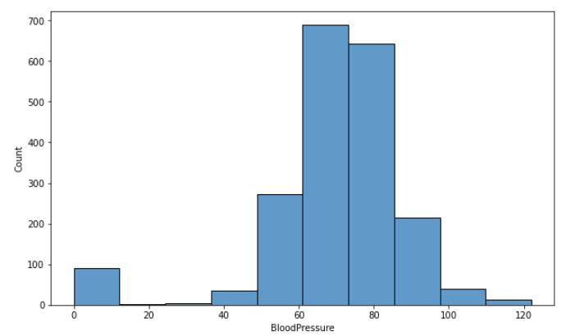
Data Understanding BloodPressure

Slide 13

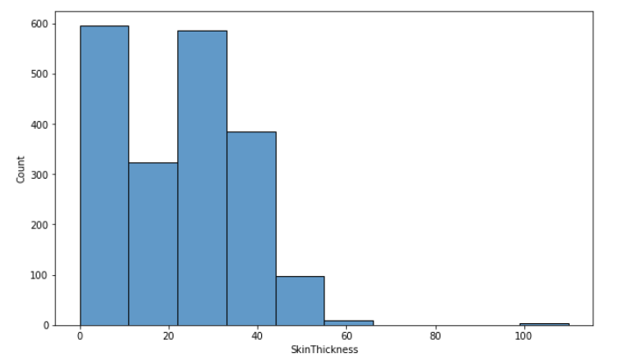
Data Understanding SkinThickness

Slide 14

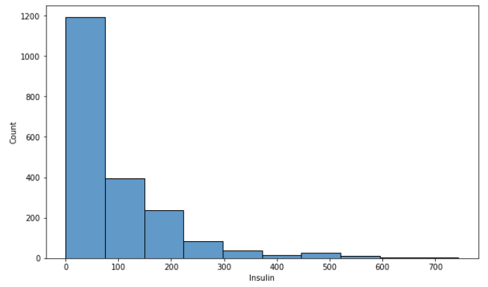
Data Understanding Insulin

Slide 15

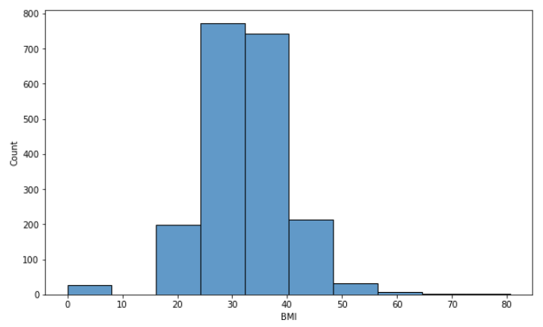
Data Understanding BMI

Slide 16

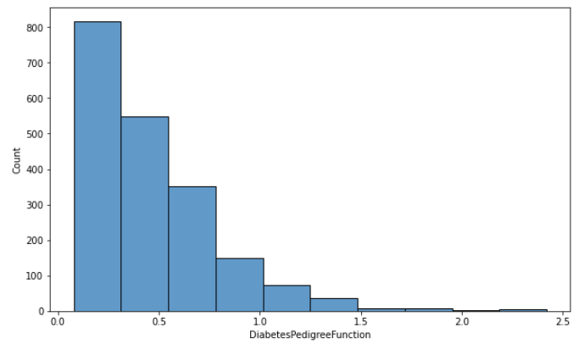
Data Understanding DiabetesPedigreeFunction

Slide 17

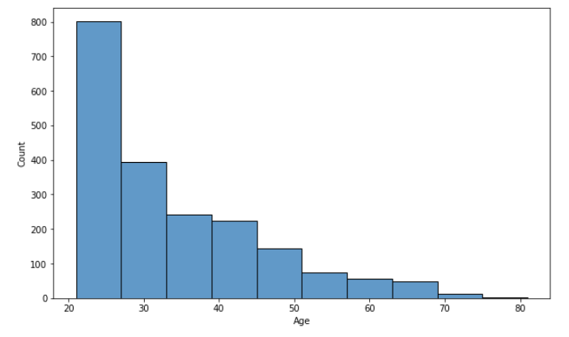
Data Understanding Age

Slide 18
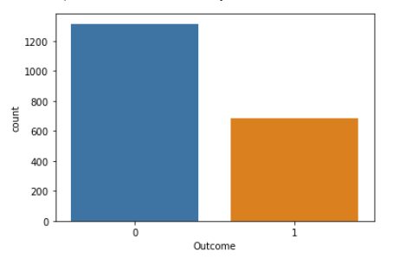
Data Understanding Outcome

Slide 19
Data Preprocessing

Slide 20
Data Preprocessing
Filling Zero-value
Remove Outliers

Slide 21
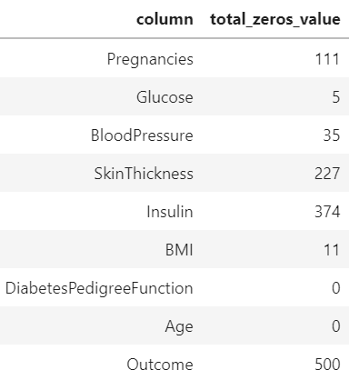
Data Preprocessing Filling Zero-value

Slide 22
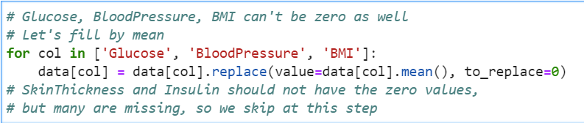
Data Preprocessing Filling Zero-value – by Mean
We just fill by mean on columns that not have many zero-values.

Slide 23
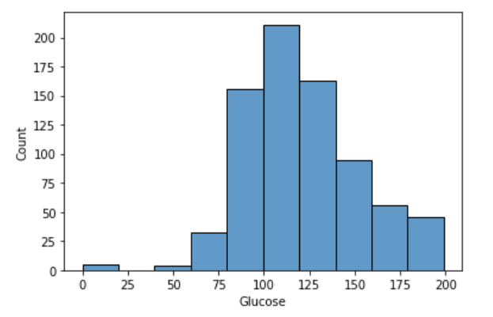
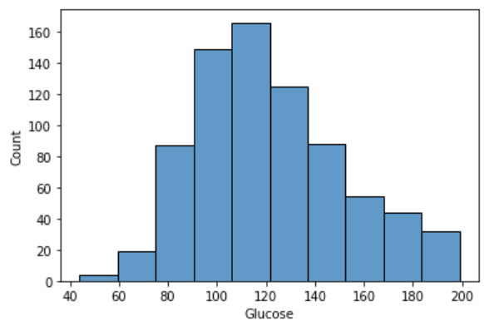
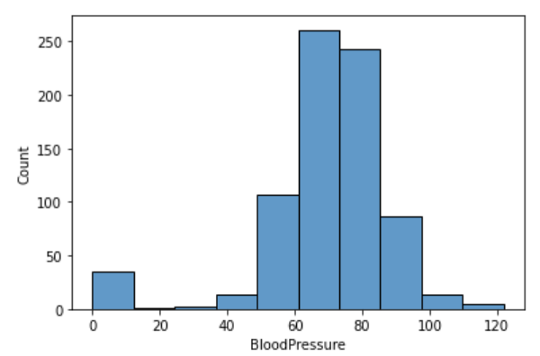
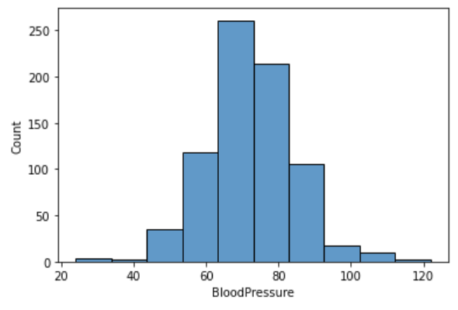
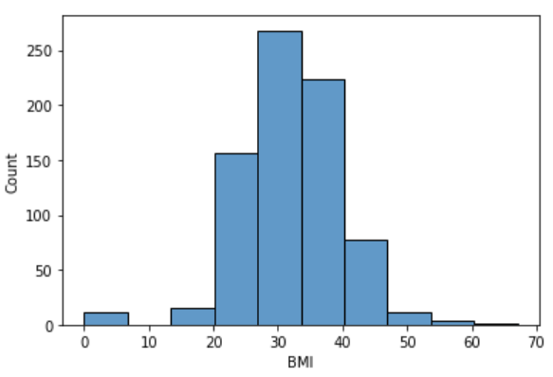
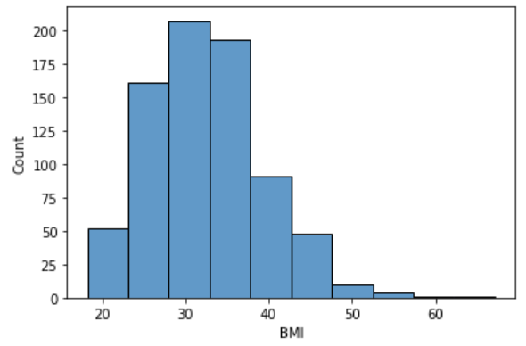
Column | Before filling zeros | After filling zeros
Glucose
BloodPressure
BMI

Slide 24
Data Preprocessing Filling Zero-value – ?

Slide 25
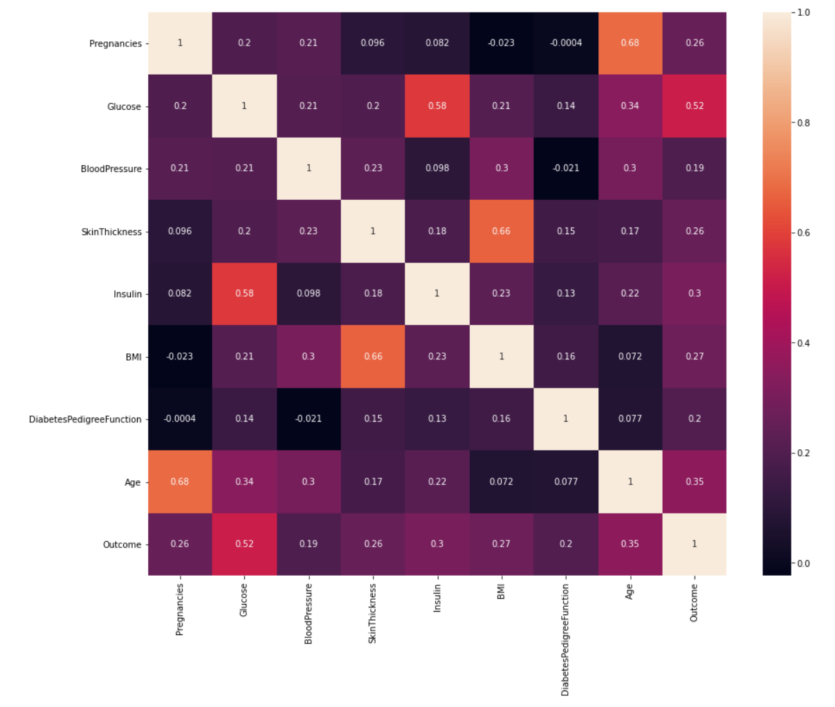
Data Preprocessing Filling Zero-value – ?
Correlation Matrix, Pearson metric
(on dataset that have Insulin != 0 and SkinThickness != 0):

Slide 26
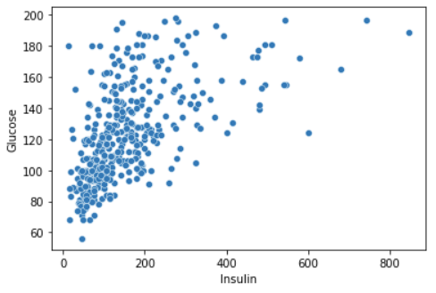
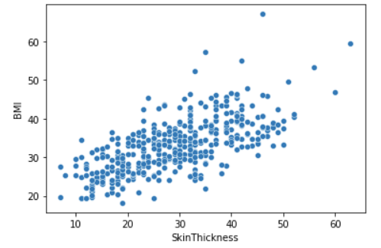
Data Preprocessing Filling Zero-value – ?
There are some high correlations:
Insulin and Glucose (0.58) | SkinThickness and BMI (0.66)

Slide 27
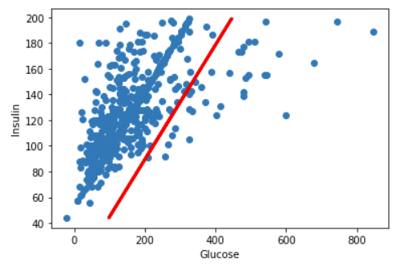
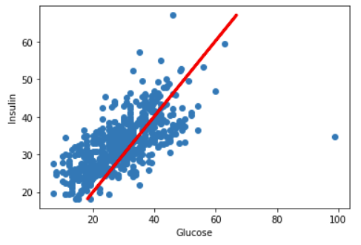
Data Preprocessing Filling Zero-value – Regression Method
Linear Regression
Insulin = Glucose * 2.23952761 | SkinThickness = BMI * 0.99549695

Slide 28
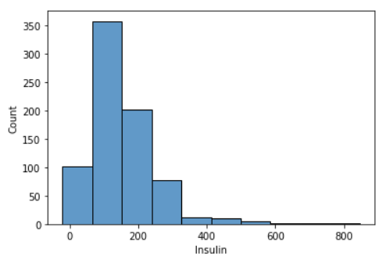
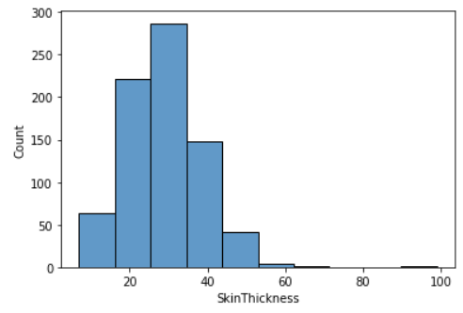
Data Preprocessing Filling Zero-value – Regression Method
Column | Before filling zeros | After filling zeros
Insulin
SkinThickness

Slide 29
Data Preprocessing Remove Outliers
Inter-quartile Range
In case the data point is out of range
[ Q1 – 1.5*IQR, Q3 + 1.5*IQR ]
it is considered as outliers.

Slide 30
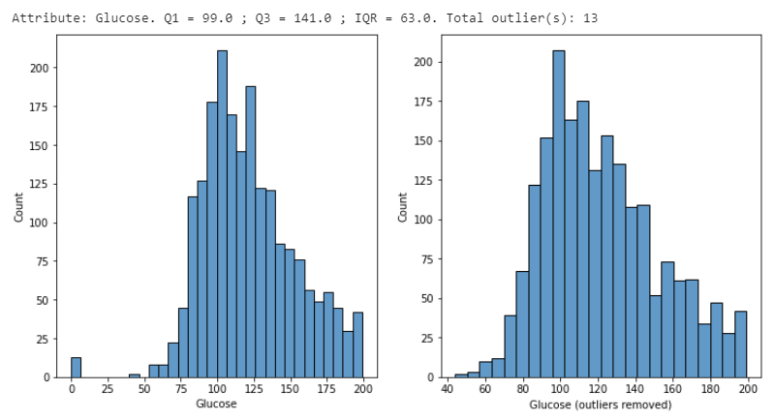
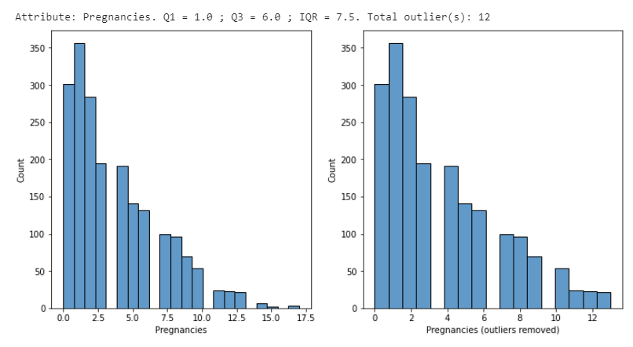
Data Preprocessing Remove Outliers
Total removed outliers in dataset:
11,2%

Slide 31
Solution

Slide 32
Solution
Normalization Dataset
Model Training
Result

Slide 33
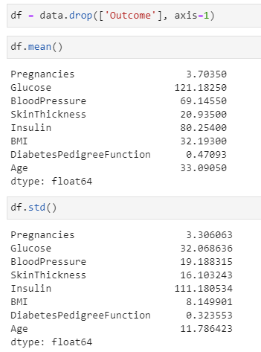
Solution Normalization
We standardize features by removing the mean, then scaling dataset to unit variance.
The standardized score is calculated as below:
Z = (X – U) / S
Where:
X: The value of sample in dataset.
U: The mean of dataset.
S: The standard deviation of dataset.

Slide 34
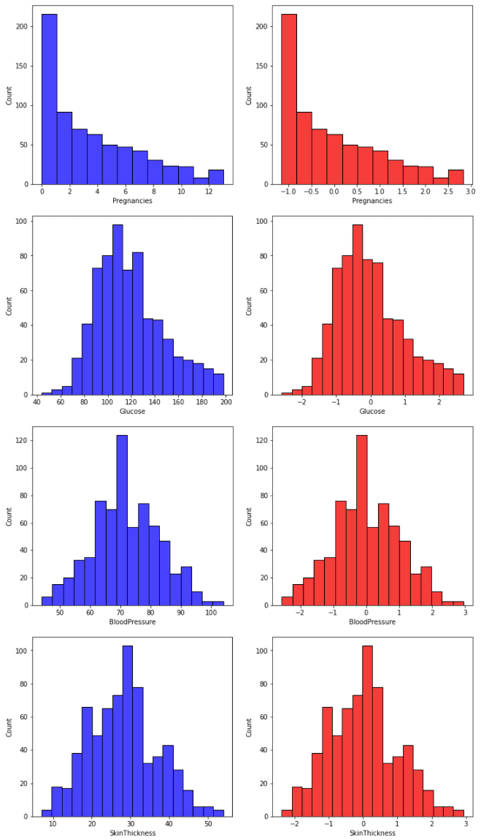
Solution Normalization

Slide 35
Solution Model Training
(1) Logistic Regression
(2) Decision Tree
(3) Random Forest
(4) SVM (Linear Kernel)
(5) kNN

Slide 36
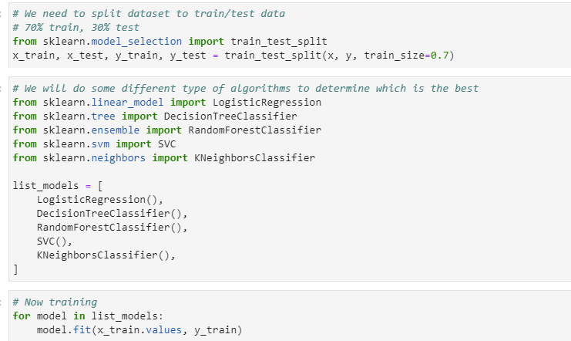
Solution Model Training
The data is randomly split to trainset (70%) and testset (30%)

Slide 37
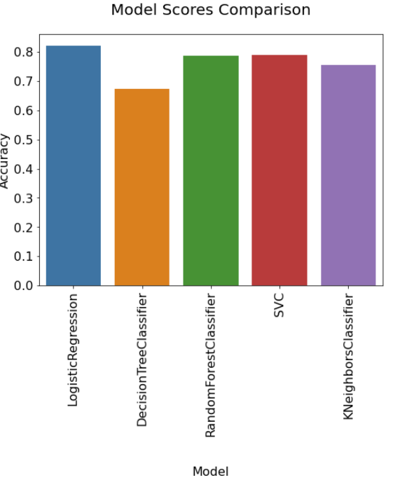
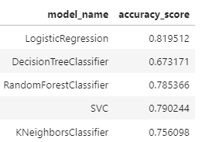
Solution Result – Accuracy Score

Slide 38
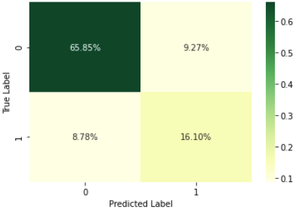
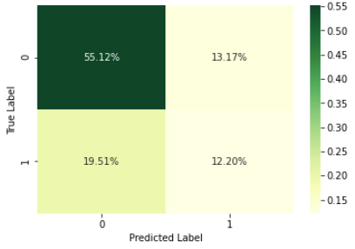
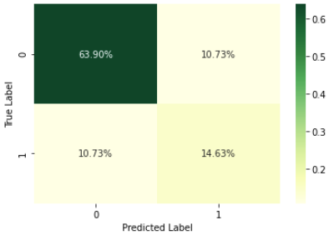
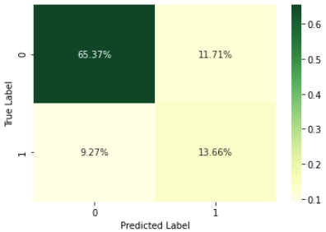
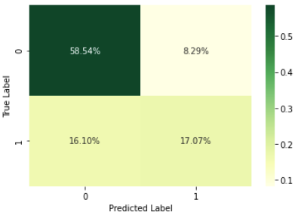
Solution Result – Confusion Matrix
LogisticRegression
DecisionTreeClassifier
RandomForestClassifier
SVM
kNN

Slide 39
Conclusion

Slide 40
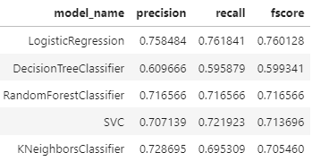
Conclusion
An end-to-end flow to analyze, process and do some classification methods on the Diabetes Prediction task.
The simple Logistic Regression performs the best result on the provided dataset.
Might be improved if we use other complex methods, e.g., Deep Learning.

Slide 41
Thank you

