Slide 1
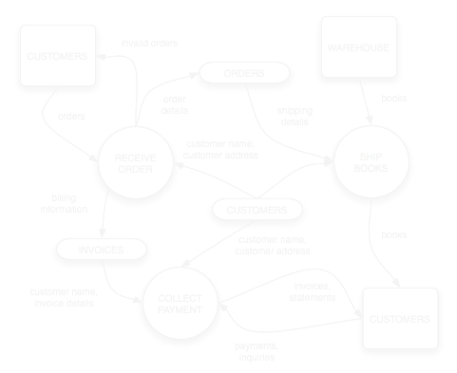
VCE IT Theory Slideshows
DFD EXERCISE
Worked Library Example
By Mark Kelly
mark@vceit.com
Vceit.com

Slide 2
Thanks
To the unknown author of the original DFD exercise.

Slide 3
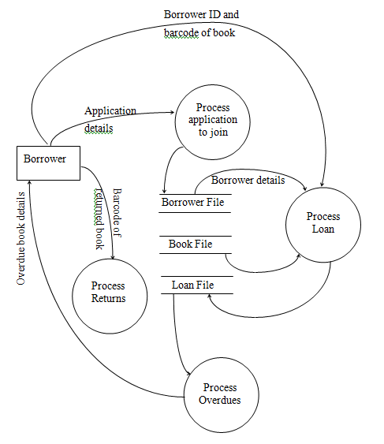
Refer to the library DFD handout

Slide 4
When a borrower applies to join the library they provide data about themselves on an application form. The library processes this data. When the application has been processed the borrower’s details are stored in the Borrower File.
Add a label “Borrower details” to the data flow from “Process application to join” to the Borrower File

Slide 5
When a borrower applies to join the library they provide data about themselves on an application form. The library processes this data. When the application has been processed the borrower’s details are stored in the Borrower File.
Add a label “Borrower details” to the data flow from “Process application to join” to the Borrower File
BORROWER DETAILS

Slide 6
The application process sends a confirmation letter to the borrower with their borrower number.
Draw an arrow from “Process application to join” back to the Borrower and label it “Borrower Number”.
BORROWER DETAILS

Slide 7
The application process sends a confirmation letter to the borrower with their borrower number.
Draw an arrow from “Process application to join” back to the Borrower and label it “Borrower Number”.
BORROWER NUMBER
BORROWER DETAILS

Slide 8
When the library processes a loan they get the borrower ID and the Barcode of the book from the borrower. During the processing Borrower details and Book details are retrieved from the appropriate files.
Add a suitable label to the arrow going from the Book File to “Process loan”.
BORROWER NUMBER
BORROWER DETAILS

Slide 9
When the library processes a loan they get the borrower ID and the Barcode of the book from the borrower. During the processing Borrower details and Book details are retrieved from the appropriate files.
Add a suitable label to the arrow going from the Book File to “Process loan”.
BORROWER NUMBER
BORROWER DETAILS
BOOK DETAILS

Slide 10
When the loan has been processed data about the loan is written to the Loan File.
Add a suitable label to the arrow going from “Process loan” to the Loan File.
BORROWER NUMBER
BORROWER DETAILS
BOOK DETAILS

Slide 11
When the loan has been processed data about the loan is written to the Loan File.
Add a suitable label to the arrow going from “Process loan” to the Loan File.
BORROWER NUMBER
BORROWER DETAILS
BOOK DETAILS
LOAN
DETAILS

Slide 12
When the library processes a return they get the barcode of the book from the borrower. During the processing details of the loan are retrieved from the Loan File.
Add a labelled arrow to represent the retrieved data.
BORROWER NUMBER
BORROWER DETAILS
BOOK DETAILS
LOAN
DETAILS
LOAN
DETAILS

Slide 13
After the return has been processed the date returned is written back to the Loan File.
Add a labelled arrow to represent this data flow.
BORROWER NUMBER
BORROWER DETAILS
BOOK DETAILS
LOAN
DETAILS
LOAN
DETAILS

Slide 14
After the return has been processed the date returned is written back to the Loan File.
Add a labelled arrow to represent this data flow.
BORROWER NUMBER
BORROWER DETAILS
Date Returned
BOOK DETAILS
LOAN
DETAILS
LOAN
DETAILS

Slide 15
When the library processes overdue books it retrieves data about each loan from the Loan File.
Add a label to the appropriate arrow
BORROWER NUMBER
BORROWER DETAILS
Date Returned
BOOK DETAILS
LOAN
DETAILS
LOAN
DETAILS
LOAN
DETAILS

Slide 16
In order to produce the overdue letter “Process overdues” needs two more sets of data.
Add appropriately labelled arrows to represent this data
BORROWER NUMBER
BORROWER DETAILS
Date Returned
BOOK DETAILS
Book data
LOAN
DETAILS
LOAN
DETAILS
LOAN
DETAILS
Borrower data

Slide 17
In order to produce the overdue letter “Process overdues” needs two more sets of data.
Add appropriately labelled arrows to represent this data
BORROWER NUMBER
BORROWER DETAILS
Date Returned
BOOK DETAILS
Book data
LOAN
DETAILS
LOAN
DETAILS
LOAN
DETAILS
Borrower data

Slide 18
When borrowers wish to reserve book that are out on loan they provide information to a “Reserve book” process that sends information to a “Reserved Books” file. When a book is returned one of the things that “Process returns” does is check this file to see if another borrower has reserved this book. If it has the borrower making the reservation is notified.
Complete the following data flow diagram describing the reservation system.
Process Returns
Borrower File
Borrower
Book File
Process Reservations
Reserved Books

Slide 19
When borrowers wish to reserve book that are out on loan they provide information to a “Reserve book” process that sends information to a “Reserved Books” file. When a book is returned one of the things that “Process returns” does is check this file to see if another borrower has reserved this book. If it has the borrower making the reservation is notified.
Complete the following data flow diagram describing the reservation system.
Borrower info
Book availability
Process Returns
Borrower File
Borrower
Reservation info
Book File
Reservation request
Process Reservations
Reserved Books
Reservation request

Slide 20
Finally
The following system is used by the library to acquire new books:
Publishers send literature about new releases to the librarian. These are stored in a filing cabinet.
During the ordering process the librarian uses this information to order books from the publishers.
When the books arrive a cataloguing process uses information from the publisher’s invoice to enter the information about each book into the “Book file”.
Draw a DFD representing the library’s acquisition system.

Slide 21
Publishers send literature about new releases to the librarian. These are stored in a filing cabinet.
New book info
New book info
Process new release
New releases file
Publisher

Slide 22
During the ordering process the librarian uses this information to order books from the publishers.
New book info
New book info
Process new release
New releases file
Publisher
Order new books
New book info
Order

Slide 23
When the books arrive a cataloguing process uses information from the publisher’s invoice to enter the information about each book into the “Book file”.
New book info
New book info
Process new release
New releases file
Publisher
Order new books
New book info
Order

Slide 24
When the books arrive a cataloguing process uses information from the publisher’s invoice to enter the information about each book into the “Book file”.
New book info
New book info
Process new release
New releases file
Publisher
Order new books
New book info
Order
Invoice
Book file
Catalogue new books
Book info

Slide 25
VCE IT THEORY SLIDESHOWS
By Mark Kelly
mark@vceit.com
vceit.com
These slideshows may be freely used, modified or distributed by teachers and students anywhere on the planet (but not elsewhere).
They may NOT be sold.
They must NOT be redistributed if you modify them.

