Slide 1
VCE IT Theory Slideshows
1
a
Data Types
By Mark Kelly
mark@vceit.com
vceit.com
Version 2 – updated for 2016

Slide 2
Mandated data types
In the 2016-2019 study design, there are no mandated data types. The Glossary only says…
Data types are the particular forms that an item of data can take including numeric, character and Boolean, and are characterised by the kind of operations that can be performed on it...
these fundamental types can be divided into more specific types, for example integer and floating point are numeric types.
More sophisticated types can be derived from them, for example a string of characters or a date type.
Their names may vary, such as text versus string.

Slide 3
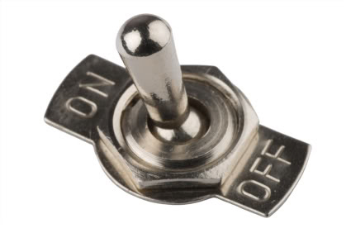
Boolean (logic)
Boolean - stores only a True or False value.
Very efficient storage. Little memory required.
Ideal for flags which store a yes/no true/false state.
Note – just because a field or variable can take 1 of only 2 possible values does not make it Boolean.
Boolean must be a true/false answer, not (for example) a “left-handed/right-handed” option.

Slide 4
Integer
Cannot hold fractional parts (decimal places)
Little storage needed compared with floating point numbers
Quicker to do calculations with integers
Some variants supported by different apps…
Short Integer - stores values from negative 32768 to +32767
Long Integer - stores values from negative 2,147,483,648 to 2,147,483,647
Byte - stores values between 0 and 255 in one byte. Efficient storage for small numbers.

Slide 5
Floating point numbers a.k.a. Decimal, Real
Store numbers with a fractional (decimal) part (e.g. 3.14159)
Variants…
Single Precision - stores values from -3.402823e38 to -1.401298e-45 for negative values and from 1.401298e-45 to 3.402823e38 for positive values…

Slide 6
Floating Point Numbers
Double Precision - for storing values from -1.79769313486232e308 to -4.94065645841247e-324 for negative values and from 4.94065645841247e-324 to 1.79769313486232e308 for positive values.
The 'e' means 'times 10 to the power of'. In other words 4.94065645841247e-324 is roughly 4.9 followed by 324 zeroes. It allows extreme precision...

Slide 7
Double precision!
49,000,000,000,000,000,000,000,000,000,000,000,000,000,000,000,000,000,000,000,000,000,000,000,000,000,000,000,000,000,000,000,000,000,000,000,000,000,000,000,000,000,000,000,000,000,000,000,000,000,000,000,000,000,000,000,000,000,000,000,000,000,000,000,000,000,000,000,000,000,000,000,000,000,000,000,000,000,000,000,000,000,000,000,000,000,000,000,000,000,000,000,000,000,000,000,000,000,000,000,000,000,000,000,000,000,000,000,000

Slide 8

Currency data type
A special type of floating point used for finances.
Has a high-precision fractional part to prevent bad rounding of cents.

Slide 9

String (text)
String - stores text composed of any ASCII* characters (alphabetic letters, numerals, punctuation and control codes like carriage return, backspace, bell).
Character - can hold a single ASCII character, e.g. “A”, “3”, “&”, tab character.

Slide 10
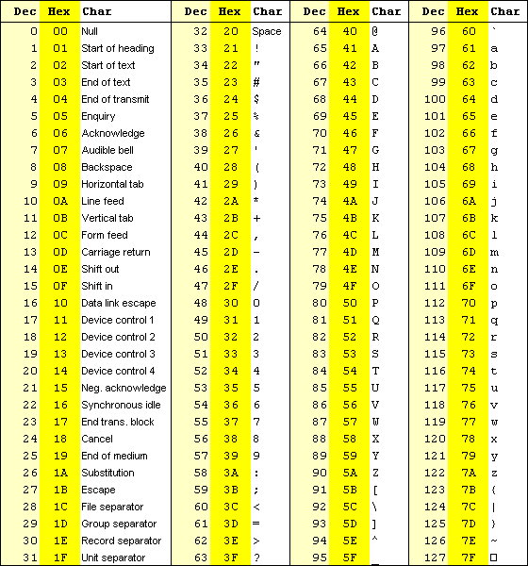
A
S
C
I
I

Slide 11
String (text)
While strings can store numerals, they cannot interpret the value of numbers and instead treats them as plain text.
So if you add "1" and "2" you'll get "12" instead of 3
Beware of this when adding numbers in text boxes!

Slide 12
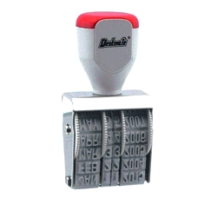
Special data
Date - holds a complete date value (including day, month and year). Stored as a number.
Time – stores a time of day as a number of seconds since midnight
Timestamp - holds a complete date (DDMMYYYY) and time of day (hours, minutes and seconds) in a single value. Stored as a number.

Slide 13
Special types
The programming language C has a special data type designed to hold a pointer to a memory location.
Filemaker Pro databases have a container data type which can hold any binary data like video, photo, audio, word processor documents etc
Different software may support other data types (e.g. nybble – half a byte)

Slide 14
Why bother with data types?
Use the right data type to get maximum manipulation power
E.g. When a date is stored as “Date” data type instead of text, the software can perform data calculations
Age ←(DateToday – DateBirth)/365

Slide 15
Why bother with data types?
Use the right size data type to avoid wasted memory (e.g. using double when byte would do, or using float when number will always be integer)
Programs run faster when using smaller, simpler variables.
Calculations using decimal places takes extra processing.

Slide 16
Using GUI storage structures
Textboxes can store numbers, but to do calculations, the text must be converted to number format first. (Slow, painful)
List boxes/combo boxes are good for displaying data, but not efficient for large storage and manipulation tasks compared with arrays.

Slide 17
Also see
Naming conventions for variables etc

Slide 18
VCE IT THEORY SLIDESHOWS
By Mark Kelly
mark@vceit.com
vceit.com
These slideshows may be freely used, modified or distributed by teachers and students anywhere on the planet (but not elsewhere).
They may NOT be sold.
They must NOT be redistributed if you modify them.

