Slide 1

VCE IT Theory Slideshows
Referential Integrity
in databases
By Mark Kelly
mark@vceit.com
Vceit.com

Slide 2
Contents
This is not key knowledge. It is not assessable.
What it is
How it works
Why you want it

Slide 3
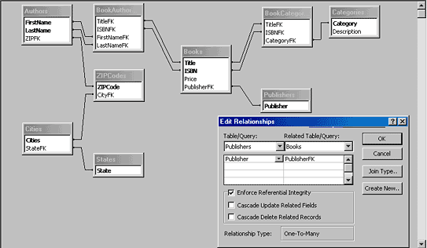
What is referential integrity?
It’s a term that may be unfamiliar to Filemaker Pro users
Access users might be more aware of it

Slide 4
Referential integrity
A method of ensuring that references from one related table to another remain unbroken
Broken references can happen where a foreign key in a table refers to a primary key field that does not exist in the related table.

Slide 5
For example
This schema has referential integrity
ARTISTS TABLE
Artist ID | Artist Name
BEAT | Beatles
ROLL | Rolling Stones
REM | R.E.M.
CD SALES TABLE
SaleID | Artist ID
1029 | BEAT
1030 | ROLL
1031 | REM
1032 | REM
1033 | REM
1034 | BEAT
In the CD SALES TABLE, each reference to an artist has a match in the ARTIST TABLE

Slide 6
For example
This schema has broken referential integrity
ARTISTS TABLE
Artist ID | Artist Name
ROLL | Rolling Stones
REM | R.E.M.
CD SALES TABLE
SaleID | Artist ID
1029 | BEAT
1030 | ROLL
1031 | REM
1032 | REM
1033 | REM
1034 | BEAT
References in the CD SALES TABLE to BEAT fail because there’s no matching value in the ARTIST TABLE.

Slide 7
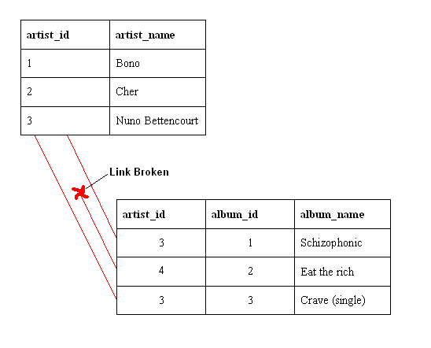
Why referential integrity is good
It prevents “Missing value” errors like this…

Slide 8
How it works
With referential integrity turned on if you try to delete a key field value (e.g. “BEAT”) that another table refers to, the RDBMS may
Warn you that you would be breaking referential integrity.
Delete all related fields that refer to the deleted value.
Forbid the deletion until all records that refer to the key field have been deleted first.

Slide 9
Filemaker
Does not enforce referential integrity
Allows you to delete key values
Results in null (empty) lookup values

Slide 10
VCE IT THEORY SLIDESHOWS
By Mark Kelly
mark@vceit.com
vceit.com
These slideshows may be freely used, modified or distributed by teachers and students anywhere on the planet (but not elsewhere).
They may NOT be sold.
They must NOT be redistributed if you modify them.

Slide 11
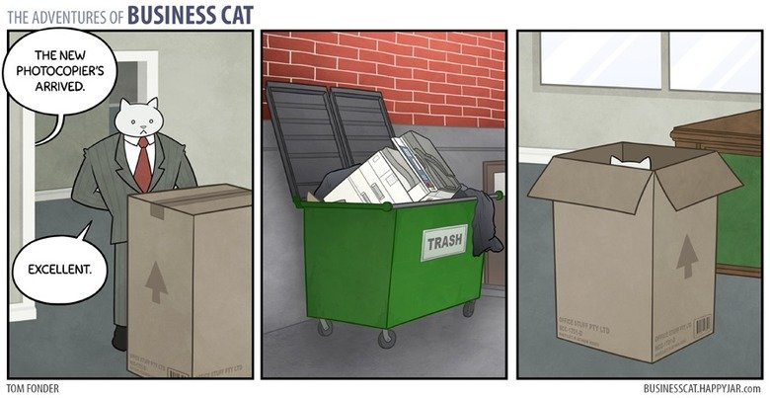
Because you’ve been good…

