Slide 1
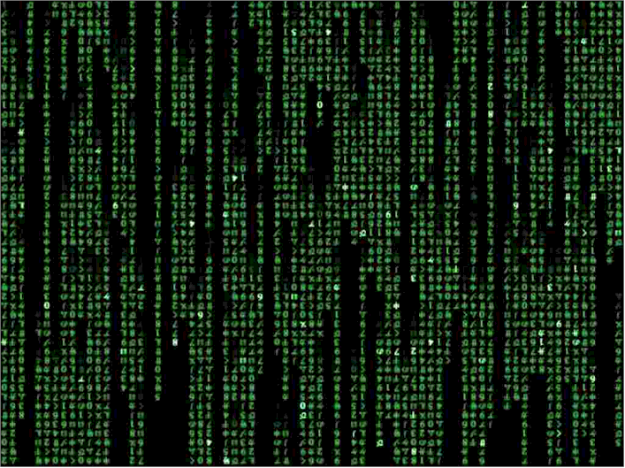
IT Applications Theory Slideshows
Database purposes
By Mark Kelly
mark@vceit.com
Vceit.com

Slide 2
What are databases?
A database is an organised collection of data (e.g. details of your CD collection)
DBMS (Database Management System) is software that creates and manages databases. E.g. Access, Filemaker, SQL.
Let’s use their names carefully, OK?

Slide 3
What do databases do?
Store data
Search data
Sort, group, calculate data
Report on data

Slide 4
Capabilities of DBMS
Capable of handling immense quantities of data of many types, including pictures etc.
Can search, sort, reorganise very quickly
Can combine related data from separate files
Can import & export data in many formats, e.g. CSV and exchange data with other apps.

Slide 5
Capabilities of DBMS
Can produce quality individualised output such as bills, certificates, letters etc.
Can be programmed to perform powerful data manipulation.
Can calculate new information from existing data (e.g. age from date of birth)

Slide 6
Limitations of DBMS
Database must be defined before data can be entered
Relationships and macro/script programming can be difficult to design
Get slower as they get bigger
Data loss can be catastrophic if there are no backups
Can be very bulky to store & transfer

Slide 7
Purposes
Databases are used to store and manage large quantities of information such as…
Recording transactions
Bank deposits, withdrawals, credit card use
Transaction Processing System (TPS) recording sales
Summarising bulk data
Management Information Systems
Executive information Systems

Slide 8
Purposes
Chronologies
Calendars
Diaries
Work Logs

Slide 9
Purposes
Mass mailings
Cheques
Gas bills etc
Renewal notices
Membership notifications
Cards, labels (e.g. cross country)

Slide 10
Purposes
Personnel records
A school’s student records
A company’s staff records
School attendance
Factory work logs, to calculate wages

Slide 11
Purposes
Network management
Network & internet login names, passwords, privileges, restrictions
Printing credit
Internet credit

Slide 12
Porpoises
Storing knowledge
KnowledgeBases
FAQs
Expert Systems
Wikis

Slide 13
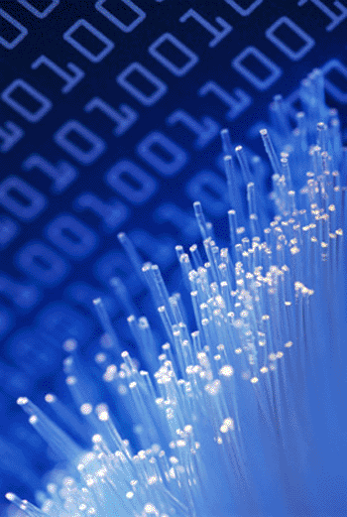
Purposes
Event information
Automated system error log
Help desk requests
Medications issued to patients
Reports
School reports
Financial summaries
Monthly bank statements

Slide 14
Purposes
Booking systems
Airlines
Theatre tickets
Doctors’ appointments
Restaurant bookings

Slide 15
Puppies
Inventories
How many size 26 blue socks are left in stock?
Is it time to reorder left-handed rubber flange grommets?
Software registers
Online shopping with real-time stock availability (e.g. Amazon)
Library catalogues

Slide 16
Papooses
Customer Lists
Customer records: name, address, purchases etc
Car buyers automatically notified of safety recalls
Dentist, doctor, optometrist reminders about checkups being due
Library loans

Slide 17
Purposes
Government records
Medicare payments
Tax records
Car registrations, driver licences
Births, deaths and marriages
Criminal records
Passports, immigration records
Pharmacy prescriptions

Slide 18
Posses
Supplier lists
Who provides your shop with green socks?
Assets
Furniture, IT equipment, vehicles, tools etc owned by an org

Slide 19
Purposes
Event management
School sports carnival events, competitors and results
Competition entries, winners
Community management
Website, web forum memberships
Mailing lists
Club membership lists

Slide 20
Purpoos
Financial records
Tax records, including GST & BAS figures
Income, costs, profit/loss
ISP records of customer downloads
Insurance company policy holders & expirations
Magazine subscriptions

Slide 21
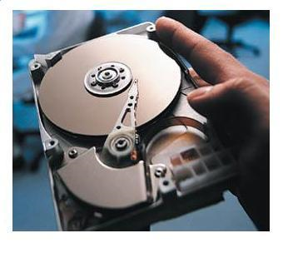
Purr pussies
Catalogues
Libraries
University & museum collections
Photos (e.g. Flickr)
Torrent trackers
eBay items
Timetabling
School timetables, class lists
Public transport timetables

Slide 22
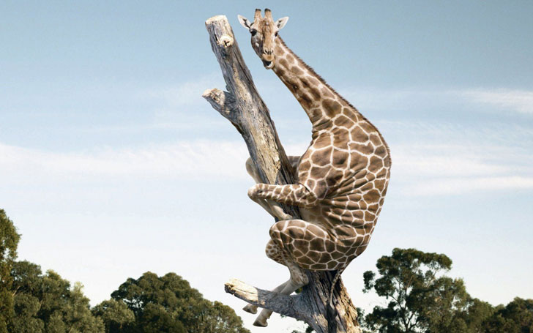
Because you’ve been good

Slide 23
IT APPLICATIONS SLIDESHOWS
By Mark Kelly
mark@vceit.com
vceit.com
These slideshows may be freely used, modified or distributed by teachers and students anywhere on the planet (but not elsewhere).
They may NOT be sold.
They must NOT be redistributed if you modify them.

