Slide 1

IT Applications Theory Slideshows
Database Design Tools
Note – the only mandated design tool for databases in 2016 is the ERD.
By Mark Kelly
mark@vceit.com
vceit.com

Slide 2
Contents
Input-Process-Output (IPO) charts
Data tables
Structure Charts
ERD - now has its own slideshow
Data dictionaries also have their own show
Other design tools can be found in other slideshows:
DFD, website, software development design tools

Slide 3


Slide 4
IPO chart
Used to design formulae for calculated fields
Also commonly used for spreadsheets and programming.
Components (in order of thinking):
Output – the information required
Input – the data required to get the information
Processing – the algorithm (calculation strategy) that will convert the input into the output.

Slide 5
IPO chart
Input | Process | Output

Slide 6
IPO chart
Work backwards
Start by deciding what information you want
For example, someone’s age in years
Input | Process | Output
 |  | Age in years

Slide 7
IPO chart
Now work out what data (input) you need to calculate this information (output).
Need 2 pieces of data – the current date and the person’s date of birth.
Input | Process | Output
Current date Date of birth |  | Age in years

Slide 8
IPO chart
Now the tricky bit. How will the output be calculated?
The strategy used is also called an algorithm.
In the IPO chart it can be expressed in an informal but understandable fashion called pseudocode.

Slide 9
IPO chart
Pseudocode describes the processing needed. It’s not meant to be 100% accurate programming.
It does need to tell a programmer what to do.

Slide 10
The algorithm
Age = time between date of birth (DOB) and date now.
The current date would not be typed into the database! (Why?)
Database can fetch current date from the system clock.
In Filemaker, the function is GET(Currentdate)
Other DBMS use similar functions.

Slide 11
The algorithm
In Excel, Filemaker, Access etc, subtracting one date from another gives the number of days between the dates
Note: only works if the dates are saved in a date field, or as type date so the software can do the calculations!

Slide 12
The algorithm
To convert days to years, divide by 365.25
(Why the .25?)

Slide 13
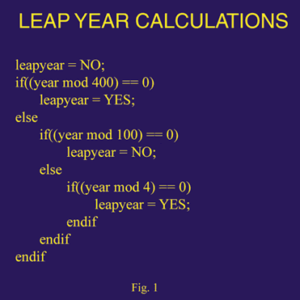
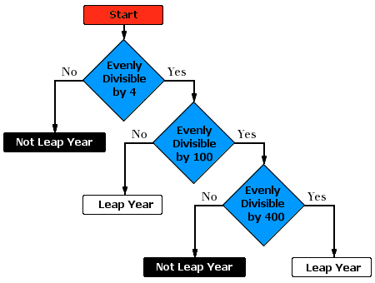
Speaking of leap years and algorithms…
Two ways of representing an algorithm: a decision tree (this one uses flow chart symbols), and pseudocode (which is half-programming language, half normal English)

Slide 14
IPO chart
Now work out what data (input) you need to calculate this information (output).
Need 2 pieces of data – the current date and the person’s date of birth.
Input | Process | Output
Current date Date of birth | (Now – DOB)/365.25 | Age in years

Slide 15
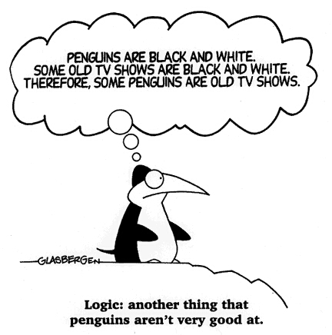
IPO chart
Should describe the logic of every calculation in the database, spreadsheet or software being developed.

Slide 16
Data structure table / diagram
A data structure table is like a data dictionary
It’s a table that summarises the fields in a table, including the fields’:
Names
Data types
Size (if relevant)
Validation rules
Other useful information on each field

Slide 17
Data structure table
Field Name | Type | Length (if relevant) | Validation rule
Givenname | Text | 15 | Must exist
DOB | Date | - | Must be between 1 Jan 1908 and 31 Dec 2008
State | Text | 3 | Must exist in list: Vic, NSW, Qld, SA, WA, Tas, ACT
ID | Text | 5 | Must be unique; must be 3 uppercase letters + 2 digits; must exist.

Slide 18
Data structure charts
May be known as a data structure diagram.
Is a visual map of how tables in a database are related

Slide 19
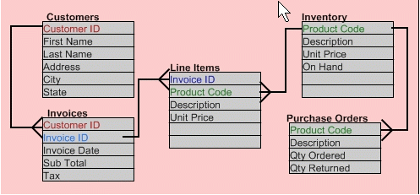
Data structure chart - Like an ERD

Slide 20
Also see ERD
Entity Relationship Diagram (ERD) as demonstrated by VCAA in their sample exam questions

Slide 21

Because you’ve been good

Slide 22
IT APPLICATIONS SLIDESHOWS
By Mark Kelly
mark@vceit.com
vceit.com
These slideshows may be freely used, modified or distributed by teachers and students anywhere on the planet (but not elsewhere).
They may NOT be sold.
They must NOT be redistributed if you modify them.

