Slide 1
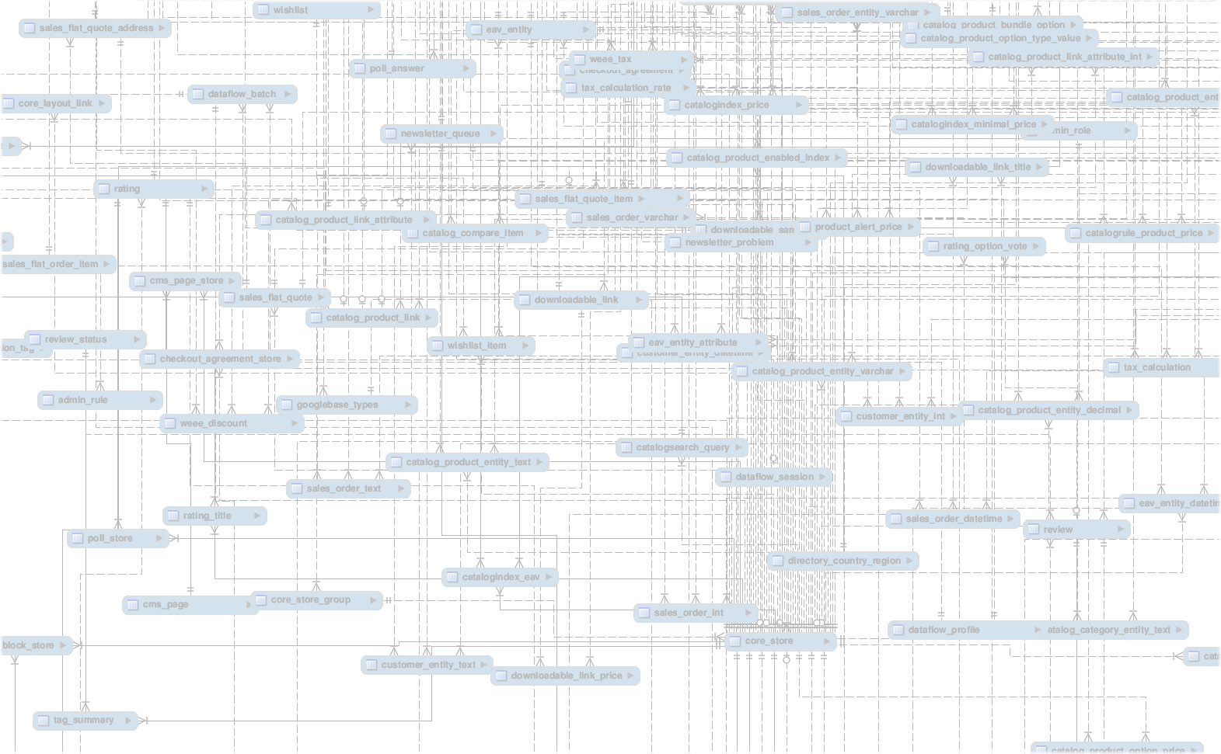
VCE IT Theory Slideshows – ITI Updated for 2016
Entity Relationship Diagrams
(ERD)
By Mark Kelly
mark@vceit.com
Vceit.com

Slide 2
This is based on the the VCAA ERD conventions, published April 2016 for Informatics. http://www.vcaa.vic.edu.au/Documents/vce/computing/Informatics_examination_ER_Conventions.docx WARNING – the version published in April has a serious error in the description of cardinality. This slideshow uses the corrected version.

Slide 3
VCAA is acknowledging two forms of ERD – Chen style and Crow’s foot notation.
Each form conveys the same information.
Both forms now include cardinality markers (e.g. 1:many)
You might be examined on either or both methods.

Slide 4
CHEN STYLE

Slide 5
ENTITY

Slide 6
ENTITY
RELATIONSHIP

Slide 7
ENTITY
RELATIONSHIP
ATTRIBUTE

Slide 8
KEY FIELD
ENTITY
RELATIONSHIP
ATTRIBUTE

Slide 9
Reading the ERD
A Library member

Slide 10
Reading the ERD
Can borrow

Slide 11
Reading the ERD
Many books

Slide 12
Reading the ERD
Which have titles etc

Slide 13
Reading the ERD
Every library member ENTITY has a Phone Number ATTRIBUTE

Slide 14
Reading the ERD
MemberID is the primary key for the MEMBERS entity.

Slide 15
Reading the ERD
Author is the primary key for the BOOKS entity (table)

Slide 16
New!
Unlike the old study design, the VCAA sample ERD has CARDINALITY
i.e. indications of
1:1
1:many
many:1
many:many relationships

Slide 17
Reading the ERD
The 1 end of the relationship

Slide 18
Reading the ERD
The ‘many’ end of the relationship

Slide 19
But of course the example is unrealistic because it says that one member can borrow many books, but each book can only ever be borrowed by one member!

Slide 20
How would you fix this ERD?

Slide 21
VCAA also included a “high-level entities only” version of Chen notation

Slide 22
Notice the confusing use of “N” to represent “many” in this example. VCAA likes to complicate things unnecessarily.
Confusing

Slide 23
CROW’S FOOT NOTATION

Slide 24
CROW’S FOOT NOTATION
ENTITY

Slide 25
CROW’S FOOT NOTATION
ENTITY

Slide 26
CROW’S FOOT NOTATION
ATTRIBUTE

Slide 27
CROW’S FOOT NOTATION
RELATIONSHIP

Slide 28
CROW’S FOOT NOTATION
The “1” end of the relationship

Slide 29
CROW’S FOOT NOTATION
The “many” end of the relationship

Slide 30
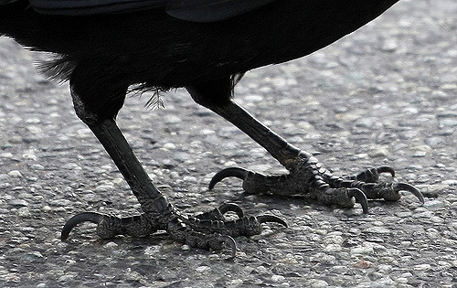
Can you see where CROW’S FOOT notation got its name now?

Slide 31
CROW’S FOOT NOTATION
Key field marker

Slide 32
And for the sake of being complete
VCAA also specified these conventions…

Slide 33
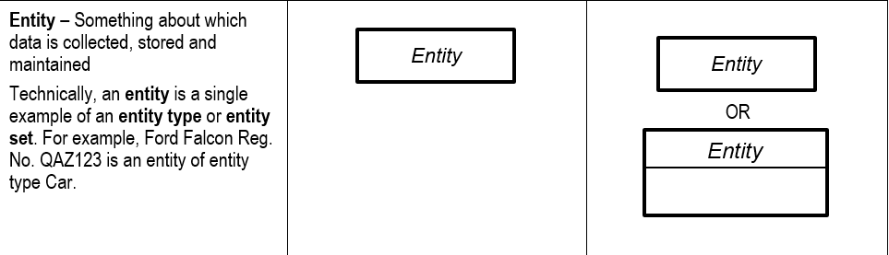
VCAA ERD CONVENTIONS
CHEN notation Crow’s foot notation

Slide 34
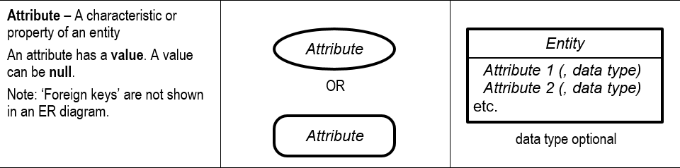
VCAA ERD CONVENTIONS
CHEN notation Crow’s foot notation

Slide 35
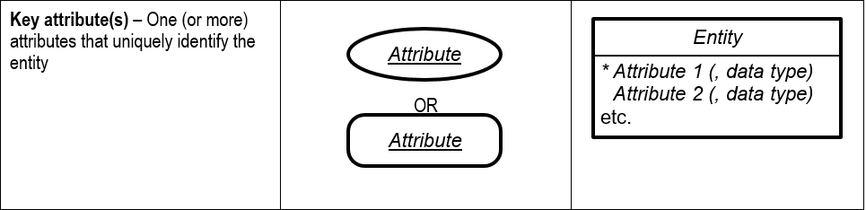
VCAA ERD CONVENTIONS
CHEN notation Crow’s foot notation

Slide 36
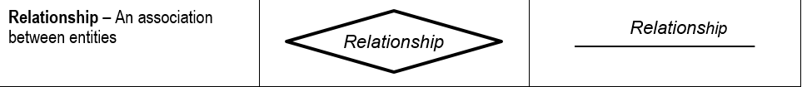
VCAA ERD CONVENTIONS
CHEN notation Crow’s foot notation

Slide 37
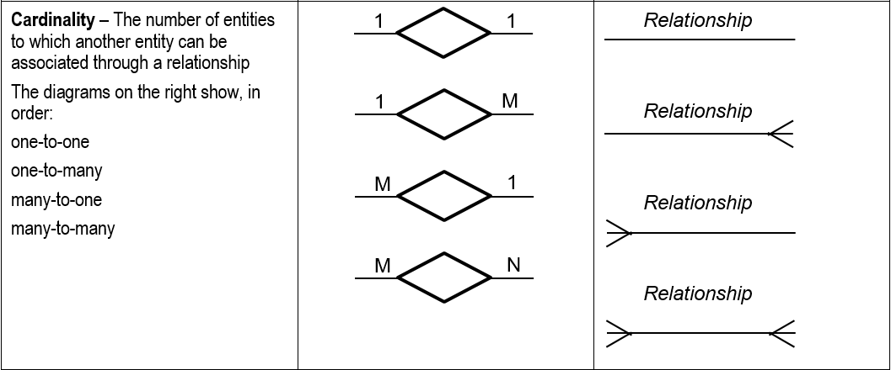
VCAA ERD CONVENTIONS
CHEN notation Crow’s foot notation
Note – if you got a very early (18 April 2016) version of the document from the VCAA site, check it because this section may be incorrect in your copy. It should look like the image above.

Slide 38
Think about it
Of course, you need to keep in mind that the only relationships you will see in real-life databases are 1:many.
- 1:1 relationships are just basic lookup tables and are rarely if ever used. Such fields should and would be in the original table.
- many:many relationships cannot be created in real databases. Try it. I dare you. You need a third table (a “line table”) to join fields between two other tables.

Slide 39
As a treat because you’ve been good

Slide 40
VCE IT THEORY SLIDESHOWS
By Mark Kelly
mark@vceit.com
vceit.com
These slideshows may be freely used, modified or distributed by teachers and students anywhere on the planet (but not elsewhere).
They may NOT be sold.
They must NOT be redistributed if you modify them.

