Slide 1

IT Applications Theory Slideshows
Privacy Laws
Updated 2016
By Mark Kelly
mark@vceit.com
Vceit.com

Slide 2
Contents
The Privacy Act 1988
Privacy and Data Protection Act 2014 (replaces the previous Information Privacy Act, Victoria 2000)
The Health Records Act 2001, Victoria

Slide 3

Privacy Laws
Safeguard personal or sensitive information stored by organisations about people.

Slide 4
What’s personal information?
Name, address, age, sex
Shopping habits, Personal opinions
Living arrangements, partners, children
Etc
Does not include records held by an employer about an employee, including health information.
So an employer who stores employees’ health info is not necessarily subject to the privacy laws.

Slide 5
What’s sensitive information?
racial or ethnic origin
political opinions
membership of a political association
religious beliefs or affiliations
philosophical beliefs
membership of a trade union
sexual preferences or practices
criminal record.

Slide 6
What’s medical information?
medical history
current medical condition and treatments
dental records
genetic information
notes and opinions of health service provider (e.g. doctor, psychiatrist)

Slide 7
Who’s subject to the Federal Privacy Act?
Any federal government department
Any private organisation which:
Turns over $3 million or more annually, or
Profits from trading in personal information, or
Holds health information about people*
In 2001 98.9% of businesses turned over less than $3 million.
* Not including employees

Slide 8

The spirit of the Privacy Act
The basis of the Privacy Act’s rules is the Information Privacy Principles (IPPs)
Same principles underlie most other Australian states’ privacy legislation.

Slide 9
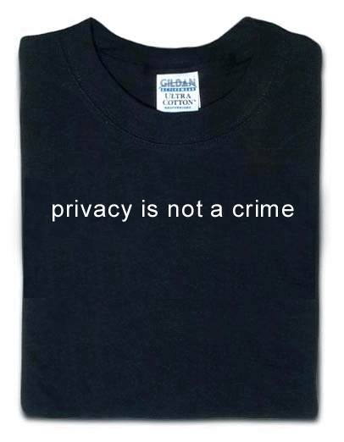
Privacy Principles
1. Collection Organisations should only collect personal information that is necessary for one or more of its functions and activities.

Slide 10
Privacy Principles
2. Use and Disclosure An organisation must not use or disclose information about an individual for any other purpose (a secondary purpose) other than the purpose for which the information was collected, except in a number of exceptions specified in the Act.

Slide 11

Privacy Principles
3. Data Quality An organisation must take reasonable steps to ensure that the personal information it collects, uses or discloses is accurate, complete and up to date.

Slide 12
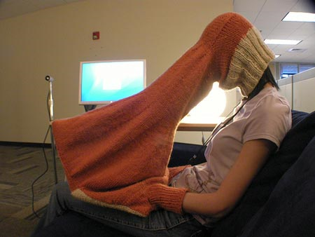
Privacy Principles
4. Data Security An organisation must take reasonable steps to ensure that the personal information that it collects is protected from misuse such as unauthorised access, modification or disclosure, or loss.
Laptop privacy >>

Slide 13


Privacy Principles
5. Openness An organisation must set out in a document a clearly expressed policy on its management of personal information and make this document available to anyone who asks for it.

Slide 14

Privacy Principles
6. Access and Correction If an organisation holds personal information about an individual, it must provide the individual with access to the information on request by the individual.

Slide 15

Privacy Principles
7. Identifiers Identifiers, an organisation cannot use the same identifier that another organisation uses to identify an individual (e.g. Tax File Number, Medicare number.)
Must create their own idenifier (e.g. account number, user ID,)
Why? Look up data mining – collating info on an individual from several different databases

Slide 16


Privacy Principles
8. Anonymity Where it is lawful and practicable, individuals must have the option of not identifying themselves when entering transactions with an organisation.

Slide 17

Privacy Principles
9. Transborder data flow An organisation in Australia or an external Territory may not transfer personal information about an individual to someone (other than the organisation or the individual) who is in a foreign country without the consent of the individual.

Slide 18

Privacy Principles
10. Sensitive Information An organisation must not collect sensitive information about an individual unless the individual has consented, or law requires the collection.

Slide 19
Victorian Laws
Privacy and Data Protection Act 2014
Establishes a regime for the responsible collection and handling of personal information in the Victorian public service sector (i.e. government departments).
Also applies to organisations providing services funded by government departments.
Does not apply to non-gov’t orgs!

Slide 20
Privacy and Data Protection Act 2014
The Act covers all personal information that identifies or could be used to identify an individual other than health information.
Aligns closely with the principles in the Federal Privacy Act;
* Replaces the last study design’s Information Privacy Act 2000 (Vic)

Slide 21
Health Records Act 2001 (Vic)
Establishes privacy standards for the handling of all health information and the operation of all health services: health, mental health, disability, aged care or palliative care services.
Gives individuals a conditional right of access to their own health information held in the private sector.

Slide 22
Health Records Act 2001 (Vic)
Applies to all Victorian businesses (profit and non-profit, public and private sector) and everyone handling health information.
Allows de-identified* health information to be used for planning and research.
* Information that cannot be linked to a particular individual

Slide 23
Because you’ve been good…

Slide 24
IT APPLICATIONS SLIDESHOWS
© Mark Kelly
mark@vceit.com
vceit.com
These slideshows may be freely used, modified or distributed by teachers and students anywhere on the planet (but not elsewhere).
They may NOT be sold.
They must NOT be redistributed if you modify them.

