Slide 1

VCE IT Theory Slideshows
Problem Solving Methodology
Analysis Activities
Revised version 3 : 2016
By Mark Kelly
Vceit.com

Slide 2
Problem-solving activities relating to the analysis of ongoing information problems

Slide 3
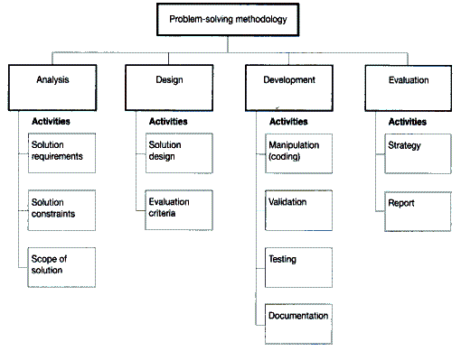
From the study design

Slide 4
Analysis
Analyse problems before trying to solve them
See PSM slideshow: Analysis
Watch the system being used
Interview users
Log faults, errors and performance figures
Consult stakeholders

Slide 5
1.Determine Solution Requirements
Functional requirements – what the system should be able to do
Non-functional requirements – qualities or characteristics the system should have

Slide 6
Functional requirements (FR)
Expressed as actions, with verbs
E.g. The new system should be able to…
  Produce invoices
  Send automated emails to customers
  Produce annual reports
  Calculate monthly totals
  Backup system files daily
Task: list the functional requirements of a toaster.

Slide 7
Non-Functional requirements (NFR)
Not things that need to be done
Are qualities, features, characteristics the finished solution should have
May or may not need specific programming to make them happen.
May be the result of a combination of things that are added, or it may be the way they are done

Slide 8
NFRs
Expressed as descriptions, with adjectives
E.g. The new system should be…
  Easy to use
  Reliable
  Fun
  Easy to read
  Accurate
  Safe
  Secure
Task: list the non-functional requirements of a toaster.
From the study design…
user-friendliness, response rates, robustness, portability, reliability and maintainability

Slide 9
2. Determine solution constraints
Constraint = limit on your freedom of choice when choosing how to solve a problem
Constraint = a condition affecting the solution (during its development, or its ongoing use)

Slide 10
2. Determine solution constraints
May be caused by special user needs (e.g. age, interests, education levels, skills)
May be caused by conditions unique to the customer (e.g. remoteness, lack of money or time, available equipment)
Designers and developers must create a system that will work within the specified limits

Slide 11
2. Determine solution constraints
Example constraints:
  Users have little IT expertise
  Solution must be in place within 2 weeks
  Solution will be used by untrustworthy users (e.g. students!)
  Will be used on computers running Windows XP, Win7 and Mac
  Users will be very young children
  System will be used on mobile phones

Slide 12
2. Determine solution constraints
Each constraint will force a designer or developer to give up a preferred option and use ‘Plan B’ instead.

Slide 13
3. Determine scope
Scope = the parameters of the solution
Parameter = beginning or ending value
Scope = what the solution should be expected to do and what it should not be expected to do
Largely defined by functional requirements list

Slide 14
3. Determine scope
Is important to define scope to avoid arguments about whether a solution is ‘finished’ or not
Avoids legal battles in court between developer and customer
Scope should be written down and signed by customer and developer before design begins
Later changes to scope will increase development costs and time.

Slide 15
And in the end
Solution Requirements (FR and NFR), constraints and scope are all written down
For SD kids – they are put in the SRS (Software Requirements Specification) document
Customer and developer must agree on all 3 before design begins
They act as a blueprint for later design, development and evaluation stages of the PSM.

Slide 16
IT APPLICATIONS SLIDESHOWS
By Mark Kelly
vceit.com
These slideshows may be freely used, modified or distributed by teachers and students anywhere on the planet (but not elsewhere).
They may NOT be sold.
They must NOT be redistributed if you modify them.

