Slide 1

VCE IT Theory Slideshows Updated for 2016
Problem Solving Methodology 4
EVALUATION
By Mark Kelly
Vceit.com

Slide 2

Contents
What it is – and what it isn’t
When
How
What
Methods
Criteria

Slide 3
Evaluation
Evaluation is not testing!
Does not try to prove the system works – that was established during testing!
Establishes how successfully the project performs in achieving organisational goals and objectives.

Slide 4
Evaluation is not testing!
E.g. an organisation wanted to improve profit.
Their solution is to create a website to appeal to young people.
They create the website and test it. It works 100%. Testing result: site is a complete success.

Slide 5
Evaluation is not testing!
They put the website online. Months later they evaluate it.
Profits have not risen because none of the visitors have credit cards or Paypal.
Evaluation result: site is a complete failure!
It has not achieved its goal of producing profit even though it tested as 100% good.

Slide 6
When to evaluate?
Not too soon after implementation – users still maybe uncomfortable with it, may not feel “expert” yet
Not too long after implementation – users will have forgotten the old system and be unable to compare them
Let users use the new system long enough to be comfortable (e.g. a month of daily use, six months of weekly use)

Slide 7
How to evaluate
Measure whenever possible – time operations, count errors, add up costs etc
Interview or survey only when opinions are being evaluated – e.g. Is it easy to use?, Do you feel comfortable?, Is it fun? Is the output attractive?
Don’t ask “Do you think the new system is faster/more accurate than the old one?”
Cold, hard facts are more reliable.

Slide 8
What to evaluate
Evaluate the criteria laid down during design.
These criteria should be based on the specifications set out in the logical design.
If the original aim was to make a system faster and more accurate, evaluate its speed and error rate.

Slide 9
Evaluation methods
For each criterion to evaluate (e.g. speed) there needs to be a method with which to evaluate it. E.g.
Speed – add up how much output the system produced in 3 months.
Accuracy – count the number of errors recorded in the error log
Fun to use – interview users and ask their opinion

Slide 10
Remember
Evaluation criteria are topics to study
Evaluation methods are actions taken to study the topic.
Each criterion has a corresponding method.

Slide 11
Efficiency criteria
Speed
Output produced in a given time
Amount of labour required
Total Cost of Ownership of the system
Including initial cost, running costs, repairs, upgrades, consumables, training

Slide 12
Effectiveness criteria
Generally: Quality of the product.
Accuracy / error rate
Reliability
Attractiveness of output, readability
Ease of use

Slide 13
Effectiveness criteria
Fun factor
Accessibility
Portability
Security
Compatibility with existing equipment
Expandability, flexibility
Ruggedness
Etc etc

Slide 14
Evaluation Criteria
There’s a VCEIT slideshow dedicated to evaluation criteria that you might want to look at.

Slide 15
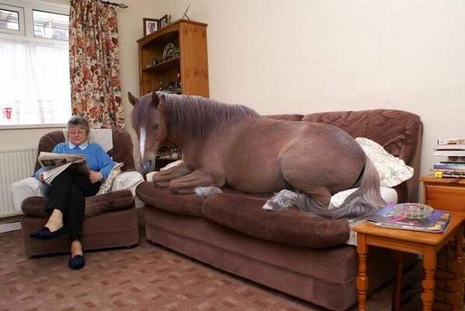
Because you’ve been good

Slide 16
VCE IT THEORY SLIDESHOWS
By Mark Kelly
vceit.com
These slideshows may be freely used, modified or distributed by teachers and students anywhere on the planet (but not elsewhere).
They may NOT be sold.
They must NOT be redistributed if you modify them.

