Slide 1
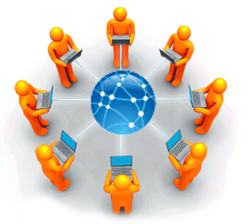
VCE IT Theory Slideshows
Intranet, Internet, VPN
Version 2
By Mark Kelly
Vceit.com

Slide 2
To start at the beginning…
A ‘standalone’ computer is not connected to any other computer.
If two or more computers are connected so they can communicate, you have a LAN (local area network) – e.g. like the one in your school.

Slide 3
To start at the beginning…
If two or more LANs interconnect, you have a WAN (Wide Area Network).
E.g. the branches of the Commonwealth Bank, or all the McDonalds stores.

Slide 4
To start at the beginning…
Note – The word “Local” in “LAN” means the connected computers are physically near each other, e.g. in the same room, building or site.
“Wide” in “WAN” just means the geographical spread of the connected computers is bigger than a LAN. It may be across a suburb, state, country, continent, hemisphere.

Slide 5
To start at the beginning…
The difference between a LAN and a WAN is not defined by the number of computers it has.
A LAN may have thousands of workstations (networked computers)
A WAN may only have a dozen workstations.

Slide 6
To start at the beginning…
Computers connect to create a LAN.
LANs connect to create a WAN.
When WANs connect – that is the internet.

Slide 7
Internet
A worldwide network of WANs
Uses TCP/IP protocols to manage communications. So any device with any operating system can connect to any other device that also speaks TCP/IP.

Slide 8
TCP/IP
Two protocols working together – TCP and IP.
TCP (Transport Communication Protocol)
takes data to be sent (e.g. a file) and breaks it into small packets.
addresses the packets so they can reach their destination.
takes incoming packets and reassembles them back into their original file.

Slide 9
TCP/IP
Two protocols working together – TCP and IP.
IP (Internet Protocol)
Takes the data packets that were prepared by his mate, TCP.
Sends them out into the world.
Guides each packet to its destination address.
(When the packets reach their destination, TCP on the receiving computer reassembles the packets back into their original file structure.)

Slide 10
Internet
The World Wide Web is only part of the internet
WWW uses HTTP (Hypertext Transfer Protocol) to request/send/receive web pages.

Slide 11
Other services using the internet
Usenet - a network of discussion groups
File sharing networks – torrent sites, Kazaa, Limewire etc
Email
FTP
Closed networks like Facebook, Twitter
Blogs
RSS feeds

Slide 12
IP
Like every phone, each device on the internet needs a unique IP (Internet protocol) address (e.g. 209.33.1.102)
Your IP address is like a unique phone number for a computer or website.

Slide 13
Domains
Human readable URLs with domain names (e.g. microsoft.com) are not computer friendly
Domain names are converted to an IP address to find the destination server.
DNS (Domain Name System) does the conversion
DNS = massive ‘phonebook’ with all domain names and matching IP addresses

Slide 14
DNS
Domain Name System.
IP addresses are always used to identify computers (and web servers) on LANs, WANs and internet.
But numbers like ‘103.68.101.33’ mean nothing to humans. Humans like words.
Enter the DNS.

Slide 15
DNS
Let’s say you want contact the Microsoft website.
Its IP address is 104.43.195.251.
You’ll never remember that.
But the DNS is a database that stores a domain’s name like “Microsoft.com” and its actual IP address, 104.43.195.251.

Slide 16
DNS
You enter “Microsoft.com” into your browser.
You browser immediately queries the DNS database asking for the matching IP address.
The DNS tells your browser “104.43.195.251”
Your browser requests a connection to that IP address.
HTTP can then negotiate requests and delivery of webpages between your browser and the Microsoft web server.

Slide 17
Web servers
Computer that stores web pages making up a site.
Visitors use web browsers to make requests for web pages using HTTP.
Web server uses HTTP to return requested page to visitor.

Slide 18
Intranet
A local, private version of the internet on a LAN
Uses the Internet Protocol to securely share information within a LAN
May involve local websites, email, collaboration tools, databases etc
Intranets are guarded (by routers) against people who are outside the LAN.

Slide 19
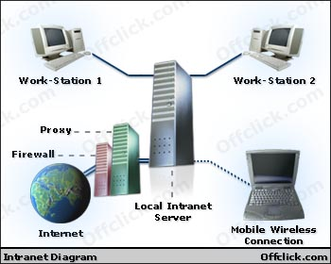
Intranet
Can be as simple as webpages stored on a shared network drive.
Often stores webpages on a file server rather than on a webserver.
Simple to access with only a web browser.

Slide 20
Intranet
Intranet is protected by a router and firewall to keep outsiders out.
Intranet can be made safe by using private, local IP addresses (e.g. 192.168.1.xx or 10.1.1.x)
These local IP addresses cannot be used by outsiders to refer to computers within the LAN.

Slide 21

Intranet uses
Collaboration – tools (e.g. Google docs, and shared documents)
Communication (email, VoIP, messaging)
Resource sharing
Training

Slide 22
Intranet
In some cases an intranet allows access via the internet, but a password-protected login is needed to gain access.

Slide 23
Intranet / VPN
Security is needed to keep the LAN users safe within the LAN.
But still allow authorised people to get into the LAN from the internet (e.g. travelling salesmen on the road connecting to their headquarters; teachers or students at home getting into their school network)

Slide 24

VPN
Virtual Private Network
Used to provide access to a LAN or intranet to off-site people.
A secure, private link using normal internet infrastructure.
A VPN box creates an encrypted tunnel between offsite users and their LAN.

Slide 25
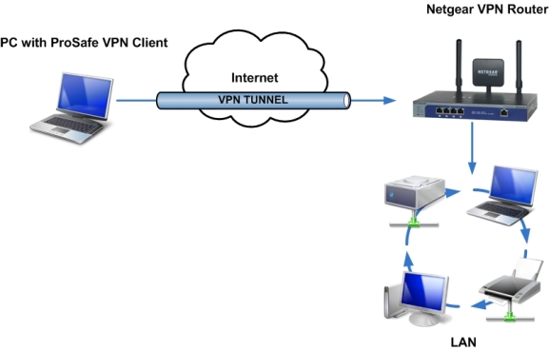
VPN
http://kbserver.netgear.com/media/images/answer_1128/clienttobox.jpg

Slide 26
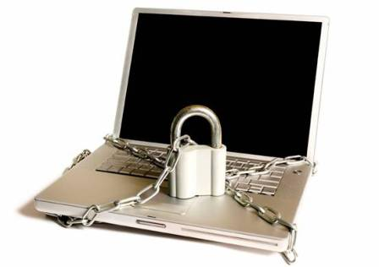
Corporate VPNs
Corporate VPN box can support hundreds of simultaneous encrypted remote access connections.
A VPN can also be done with just software
A 200-user VPN box can be very expensive e.g. $7,000

Slide 27
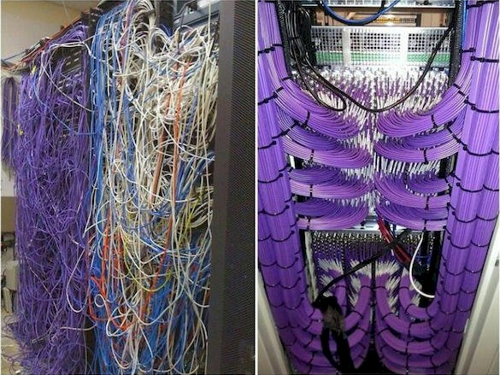
Because you’ve been good How to install network cable like a champion

Slide 28
VCE IT THEORY SLIDESHOWS
By Mark Kelly
mark@vceit.com
These slideshows may be freely used, modified or distributed by teachers and students anywhere on the planet (but not elsewhere).
They may NOT be sold.
They must NOT be redistributed if you modify them.

