Slide 1

VCE IT Theory Slideshows
Searching
Techniques
By Mark Kelly
mark@vceit.com
Vceit.com

Slide 2
Contents (2016-2019)
Linear search
Binary search

Slide 3
When searching is required
You have thousands of clients on file and you need to find one client’s record
In a list of a thousand exam results, you need to find all those who failed and count them.
You need to find the smallest value in a list.
When processing surveys, you develop a list of unique responses. If the same response recurs, you just add 1 to its count. To do this, you need to search the list to see if it already exists.

Slide 4
Linear search
Go to the first item in the list.
Compare the list item with the target value.
If it does not match, move to the next item.
Go to step 2 unless the list is finished.
PROS: easy to code; the only method in an unsorted list.
CON: can be very slow (up to N comparisons needed to search a list of N items)

Slide 5
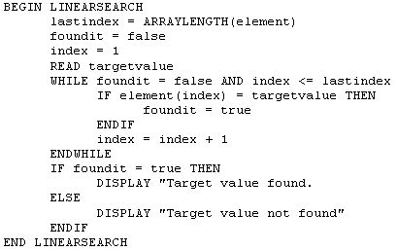
Linear Search Algorithm

Slide 6
Binary Search
Data being searched must be sorted
The sorting lets you know whether or not you have passed the value being sought

Slide 7
Binary Search
Algorithm:
Divide the data set in half
Is the value being sought less than or greater than the half-way value?
Throw away the wrong half.
Repeat
In only a few comparisons the value will be either found or proved not to be in the data set

Slide 8
Pros/Cons of Binary Search
+ Far faster – many fewer comparisons needed to find an item (rarely more than 5 or so)
- Data must be sorted, which adds processing time

Slide 9
Binary Search Algorithm
Found ← false
Start ← index of first item
End ← index of last item
While not found
Halfway ← (start + end) /2
Halfwayvalue ← value of item at index halfway
If ValueBeingSearched = Halfwayvalue then
exit (value was found)
Else
if valuebeingsearched < halfwayvalue
end ← halfway ’ ignore top half of data set
else
start ← halfway ’ ignore bottom half of data set
end if
if start >= end then exit (item does not exist in the data set)
End if
End while

Slide 10
A Practical Binary Search Demo
Pick up a book with many pages
Choose a page number at random (call it ‘n’)
Use the binary search technique to find page n
Count how many page number comparisons you make
Compare with a linear search which would’ve taken n comparisons!

Slide 11
For example
1000 page book. We’re looking for page 296
Start = 1, End = 1000
Success in 6 comparisons.
Linear search would have taken 296 comparisons
PASS | HALF WAY | Test | New Start | New Half | New End
1 | 500 | 296 < 500 | 1 | 250 | 500
2 | 250 | 296 > 250 | 250 | 375 | 500
3 | 375 | 296 < 275 | 250 | 312 | 375
4 | 312 | 296 < 312 | 250 | 281 | 312
5 | 281 | 296 > 281 | 281 | 296 | 312
6 | 296 | 296 = 296 | End!

Slide 12
So, which to choose?
If linear search was always worse than binary, it would no longer exist.
The fact the it still exists means it has advantages.
It’s much easier to program. Saves time.
Data does not have to be always kept sorted. Saves processing.
For small data sets, it’s quite adequate.
If sorting time is not an issue, it’s quite adequate.

Slide 13
Quick Tip
Do not confuse searching (linear, binary) with sorting (selection, quick)
The exam often asks which search technique is better. Consider both the size of the dataset and the urgency of the search duration.

Slide 14
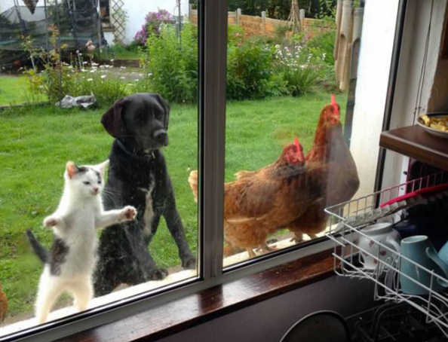
And because you’ve been good here’s a picture you can look at

Slide 15
VCE IT THEORY SLIDESHOWS
By Mark Kelly
mark@vceit.com
vceit.com
These slideshows may be freely used, modified or distributed by teachers and students anywhere on the planet (but not elsewhere).
They may NOT be sold.
They must NOT be redistributed if you modify them.

