Slide 1

VCE IT Theory Slideshows
User Acceptance Testing
By Mark Kelly
mark@vceit.com
Vceit.com

Slide 2
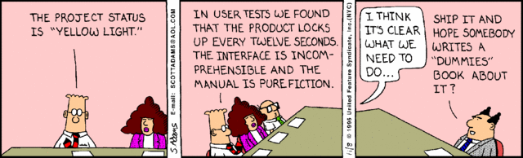
User Acceptance Testing (UAT)
Formal testing of whether the intended end-user of a system or product is happy with the way it carries out its functional and non-functional requirements.
i.e. do average users think it’s functional?

Slide 3
UAT
Informal testing by developers is complete.
The programmers have tested and fixed all the bugs.
The client is happy that the solution satisfies all functional and non-functional requirements.
But is the solution suitable for real users?

Slide 4
UAT
Actual typical end-users are used for UAT rather than managers
Skilled users can tell if a product has problems that a non-user (e.g. manager) would never notice

Slide 5
UAT
For example, a supermarket manager would not know the pain of using an awkward checkout register 8 hours a day
Real checkout operator would know what usually goes wrong and can focus on testing those features

Slide 6
What is the purpose of UAT?
To demonstrate that the system is fit for real use by real people in the business.
Is different to system testing which proves that the system behaves as promised in the original design.
A product could satisfy the design but still be a never-ending pain for its users.

Slide 7
What UAT sounds like
Developer: The product should respond briskly. I click here, and we get instant response.
User: OK.
Developer: The product should be easy to read. See the font size and colours we used? OK?
User: They’re fine.
Developer: Help needs to be contextual. See, I open this and press F1 – relevant help appears.
User: Yep. OK. But that help makes no sense. And why is the font size so small? And if I click here I’d expect it to expand, but it doesn’t. I have to go up to a menu and that’s a pain…

Slide 8
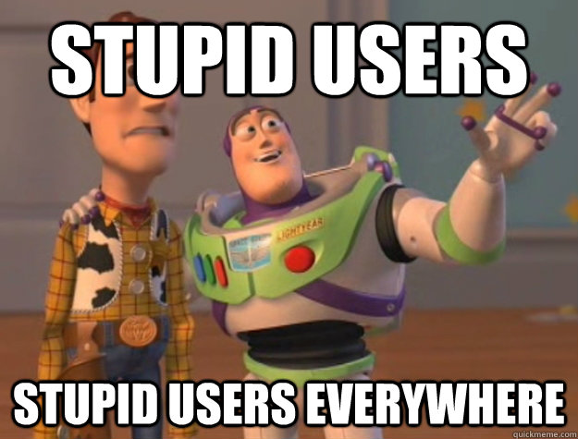
After UAT
The product is known to be suitable for use by real-world average users.
Even if they’re not the brightest people.

Slide 9
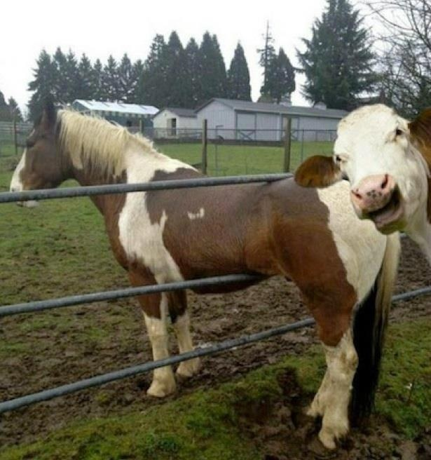
Because you’ve been good

Slide 10
VCE IT THEORY SLIDESHOWS
By Mark Kelly
mark@vceit.com
vceit.com
These slideshows may be freely used, modified or distributed by teachers and students anywhere on the planet (but not elsewhere).
They may NOT be sold.
They must NOT be redistributed if you modify them.

