Slide 1

VCE IT Theory Slideshows by Mark Kelly 2016-2019 study design
Data Entry Controls
Version 1
Begin
By Mark Kelly, vceit.com, mark@vceit.com

Slide 2
GUI Data input controls
Online surveys and questionnaires can use GUI (Graphical User Interface) data entry controls to
Limit respondents’ answers to pre-set options
Improves the consistency of data
Data are easier to process
E.g. unlimited answers to “Your sex?” could be answered with “Male”, “M”, “Man”, “Boy”
Save time for respondents
They are more likely to cooperate

Slide 3
GUI Data input controls
GUI data entry controls also
Prevent invalid data being entered (e.g. impossible dates cannot be entered with a calendar control)
Automatically encode and store data, saving time and effort for the researchers
Tip
For easy, free, form-based online data acquisition and storage, try Google Drive

Slide 4
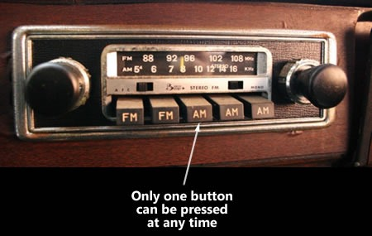
GUI Data input controls
Radio buttons. One, and only one answer must be chosen from a limited list of options.
Answer cannot be left blank
No more than one item may be selected.
Named after old-style car radios with a series of buttons that are pushed in to select a pre-tuned station. Pressing any button automatically de-selects whichever button is already pushed in.

Slide 5
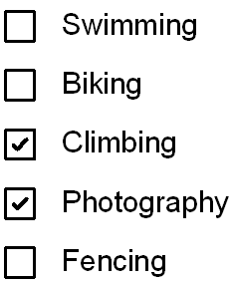
GUI Data input controls
Check boxes (tickboxes). None or any number of items may be chosen from a limited list of options.
Answer can be left blank
Several options may be selected.
Named after the American term “check”. We say “tick”

Slide 6
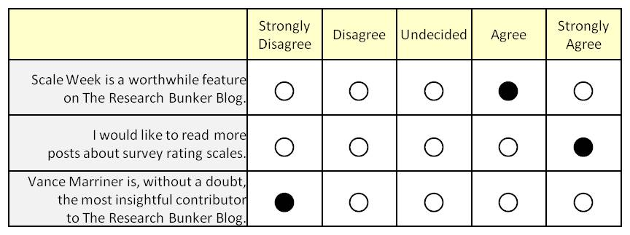
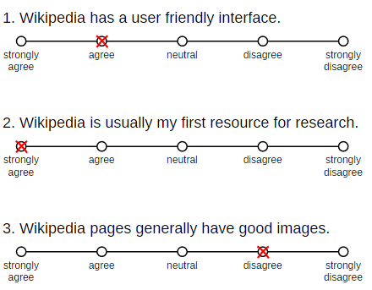
GUI Data input controls
Likert scale. A response is chosen from a list of discrete options on a scale.
To make encoding easier, cannot choose “mid-way” values.
Named after its inventor, psychologist
Rensis Likert

Slide 7
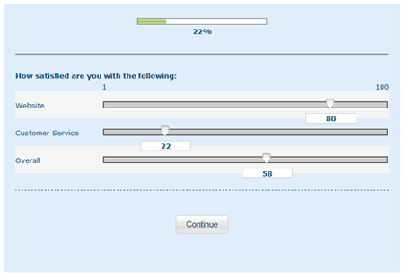
GUI Data input controls
Sliding scale. A response is chosen from a continuous range between pre-set limits.
Named after inventor,
Mario Sliding*

Slide 8
GUI Data input controls
Textbox. Allows a free-form, variable-length response with any text.
Very hard to validate much apart from existence.
So use labels to provide guidance to respondents
E.g.
Date of birth (dd/mm/yyyy)
Email (e.g. fred@smith.com)

Slide 9
GUI Data input controls
Calendar control
Intelligent control that forces the entry of a valid date
E.g. 29 Feb 2016 can be entered, but not 29 Feb 2017.
Good for researchers – all date entries must be valid (if not correct)
Good for respondents – quick, easy, no stress about required date format
Good for international respondents who use different date formats (e.g. American 2/29/2016 or Asian 2016/2/29)

Slide 10
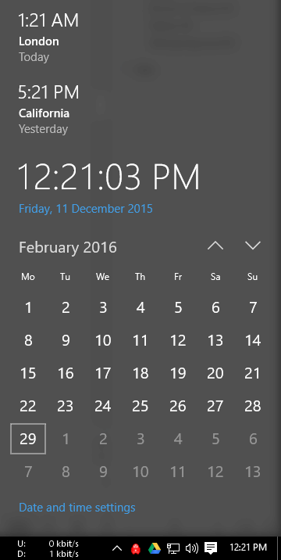
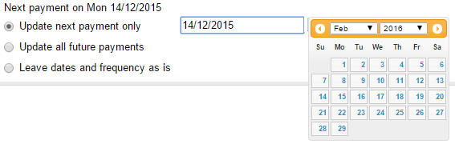
GUI Data input controls
Calendar control
Windows 10 Netbank

Slide 11
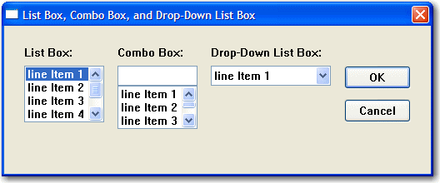
GUI Data input controls
List box
A list of options, with many items visible at once
Drop-down list box
A space-saving version of the list box. All list items apart from the currently-selected on are hidden until the control is activated.
Combo box
A list box which also allow editing of the selected value.

Slide 12
GUI Data input controls
List box
A list of options, with many items visible at once
Drop-down list box
A space-saving version of the list box. All list items apart from the currently-selected on are hidden until the control is activated.
Combo box
A list box which also allow editing of the selected value.

Slide 13
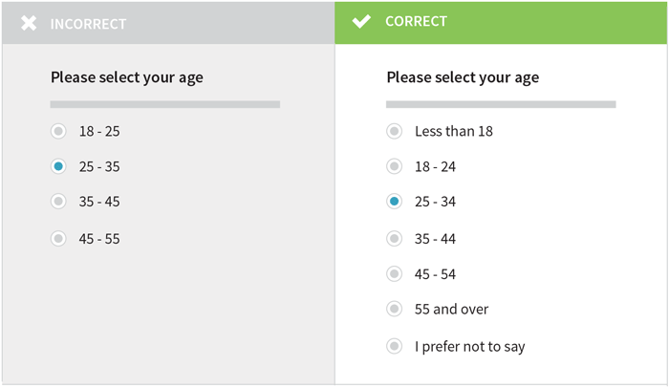
GUI Data input controls
Tips
Answers should allow the entry of any valid data
Give TWO reasons why the following “Incorrect” example is incorrect.

Slide 14
GUI Data input controls
It does not allow ages <18 or >55 to be entered.
Ranges overlap – does a 25 year old choose option 1 or 2?

Slide 15
GUI Data input controls
Also notice the “No answer” option for questions that are potentially sensitive. Without the option, some people may lie, and data loses its integrity.

Slide 16
GUI Data input controls
Also notice that a range of ages may be more comfortable for people who don’t want to reveal their exact age. Right, ladies? ☺

Slide 17
GUI Data input controls
Also notice that a range of ages may be more comfortable for people who don’t want to reveal their exact age.
Right, ladies? ☺

Slide 18

GUI Data input controls
Sorry, ladies…
Errr, ‘women’?
Be sure to visit my other great slideshow for the SAT:
‘How To be Gender Inclusive when Writing for a Global Audience’.
☺

Slide 19
VCE IT THEORY SLIDESHOWS 2016-2019 study design
Mark Kelly
mark@vceit.com
vceit.com
These slideshows may be freely used, modified or distributed by teachers and students anywhere
but
they may NOT be sold.
they must NOT be redistributed if you modify them.
This is not a VCAA publication and does not speak for VCAA.
Portions (e.g. exam questions, study design extracts, glossary terms) may be copyright Victorian Curriculum and Assessment Authority and are used with permission for educational purposes. Thanks, guys!

Slide 20
THANKS!
Because you’ve been so good, here’s a picture you can look at
while your teacher works out what to do next

