Slide 1
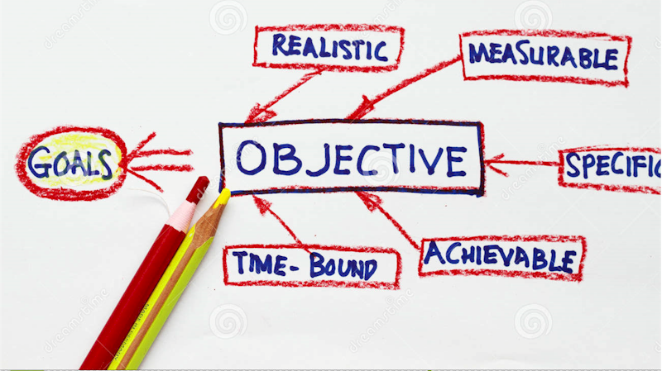
VCE IT Theory Slideshows by Mark Kelly 2016-2019 study design
Organisation and system goals and objectives Version 2
Begin
By Mark Kelly, vceit.com, mark@vceit.com

Slide 2
Contents
Goals
Objectives
Organisational goals and objectives
System goals and objectives

Slide 3
Goals
Big, long term, rather vague targets to be achieved
Hard to measure how well – or if, or when – they have been achieved
For example “Good customer service”, “Security”

Slide 4
Objectives
Specific, measurable, achievable steps towards achieving a larger goal
Quantifiable – can be proved to be achieved or not using statistics, observation, logs.
For example, “Answering customer enquiries within 24 hours” is a good step towards achieving the larger goal of “Good customer service”.

Slide 5
Organisational goals
Organisations have goals that the entire organisation aims to achieve in all of its departments and operations. For example
Profit (for commercial organisations)
Good customer service
Good communications with staff and customers
Efficient work practices
Good reputation
Good decision-making practices
Protection of data
Good staff morale
Cheap, reliable products (or expensive, luxurious, top-quality products)

Slide 6
Organisational goals
Such goals often serve to define the nature of each organisation.
Compare the probable organisational goals of Rolls Royce vs Hyundai, or Ferrari vs Land Rover.
Compare the probable goals of Myers and K-Mart.

Slide 7
Organisation goals
The aims of an organisation - the things the org strives for and prides itself on.
These goals are often written down in a mission statement: a brief philosophical statement that defines what is important to the organisation.

Slide 8
Org goals
Customers often select one organisation over another based on its goals.
You can tell an organisation's genuine organisational goals when they have to make a decision

Slide 9
Org goals
If a store had to choose between raising prices or reducing product quality, its decision can reflect its organisational goals.

Slide 10
Org goals
If store 'A' raised prices and kept product quality high, it implies that it values its product quality.
If store ‘B’cut its product’s quality and kept prices stable, what does this imply?

Slide 11
Org goals
Org goals reflect a culture or attitude held by an org that shapes every decision it makes.

Slide 12
Org goals
Some organisations goals are pretty easy to work out.
Hospitals would, you'd hope, have excellent medical outcomes as their main organisational goals.
Schools would aim primarily for providing quality education.
A shop might aim for personalised and courteous service.
Another shop might aim to provide the best prices.

Slide 13
Org goals
Conflicts can occur when different goals collide.
What if a private school that valued the quality of its education had to cut costs?
Would a private hospital start using second-hand scalpels to save money in tough times?
Company directors or staff sometimes resign because they believe their company has started ignoring its primary goals.

Slide 14
Detecting org goals in a case study
When you are given a case study, you are often told what the organisation goals are. It might say, "Fred's Moving Company" prides itself on..." or "ABC Printing aims to..." or "Giraffe Restumping Co. is concerned that..."

Slide 15
Detecting org goals in a case study
These are clues to what the organisations consider important.
The fact the the Giraffe Restumping Co. is "concerned" suggests that one of their valued organisational goals is being threatened.

Slide 16
Generic goals
Apart from the organisational goals given to you in a case study, there are some standard ones you can assume for any organisation:

Slide 17
Generic goals
FOR COMMERCIAL ORGANISATIONS: profit.
Whatever they do, in the end, should eventually lead to increased profit.
Some actions may not be immediately obvious as profitable, but may yield profit in the long term.

Slide 18
Generic goals
E.g. Sponsoring charities may seem like a waste of profits, but if it gets them publicity and "warm fuzzies" from the community, they will increase their number of customers and their competitiveness against rivals.

Slide 19
Generic goals
Spending big money on new technology may seem foolish but…
the expense may be recouped from better productivity (producing more stuff in a given time)
reduced costs or better quality products may attract customers

Slide 20
Generic goals
NOT-FOR-PROFIT / SERVICE ORGS: service.
Whatever they do, in the end, should eventually lead to providing a better service to their clients.
Any profits are re-invested in the organisation.

Slide 21
FOR ANY ORGANISATION
Efficiency: No organisation (profit or service) wants to waste time, money or effort.
Good decision making: Every organisation wants to make informed and wise decisions to help them achieve their organisational goals.

Slide 22
FOR ANY ORGANISATION
Effectiveness. Every organisation wants to do their work well.
The amount of time and effort they put into doing a good job will be affected by their organisational goals.
E.g. The manager of a company making the dinky little toys in K-Mart christmas crackers is probably not going to worry that his plastic jewellery does not look realistic enough.)

Slide 23
FOR ANY ORGANISATION
The K-Mart christmas cracker company manager will value cost over quality.
On the other hand, the designer of an anti-missile system is not likely to try to offer countries a cut-price missile defence shield that only intercepts half of the incoming nuclear missiles.

Slide 24
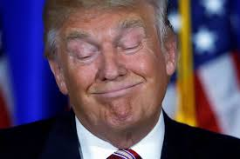
FOR ANY ORGANISATION
Good reputation: no organisation aims to look stupid or incompetent

Slide 25
FOR ANY ORGANISATION
Every organisation wants to be regarded as competent in whatever they do, whether it is quality, price, speed or any other factor.
Companies will often go to extreme lengths to build or hold on to a reputation because their reputation is their biggest asset.
Research “good will” as a factor in the price of a company being sold.

Slide 26
FOR ANY ORGANISATION
If, in a store that prided itself on customer service, a sales assistant insulted a customer you could expect the management to be horrified and bend over backwards to make amends.
If "Pronto Printing" were renowned for its accuracy and quick results and its production suddenly got late and sloppy, you'd expect the management to very quickly find the causes of the problems and eliminate them.

Slide 27
FOR ANY ORGANISATION
Good customer service: one hopes most organisations would value this

Slide 28
System Goals and Objectives
Within each organisation there are information systems.
Each information system has its own specific system goals and objectives.
The systems exist to do a particular job, and their success can be measured by specific criteria.

Slide 29
System goal examples
a payroll system's goal may be to:
be accurate and avoid errors
work efficiently, so wages are paid on time
produce readable summary statements for management so the bosses can easily track their finances.

Slide 30
System goal examples
a desktop publishing system's goal may be to
produce high quality page layouts.
be easy to use
be forgiving if users make mistakes

Slide 31
System goal examples
Note the difference between system goals and organisational goals.
An organisation contains many different systems.

Slide 32
System goals
System goals are what each system in that organisation is aiming to achieve in the long term.

Slide 33
Org goals and system goals
Organisational goals should be supported by the systems in the organisation.
E.g. if an organisational goal is "efficiency", each system in the organisation would also need to have its own efficiency goals to support the overall efficiency of the org.

Slide 34
A company priding itself on good communications as an org goal would make sure its email system was "fast, easy to use, high capacity" etc.

Slide 35
Common system goals
Speed
Accuracy
Reliability
quality of output
Capacity (how much it can handle)
Security
ease of use

Slide 36
Common system goals
Cost effectiveness
Readability of output
Flexibility
Expandability
Safety

Slide 37
Common system goals
operator comfort
Durability
Robustness (strength, toughness, endurance)
Compatibility with other systems in the org

Slide 38
If you're still confused
Think of your house as an organisation: its organisational goal is to keep you safe, healthy, comfortable and entertained.
In the house there are many systems: the doors; the beds and chairs; the TV, radio, computer, medicine cabinet; and bookshelves.

Slide 39
If you're still confused
The security system (e.g. doors, locks) have their system goals: to prevent unauthorised entry of burglars, to keep out insects and wild animals, to keep out rain and wind.

Slide 40
If you're still confused
The furniture system has their own system goals: to provide comfortable support. The entertainment system's goals are to provide entertainment such as Bob the Builder, cricket commentaries and fine story telling.

Slide 41
If you're still confused
You would not, however, expect a toaster to entertain you (unless you're weird) because that is not one of its system goals.
Nor would you expect a bed to entertain you.

Slide 42
OBJECTIVES
System Goals and Objectives - small, specific, measurable, achievable steps towards achieving a larger goal.
They can definitely be seen to have been achieved or not (unlike goals, which are too vague and big to be conclusively "achieved" or not)

Slide 43
IDENTIFYING OBJECTIVES
Objectives are quite precise. If it contains an exact target (e.g. a 5% increase in output) it's an objective, not a goal.
Well-defined time scales – for example, “Within six months…”
Defined limits on cost, e.g. “Spending no more than $500,000 we want to…”
Tip – objectives often contain specific numeric targets.

Slide 44
OBJECTIVES
e.g. A system goal of a desktop publishing system may be “To produce attractive output.” The corresponding objectives may be:
Print at a minumum resolution of 600 dots per inch.
Handle colour and monochrome photographic images.
Offer at least 100 typefaces.
VCE IT slideshows © 2016-2019 Mark Kelly, vceit.com
44

Slide 45
VCE IT THEORY SLIDESHOWS 2016-2019 study design
Mark Kelly
mark@vceit.com
vceit.com
These slideshows may be freely used, modified or distributed by teachers and students anywhere
but
they may NOT be sold.
they must NOT be redistributed if you modify them.
This is not a VCAA publication and does not speak for VCAA.
Portions (e.g. exam questions, study design extracts, glossary terms) may be copyright Victorian Curriculum and Assessment Authority and are used with permission for educational purposes. Thanks, guys!

Slide 46
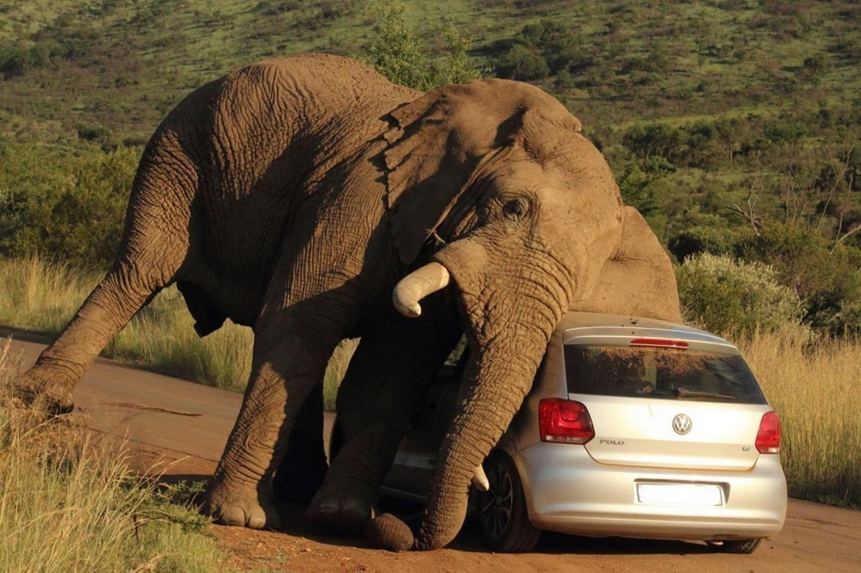
THANKS!
Because you’ve been so good, here’s a picture you can look at
while your teacher works out what to do next

