Slide 1
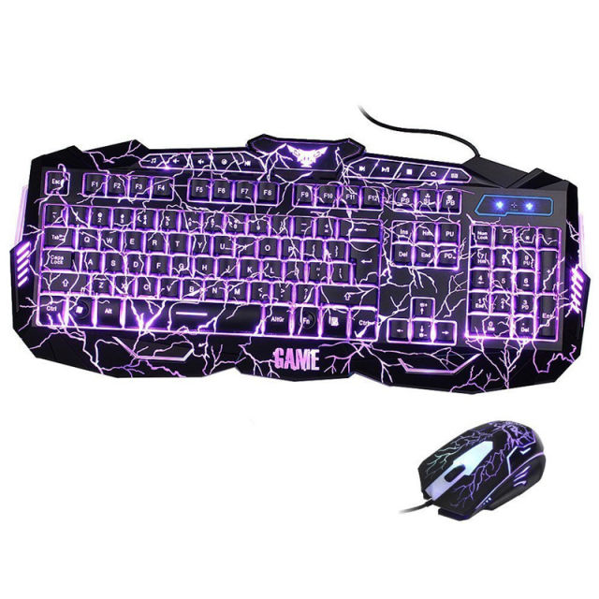
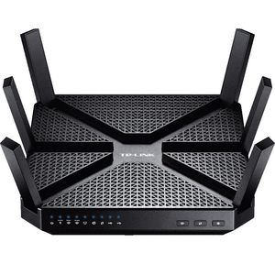
VCE IT Theory Slideshows by Mark Kelly 2016-2019 study design
Digital System Components
Version 1
Begin
By Mark Kelly, vceit.com, mark@vceit.com

Slide 2
Contents
ITI U3O2 KK 14 - roles, functions and characteristics of digital system components used to
Input
Store
Communicate
Output
data and information.

Slide 3
INPUT
Keyboards
why is QWERTY universal?
Dvorak
Mouses (mice? Discuss)
Invented for the GUI OS
Touchscreens
For portable devices – tablets, phones

Slide 4
INPUT
Speech recognition
Discuss: Why has it not taken over from primitive keyboards and mice, like in Star Trek?
Buttons, switches
Custom hardware e.g. PC reset switches, MyKi machines, phone volume controls, “walk” buttons on traffic light poles.

Slide 5
INPUT
Scanners
Analogue to Digital conversion
OCR (Optical Character Recognition) – printed text to electronic text – for example Google Books, Trove at the National Library.

Slide 6
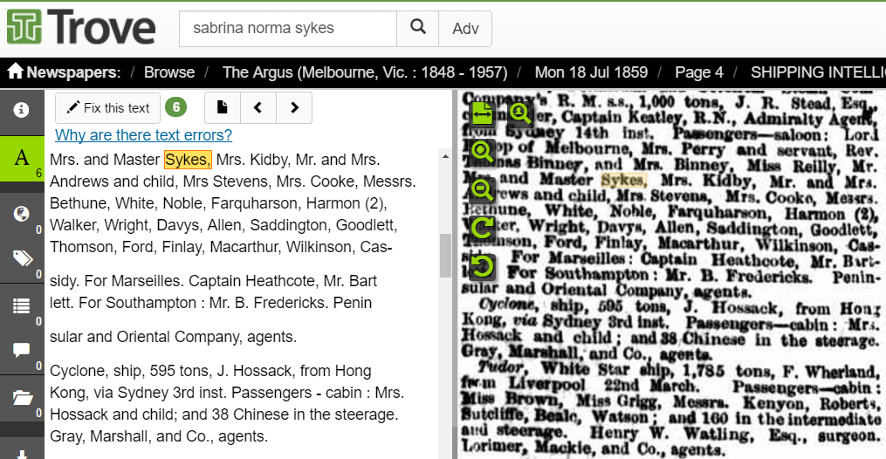
INPUT
Most archives, such as Trove at the National Library of Australia uses OCR to digitise printed newspapers.

Slide 7

INPUT
Input device assessment criteria
Speed
Accuracy
(Others?)

Slide 8
STORE
Hard disk drives (HDD)
Is mechanical, has moving parts
aluminium platters spinning at 5,400 or 7,200 RPM
read/write heads hover over the disk platters
Any moving parts will eventually fail
Great capacity (e.g. 8 terabtyes - TB)
Good speed
Low cost per TB
Generate noise, heat.
Consume reasonable amounts of electricity.

Slide 9
STORE
Solid State disks (SSD)
Electronic (like USB drive), no moving parts
But memory cells will also fail after a given number of read/write operations.
Silent (good for home theatre systems)
Generates less heat than HDD
Low power consumption.
Poor capacity (e.g. 1 terabyte in 2016)
Great speed (access times are much faster than HDD)
High cost per TB compared to HDD (but reducing over time)

Slide 10
STORE
Magnetic tape
Going out of favour
Tapes stretch, degrade over time
May still be used by commercial sector
Relatively slow read/write times
Tapes need to be loaded/unloaded manually
Good data capacity
Media are easily portable

Slide 11
STORE
Optical media – CD – DVD – BluRay
CD capacity about 740MB
DVD capacity about 4.7GB
BluRay capacity about 25GB
Slow read/write speeds
Easily scratched and become unreadable
Dubious long-term storage lifetimes
Relatively little physical storage space needed

Slide 12
STORE
Magnetic tape
Going out of favour
Tapes stretch, degrade over time
May still be used by commercial sector
Relatively slow read/write times
Tapes need to be loaded/unloaded manually
Good data capacity
Media are easily portable
Can be damaged/erased by strong magnetic fields

Slide 13
STORE
Magnetic tape
Going out of favour
Tapes stretch, degrade over time
May still be used by commercial sector
Relatively slow read/write times
Tapes need to be loaded/unloaded manually
Good data capacity
Media are easily portable

Slide 14
STORE
Network Attached Storage (NAS)
A group of HDD or SSD working as a team in a box
Usually support RAID (Redundant Array of Independent Disks) to provide*
data redundancy (one or more disks can fail without data loss) to improve reliability
Speed (multiple disks can serve different data segments from a file at the same time)
Backups via disk mirroring
Centralised storage for offices – aids data sharing
*Depending on the type of RAID selected

Slide 15
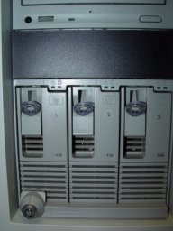
Redundant Array of Independent Disks) arrays for reliability and/or speed.
RAID uses a group of hard disks that work as a single disk under a RAID controller.
Flavours of RAID: RAID0 to RAID10 (RAID 1 + RAID 0) offer reliability and/or speed (at ever-increasing cost). Includes mirroring (for reliability) and striping (spanning a logical single volume over several physical disks for greater performance – several simultaneous disk reads/writes are possible).
RAID disks are usually "Hot Swap“ – no server downtime to replace sick disks.
EXPENSIVE – needs justifying for small org
R.A.I.D.
3-disk RAID array

Slide 16
STORE
FLASH/NAND storage
Includes familiar USB drives, SD drives
Very portable
Relatively low capacity in 2016 (e.g. 128GB)
Relatively low read/write speeds using USB3
Limited number of read/write cycles (like SSD)
Can fail without warning
Not affected by electromagnetic forces

Slide 17
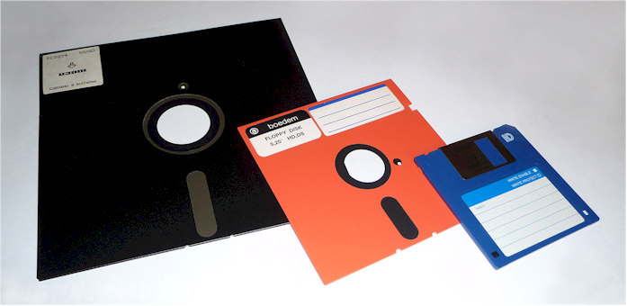
STORE
Floppy disks
Hehehe. Yeah, let’s not even go there.

Slide 18
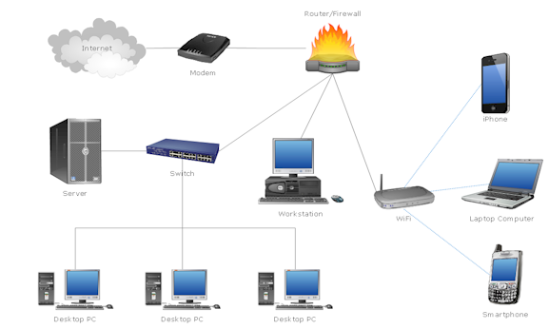
COMMUNICATE
Mainly concerns networking hardware in a LAN (Local Area Network)

Slide 19
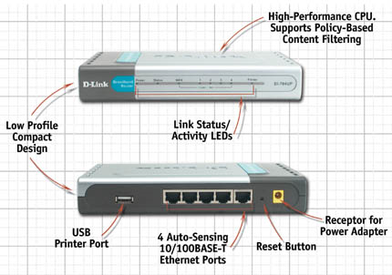
Network Hardware
The main bits:
Modem
Cables
Network interface card (NIC)
Server (e.g. file server)
Switch
Router – often combined with ADSL modem, WAP, switch, print server, coffee maker etc)

Slide 20
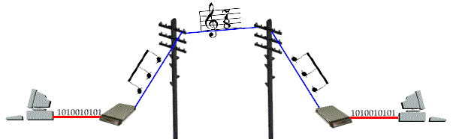
The modem Modulator/demodulator
Modulate (when uploading) = turn digital data into analogue sound for transmission over phone network.
Demodulate (when downloading) = convert sound back to digital data.

Slide 21
Note!
Transmission speed is measured in bits per second (not Bytes per second!)
56Kbps modem downloads at a theoretical maximum of approx 56,000 bits per second (about 7KB/sec). Can only transmit (upload) at 33.6kbps.

Slide 22
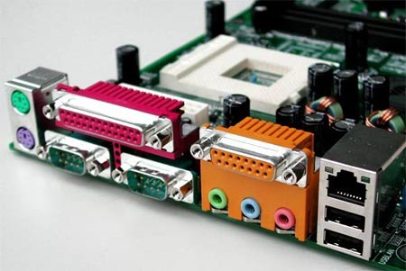
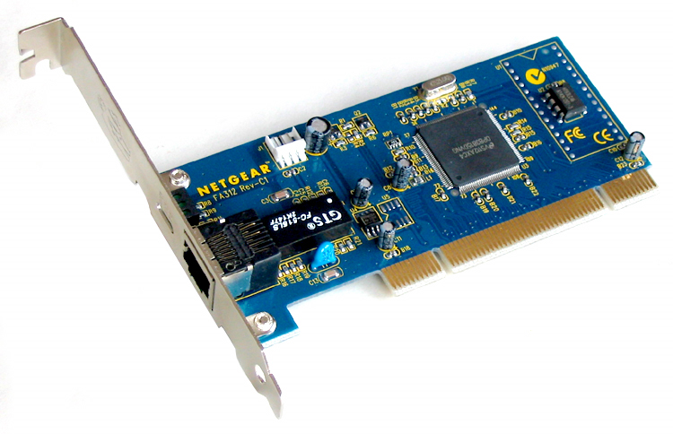
Hardware - NIC
The Network interface card (NIC) allows a stand-alone computer to connect to a network.
Can be cabled or wireless
Usually built into motherboards. Separate card not needed in most cases.

Slide 23
Internet Choices Not all options are available to everyone, especially those not in major cities
ADSL, ADSL2, ADSL2+
(256Kbps-24Mbps speed caps)
Cable
(10-200Mbps)
Satellite
1 or 2 way (averaging 10-20 Kbps)
Dialup (analogue, av. 40Kbps)
WAN Wireless
3G/4G – internet access via mobile phone towers

Slide 24
Hardware - NIC
Network Interface Card
Rated by speed: 10, 100, or ‘Gigabit’ 1000Mbps.
For a NIC to work at its maximum speed, all the other network devices between it and the server must have at least the same bandwidth (data-carrying capacity).
‘Auto-sensing’ e.g. 10/100/1000 NICs adjust themselves to the best possible speed.
Tip: go for GIGABIT NIC in servers

Slide 25
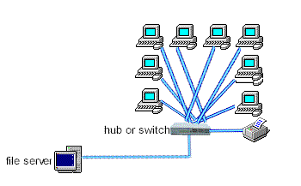
Hardware – Switches and Hubs
Switches (and hubs) are connection points where cables can join up or be split.
Typically, a single incoming cable is split into multiple outgoing cables.

Slide 26
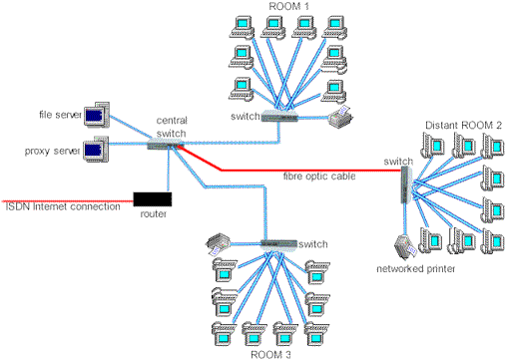
Network segments
A network segment is a self-contained section of a network bounded by a bridge, router, or switch.
Using segments reduces network congestion.
Like classrooms in a school.

Slide 27
Hardware – Routers
4 main roles…
Join dissimilar networks together, like a gateway (as the original routers used to be called)
Route packets across networks and internet
Act as a security device to guard the connection between a LAN and the outside world (another LAN or a WAN.)
Divide LANs into self-contained, protected areas, e.g. admin / student networks in a school.

Slide 28
Hardware – Routers
Act as a firewall at home, complementing software firewalls like Windows Firewall
Can be programmed to only allow authorised incoming and outgoing traffic. E.g. can block certain sites, forbid MP3 music files to enter.
Most home routers also have a built-in mini-switch but remember … a switch is not a router!
Home routers often combine: switch, ADSL modem, print server, WAP

Slide 29
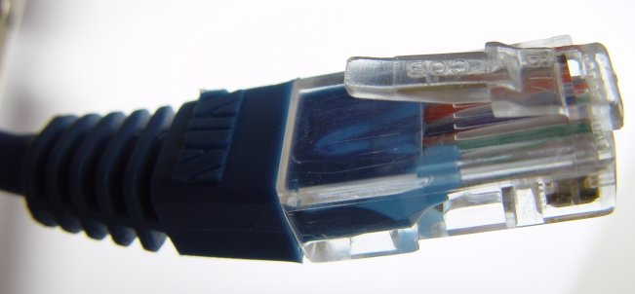
Connections – UTP
UTP (Unshielded Twisted Pair) e.g. CAT6 (‘Category 6’)

Slide 30
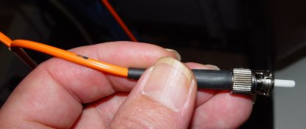
Connections – Fibre optic
Made of glass (or plastic)
Optical, not electrical – little signal fade
Optical Signals created by LED or laser
Multiple signals on a single fibre
Resists EMI (electromagnetic interference)
Light signals bounce down Fibre Optic cable using Total Internal Reflection.

Slide 31
Connections – Fibre Optic
Core is as thin as a human hair
Not very flexible – needs thick protective coat
VERY fast
VERY high bandwidth
Very secure (can’t be tapped or snooped)
VERY long distance (>2km without repeaters)
Light weight, small size
Expensive adaptors to convert digital <> electrical signals

Slide 32
Connections – Cables and wireless
Many fibre optic cable (‘FOC’) threads can be bound into a slim, single cable without their signals interfering with each other, giving massive data throughput.
FOC is replacing old, heavy, expensive copper cables to cross oceans
Warning! Sharks can damage your network!
Sharks get over-excited by the electromagnetic fields radiated by copper cable. FO is silent.

Slide 33
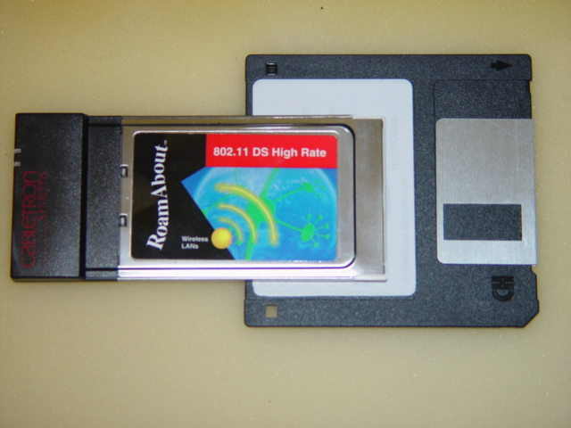
Connections – Wireless
Data sent as radio signals between NICs and base stations (WAP=wireless access point)
short distances (e.g. 80m-200m), reduced by obstacles
Speeds of 54Mbps and increasing
Encrypted to prevent eavesdropping

Slide 34
Wireless
Many PCs can connect to a base station, share its bandwidth
PCs can “roam” and will automatically connect to the base station that has the strongest signal
Wireless NICs and antennae now built into laptops

Slide 35
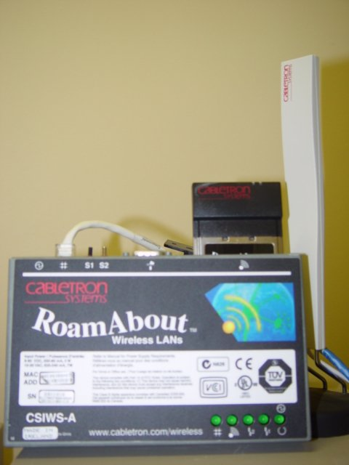
Connections – Wireless
Good for temporary networks, or when PCs rarely needed in a location
Good for laptop-intensive places (e.g. classrooms, staffrooms). Great at home
Relatively expensive compared to cable, but a useful network add-on
Security concerns – never run it unsecured!
Wireless base station &
white radio antenna

Slide 36
Server farms
On smaller networks, network services are performed by software in a single server.
On busy LANs, multiple servers share the work…
Login servers – authenticate users
Proxy servers – cache downloads
DHCP servers – allocate IP addresses
Print servers –manage print job queues
Web/FTP servers – serve web pages or files
Email servers –handle email

Slide 37
OUTPUT
Monitors – CRT (extinct), LCD, plasma, data projectors
Printers – laser, ink jet, thermal
Audio – for warnings, information, voice cues
Custom controls – aeroplane altimiters, router LEDs, on/off signals on machines etc

Slide 38
VCE IT THEORY SLIDESHOWS 2016-2019 study design
Mark Kelly
mark@vceit.com
vceit.com
These slideshows may be freely used, modified or distributed by teachers and students anywhere
but
they may NOT be sold.
they must NOT be redistributed if you modify them.
This is not a VCAA publication and does not speak for VCAA.
Portions (e.g. exam questions, study design extracts, glossary terms) may be copyright Victorian Curriculum and Assessment Authority and are used with permission for educational purposes. Thanks, guys!

Slide 39
THANKS!
Because you’ve been so good, here’s a hardware picture you can look at while your teacher works out what to do next

