Slide 1
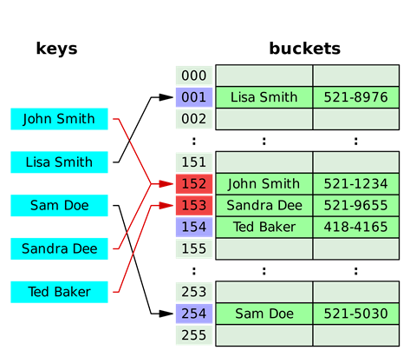
VCE IT Theory Slideshows by Mark Kelly 2016-2019 study design
Associative arrays, hash tables and functions
Version 1
Begin
By Mark Kelly, vceit.com, mark@vceit.com

Slide 2
Contents
Freak not out. It all sounds difficult, but it’s actually an interesting, rich and important slice of programming theory.
Associative Arrays
Hash tables
Hashing functions

Slide 3
Associative Array
A fundamental, powerful (and relatively simple) programming concept.
Also called
map
symbol table
dictionary

Slide 4
Associative Array
is an abstract data type (ADT)
i.e. it’s a model or concept, not an actual structure
Like the PSM is abstract, not an actual method
composed of a collection of (key, value) pairs
Often implemented using a hash table.

Slide 5
Key - Value Pair (KVP)
KVP - a set of two linked data items:
a key - a unique identifier for some item of data.
Informatics kids: think “primary key”
the value of the associated data (or a pointer to the location of that data)

Slide 6
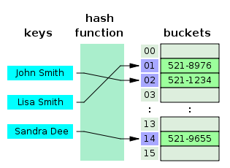
Key - Value Pair (KVP)
The key (people’s names) are converted by the hash function calculation to generate a number which is used as an index to an array of buckets containing data that matches the key.
e.g. In the phone book below, the hash function converts “John Smith” to the value of 2, and bucket(2) contains John Smith’s phone number.
Values

Slide 7
Searching values
Imagine a list of thousands or millions of values (e.g. a national bank’s customers’ names)
Searching this list for a specific name is VERY intensive in processing and slow in terms of data retrieval.
Remember that to match a string requires comparing the text character by character…

Slide 8
Searching values
E.g. the simple programming statement
IF strX = strY THEN DISPLAY “Match!”
Actually makes the CPU have to do this…

Slide 9
Searching values
String to find: “Fred Smith”
Name to compare: “Fred Smythe”
String to find | String being searched | Result
F | F | Match so far
r | r | Match so far
e | e | Match so far
d | d | Match so far
_ | _ | Match so far
S | S | Match so far
m | m | Match so far
i | y | Match failed. D’oh.
Work involved: 8 text comparisons

Slide 10
The moral of the story
Searching large quantities of unorganised text is VERY slow and VERY processor-intensive.
Hash tables can greatly speed up data retrieval.
So they are very commonly used in large
associative arrays,
database indexes and
cached data.

Slide 11

Speeding up searches
‘Searching’ with a hash table is really quick… largely because actual linear or even binary searching is no longer required.
The original data is used to create its own indexed location in the data store.

Slide 12
A really dumb example
We want to store information on thousands of people’s favourite foods.
Jim says his favourite food is beans.
Our stupidly-simple Hashing function #1 uses this algorithm: the hash value is the length of the name. “Jim” converts to hash value 3, which is used as his value’s slot number in the ‘buckets’
Index | Value / Buckets
1
2
3 | Beans
4
5
…
99,999

Slide 13
A really dumb example
Weeks later, we need to retrieve Jim’s favourite food value.
So we take the key “Jim” again. Apply the hashing function again to discover the index - 3. Read the value in bucket(3)… Beans.
No searching required!
Brilliant, eh?
Index | Value
1
2
3 | Beans
4
5
…
99,999

Slide 14
A really dumb example
Now assume Peter’s favourite food - jam - needs to be added to the data store.
Key – “Peter” – yields a hash value of 5 (the length of his name)
Store the value “Jam” in bucket 5…
All’s good
Index | Value
1
2
3 | Beans
4
5 | Jam
…
99,999

Slide 15
A really dumb example
Now Amy says her favourite food is lamb.
Key “Amy” yields hash value 3… which is already assigned to someone else’s data.
Collision.
Index | Value
1
2
3 | Beans
4
5 | Jam
…
99,999

Slide 16
Sidenote: uniformity
Note another problem here: nearly every key generated using this stupid algorithm will be packed into bucket numbers 3 to 15 even though 100,000 buckets are available.
Nearly every key will result in a collision!
A good hash function seeks uniformity*: spreading hash values evenly across the entire range of buckets, not just a few.
Later there will be more about the qualities of good hash functions
*not examinable, but nice to know
Index | Value
1
2
3 | Beans
4
5 | Jam
…
99,999

Slide 17
Hashing functions
So the hashing code will need a method (with links or whatever) to get from Amy’s key to discover her true bucket number
One way is to use a linked list.
The index points to the first bucket matching the hash value. If there is another bucket with the same hash value, there is a link to that bucket. If the link is NULL, that is the last link.

Slide 18
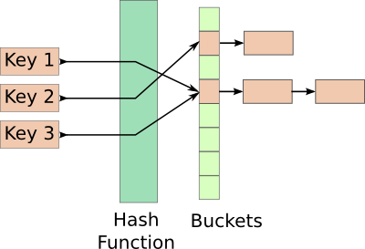
Handling Collisions
Like this…
Such linked lists seem to be the most common way of dealing with collisions.

Slide 19
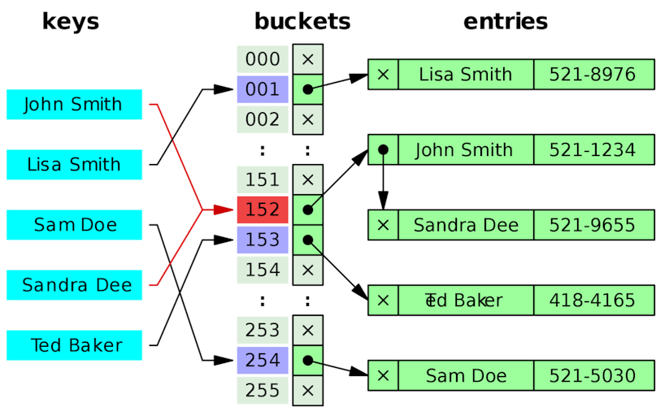
Handling Collisions
Or this (an ‘x’ means ‘no link’)

Slide 20
Hashing functions
So - any hashing technique must be able to use a method to handle “Jim/Amy” sorts of collisions.
But all such methods take time and processing
So - it’s still best to avoid collision in the first place.
Good hashing functions try their best to do that.

Slide 21
Hashing functions
OK. That “length of key” hashing function was a bit too stupid.
Let’s try creating a slightly better one.

Slide 22
Let’s hash “Fred Smith”
Hashing Algorithm 2
Step 1: Convert each character into a number, using its ASCII code.
Wot? You really don’t know ASCII? …

Slide 23
ASCII
Computers only understand, process and store numbers.
Letters and punctuation (and pictures, music, video, documents) are all converted to and stored as numbers.
ASCII was* the original way to convert characters to nice numbers…
*In 2007 ASCII became a subset of its replacement encoding scheme, UTF-8 which supports foreign character sets.

Slide 24
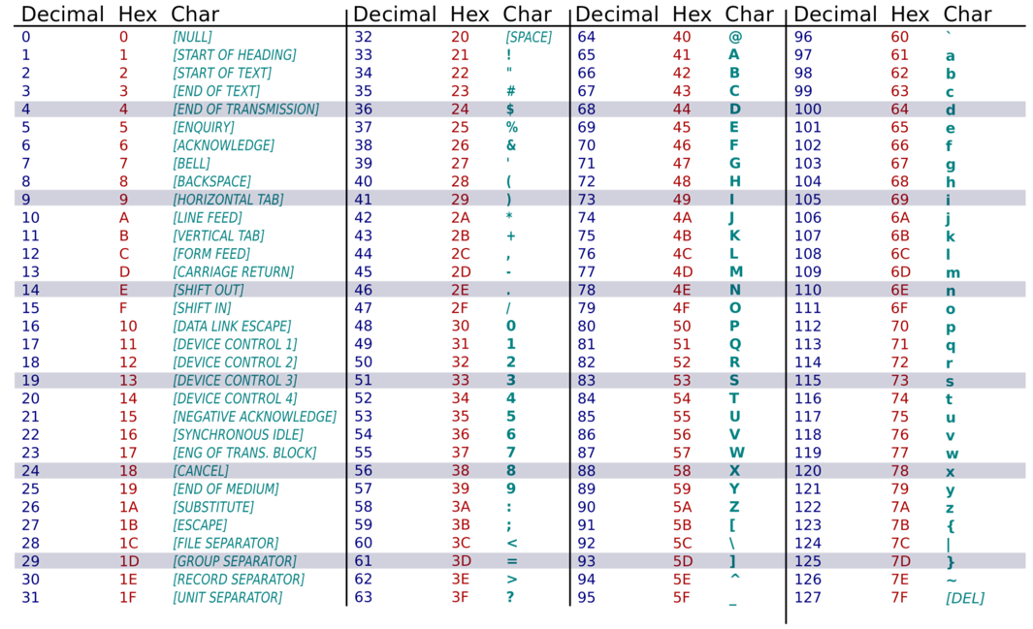
ASCII chart

Slide 25
Simplifying “Fred Smith”
Character in string | ASCII code (decimal)
F | 70
r | 114
e | 101
d | 100
<space> | 32
S | 83
m | 109
i | 105
t | 116
h | 104
TOTAL | 934
Step 2: Add up the values of the ASCII codes for every character in the string…
Total for “Fred Smith” = 934

Slide 26
Simplifying “Fred Smith”
Step 3: Store value in array (bucket) slot 934, with its associated value (“Fred Smith”).
Key | Value
934 | Fred Smith
1242 | Maria Xenides
1692 | Phillipe Pompadou
1358 | Humphrey B Bear

Slide 27
Try searching now…
We can then add other records hashed with the same function…
Key | Value
934 | Fred Smith
1242 | Maria Xenides
1692 | Phillipe Pompadou
1358 | Humphrey B Bear

Slide 28
Try searching now…
To search for “Fred Smith” using the hash table we convert the target string (“Fred Smith”) to a key (934) using our hash function. Then we just seek the contents of bucket 934 … “Fred Smith”
Key | Value / Bucket
934 | Fred Smith
1242 | Maria Xenides
1692 | Phillipe Pompadou
1358 | Humphrey B Bear

Slide 29
It looks like this…

Slide 30
Wot? Collisions… again?
Let’s say a new person needs to be added to the data… this person is named “Derf Smith”
Yeah – ‘Derf’. Just go along with me on this, OK? Pretend it’s a common name in Bendigo.
Can you see the problem already?

Slide 31
Collisions…
Key | Value
934 | Fred Smith
1242 | Maria Xenides
1692 | Phillipe Pompadou
1358 | Humphrey B Bear
934 | Derf Smith
Two different names - “Fred Smith” and “Ferd Smith” - are converted to the same hash key. Another collision.
The simpler the hashing function is, the greater is the chance of having collisions.

Slide 32
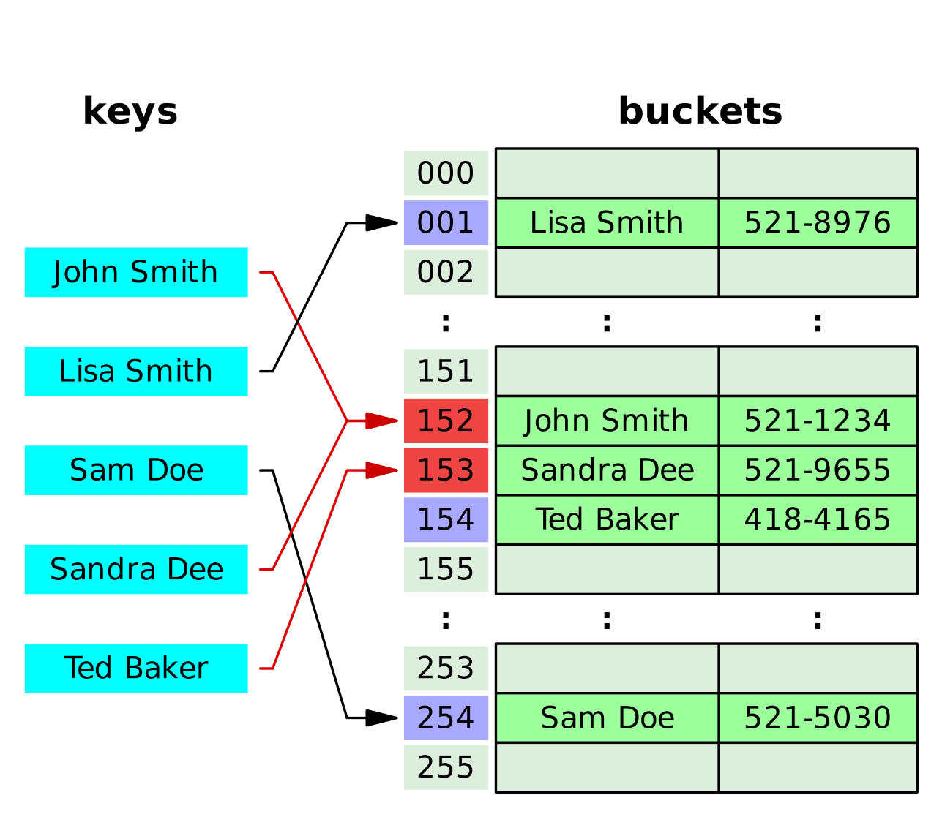
Collisions…
Here, both “John Smith” and “Sandra Dee” generate the same key (152) – a collision

Slide 33
Hashing Rule #1
Any software that uses hashing to store/retrieve data must expect that collisions will occur and be able to handle them.
Typically, a search that finds more than one matching key must then fully examine each candidate to see which is the sought value.

Slide 34
Remember
Hashing is (usually) only approximate.
The better the hashing algorithm is (i.e. the less chance it has of collisions), the more complex it is, and the slower it will be.
Once again in IT we see efficiency and effectiveness as natural enemies. Choose one or the other: rarely will you get both.

Slide 35
Hashing Algorithm 3
Let’s say we’re unhappy with the number of collisions we get with our second hashing algorithm.
We make the algorithm more rigorous… Algorithm #3

Slide 36
Hashing Algorithm 3
We know Algorithm 2 is weak because it does not care about the position of characters in the string.
Anagrams confuse it completely.
To algorithm 1, “President Bush of the USA” is a match for “A fresh one but he's stupid”
So – the new, improved Algorithm #3…

Slide 37
Hashing Algorithm 3
In Algorithm 3, both character value and character position are considered…
Key ← SUM(each character’s ASCII value * each character’s position in the string)

Slide 38
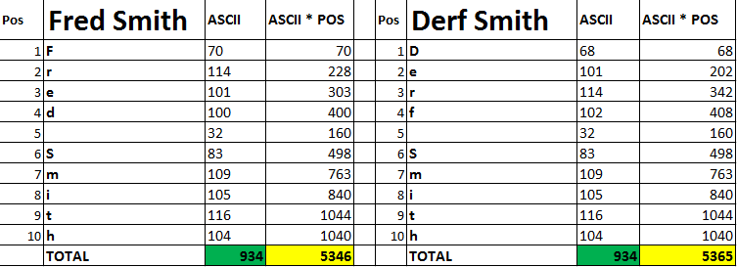
Hashing Algorithm 3
Algorithm 2 gave the same key for “Fred Smith” and “Derf Smith” but algorithm 3 creates different keys.
Fewer collisions, but more processing needed.

Slide 39
In the real world
Realistic hashing algorithms aim for maximum key uniqueness for minimum calculation.
What else constitutes a good hashing algorithm?

Slide 40
In the real world
There are many real hashing functions e.g.
Bernstein
Fowler-Noll-Vo
Jenkins
Pearson
Zobrist
Keccak

Slide 41
A simple, real hashing function
Created by Kernighan and Ritchie – creators of the ‘C’ programming language.
Add up the ASCII values of the characters in the key.
Calculate HASHVALUE modulo ARRAYSIZE
This forces the final value to be within the array’s size limits so we don’t overflow
HASHVAL | ARRAY SIZE | HASHVAL modulo ARRAYSIZE
10 | 100 | 10
90 | 100 | 90
120 | 100 | 20
290 | 100 | 90

Slide 42
Why so many algorithms?
There is no perfect hashing function for all occasions.
Just as there no ‘best’ sorting or searching algorithm for all data
The search for the ‘best’ function is an ongoing mission.
All functions have strengths and weaknesses
There was an international competition (NIST) to find the best hashing function for encryption purposes.

Slide 43
What makes a hashing algorithm good?
NOTE: none of the following terms in red is examinable!
Few collisions
The fewer the collisions, the less time is needed to search within candidate values.
Determinism
A given key must always generate the same hash value

Slide 44
What makes a hashing algorithm good?
Uniformity
Hashed keys should be spread evenly over a given range, and not all bunched together. This greatly reduces the chance of collision.
Remember the hash function before that bunched 100,000 values into only 13 slots? Bad uniformity.

Slide 45
What makes a hashing algorithm good?
Non-invertibility
It should be VERY hard (preferably impossible) to determine the original value from a key that is hashed from that value.
Especially important for hashed passwords that are stored and vulnerable to being hacked.
Don’t want hackers to be able to reverse-engineer passwords, credit card numbers etc from the hashed values.
Is very hard to reverse-engineer “Jim” from the number 3!

Slide 46
In conclusion
Hashing tables can completely avoid having to search data tables!
The very value of the thing you seek tells you where it’s stored!
The loss of information during hashing leads to multiple matches (collisions)
The ability to efficiently detect and handle collisions is compulsory in all hashing routines.

Slide 47
In Conclusion
Even if you have a billion key/values stored and only 1,000 buckets, you will only need to maybe check a relatively small number of links to find the desired value.
It’s still far quicker than searching the billion buckets!

Slide 48
References
https://en.wikipedia.org/wiki/Hash_table
http://research.cs.vt.edu/AVresearch/hashing/introduction.php
Kernighan & Ritchie – The C Programming Language, 1978.
https://www.youtube.com/watch?v=MfhjkfocRR0

Slide 49
VCE IT THEORY SLIDESHOWS 2016-2019 study design
Mark Kelly
mark@vceit.com
vceit.com
These slideshows may be freely used, modified or distributed by teachers and students anywhere
but
they may NOT be sold.
they must NOT be redistributed if you modify them.
This is not a VCAA publication and does not speak for VCAA.
Portions (e.g. exam questions, study design extracts, glossary terms) may be copyright Victorian Curriculum and Assessment Authority and are used with permission for educational purposes. Thanks, guys!

Slide 50
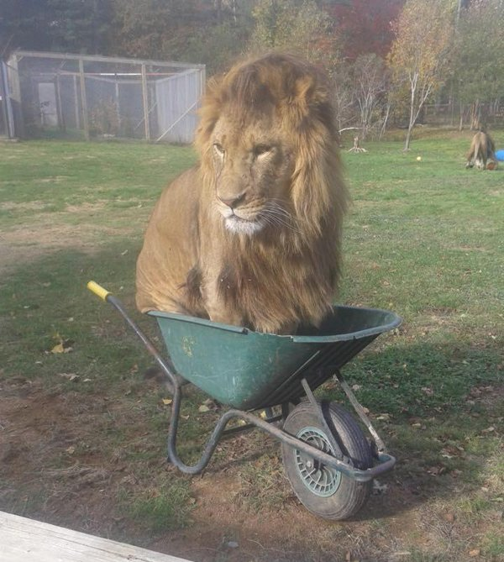
THANKS!
Because you’ve been so good, here’s a picture you can look at
while your teacher works out what to do next

