Slide 1
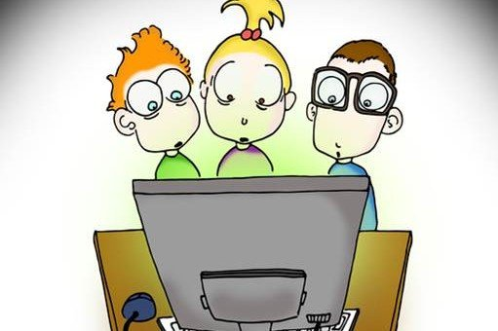
VCE IT Theory Slideshows by Mark Kelly 2016-2019 study design
MMOS Inclusiveness -
Gender, culture, language, age Version 1
Begin
By Mark Kelly, vceit.com, mark@vceit.com

Slide 2
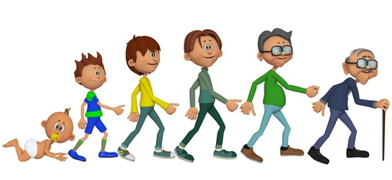
Contents
Gender Inclusiveness
Culture Inclusiveness
Commonality of language
Age appropriateness

Slide 3

“Inclusiveness”
Do your best to make information available to as many people as possible by not excluding them.
Don’t deliberately or ignorantly offend people based on their sex/gender or culture.
Don’t use language that offends or confuses.
Consider the different information needs of audiences of different ages.

Slide 4
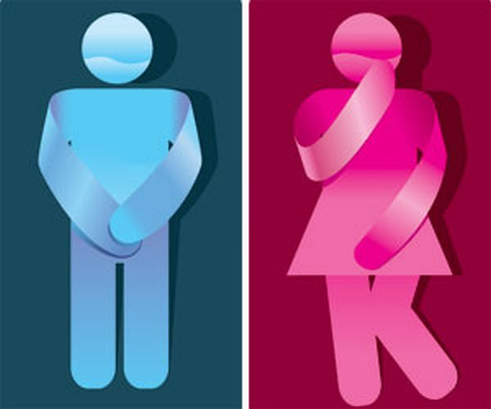
Gender Inclusiveness
Some people get quite emotionally worked up when the issue of 'gender' arises. Be careful in your MMOS.
Start with knowing some similar and confusing terms….
The following definitions come from the Australian Government's Attorney-General's Department. (July 2013)

Slide 5
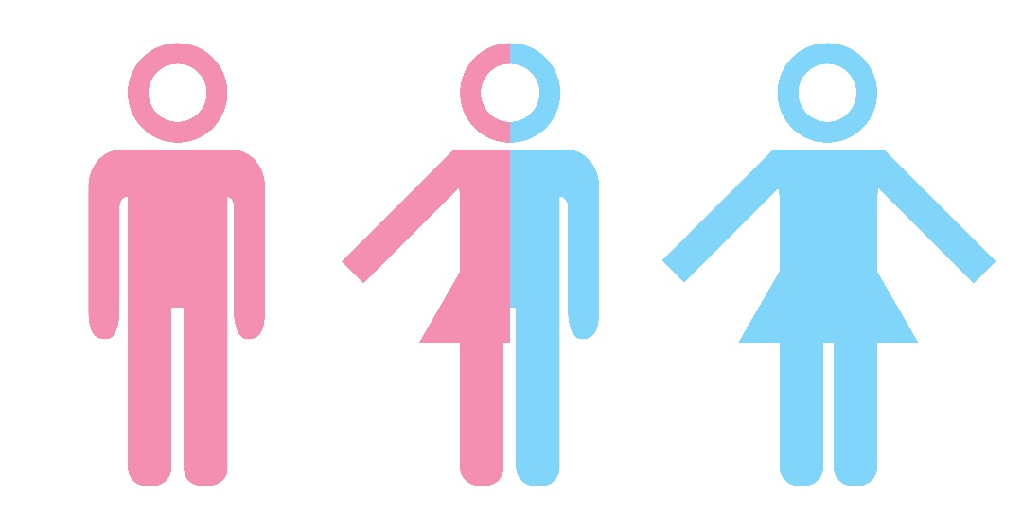
Gender Inclusiveness
"In 2013, the Sex Discrimination Act 1984 was amended to introduce new protections from discrimination on the grounds of
sexual orientation,
gender identity and
intersex status”

Slide 6
Gender Inclusiveness
There are now three official sexes recognised by Australian law: male; female; intersex.
Government guidelines say that "Where sex and/or gender information is collected and recorded in a personal record, individuals should be given the option to select
M (male),
F (female) or
X (Indeterminate / Intersex / Unspecified)."

Slide 7
Gender Inclusiveness
Important: the Sex Discrimination Act is not examinable in Informatics.
But remember that the collection, use, storage and disclosure of all personal information, including sex and gender information are regulated by the Privacy Act 1988" - which is examinable!

Slide 8

Gender Inclusiveness
But hang on… sex and gender are the same thing, aren’t they?
No.
What do you think they mean?
Discuss.

Slide 9
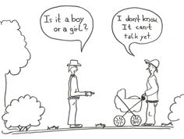
Gender Inclusiveness
Sex - "refers to the chromosomal, gonadal and anatomical characteristics associated with biological sex.”
i.e. the hardware one is born with

Slide 10
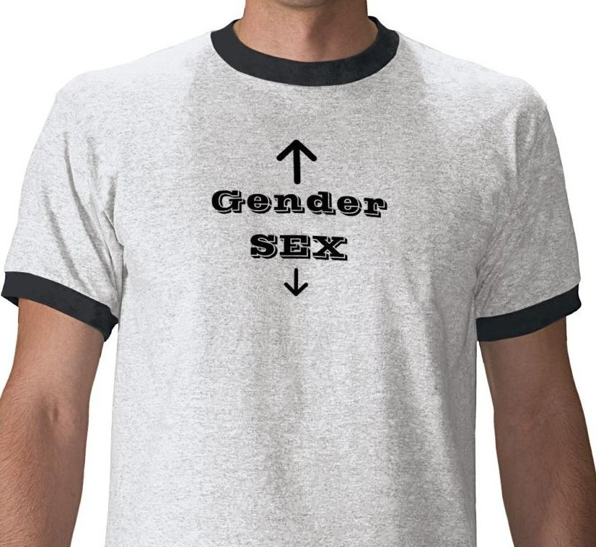
Gender Inclusiveness
Gender - "is part of a person’s personal and social identity.
It refers to the way a person feels, presents and is recognised within the community.
A person’s gender may be reflected in outward social markers, including their name, outward appearance, mannerisms and dress."

Slide 11
Gender Inclusiveness
Intersex - "refers to people who are born with genetic, hormonal or physical sex characteristics that are not typically ‘male’ or ‘female’.
Intersex people have a diversity of bodies and gender identities, and may identify as male or female or neither."

Slide 12
Gender Inclusiveness
Just to confuse matters for you, the government's guidelines add that…
"Although sex and gender are conceptually distinct, these terms are commonly used interchangeably, including in legislation.
A person’s sex and gender may not necessarily be the same.
Some people may identify as a different gender to their birth sex and some people may identify as neither exclusively male nor female."

Slide 13
Gender Inclusiveness
The guidelines say, " Individuals may have biological characteristics or undergo a variety of treatments that make it difficult to identify or define a person’s true biological sex.
Sex can also be legally changed in Australian identity documents, including birth certificates."
"Sex reassignment surgery and/or hormone therapy are not pre-requisites for the recognition of a change of gender in Australian Government records."

Slide 14
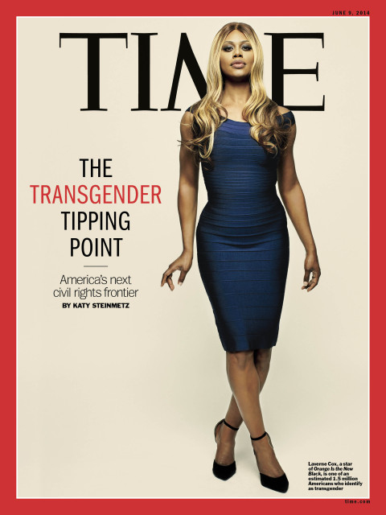
Gender Inclusiveness
Clear enough so far?
I said you had to be careful.
But how is this relevant to your MMOS?
What are the ‘do’ and ‘don’t’ dotpoints?

Slide 15
Gender Inclusiveness
Don't assume readers are only either traditional males or females.
Gender involves shades of grey, not black and white.
Don't assume that readers will think a certain way because of the biological hardware with which they were born.
Don't alienate readers based on their sex or gender. Don’t be sexist at the expense of women or men.

Slide 16

Gender Inclusiveness
Don't assume that stereotypes are valid.
Pretty pink pastel colours for a webpage does not make "more it suitable for the girls."
Not all men are emotionally tough and enjoy footy and a beer.
Don't assign stereotyped roles to sexes, e.g. a mechanic must be male, a nurse must be female.
Wherever possible, do not even consider the sex or gender of readers.
As soon as you do, you're in trouble.

Slide 17
Gender Inclusiveness
Try to avoid pronouns like "his" or "her". Instead of saying, "A clever reader will know that his options are limited." you could recast the sentence as:
"A clever reader will know that his or her options are limited
"Clever readers will know that their options are limited."
"A clever reader will know that their options are limited.“ (a grammatically-nasty, but popular solution)

Slide 18
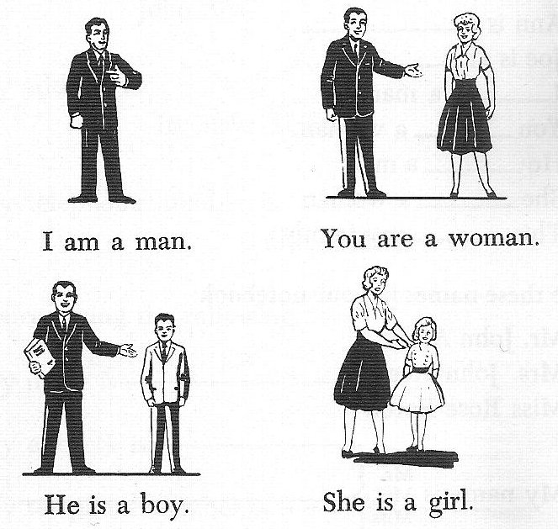
Gender Inclusiveness
The moral of this key knowledge is - don't assume.
Don't exclude people because of their sex or gender.
Be fair.

Slide 19
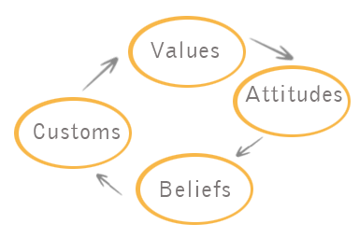
Culture Inclusiveness
A culture is a defining characteristic of a group of people based on their shared beliefs, history, attitudes, religious or political beliefs, preferences, habits, loves and hates, priorities, goals, etc.

Slide 20
Culture Inclusiveness
An individual may belong to many cultures, for example a
Jewish (or Muslim or Buddhist or other)
aboriginal (or not)
teenage (or elderly)
boy or girl (or other)
barracks for St Kilda (or Melbourne Storm)
plays World of Warcraft (or Farmville)
is a regular in an online forum dedicated to Spongebob Squarepants (or Masterchef)
may happily belong in 6 different cultures.

Slide 21
Culture Inclusiveness

Slide 22
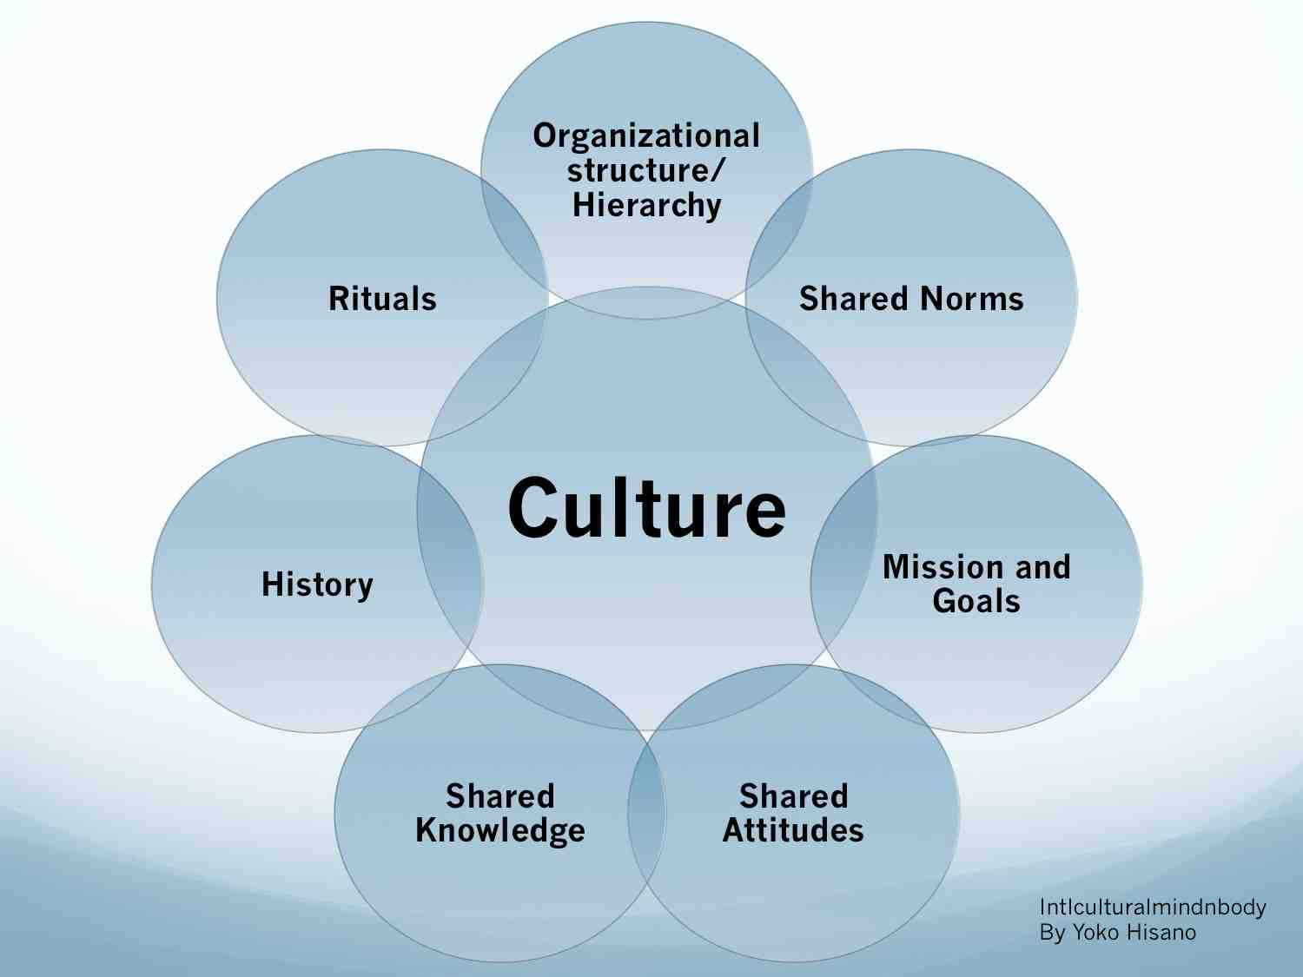
Culture Inclusiveness

Slide 23
Culture Inclusiveness
Cultures may…
Be ancient, or modern
Have dozens or billions of members
Be worldwide, or strictly local
Be life-defining or relatively trivial
Be dominant, or a minority
Be powerful or repressed
Be repressive or liberal

Slide 24
Culture Inclusiveness
But…
All members of a culture know what is expected of them if they are to be accepted or rejected.
They embrace and defend shared beliefs
They often work to maintain and develop their beliefs
They learn and avoid the culture’s taboos

Slide 25
Culture Inclusiveness
An exercise…
Choose a culture. Any culture.
Describe the identifiable visible characteristics its members.
List some taboos or expected behaviours or attitudes of the culture.
Explain the consequences of members disobeying their culture’s traditions, rules or expectations.
Describe how you might be affected if your MMOS offended members of a culture.

Slide 26
Culture Inclusiveness
When writing for a global audience…
be aware that many or most readers will belong to cultures that may be slightly or completely differently to yours.
Don't assume that all readers will understand the references you use that are based on your culture, for example local geographic or climatic characteristics, slang, vocabulary, history.

Slide 27
Culture Inclusiveness
For example, the "nasty January temperatures" means very different things to people in the northern and southern hemispheres.
Even saying "It reached 50 degrees" will mean different things to an Australian (thinking in degrees Celsius) and an American (thinking in degrees Fahrenheit).

Slide 28
Culture Inclusiveness
Carelessly assuming that everyone is like you and shares your knowledge and values can lead to a backlash that you never could have anticipated.
If readers are annoyed or confused by what your MMOS says, they stop reading.
The message is not conveyed. The MMOS fails.

Slide 29
Commonality of language
"I was scoffing a Golden Gaytime on the tram on the way to the footy on Saturday arvo when this larrikin started carrying on like a dropkick. Fair dinkum, he rubbed me up the wrong way."
What would this statement mean to (for example) a schoolgirl in a Nigerian village?

Slide 30
Commonality of language
We often use expressions and vocabulary that are bound to our cultures, but these may not be understood by some, many or all other people.
Use generic, simple, standard English.
Avoid slang which may be meaningless or misunderstood.
Keep sentences short and simple.
Constrain your vocabulary (without being condescending.)
Do you know what condescending means?

Slide 31
Age appropriateness
People’s age affects the nature of information that is suitable for them.
The following points are generalisations, but typically true.
Young children:
have smaller vocabularies – they don’t know the meanings of many words yet.
lack understanding of certain concepts, such as death, divorce, tax returns, or menopause.
are sensitive to some topics may scare them, like traumatic accidents or domestic violence.

Slide 32
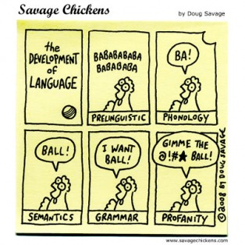
Age appropriateness
Young children:
prefer text to be illustrated.
need larger text for their younger eyes.
should not be exposed to swearing or other culturally-inappropriate language, such as racism, sexism, blasphemy, political liberalism.

Slide 33
Age appropriateness
Older people have different needs.
They might not be as technologically up-to-date so new terms may need to be defined or explained.
They may be impatient because they know a lot more than you do.
They might also need text to be larger so it is more readable
GUI controls may need to be larger to suit people with shaky hands

Slide 34
In summary
It is nearly impossible to perfectly suit every possible age group, culture and sexual identity in a MMOS.
Try to anticipate the nature of the majority of your audience and cater for their needs.
When you can't please everyone, try at least not to offend, anger, or confuse anyone.

Slide 35
In conclusion
The audience of your MMOS are voluntary.
Readers are not forced to keep reading.
They will leave if they are offended, confused, annoyed, bored, uninterested, distrustful.

Slide 36
In conclusion
Your MMOS is meant to be educational.
Readers/students must trust the teacher if they are to be engaged and absorb the teaching.
Trust is hard to gain for an author or educator… and it is easy to lose.
Once a reader loses faith in the author, communication suffers – or stops - and the MMOS fails.

Slide 37
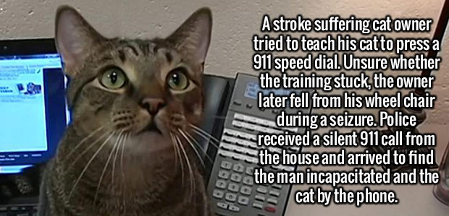
THANKS!
Because you’ve been so good, here’s a picture you can look at
while your teacher works out what to do next

Slide 38
VCE IT THEORY SLIDESHOWS 2016-2019 study design
Mark Kelly
mark@vceit.com
vceit.com
These slideshows may be freely used, modified or distributed by teachers and students anywhere
but
they may NOT be sold.
they must NOT be redistributed if you modify them.
This is not a VCAA publication and does not speak for VCAA.
Portions (e.g. exam questions, study design extracts, glossary terms) may be copyright Victorian Curriculum and Assessment Authority and are used with permission for educational purposes. Thanks, guys!

