Slide 1

VCE IT Theory Slideshows by Mark Kelly 2016-2019 study design
Search, Sort, Filter
Begin
By Mark Kelly, vceit.com, mark@vceit.com

Slide 2
Contents
Searching, queries, finds
Sorting
Filtering

Slide 3
Information Retrieval Techniques
Queries / Finds
Called 'finding' in Filemaker, a RDBMS can perform powerful searches using AND and OR logic, often using Query By Example where the desired data is entered into the field(s) where it should be found.

Slide 4
Searching
Filemaker and Access allow similar search techniques. In the search below, the RDBMS will find all records of people who have a surname starting with G and an age less than 17. Note that search terms in the same row are ANDed.
More powerful searches can be easily built...
Surname | Age
G* | <17

Slide 5
Surname | Age
G* | <17
K*G | >=16
 | <5
In this example, three search terms are used. The DBMS will now find records of ...
All people whose Surname begins with 'G' AND Age is less than 17
OR All people whose surname begins with K and ends with G AND have an age of 16 or more
OR All people whose age is less than 5.

Slide 6
Surname | Age
G* | <17
K*G | >=16
 | <5
Notice how each new row of criteria is OR'ed with the other rows, so the records found by each row are all included.

Slide 7
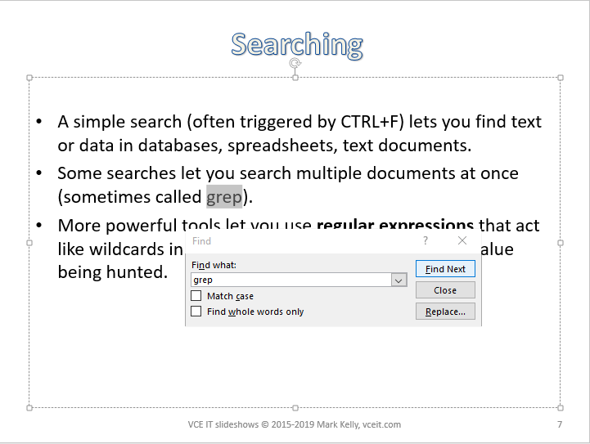
A simple search (often triggered by CTRL+F) lets you find text or data in databases, spreadsheets, text documents.

Slide 8
Some searches let you search multiple documents at once (sometimes called grep).
More powerful tools let you use regular expressions that act like wildcards in search terms to find variants of the text being hunted.
e.g. ‘colour’, ‘color’, ‘colouring’, ‘coloured’ ‘colourful’

Slide 9
Since some searches (queries, finds) are frequently used (e.g. video rental customers whose DVD is overdue for return), searches can be stored for later reuse.
This makes multi-step searches quick and simple even for inexperienced database users.

Slide 10
Sorting
Sorting is usually performed before producing output to organise data into an order where it's easy to find values (e.g. a name in a long list) or significant records (e.g. the ones with extraordinary values, such as the biggest or smallest).
RDBMS can sort by several fields in a hierarchical way. e.g. by SURNAME, then by FIRSTNAME, then by MIDDLEINITIAL.

Slide 11
Sorting
The most important field (surname) is sorted first;
Where surnames are the same, those records are sorted by first name;
Where surnames and firstnames are the same, records are then sorted by middle initial.

Slide 12
Data can be sorted differently depending on what the user needs to find. For example, a database programmer might sort records by ID, but office workers may need the same records sorted by name.

Slide 13
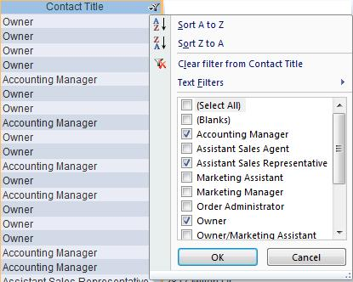
Filtering
Users can specify what records to show by indicating what contents they're looking for.
In Access.

Slide 14
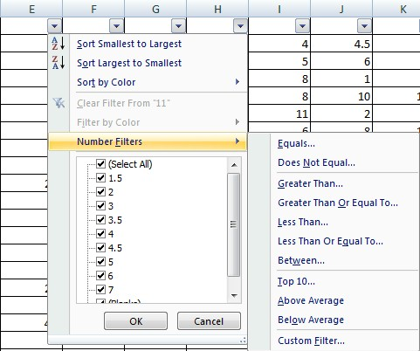
Filtering in Excel

Slide 15
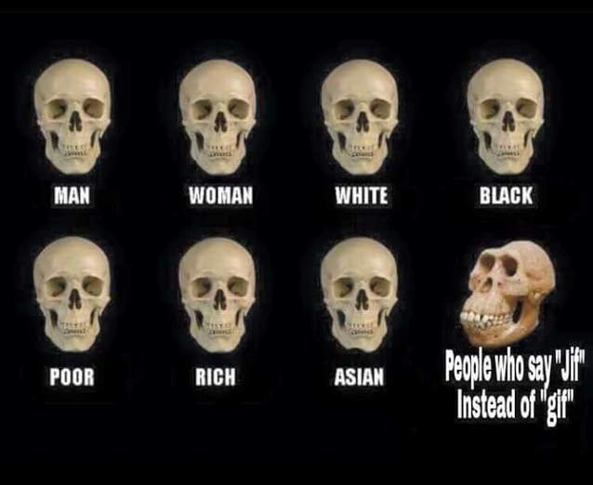
Because you’ve been good

Slide 16
VCE IT THEORY SLIDESHOWS 2016-2019 study design
Mark Kelly
mark@vceit.com
vceit.com
These slideshows may be freely used, modified or distributed by teachers and students anywhere
but
they may NOT be sold.
they must NOT be redistributed if you modify them.
This is not a VCAA publication and does not speak for VCAA.
Portions (e.g. exam questions, study design extracts, glossary terms) may be copyright Victorian Curriculum and Assessment Authority and are used with permission for educational purposes. Thanks, guys!

