Slide 1

VCE IT Theory Slideshows by Mark Kelly 2016-2019 study design
Testing Version 1
Begin
By Mark Kelly, vceit.com, mark@vceit.com

Slide 2
Contents
Informal testing
Recording test results
Test data
Beta testing
Formal testing
User acceptance testing

Slide 3
Testing
Find whether solutions do what is intended, for example correct behaviour when a link is clicked, accurate output by a formula.
Is done
during development (informal testing, by developers)
to check that the solution meets the needs of a typical user (user acceptance testing)
when development is complete (beta testing, by several external end-users)
to prove to the client that the solution satisfies all necessary functional and non-functional requirements (formal testing)
Is not the same as evaluation!

Slide 4
Other testing types* Unit testing
Testing a component of a system (e.g. a subprogram or hardware part) in isolation to see that it does what it’s supposed to do.
*This is not directly examinable

Slide 5
Integration Testing*
Joining the component (software or hardware) to see that it behaves properly when joined to related components.
E.g. does a subprogram accept parameters or return values correctly to/from another subprogram?
Is a piece of hardware pin-compatible with the device it plugs into?
*This is not directly examinable

Slide 6

System Testing*
Finding out whether the entire system with all of its components is working as it should.
*This is not directly examinable

Slide 7
Informal testing
Carried out by developers to check whether the latest piece of functionality or code works as expected.
Examples:
Test a webpage link by clicking it to see whether the right destination appears.
Test a formula by entering data for which the correct answer is already known, and seeing if the formula produces the same answer.
Timing an operation to see if it is completed within an acceptable time.

Slide 8
Informal testing
Examples:
Trying to bypass security measures to see if the solution is secure against unauthorised attack.
Testing a program/website on various platforms (computers+operating systems) with different sized displays, amounts of RAM etc.
Test readability by getting subjects to read a solution’s output and then test them on their understanding of it.
Test documentation by giving it to users and observing how many hesitations or errors they show when carrying out the actions described in the documentation.

Slide 9
What needs to be tested?
Everything that the solution is expected to do properly.
Different solutions need to test different things. Each solution has key requirements which need to be tested with special thoroughness.
Missile defence system – speed, accuracy.
Web browser – rendering time, compliance to standards, security.
Encryption – security.
Webpage – readability, ease of navigation, communication of message, compliance to standards
Dog – barking at burglars
Sorting algorithm – correct sorting, speed.

Slide 10
Documenting your testing
Your client will not simply accept you saying “Yeah, I tested it. It works great.”
Evidence is needed.
Testing table.
What was tested | How it was tested | Expected result | Actual result | Fix (if needed)
Date of birth calculation | Enter 28 Feb 1994 | 22.4 years (at July 2016) | 22.4 | NA
‘Play video’ button | Clicked button | Play video | Nothing | Added codec for MKV

Slide 11
Test data
In the previous slide, how was the ‘28 Feb 1994’ date chosen as the test data?
Randomly?
It should not be random.
Good test data:
Tests every possible class of inputs – typical, unusual but still valid, borderline conditions, invalid.
For example to test code logic that classifies people by voting age (below or above 18) you data to thoroughly test all possible inputs:
17 (below the cutoff)
18 (exactly on the borderline)
19 (above the cutoff)

Slide 12
Test data
For example to test code logic that classifies people by voting age (below or above 18) you data to thoroughly test all possible inputs:
17 (below the cutoff)
18 (exactly on the borderline)
19 (above the cutoff)
Test data must be thorough but not pointlessly repetitive
There is no point to add tests for people 20, 30, 40, 50, 60 and 67 because the test for “19” already covers all such ages over the cutoff value.

Slide 13
Test data
Focus test data on boundary conditions – the points at which the behaviour of the solution is expected to change.
Boundary conditions are where most logical errors occur.
Exams often have questions that rely on testing for boundary conditions.
Especially beware of tests for < > and <= and >=
For example a club accepts members who are 55 and over. The code checks an applicant’s eligibility with this code:
If Age > 55 then “Welcome to the club!”
The test fails on the borderline condition because it rejects people who are exactly 55. It should have used >= (greater than or equal to)

Slide 14
Audience participation time
A swimming club divides its members into these age groups:
Tadpoles – from 4 to 6 years.
Minnows – 7 to 10 years
Sardines – 11 to 15 years
Piranha – 16 to 20 years
Sharks – 21 to 54 years
Whales – 55 and over
Create a set of test data that is exhaustively tests all possible inputs and also tests validation rules to exclude ineligible applicants.

Slide 15
Solution
Minimal test data:
3 (to test an invalid applicant age)
4, 6 (tadpoles)
7,10 (minnows)
11,15 (sardines)
16,20 (piranha)
21,54 (sharks)
55 (whales)
Note that testing intermediate values (e.g. 30) not really useful, since 21 and 54 already test that range’s limits.

Slide 16
Beta testing
The problem with testing by developers is that creators of solutions usually don’t do the really dumb and human things that non-developers might do.
Developers often cannot anticipate the strange things that other people will do with their product.
Beta testing is giving a developed and in-house tested product to outsiders to try out and give feedback.
Beta testers often find problems in usability, readability, completeness, navigation, tolerance or affordance that developers could never have anticipated.
For example a developer may find the caption “DL” perfectly clear for a button, but beta users won’t understand it means “Download”

Slide 17
Formal testing
Once the solution produces accurate output and works as expected, the client will expect proof that it satisfies the requirements set down during the product’s analysis.
The client may be an external customer or the boss of the developers’ company, or the manager of a department within the company.
For example a payroll system must be able to generate summary charts, email employees and communicate with the tax office. It must also be easy to use and secure from hacking.
During formal testing, the developers demonstrate the achievement of each functional and non-function requirement to the client.
Each successful demonstration is ticked off.
When all is done, the developers get paid.

Slide 18
User acceptance testing
Since the client is often a high-level manager and will not actually ever use the solution, his or her opinion of it may be uninformed or irrelevant.
A typical end-user needs to use it and report on its suitability.
For example getting the CEO of Coles Australia to try new checkout software is not going to prove much. Bring in a real checkout person to use it.
Issues relating to usability, appropriateness, responsiveness, accuracy, robustness etc may be detected.

Slide 19
Testing is not evaluation!
Testing determines whether a solution works as expected and produces accurate output.
Evaluation determines that a developed system that has been in use for some time is achieving the organisational goals for which it was originally created.

Slide 20
Testing is not evaluation!
For example a website is created to increase a company’s profit.
The website is tested and works 100% accurately.
Millions of people visit the site and report their joy.
Three months after the site’s launch, evaluators look at historical records and find profits have not changed.
Conclusions:
the testing showed no problems.
The evaluation showed the website solution to be a complete failure.

Slide 21
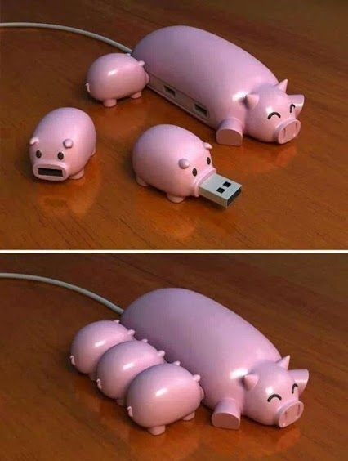
THANKS!
Because you’ve been so good, here’s a picture you can look at
while your teacher works out what to do next

Slide 22
VCE IT THEORY SLIDESHOWS 2016-2019 study design
Mark Kelly
mark@vceit.com
vceit.com
These slideshows may be freely used, modified or distributed by teachers and students anywhere
but
they may NOT be sold.
they must NOT be redistributed if you modify them.
This is not a VCAA publication and does not speak for VCAA.
Portions (e.g. exam questions, study design extracts, glossary terms) may be copyright Victorian Curriculum and Assessment Authority and are used with permission for educational purposes. Thanks, guys!

