Slide 1
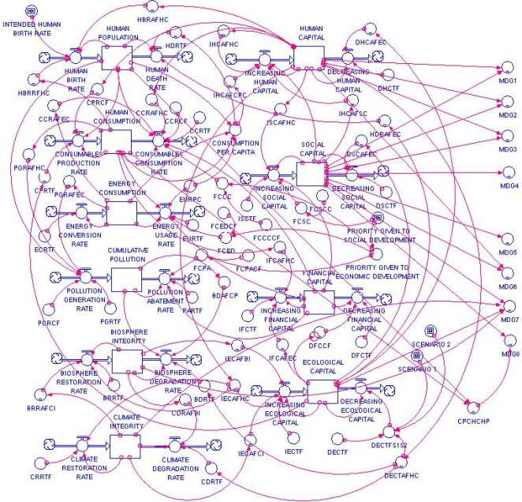
VCE IT Theory Slideshows by Mark Kelly 2016-2019 study design
User Flow Diagrams
Version 1
Begin
By Mark Kelly, vceit.com, mark@vceit.com

Slide 2
Contents
Definition
VCAA model?
UFD Examples
UFD vs Site map
Goals
Funnels
User sources
Landing Pages
Onboarding
The perfect landing page
Tips
Further reading

Slide 3
Abbreviations
Note: in UFD circles:
“UX” means “User Experience”
“UI” means “User Interface”
“IA” = “Information Architecture”

Slide 4
UFD Definition
User flow diagrams [UFD] are diagrammatic representations of the path a user travels through when using an online interactive solution to complete a task or transaction, such as making a reservation or purchasing a product.

Slide 5
UFD Definition
It is a diagram showing a user’s journey to complete a task.
User flow diagrams incorporate user interfaces and show the multiple entry points to interactive online solutions,
For example, paid advertisements, social media and search engines may direct a user to a location in the solution other than the home page.

Slide 6
UFD Definition
http://ux.stackexchange.com/questions/45405/what-are-the-differences-between-user-flows-task-flows-and-workflows User flow diagrams ... emphasise that different users may perform different tasks or travel in different paths (largely due to a different entry point). User flows are typically attached to a persona and/or a specific entry point.

Slide 7
UFD Definition
http://ux.stackexchange.com/questions/45405/what-are-the-differences-between-user-flows-task-flows-and-workflows For instance, two users seeking to purchase a Nirvana CD on Amazon may have completely different journeys - one will enter the system via the browser's address bar, search for the album she already knows she wish to buy, add to basket and buy;
where the other may search on Google, then reach Amazon product page via a link, then would like to read the reviews, perhaps compare different CDs, etc.

Slide 8
VCAA Model?
The Advice for Teachers says...
The VCAA will not be mandating a specific style of user flow diagrams; however, it is important that
the diagrammatic representations show a user’s interaction with an online solution when conducting a transaction, as well as
the user interface for the page that initiates the transaction.

Slide 9
UFD Examples
https://www.newfangled.com/how-to-tell-the-users-story/
User flows are a form of visual documentation that illustrates how users encounter your website’s content, as well as the sequence of their interactions once they get there.
Here’s an example of a diagram showing all the possible user paths to a planned landing page for a particular campaign…

Slide 10
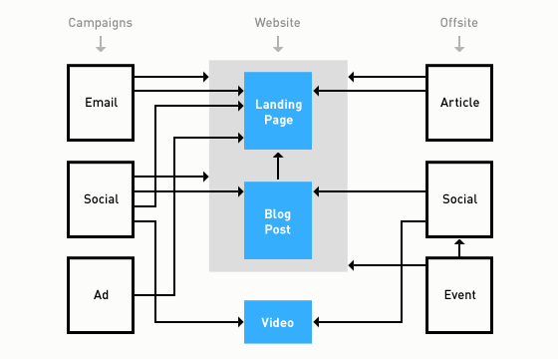
UFD Examples

Slide 11
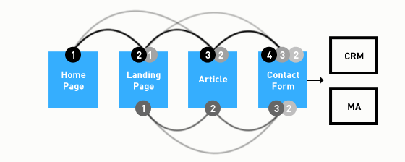
UFD Examples
Here’s an example of a diagram showing the possible paths a user might take once they have arrived at your website:

Slide 12
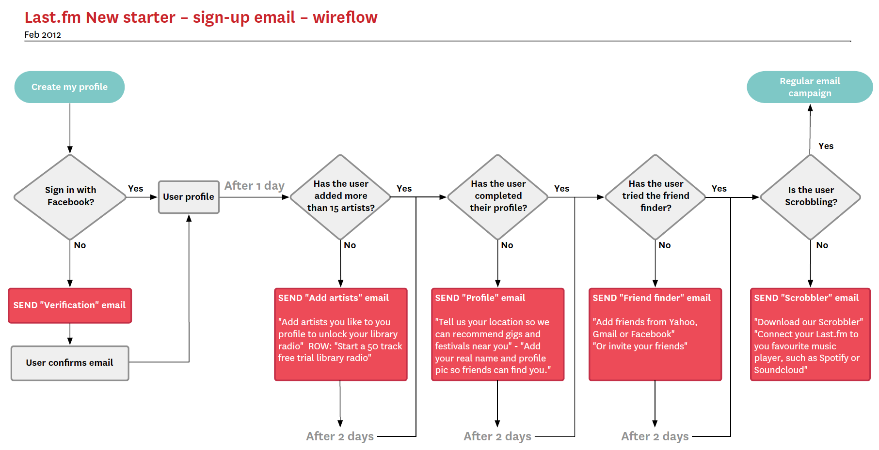
UFD Examples
http://grahamtodman.co.uk/blog/wp-content/uploads/2012/04/new-starter-email-user-flow.png

Slide 13
UFD vs Site Map
http://zurb.com/word/information-architecture
Site maps rarely find use outside of meetings between clients and designers. They organize pages into structures that look fine on paper, but we’ve never found them useful to end users. That’s why we use information architecture to define workflows, not to categorize pages.

Slide 14
UFD Examples
http://zurb.com/word/information-architecture
Successful websites are organized to help users achieve a goal — either theirs or the site owner’s. We use workflows to help us define site structure rather than traditional static site maps.
The idea is to base site structure around how we want users to experience the site.

Slide 15
UFD Examples
http://zurb.com/word/information-architecture
We create site workflows by asking, “who’s looking at their marketing site, and what are they trying to do?” Diagrams like the one below show what steps users might take to reach a goal. Sometimes the steps — like “donate” below — aren’t pages. It’s not about arranging pages. It’s about defining paths for users.

Slide 16
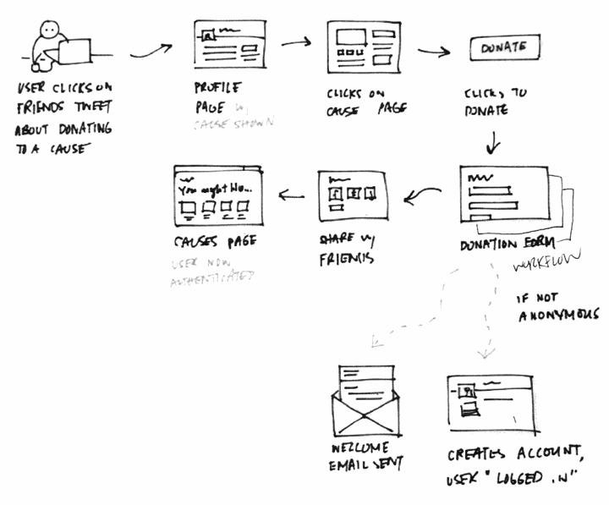
UFD Examples
http://zurb.com/word/information-architecture

Slide 17
Goals
http://zurb.com/word/information-architecture
Different Users Have Different Goals
Smart websites provide more than one possible path for users to follow.
Creating those paths depends on users motivations.
Why are users likely to visit a site? Figure that out and you can start to guide them to a goal.
Luckily many users fall into a few categories based on what they want.

Slide 18
Goals
http://zurb.com/word/information-architecture
Good design will explain exactly what the user will get with text, imagery, video or other media.
It will balance minimising users’ effort with offering the right options.
It will follow up with a thoughtful thank-you page. The site may send a confirmation email or other follow-up message.
Above all, it will work fast.

Slide 19
Goals
http://zurb.com/word/information-architecture
All Paths Lead to a Goal
For many clients, that goal is a sale.
Others want to collect email addresses, or maybe to educate users about a cause.
Some sites have many goals, e.g. selling to customers, attracting new suppliers, promoting a product category.

Slide 20
Goals
http://zurb.com/word/information-architecture
All path-followers will ask “what’s in it for me?”
A site’s architecture plan needs to satisfy followers of every path.
Don’t think of site design just as how pages are arranged (with a site map)
It’s about how to guide users to an end that serves both them and the site owner
It’s less “map,” more “timeline” — less about the site, more about the users.

Slide 21
UFD Examples
http://zurb.com/word/information-architecture
Good architecture leads casual users along series of steps designed to hold their attention.

Slide 22
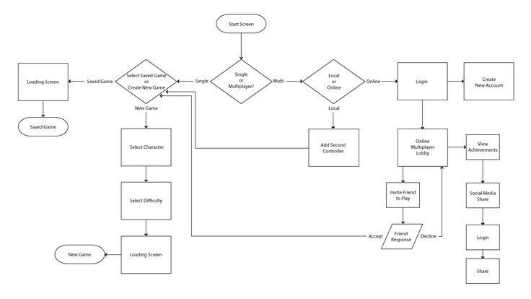
UFD Examples
https://www.pinterest.com/pin/316448311292699173/

Slide 23
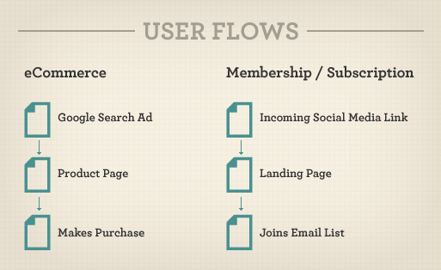
UFD Examples
https://www.smashingmagazine.com/2012/01/stop-designing-pages-start-designing-flows/

Slide 24
Goals
https://www.smashingmagazine.com/2012/01/stop-designing-pages-start-designing-flows/
Start with a detailed look at the objectives of the user and the business,
Sketch out the various flows that need to be designed in order to achieve both parties’ goals.

Slide 25
Goals
https://www.smashingmagazine.com/2012/01/stop-designing-pages-start-designing-flows/
User objectives might be
finding a fact
replacing a product
learning a new skill
buying a gift for someone
asking a question

Slide 26
Goals
https://www.smashingmagazine.com/2012/01/stop-designing-pages-start-designing-flows/
Business objectives could be getting
a lead (to a new customer),
a ‘like’
a subscriber
a buyer
a download
a phone call.

Slide 27
Goals
https://www.smashingmagazine.com/2012/01/stop-designing-pages-start-designing-flows/
Identifying each user and business objective is the first step to creating design flows that meet all of these objectives.

Slide 28
Funnels
https://www.smashingmagazine.com/2012/01/stop-designing-pages-start-designing-flows/
Not all website visitors are created equal.
Users come from different sources, with varying levels of knowledge and engagement, and with different goals.
It’s up to you as a user experience [UX] designer to map those in-bound user flows to conversion funnels that provide value to the user as well as the business.

Slide 29
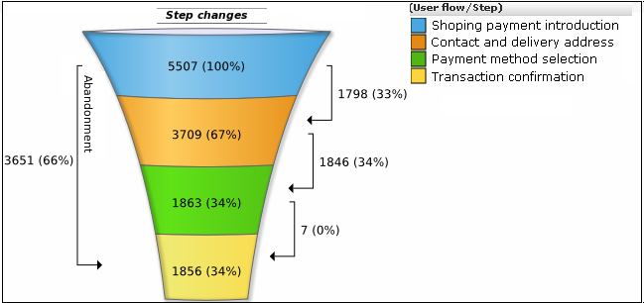
‘Funnel’?
https://docs.oracle.com/cd/E22345_01/doc.111/e22309/img/transactionfunnel.png
Not all arriving users will complete the journey to the end of the flow

Slide 30
User Sources
https://www.smashingmagazine.com/2012/01/stop-designing-pages-start-designing-flows/
Typical users may come from:
Paid advertising – e.g. a banner or Google AdWord ad.
Social media – e.g. a friend’s post on a social network.
Email – e.g. an email newsletter or referral invitation.
Organic search – e.g. a deep link that was surfaced by a search.
Press or news item – e.g. a mention in the news or a blog post.
Each visitor has their own needs, expectations and level of knowledge, and they need to be treated accordingly.

Slide 31
Landing Pages
https://www.smashingmagazine.com/2012/01/stop-designing-pages-start-designing-flows/
THE LANDING PAGE
The point in your site that a user first sees upon arrival. User flow starts there.
Give them the information they need to proceed along their (and your) desired goal, e.g. a sale, download, a fact.
Give the user a reason to keep moving through the flow, down the funnel.

Slide 32
Landing Pages
https://www.smashingmagazine.com/2012/01/stop-designing-pages-start-designing-flows/
Build user confidence by clearly articulating key benefits.
Streamline the content and design to focus on a clear call to action.

Slide 33
Landing Pages
https://www.smashingmagazine.com/2012/01/stop-designing-pages-start-designing-flows/
Remove friction at every step.
Ask for the minimum amount of information
Reduce the number of data input fields
Reduce clicks
Reduce page-loading time.

Slide 34
Landing Pages
https://www.smashingmagazine.com/2012/01/stop-designing-pages-start-designing-flows/
Create an enticing hook, an itch that can only be scratched by completing the flow to their and/or your desired goals.

Slide 35
‘Onboarding’
https://www.pinterest.com/pin/423338433697210948/
Enticing and encouraging new users to stay with the site and continue down the funnel…

Slide 36
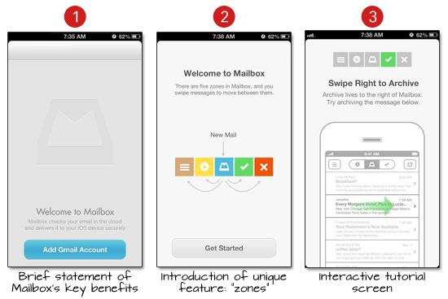
‘Onboarding’
https://www.pinterest.com/pin/423338433697210948/
Enticing and encouraging new users to stay with the site and continue down the funnel

Slide 37
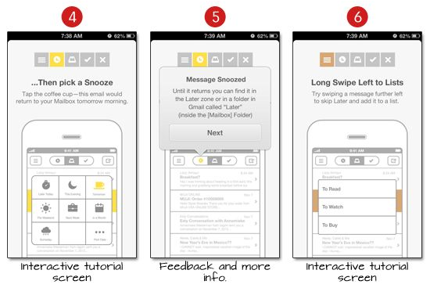
‘Onboarding’
https://www.pinterest.com/pin/423338433697210948/
Enticing and encouraging new users to stay with the site and continue down the funnel

Slide 38
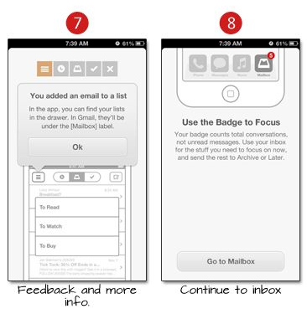
‘Onboarding’
https://www.pinterest.com/pin/423338433697210948/
Enticing and encouraging new users to stay with the site and continue down the funnel

Slide 39
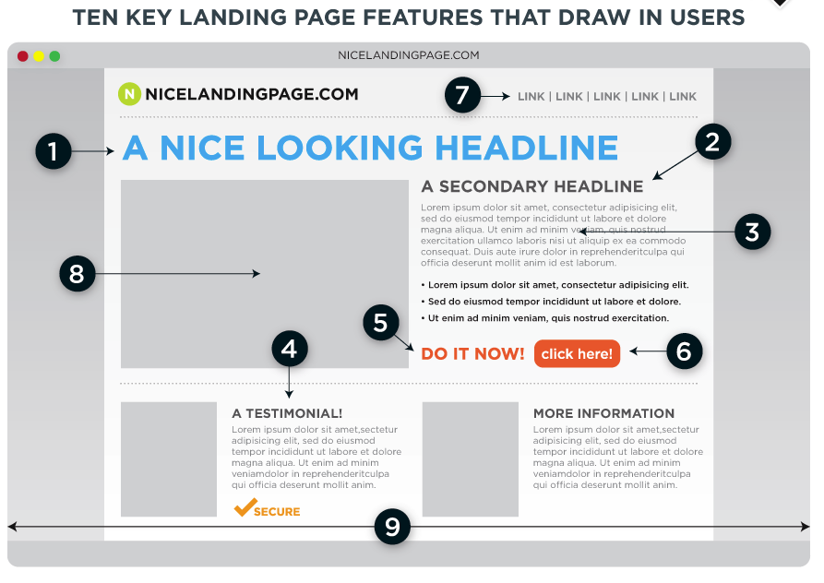
The Perfect Landing Page

Slide 40
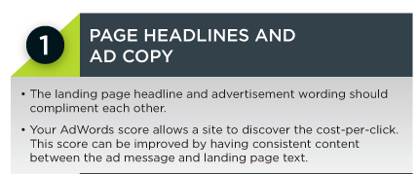
The Perfect Landing Page

Slide 41
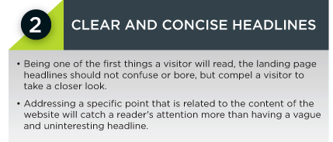
The Perfect Landing Page

Slide 42
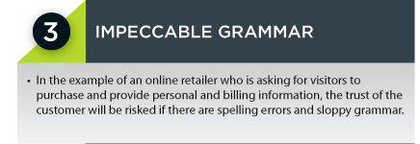
The Perfect Landing Page

Slide 43
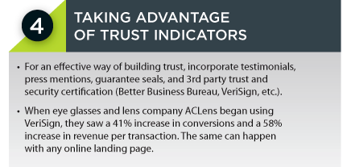
The Perfect Landing Page

Slide 44
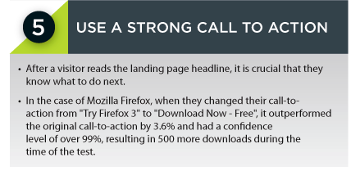
The Perfect Landing Page

Slide 45
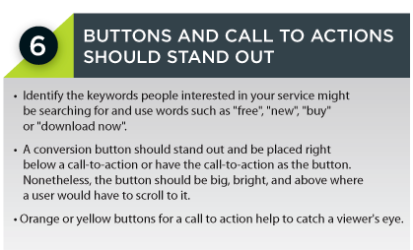
The Perfect Landing Page

Slide 46
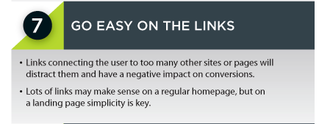
The Perfect Landing Page

Slide 47
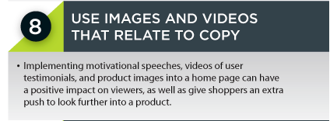
The Perfect Landing Page

Slide 48
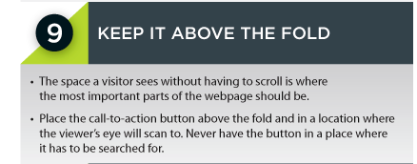
The Perfect Landing Page

Slide 49
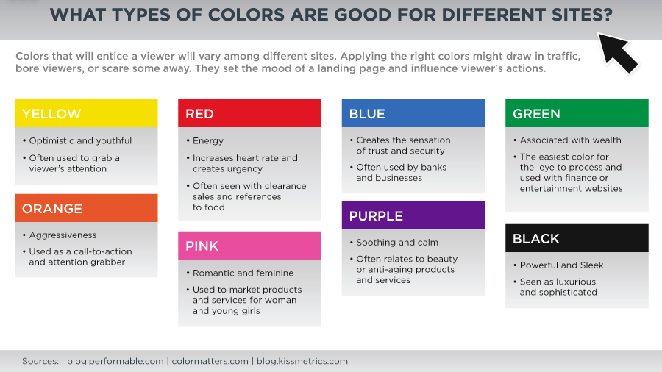
The Perfect Landing Page

Slide 50
Make sure your UFD is useful

Slide 51
Tips
http://sixrevisions.com/usabilityaccessibility/information-architecture-101-techniques-and-best-practices/
Don’t Design Based on Your Own Preferences
You are not your user. As a designer, you have to remember that site visitors won’t have the same preferences as you. Think about who a "site user" really is and what they would want from the site.

Slide 52
Tips
http://sixrevisions.com/usabilityaccessibility/information-architecture-101-techniques-and-best-practices/
Research User Needs
Get feedback through interviews or user testing to find what they want and expect.
Test the site to see if users are able to navigate the site efficiently.

Slide 53
Tips
http://sixrevisions.com/usabilityaccessibility/information-architecture-101-techniques-and-best-practices/
Have a Clear Purpose
Every site should have a clear purpose, whether that’s to sell a product, inform people about a subject, provide entertainment etc.
Without a clear purpose, it’s virtually impossible to create any kind of effective IA.

Slide 54
Tips
http://sixrevisions.com/usabilityaccessibility/information-architecture-101-techniques-and-best-practices/
The way the information on a site is organized should be directly correlated to what the site’s purpose is.
Content should be set up in such a way that it funnels visitors toward that goal.
E.g. on a site that’s meant to inform, the IA should lead people through the content in a way that one page builds on the last one.

Slide 55
Tips
http://sixrevisions.com/usabilityaccessibility/information-architecture-101-techniques-and-best-practices/
You may have sub-goals within a site, requiring you to have subsets of content with different goals.

Slide 56
Tips
http://sixrevisions.com/usabilityaccessibility/information-architecture-101-techniques-and-best-practices/
Use Personas
Create personas - hypothetical narratives of your various website users, to figure out what they want, and how best to structure the site’s content and user flow.

Slide 57
Tips
http://sixrevisions.com/usabilityaccessibility/information-architecture-101-techniques-and-best-practices/
Be Consistent
Users expect consistency – navigation, appearance, behaviour etc.
Pick a pattern and stick to it.
Inconsistencies tend to confuse visitors and reduce their confidence.

Slide 58
Further reading
Thanks to http://zurb.com/word/information-architecture
http://www.lukew.com/ff/entry.asp?1409
http://www.webmonkey.com/2010/02/information_architecture_tutorial_-_lesson_1/
http://sixrevisions.com/usabilityaccessibility/information-architecture-101-techniques-and-best-practices/
http://www.nngroup.com/articles/top-10-ia-mistakes/
http://searchengineland.com/when-good-seo-becomes-bad-information-architecture-47373

Slide 59
VCE IT THEORY SLIDESHOWS 2016-2019 study design
Mark Kelly
mark@vceit.com
vceit.com
These slideshows may be freely used, modified or distributed by teachers and students anywhere
but
they may NOT be sold.
they must NOT be redistributed if you modify them.
This is not a VCAA publication and does not speak for VCAA.
Portions (e.g. exam questions, study design extracts, glossary terms) may be copyright Victorian Curriculum and Assessment Authority and are used with permission for educational purposes. Thanks, guys!

Slide 60
THANKS!
Because you’ve been so good, here’s a picture you can look at
while your teacher works out what to do next

