Slide 1

VCE IT Theory Slideshows
Websites & Data
By Mark Kelly
mark@vceit.com
Vceit.com

Slide 2
Contents (2016-2019)
01. why organisations acquire data via online facilities
02. why individuals and organisations supply data via websites
03. techniques for acquiring data on websites (interactive online solutions ) and reasons for their choice
04. techniques for protecting the rights of individuals and organisations supplying data

Slide 3
Why organisations acquire data via online facilities including - 24 - hour customer access - improved efficiencies through direct data entry by customers, - improvements in effectiveness, and - access to global markets, marketing opportunities and ongoing services

Slide 4
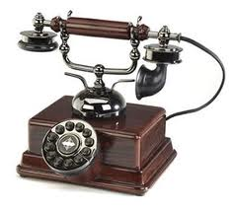
Why use websites to acquire data?
Cheap!
Compared to international phone call or even mailing a paper-based order
24-hour customer access
Important in a global market with many time zones

Slide 5

Why use websites to acquire data?
Instant!
No delay for post
No phone queues
Improved efficiencies through direct data entry by customers
e.g. When ordering goods, customer does entry rather than employee having to do it.

Slide 6
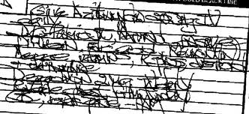
Why use websites to acquire data?
Improvements in effectiveness
increased accuracy if visitors enter their own data
less chance of error due to thick accents in a phone order
data can be processed automatically once entered
typed data easier to read than handwritten

Slide 7

Why use websites to acquire data?
access to global market
people can order from anywhere on the planet
massively increased ‘catchment area’, especially for rare & exotic goods

Slide 8
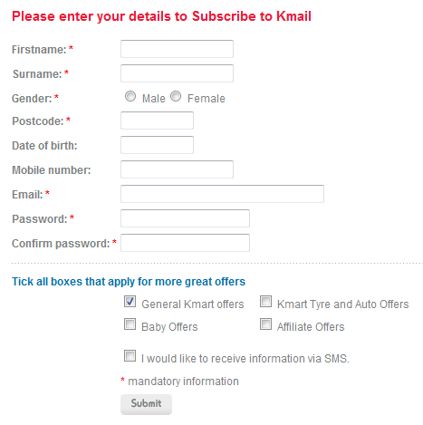
Why use websites to acquire data?
Can use prompts to collect the right data
Use controls like radio buttons to enforce data integrity
Can use electronic validation tools to make sure data are provided, and are in the right format

Slide 9

Why use websites to acquire data?
People may be put off by having to email, write or phone
Instant communication encourages impulsive purchases!

Slide 10
Why users supply data for online transactions including convenience, variety of choice, reducing costs

Slide 11

Why supply data via websites?
To purchase goods and services,
Social networking
Reach a broad audience
Exchanging information
Forums, wikis, blogs

Slide 12
Why supply data via websites?
Immediate results
Anonymity
No travel needed for disabled or lazy people.
Helping others with your expertise (e.g. forums)
Can choose from hundreds of sellers – lots of choice
Sellers compete for customers – keeps prices down
Can see a lot of detailed information on products before deciding

Slide 13
techniques for acquiring data on websites (not examinable 2016-2019 but may be handy for MMOS data collection)

Slide 14
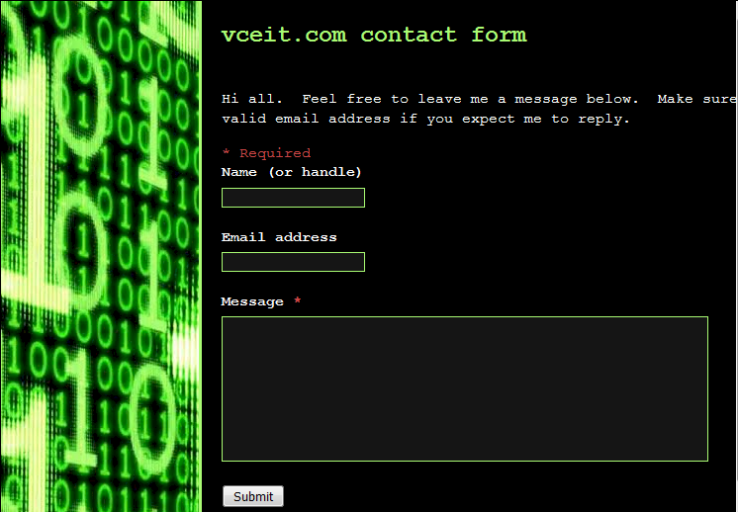
techniques for acquiring data on websites
Collating data from entries in a web form

Slide 15
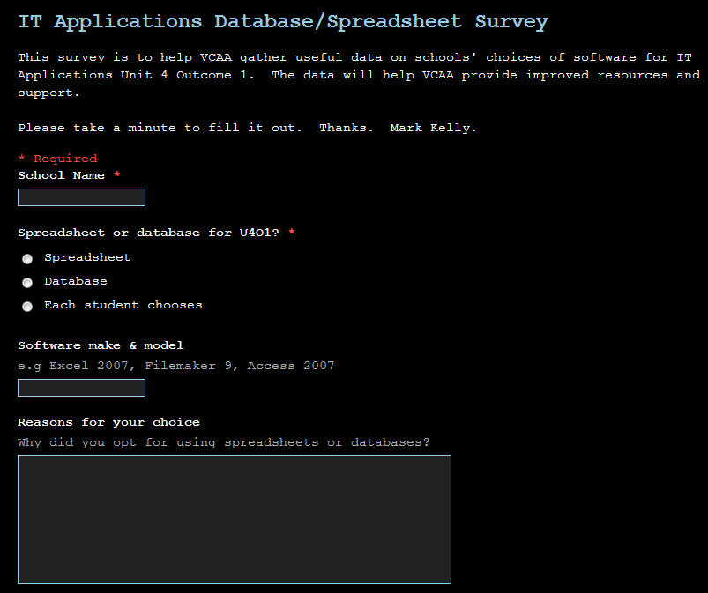
techniques for acquiring data on websites Web forms

Slide 16
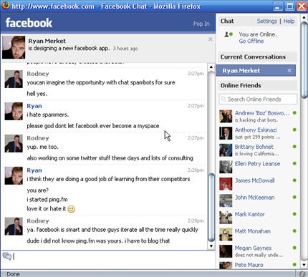
techniques for acquiring data on websites
Providing a web forum
Online chat

Slide 17

techniques for acquiring data on websites
Provide multiple forms of contact
Snail mail
Web form
Live chat
FAQ
Email
Phone

Slide 18
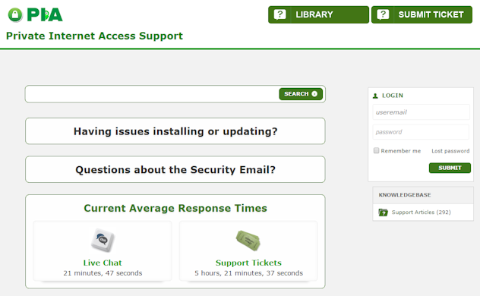
techniques for acquiring data on websites
Provide information
Document library
Support
tickets
Help search
User accounts
Support
articles
Support status information

Slide 19
techniques for acquiring data on websites
Accessing an online database
Accessing an intranet or extranet
Creating a mailing list
mass mail-outs and/or discussion groups
Allow visitors to upload files to the site
Provide downloads

Slide 20
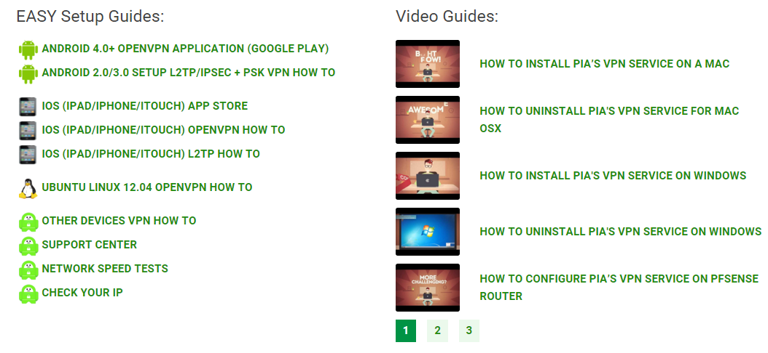
techniques for acquiring data on websites
Provide downloads

Slide 21
techniques for protecting the rights of individuals and organisations supplying data including - security protocols and - stating privacy, shipping and returns policies

Slide 22
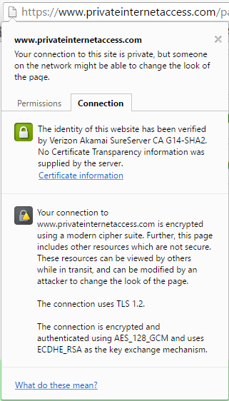
Protecting the rights of those who supply data
security protocols
SSL or TLS encryption
protects data in transit

Slide 23
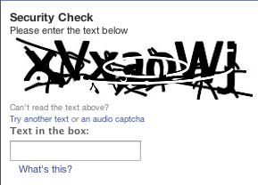
Protecting the rights of those who supply data
security protocols
File encryption – protects data in storage
Automatic timeout of idle connections
Using Captcha to deter robotic logins
But artificial intelligence is getting so good at deciphering Captcha that the Captcha puzzles are now often too hard for real humans to decode.

Slide 24

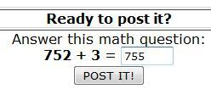
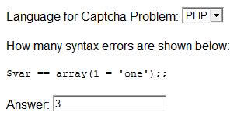
Protecting the rights of those who supply data
security protocols
Using other puzzles to prove users are human

Slide 25
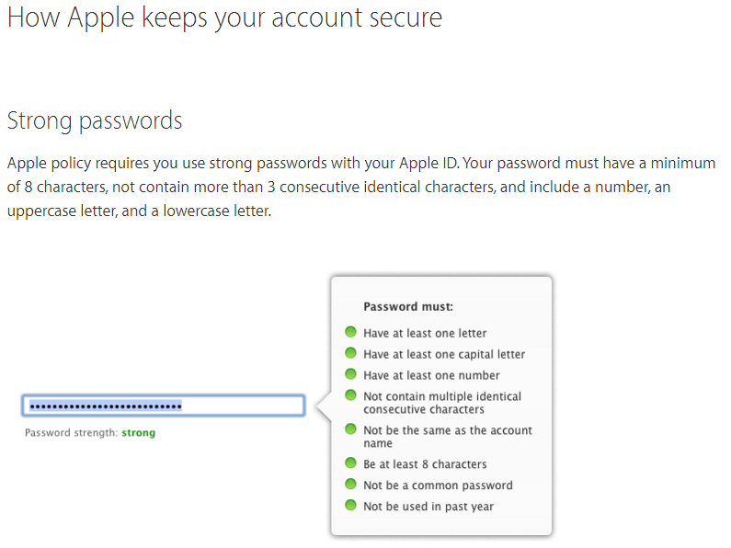
Protecting the rights of those who supply data
security protocols
Logins with usernames and passwords
Requiring strong passwords

Slide 26
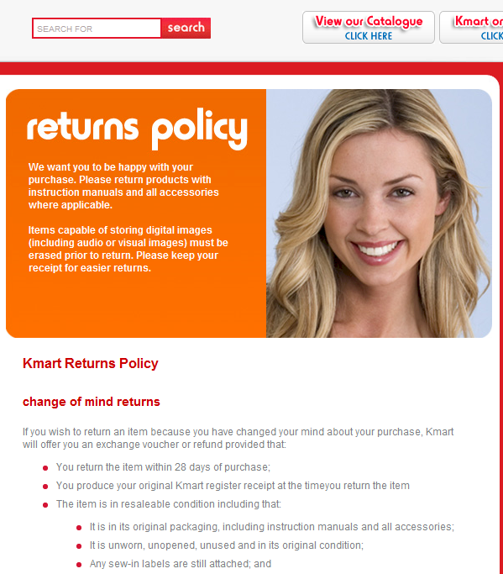
stating policies regarding
Privacy
Shipping
Returns

Slide 27
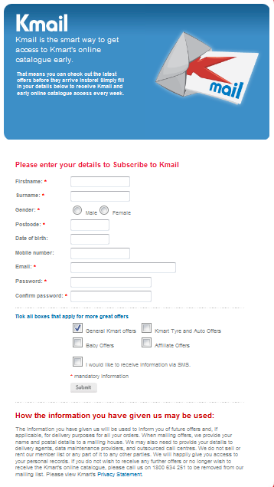
Protecting peoples’ rights
a contacts link for people to use in case their rights may not have been protected.

Slide 28
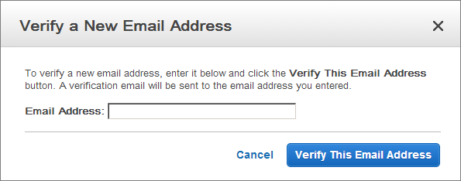
protecting the rights of those who supply data
Sending a verification email before
signing someone up to a mailing list or a site
changing a password
Using secret questions to back up passwords.
Only allowing password changes by sending an email to a user’s registered email address.

Slide 29
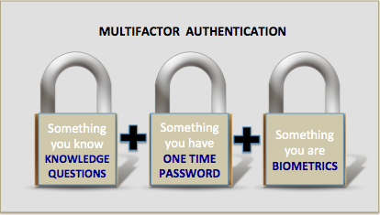
protecting the rights of those who supply data
Multi-factor authentication
Helps deal with stolen passwords.
Typically, requiring users to quote a code sent to their mobile phone by SMS.
Proves someone not only know a user’s password, but physically possess an item known to belong to the user.

Slide 30
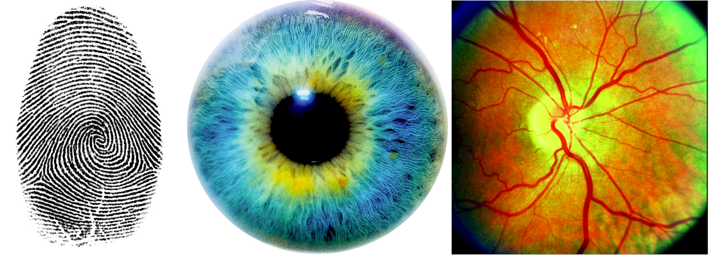
protecting the rights of those who supply data
Biometric ID
Proves you are physically whom you claim to be.
Fingerprint scan
Iris/retina scan
Voice/face identification (rather easy to fake)
DNA test (possibly painful)
A note from your mother (guaranteed security)

Slide 31

Since you’ve been so good, here’s a picture you can look at…

Slide 32
VCE IT THEORY SLIDESHOWS
By Mark Kelly
mark@vceit.com
vceit.com
These slideshows may be freely used, modified or distributed by teachers and students anywhere on the planet (but not elsewhere).
They may NOT be sold.
They must NOT be redistributed if you modify them.

