Slide 1
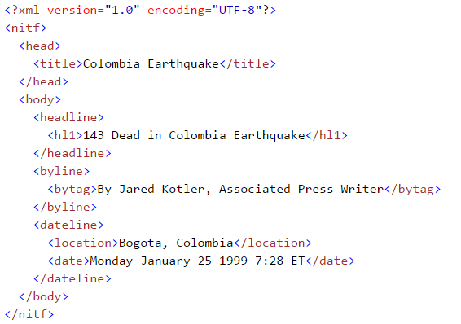
VCE IT Theory Slideshows by Mark Kelly 2016-2019 study design
XML data files Version 1
Begin
By Mark Kelly, vceit.com, mark@vceit.com

Slide 2
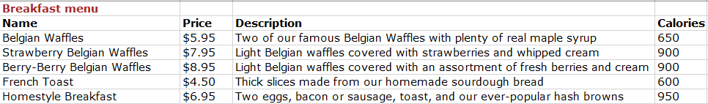
The problem
You are writing a program that processes large quantities of stored data.
Like this…

Slide 3
The problem
You want to be able to write this data so that many other programs – not just your own software - can read it and interpret it.
A CSV (comma-separated values) file is too limiting, since it cannot store field names, nor easily have extra fields added later.
You could create an Access database, but not all software can read Access data files.

Slide 4
The solution
A plain-text, information-rich, self-descriptive, universally-readable data file format…
XML

Slide 5
Introduction
XML = extensible markup language
Stores and transports data between all sorts of software
Uses metatags to give data structure and meaning
Simpler CSV (comma separated value) data files only contain raw data. XML has field names, structure.
Plain text: easy to edit and read by humans and software.

Slide 6
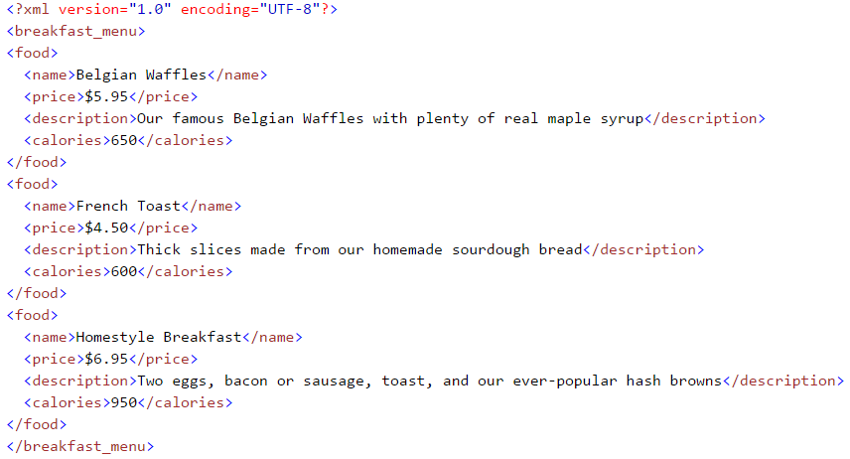
What XML looks like

Slide 7
What XML looks like
Explains its own format

Slide 8
What XML looks like
Notice the structure?
Closing tag

Slide 9
What XML looks like
Hierarchical

Slide 10
What XML looks like
Opening tag
Closing tag

Slide 11
What XML looks like
Opening + closing tags with content = an element

Slide 12
XML
Unlike HTML tags, which are pre-defined, XML tags are created by the author of the data.
“Price” could have been called “Cost” earlier.
XML is extensible – new data fields can be later added, and existing software could still read and understand it.
Its format is completely universal and open-source. No competing and incompatible file formats that have to be translated before they can be read.

Slide 13
XML
XML data contains no information about how the data should be presented. The same XML data can be displayed in many different ways.
Large data stores (e.g. weather bureau) often export data in XML format so it can be read by anyone.

Slide 14
XML
E.g. a newsfeed may be exported like this:

Slide 15
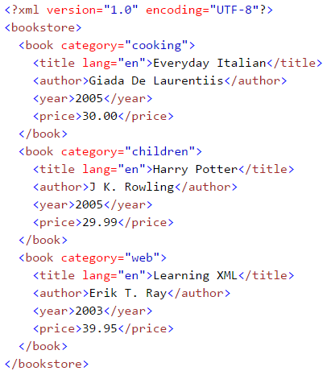
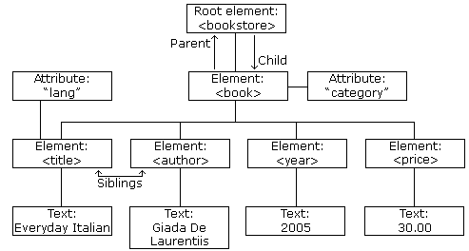
XML Trees
XML documents can have a complex hierarchical tree-like structure

Slide 16
XML Components
The optional declaration (or prologue or ‘prolog’) announces the XML version (1.0) and character encoding scheme (UTF-8)
The root element must exist
An attribute (‘lang’) can provide further information about the element (‘title’)
Every element must have a closing tag
XML tags are case-sensitive: “year” is a different tag to “Year”

Slide 17
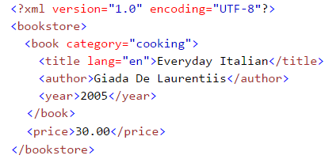
XML Components
XML elements must be properly nested.
A child element must be closed before its parent is closed.
This is illegal…

Slide 18

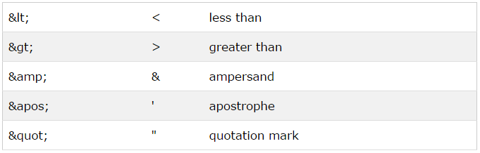
XML Components
Do not use XML reserved characters inside an XML element
< and > have special meanings to XML parsers (decoders)
Use these pre-defined replacements instead of reserved characters

Slide 19
XML Internal Documentation
Insert comments in XML using the same syntax as used in HTML
<!-- This is a comment -->
But do not use two consecutive dashes within a comment.

Slide 20
XML Element Naming Rules
Element names:
are invented by the data’s author and can be anything except they cannot start with the letters ‘xml’ (uppercase or lowercase)
are case-sensitive
must start with a letter or underscore
can contain letters, digits, underscores, (and hyphens and full stops, but these are discouraged)
cannot contain spaces

Slide 21
XML Element Naming Conventions
Element names should preferably:
Be short but meaningful
Not contain hyphens, colons or full stops which may be misinterpreted by some software
Use CamelCase if multiple words make up an element’s name

Slide 22
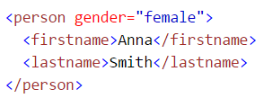
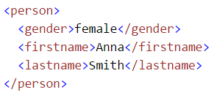
XML Elements vs Attributes
In example 1, gender is an attribute.
In example 2, gender is an element.
They both provide exactly the same data.
You can use attributes or elements.
(Attribute data must be in single or double quotes.)
Example 1
Example 2

Slide 23
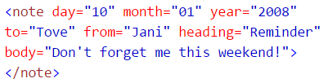
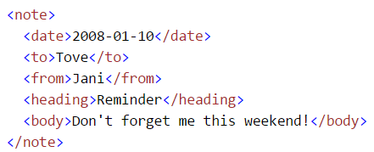
XML Elements vs Attributes
BUT IT MAY BE BETTER TO AVOID USING XML ATTRIBUTES
attributes cannot contain multiple values (elements can)
attributes cannot contain tree structures (elements can)
attributes are not easily expandable (for future changes)
This is legal but not good…
This is better…

Slide 24
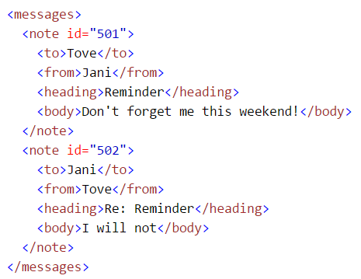
XML Elements vs Attributes
But it’s OK to use attributes to provide data about the data. (metadata).
Below, the id attribute (acting like a key field in a database) describes the note. The actual data IN the note are stored as elements.

Slide 25
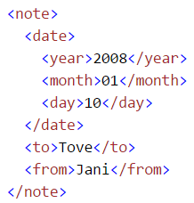
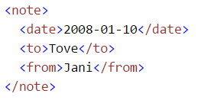
XML Field Structure
In example 1, date is stored as a single value
In example 2, date is broken into its components.
They both provide exactly the same data.
But accessing year, month and day will be far easier using example 2’s field schema
Example 1
Example 2

Slide 26
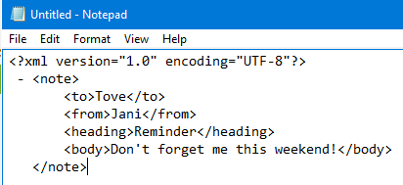
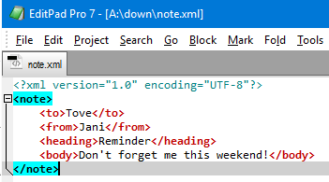
Displaying XML
Raw XML files can be loaded by lots of programs, but what do the programs show?
A very dumb text editor…
A clever text editor…

Slide 27
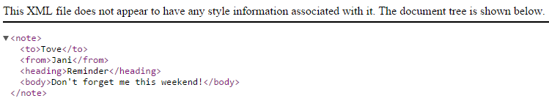
Displaying XML
Raw XML files can be loaded by lots of programs, but what do the programs show?
A Chrome browser

Slide 28
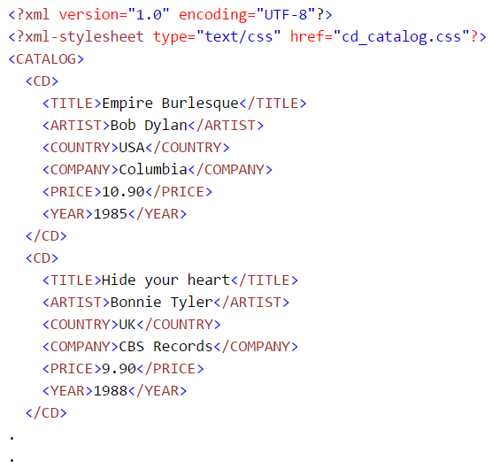
Why so ugly?
Why do raw XML files get displayed so horribly?
XML files only contain raw data.
They don’t contain any formatting information (as a database report or a webpage’s CSS file would)
So you could attach a stylesheet like a CSS file to provide formatting data to an XML file

Slide 29
Or…
Since formatting XML with CSS is not recommended, you can alternatively use
Javascript, or a
XSLT translator file

Slide 30
XSLT
XSLT (eXtensible Stylesheet Language Transformations) is the best style sheet language for XML.
XSLT is far more sophisticated than CSS.
With XSLT you can add/remove elements and attributes to or from the output file.
You can rearrange and sort elements, perform tests, and decide which elements to display.

Slide 31
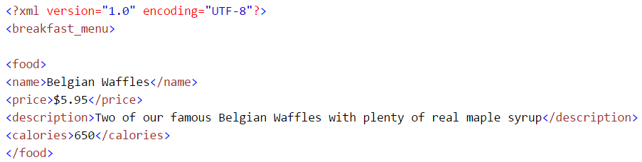
XSLT Example
Remember the previous breakfast menu XML?

Slide 32
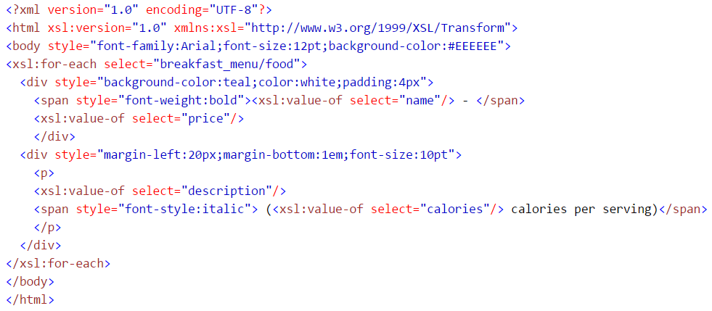
XSLT Example
We can use this XSLT stylesheet to format the data…

Slide 33
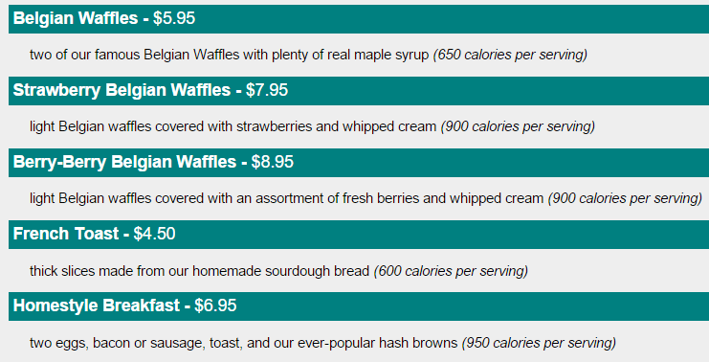
XSLT Example
And we get this…

Slide 34
Reading XML in your program
Most languages have pre-built XML support to read and interpret (‘parse’) and write XML files.
Support may include XML object classes and libraries.
They also handle XML namespaces (not covered here) to enable online data to be used.

Slide 35
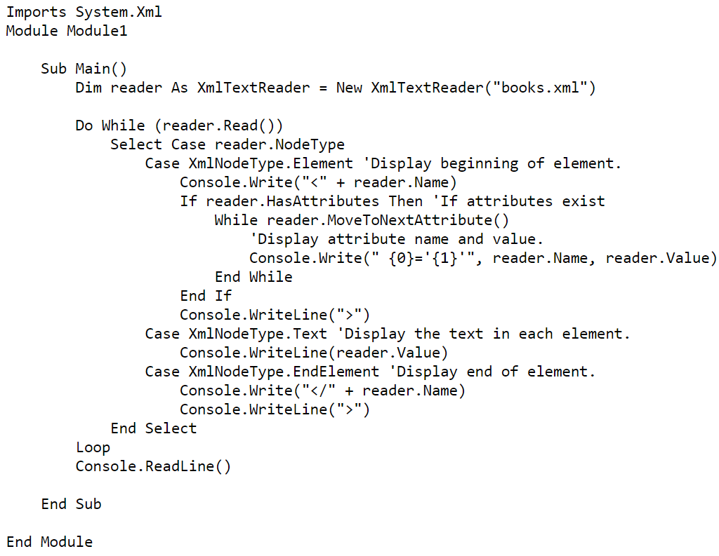
Sample Visual Basic code to write XML

Slide 36
Yeah, OK…
Must admit handling XML is more complex than working with simple CSV data files.
But the power and opportunities XML open up is well worth the effort.

Slide 37
So in conclusion
XML is good for data storage and transport.
Try it today.

Slide 38
References
http://www.w3schools.com/xml/

Slide 39
VCE IT THEORY SLIDESHOWS 2016-2019 study design
Mark Kelly
mark@vceit.com
vceit.com
These slideshows may be freely used, modified or distributed by teachers and students anywhere
but
they may NOT be sold.
they must NOT be redistributed if you modify them.
This is not a VCAA publication and does not speak for VCAA.
Portions (e.g. exam questions, study design extracts, glossary terms) may be copyright Victorian Curriculum and Assessment Authority and are used with permission for educational purposes. Thanks, guys!

Slide 40
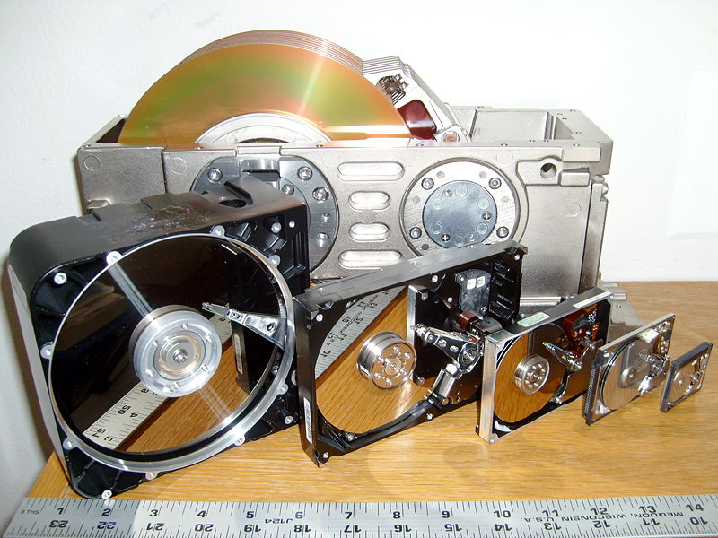
THANKS!
Because you’ve been so good, here’s a picture you can look at
while your teacher works out what to do next
The history of hard disks

