Slide 1
Install Anaconda
Install anaconda version 2.7 from:
https://www.anaconda.com/download/
It will directly install a lot of useful tools related to python usage to your computer. If your computer refuses to install it, then download python 2.7 here instead:
https://www.python.org/downloads/release/python-2712/

Slide 2
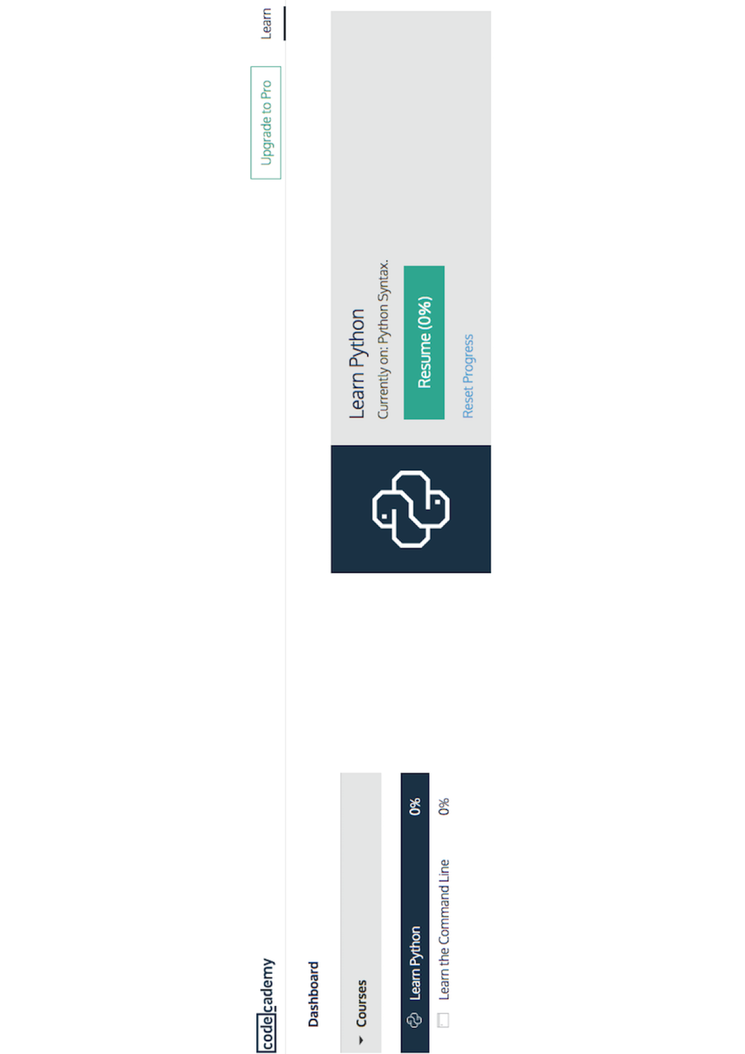
If you have never programmed
Codecademy.com
These are self-contained tutorials to get you familiar with python!

Slide 3

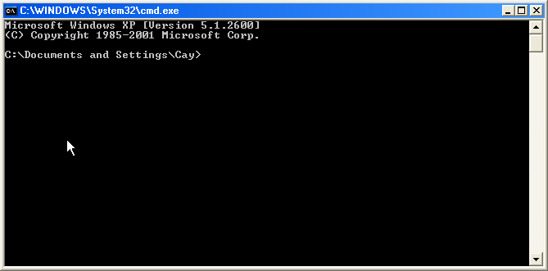
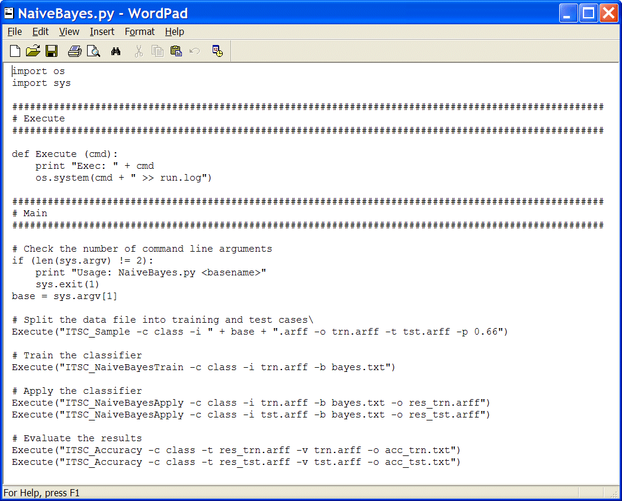
You need:
1. Windows Command Prompt
2. A Text editor. You can open scripts there.
For example wordpad. All the scripts are
text files that can be ran bit by bit or at once.
Today we want to run them bit by bit.
It will read python code if you type:
ipython
* If you opened ipython directly from Anaconda no need of starting ipython from the terminal, it is the same thing.

Slide 4


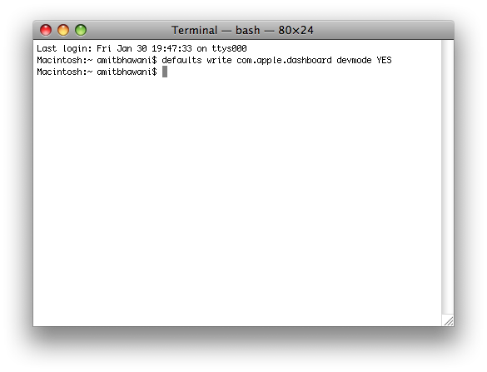
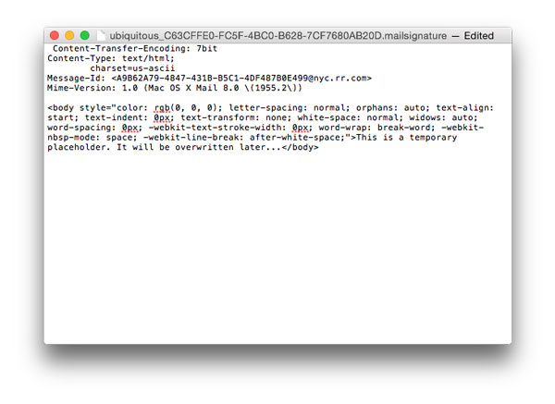
You need:
1. Terminal ( in Applications/Utilities)
2. A Text editor. You can open scripts there.
For example TextEdit. All the scripts are
text files that can be ran bit by bit or at once.
Today we want to run them bit by bit.
It will read python code if you type:
ipython
* If you opened ipython directly from Anaconda no need of starting ipython from the terminal, it is the same thing.

Slide 5
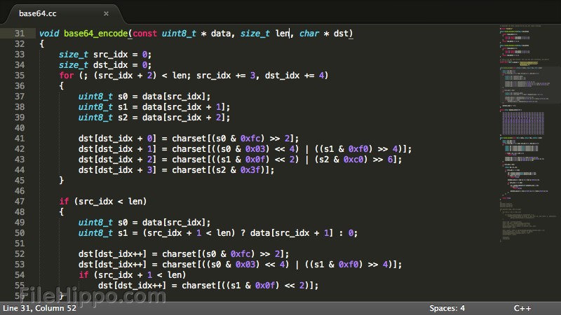
Extra tips to get started
Sublime text is a great looking and very helpful text editor for windows, OS X or linux
https://www.sublimetext.com/

Slide 6
http://tinyurl.com/k9ore9o
GettingStarted.pdf
How to open python on your own computer
AdvancedBasics.py
data structures and python basics
Summary_fasta.py
Output a brief summary from an input file
data_and_plotting.py
process data using python and easy plotting
resources.txt
Some links to a few nice resources

