Slide 1
PRIVATE PRE-SCHOOL EDUCATION INSTITUTIONS IN NEW ZEALAND
Prepared by Lidziya Vitushka

Slide 2
SUBJECT OF PROJECT
The dynamics of the birth rate in different cities of New Zealand and its correlation with the indicator of the standard of living in different regions. The current level of development of the pre-school education system in New Zealand.
Preschool education in New Zealand is paid and not compulsory.

Slide 3
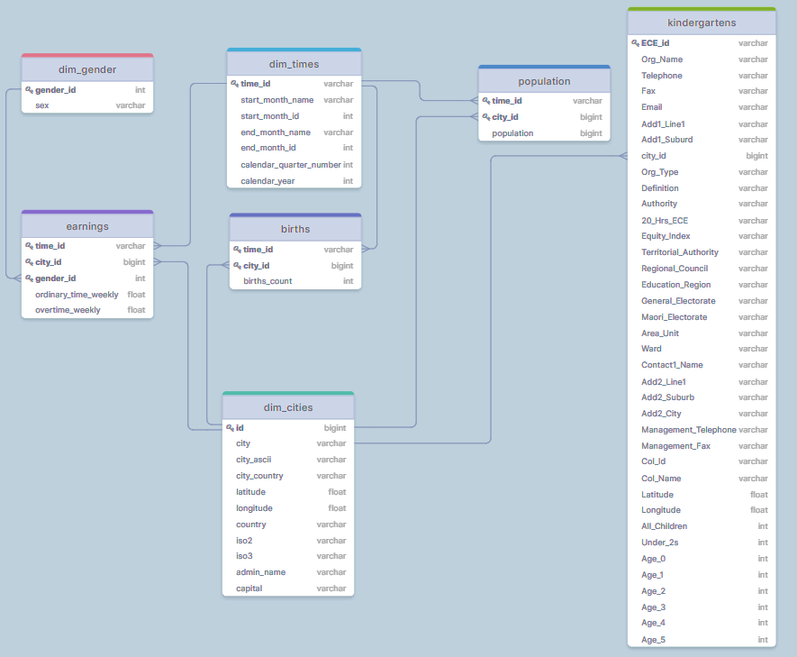
Entity Relationship Diagram (ERD)

Slide 4
GOALS
01
EXPLORE
03
ESTIMATE
the correspondence of the number of kindergartens to the number of children living there
the standard of living of the local urban population based on the average quarterly salary
02
ANALYSE
04
EVALUATE
the dynamics of the birth rate of children in cities
the overall ratio of preschool education institutions to the resident population

Slide 5
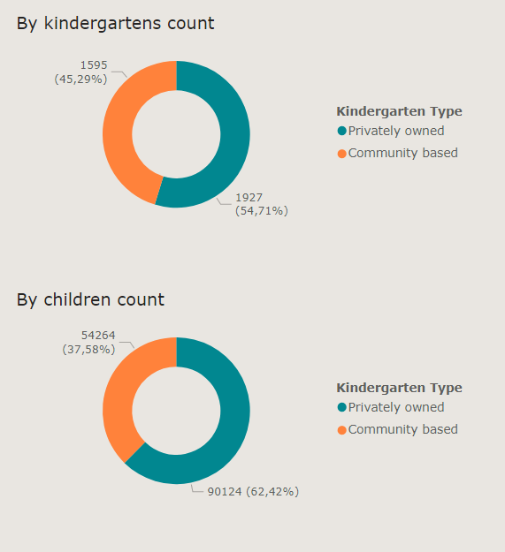
KINDERGARTENS AUTHORITY AND WORKLOAD

Slide 6
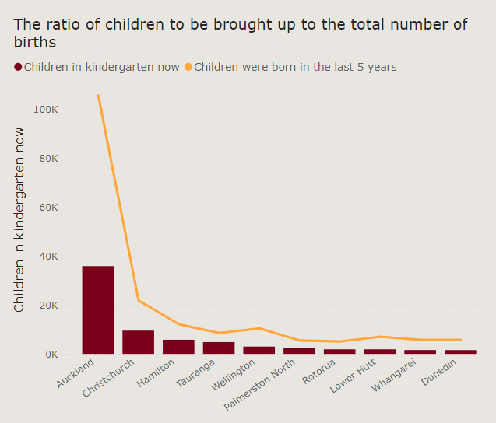
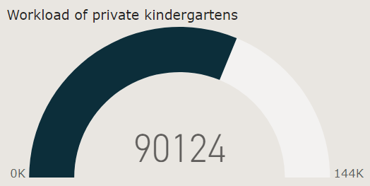
WORKLOAD OF PRIVATE KINDERGARTENS

Slide 7
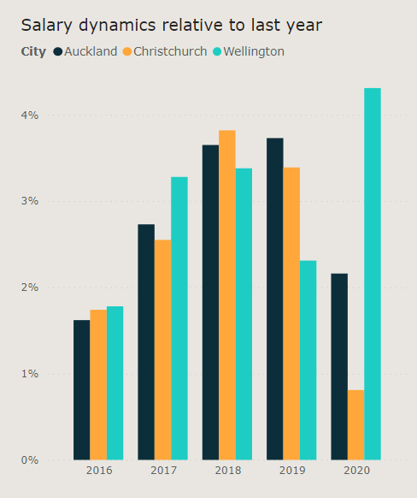
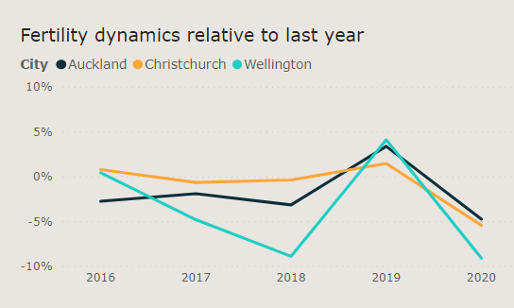
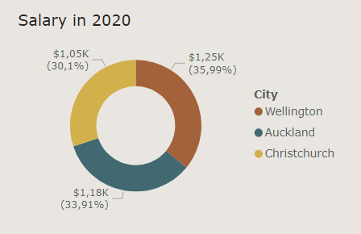
LARGEST CITY DYNAMICS

Slide 8
Conclusions:
The main share of kindergartens in New Zealand is made up of private kindergartens, which account for the majority of pupil;
Kindergartens are not fully loaded, there are free places in them, but almost half of preschool children do not attend them at all;
Auckland is the most in need of pre-school education, it is one of the Top 3 largest cities in New Zealand and is in second place in terms of average monthly salary for 2020;
There is an inverse relationship between the growth of the average annual salary and the birth rate.

Slide 9
Thanks for your attention!

