Slide 1
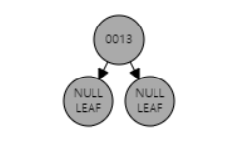
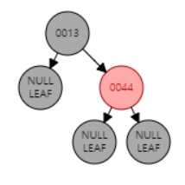


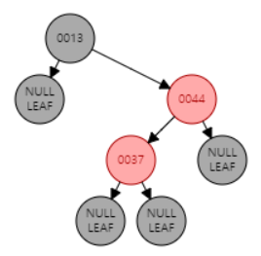
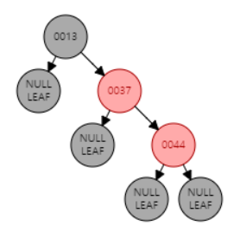
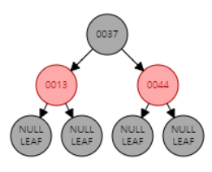

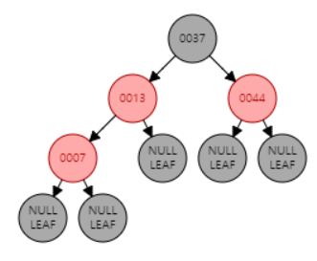
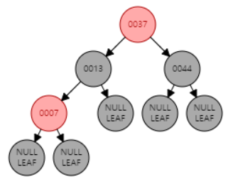
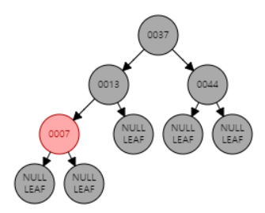

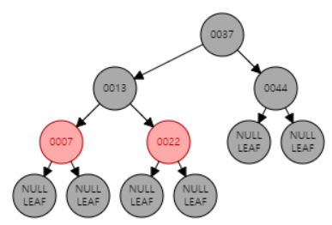

Assignment 9
Name: DONGWOOK LEE
Problem 9.1 Understanding Red Black Trees
Insert {13, 44, 37, 7, 22, 16} into an empty RB Tree in order
1
2
1. Insert 44 into the tree.
Compare keys of z and T.Root. ➔ z.key > T.Root.key
Right child of T.Root is NULL, replace with z
2. Complete
1
2
T.Root
1. Insert 13 into an empty tree T.
Violates RooB
➔ T.root.color = black;
2. Complete
z
T.Root
z
(Empty)
1. Insert 37 into the tree.
Compare keys of z and T.Root. ➔ z.key > T.Root.key
Compare keys of z and T.root.right ➔ z.key < T.root.right.key
2. T.Root.right.left is NULL, replace with z. Violates BredB
z = z.p.left & z.p = z.p.p.right & z.p.p.left = black (Symmetric to Case 2)
➔ Right rotation (T, z.p)
3. z = z.p.right & z.p = z.p.p.right & z.p.p.left = black (Symmetric to Case 3)
➔ Left rotation (T, z.p.p)
4. Complete
1
T.Root
2
3
4
z
1
2
3
3
1. Insert 7 into the tree.
Compare keys of z and T.root. ➔ z.key < T.root.key
Compare keys of z and T.root.left ➔ z.key < T.root.left.key
2. T.root.left.left is NULL, replace with z. Violates BredB
z.p = z.p.p.left & z.p.p.right = red (Case 1)
➔ z.p.color = black; z.p.p.right.color = black; z.p.p.color = red;
3. Violates RooB
➔ T.root.color = black;
4. Complete
T.Root
z
1
T.Root
2
1. Insert 22 into the tree.
Compare keys of z and T.root. ➔ z.key < T.root.key
Compare keys of z and T.root.left ➔ z.key > T.root.left.key
2. T.root.left.right is NULL, replace with z.
Complete
z

Slide 2
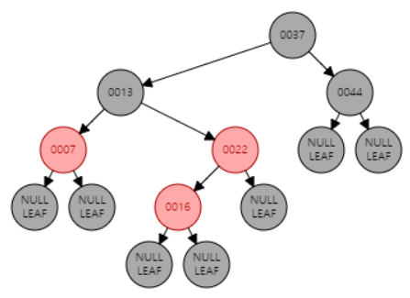
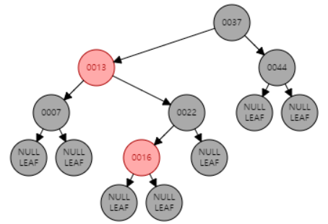

1
T.Root
2
3
z
1. Insert 16 into the tree.
Compare keys of z and T.root. ➔ z.key < T.root.key
Compare keys of z and T.root.left ➔ z.key > T.root.left.key
Compare keys of z and T.root.left.right ➔ z.key < T.root.left.right.key
2. T.root.left.right.left is NULL, replace with z. Violates BredB
z.p = z.p.p.right & z.p.p.left = red (Symmetric to Case 1)
➔ z.p.color = black; z.p.p.left.color = black; z.p.p.color = red;
3. Complete
Result:

Slide 3
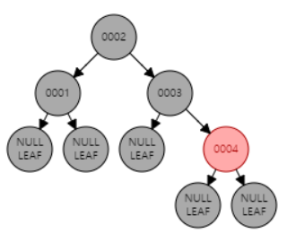
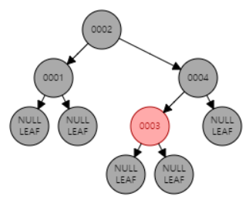
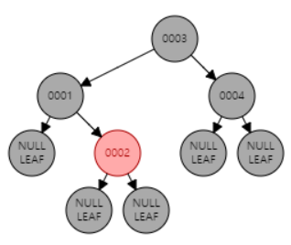
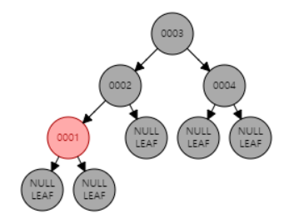
(b) Make all valid RB Tree with the elements {1, 2, 3, 4}.
1 ➔ 2 ➔ 3 ➔ 4
1 ➔ 3 ➔ 2 ➔ 4
2 ➔ 1 ➔ 3 ➔ 4
2 ➔ 3 ➔ 1 ➔ 4
3 ➔ 1 ➔ 2 ➔ 4
3 ➔ 2 ➔ 1 ➔ 4
1 ➔ 2 ➔ 4 ➔ 3
1 ➔ 4 ➔ 2 ➔ 3
2 ➔ 1 ➔ 4 ➔ 3
2 ➔ 4 ➔ 1 ➔ 3
4 ➔ 1 ➔ 2 ➔ 3
4 ➔ 2 ➔ 1 ➔ 3
1 ➔ 3 ➔ 4 ➔ 2
1 ➔ 4 ➔ 3 ➔ 2
3 ➔ 1 ➔ 4 ➔ 2
3 ➔ 4 ➔ 1 ➔ 2
4 ➔ 1 ➔ 3 ➔ 2
4 ➔ 3 ➔ 1 ➔ 2
2 ➔ 4 ➔ 3 ➔ 1
2 ➔ 3 ➔ 4 ➔ 1
3 ➔ 2 ➔ 4 ➔ 1
3 ➔ 4 ➔ 2 ➔ 1
4 ➔ 2 ➔ 3 ➔ 1
4 ➔ 3 ➔ 2 ➔ 1

Slide 4
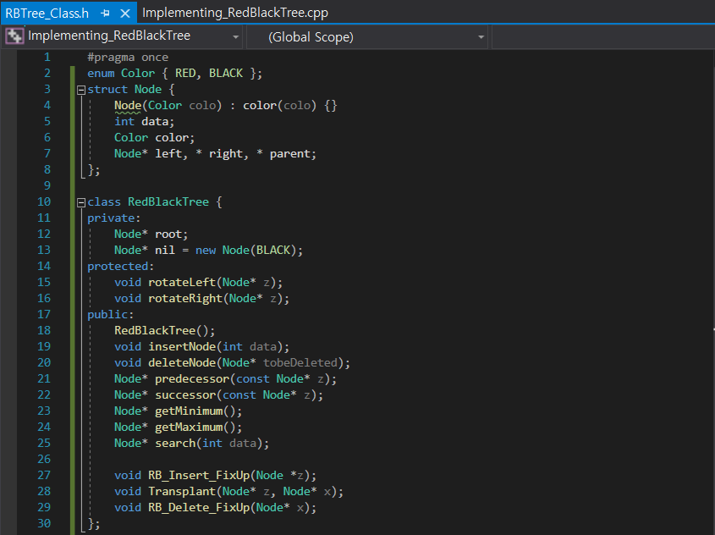
Problem 9.2 Implementing Red Black Trees

Slide 5
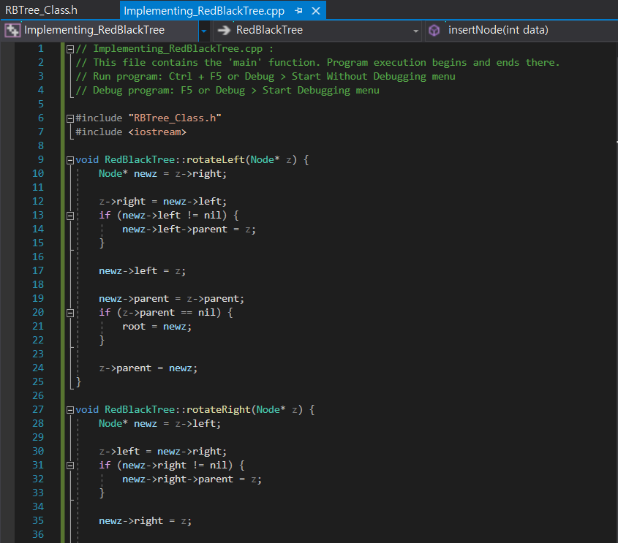
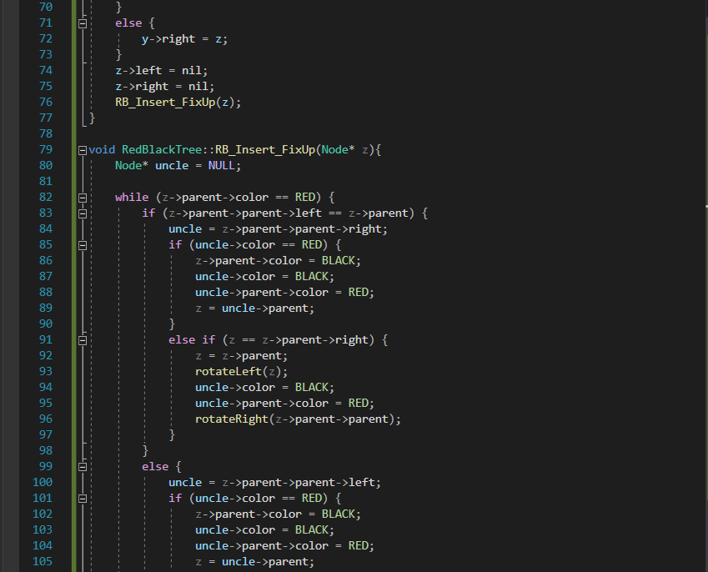
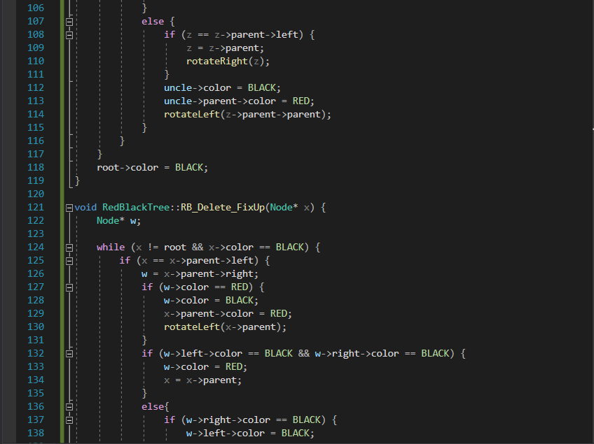
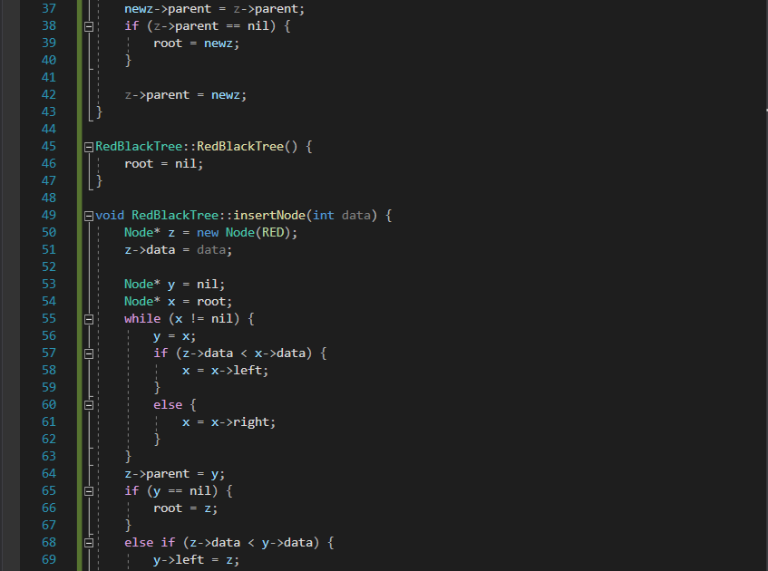

Slide 6
