Slide 2

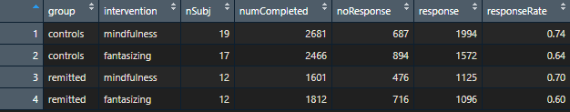
ESM data
39 participants

Slide 3
Remaining patient_id issues
patient_id | id | group | intervention | numBeeped | responseRate
md-031fd810b25401391af60242ac120002 | NA | NA | NA | 5 | 0
md-0f7ce6d02fcd0138a7a20242ac120002 | NA | NA | NA | 70 | 0.56
md-14a53fa038ce013a771d0242ac120003 | NA | NA | NA | 10 | 0.2
md-1a8d57203a1401393fe60242ac120002 | NA | NA | NA | 24 | 0.62
md-2d236e801b710139743f0242ac120003 | NA | NA | NA | 140 | 0.68
md-2f5b0660359c013a32760242ac120003 | NA | NA | NA | 14 | 0.07
md-3cd1a870d57b013840550242ac120003 | NA | NA | NA | 50 | 0.76
md-536d6b30ee830138aa060242ac120003 | NA | NA | NA | 80 | 0.79
md-5e1476f033cf0139aa6a0242ac120003 | NA | NA | NA | 20 | 0.5
md-66f2ad10922b013a52bb0242ac120004 | NA | NA | NA | 50 | 0.56
md-6a3b44202e210138a7a20242ac120002 | NA | NA | NA | 141 | 0.85
md-79f620a098a6013a52bb0242ac120004 | NA | NA | NA | 5 | 0
md-84e2701038cd013accf80242ac120004 | NA | NA | NA | 5 | 0
md-85cc2730205d013a771d0242ac120003 | NA | NA | NA | 5 | 0
md-aa0ca330a99d0139b98d0242ac120002 | NA | NA | NA | 70 | 0.39
md-e90480c0a99f0139b98d0242ac120002 | NA | NA | NA | 52 | 0.04
md-f7c1ec804d180139964d0242ac120004 | NA | NA | NA | 30 | 0.17

Slide 4
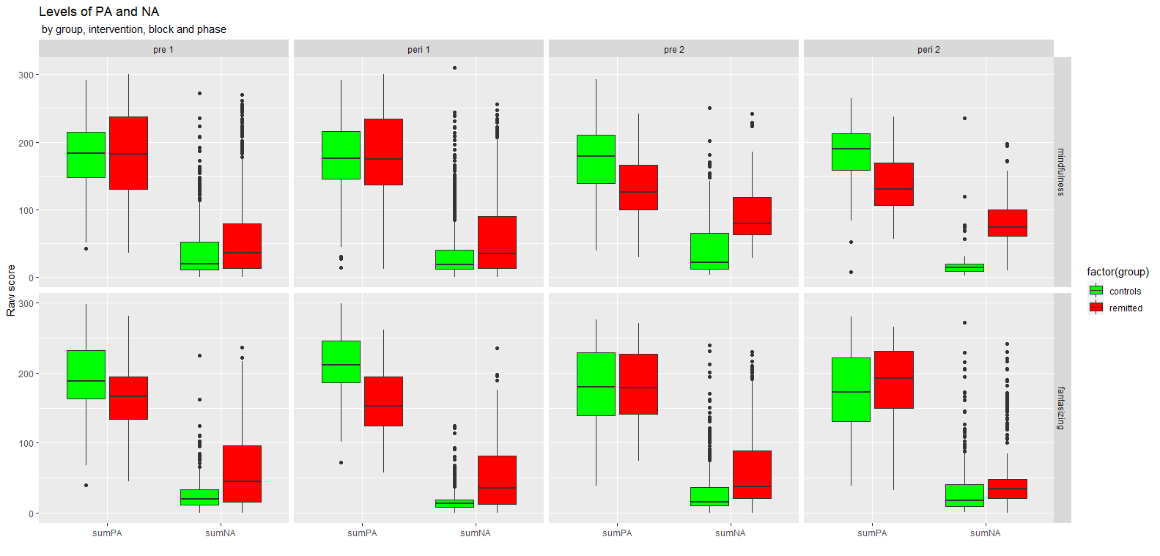

Slide 5
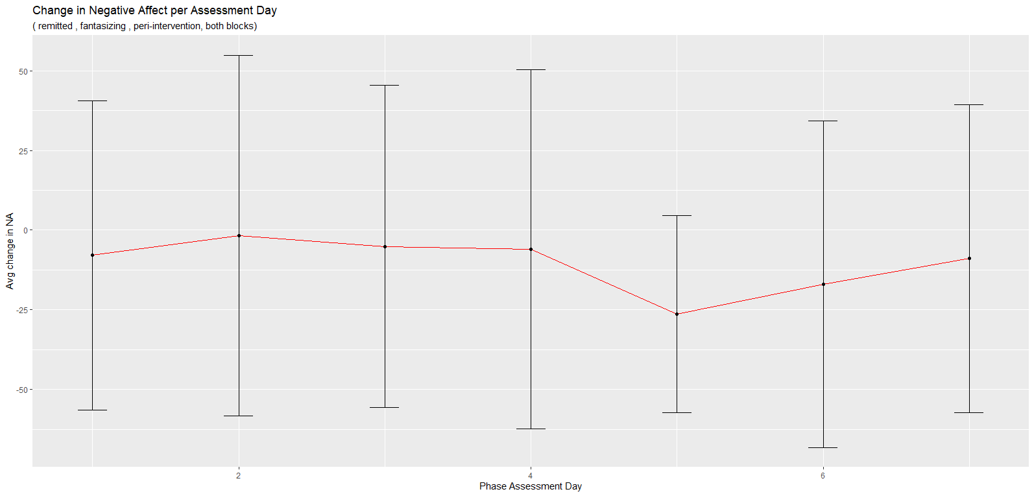
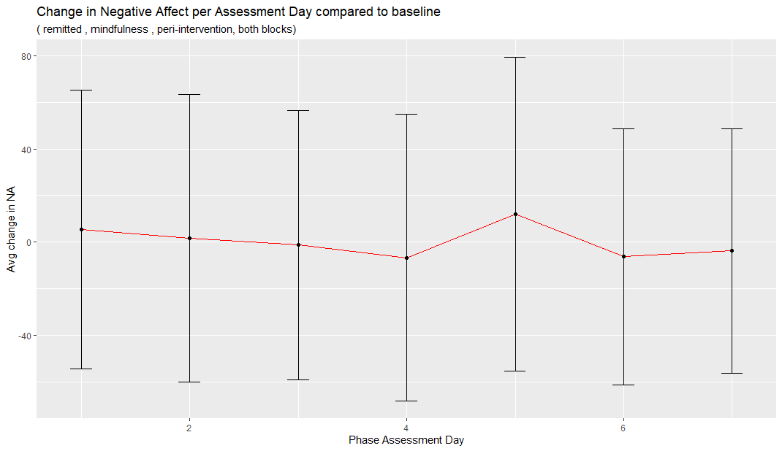

Slide 7
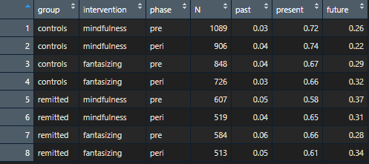
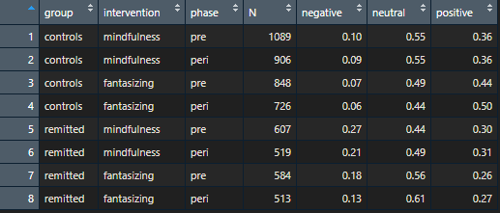

Slide 8

SART data

Slide 9
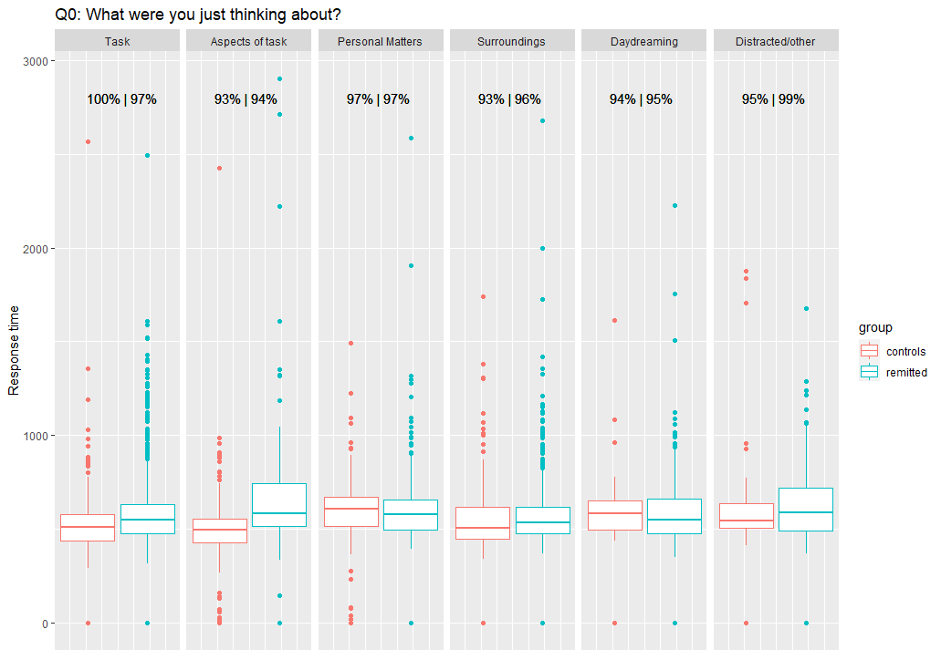

Slide 10
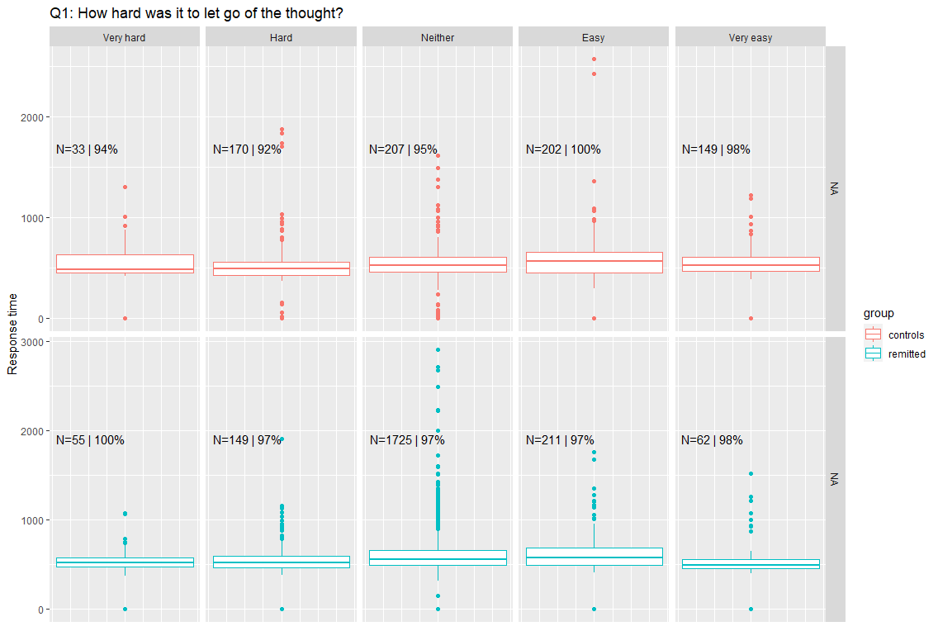

Slide 11
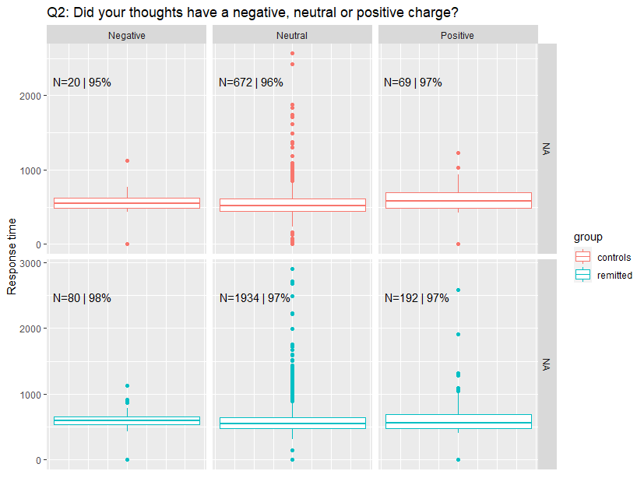

Slide 12
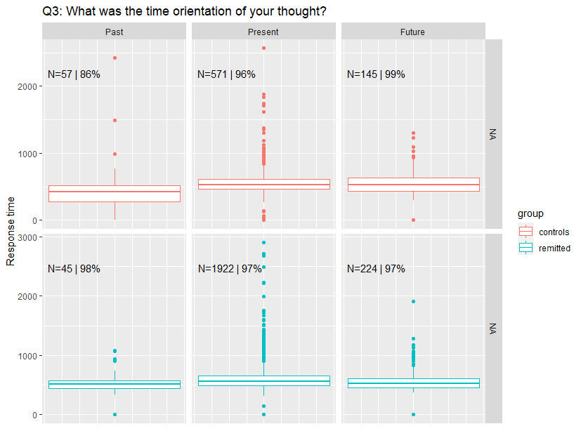

Slide 14
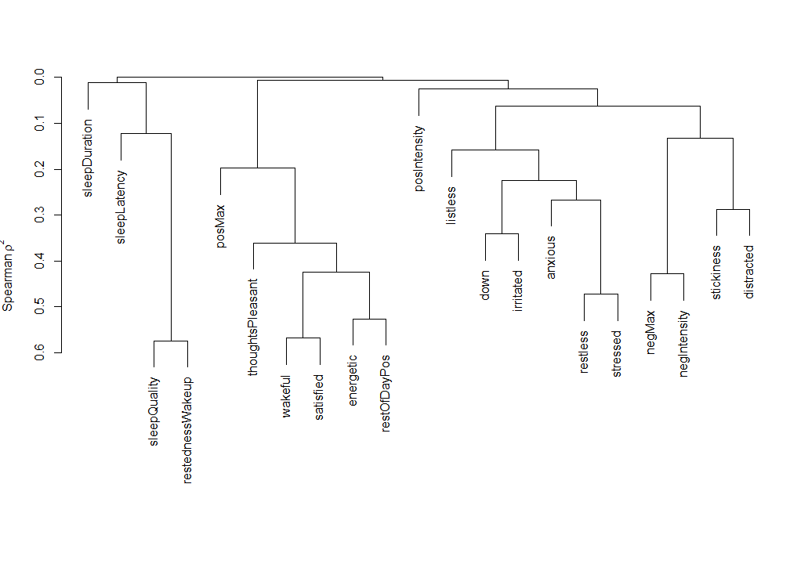
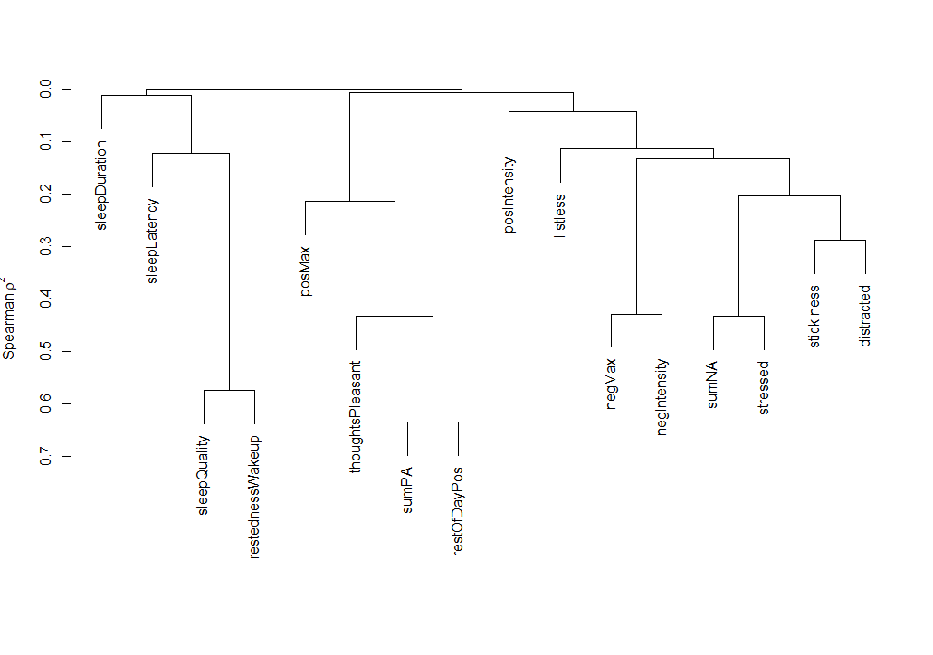
Using sumNA and sumPA Condition number: ~25.8
Condition number: ~29.6

Slide 17
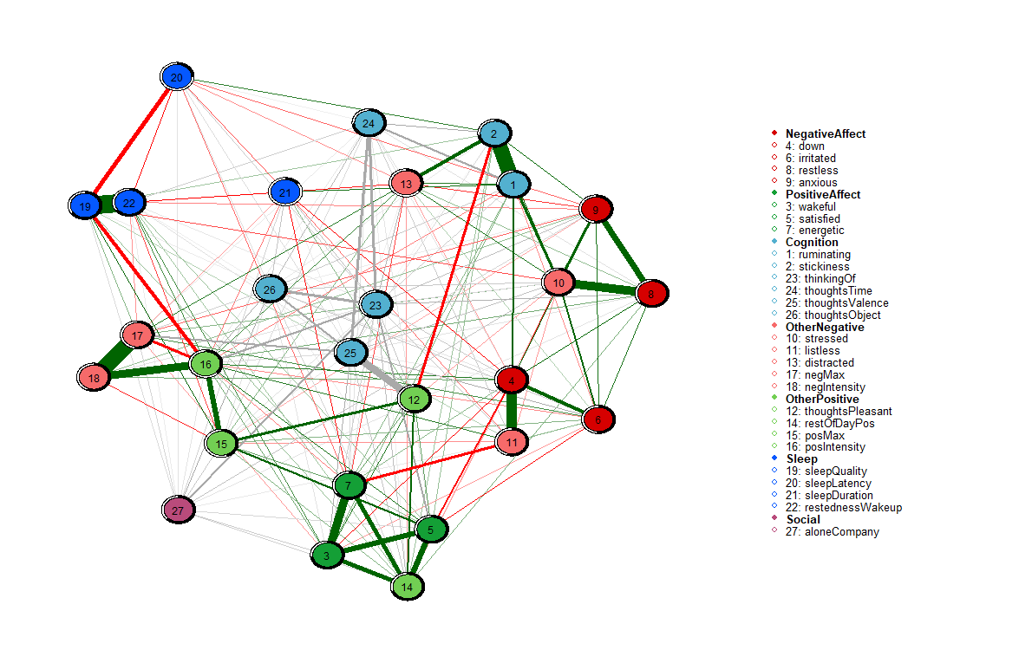
All participants

Slide 18
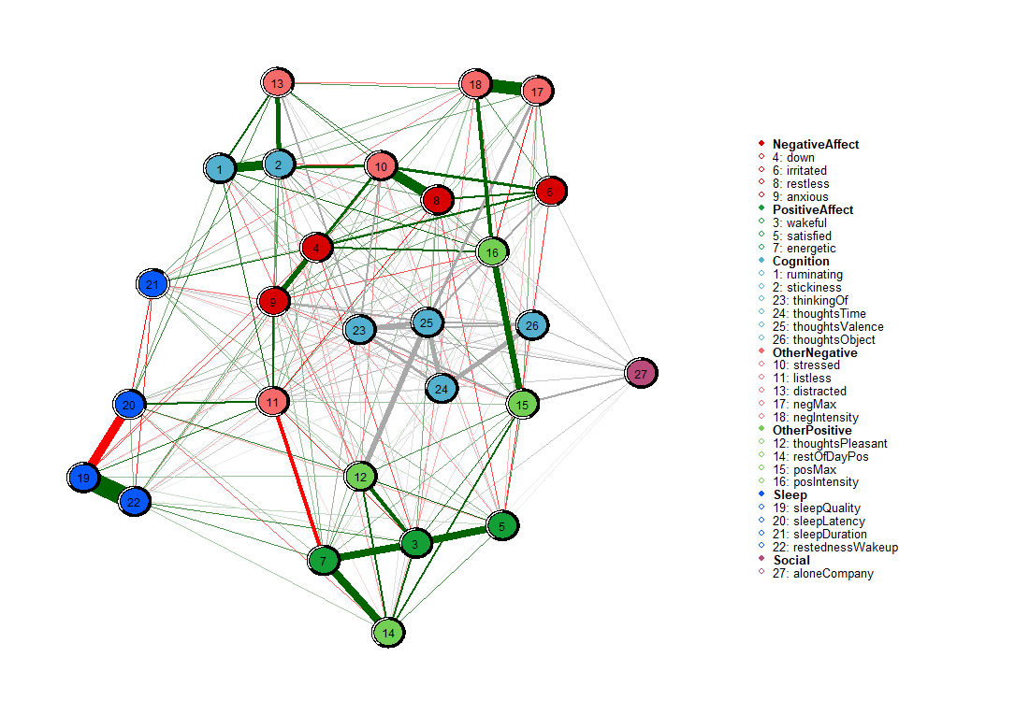
Controls

Slide 19

Remitted

