Slide 1
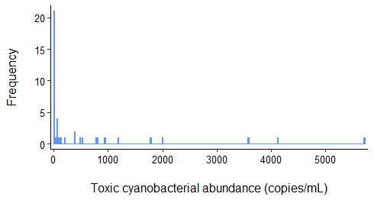
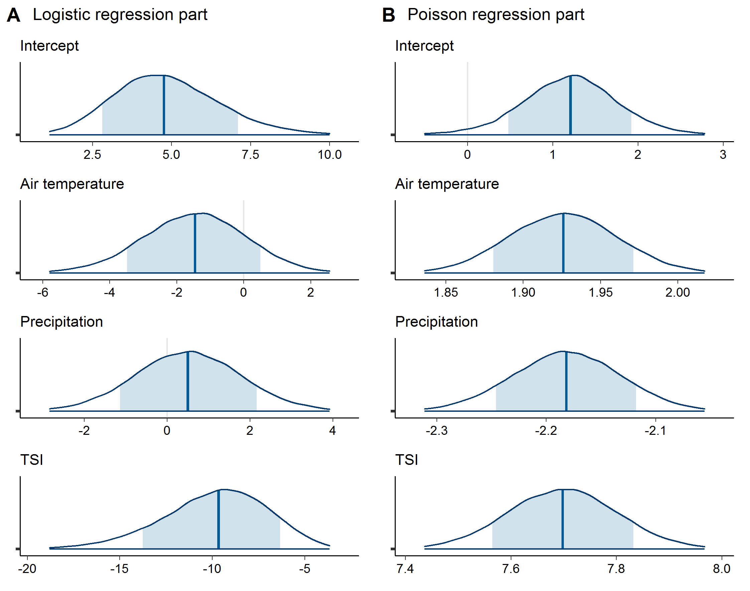
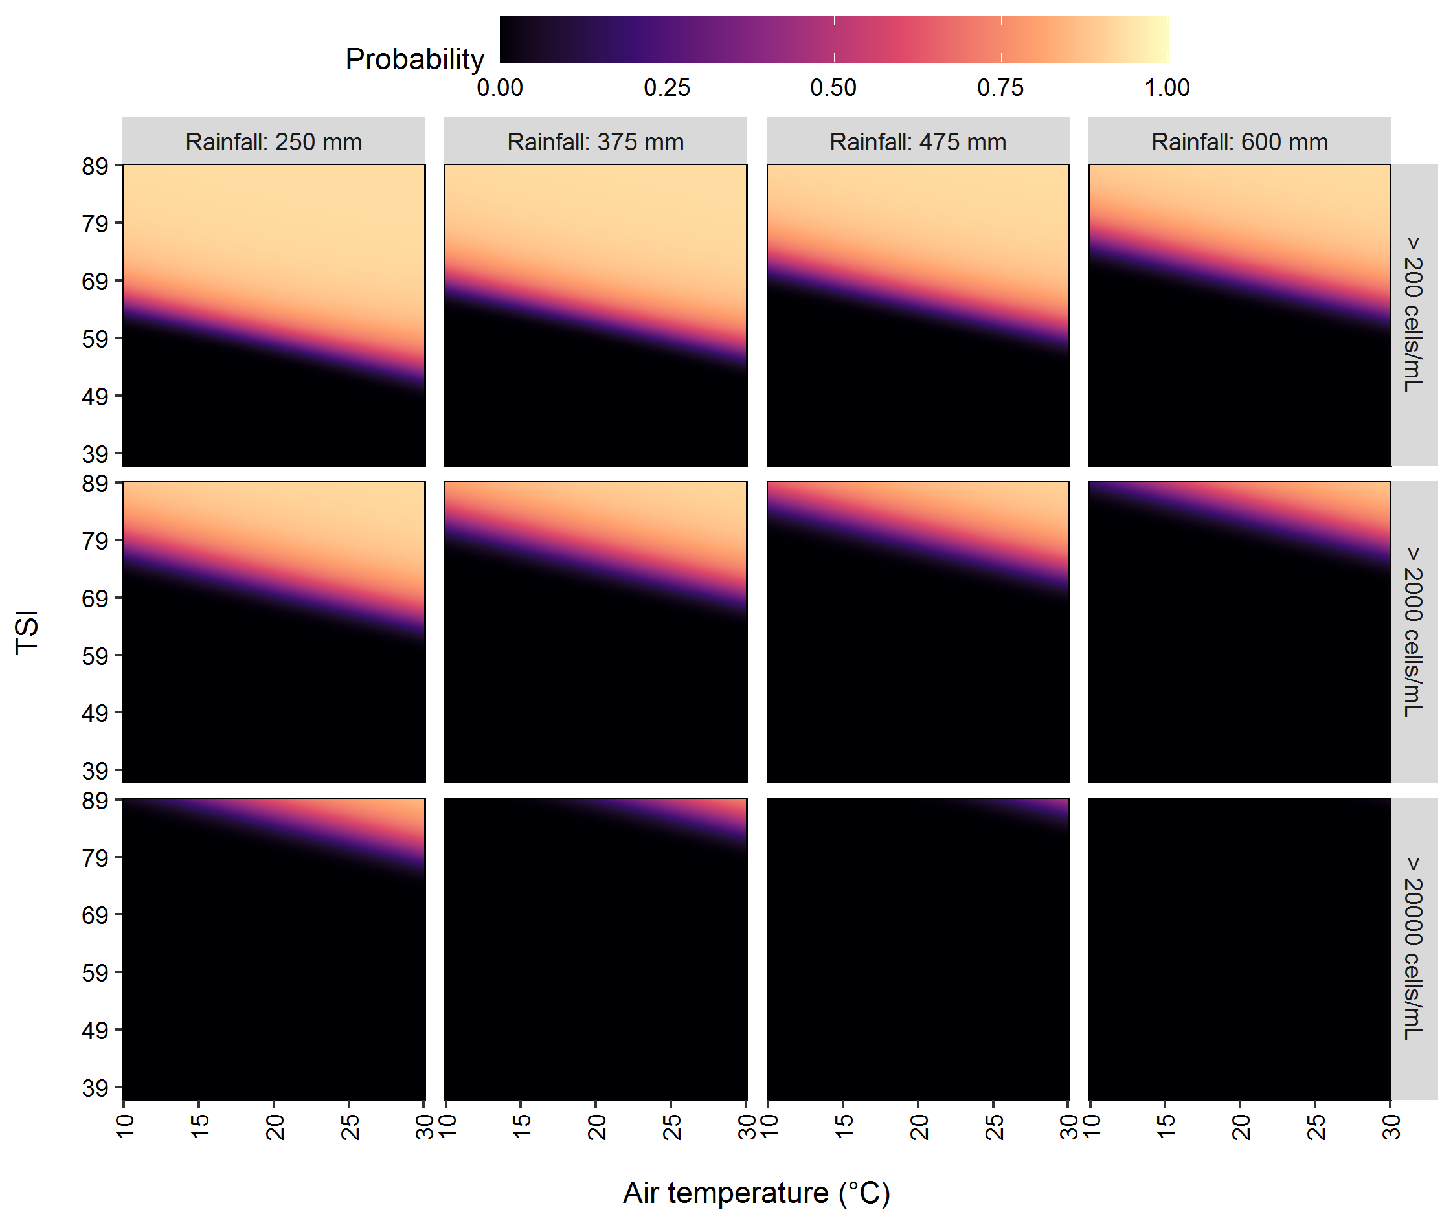
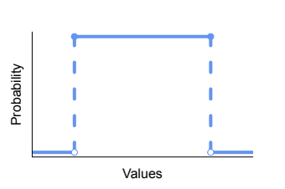
Zero-inflated data
Prediction of
toxic Microcystis
Response variable: cyanobacterial abundance
Posterior distributions
Exploratory variables
- Air temperature
- Rainfall
- Trophic state index
Bayesian Hurdle
Poisson Model
Non-informative prior distributions

