Slide 1

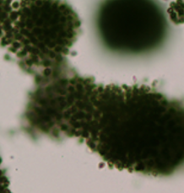
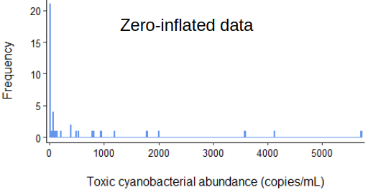

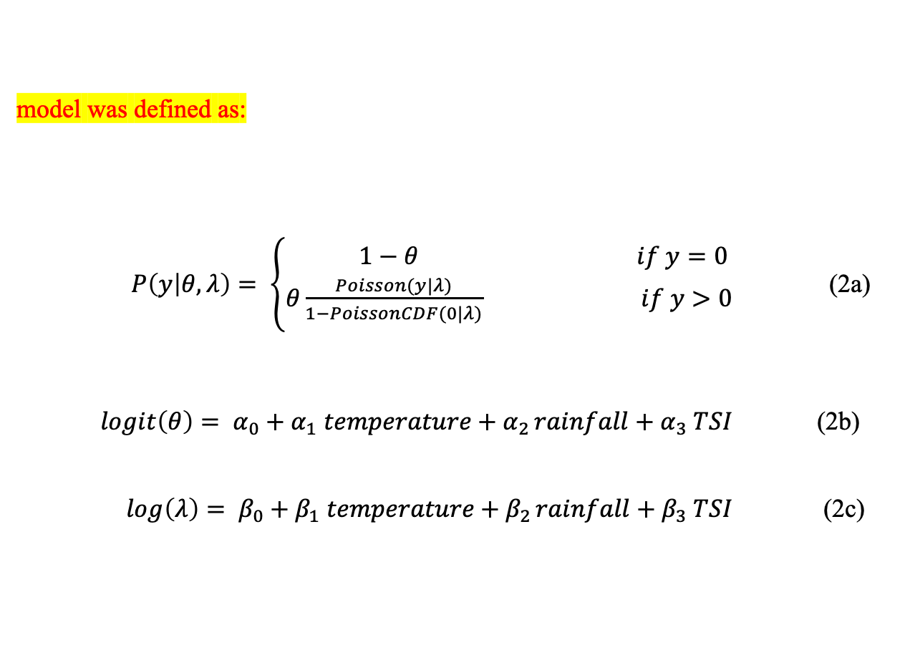
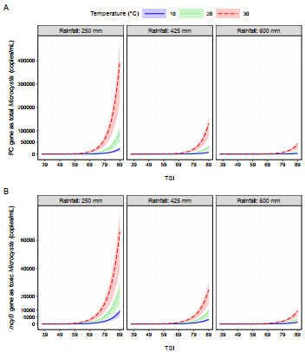
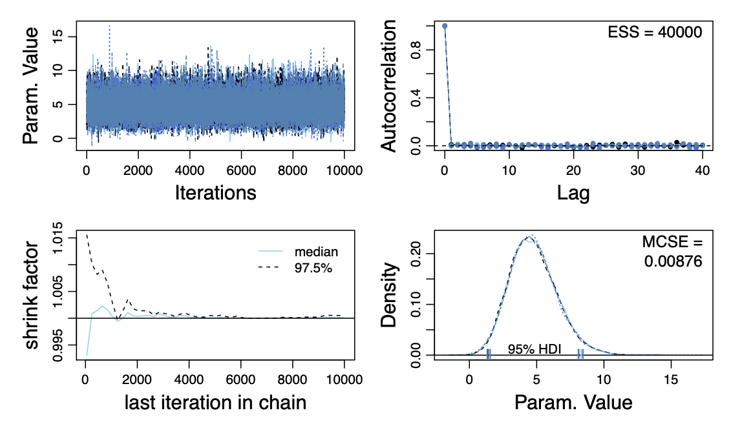
Microcystis
Real-time PCR
mcyB gene: toxic Microcystis
PC gene: total Microcystis
DNA
Reservoir
Trophic State Index (TSI)
(chlorophyll-a)
Total Microcystis abundance
Bayesian Hurdle Poisson Model
Meteorological Data
(air temperature, rainfall)
MCMC simulation
Toxic Microcystis abundance
Prediction

