Slide 1


Guide 101 to Computer Canada Database
Sara Correa-Garcia, PhD
September 2022

Slide 2
Access
https://ccdb.computecanada.ca/

Slide 3
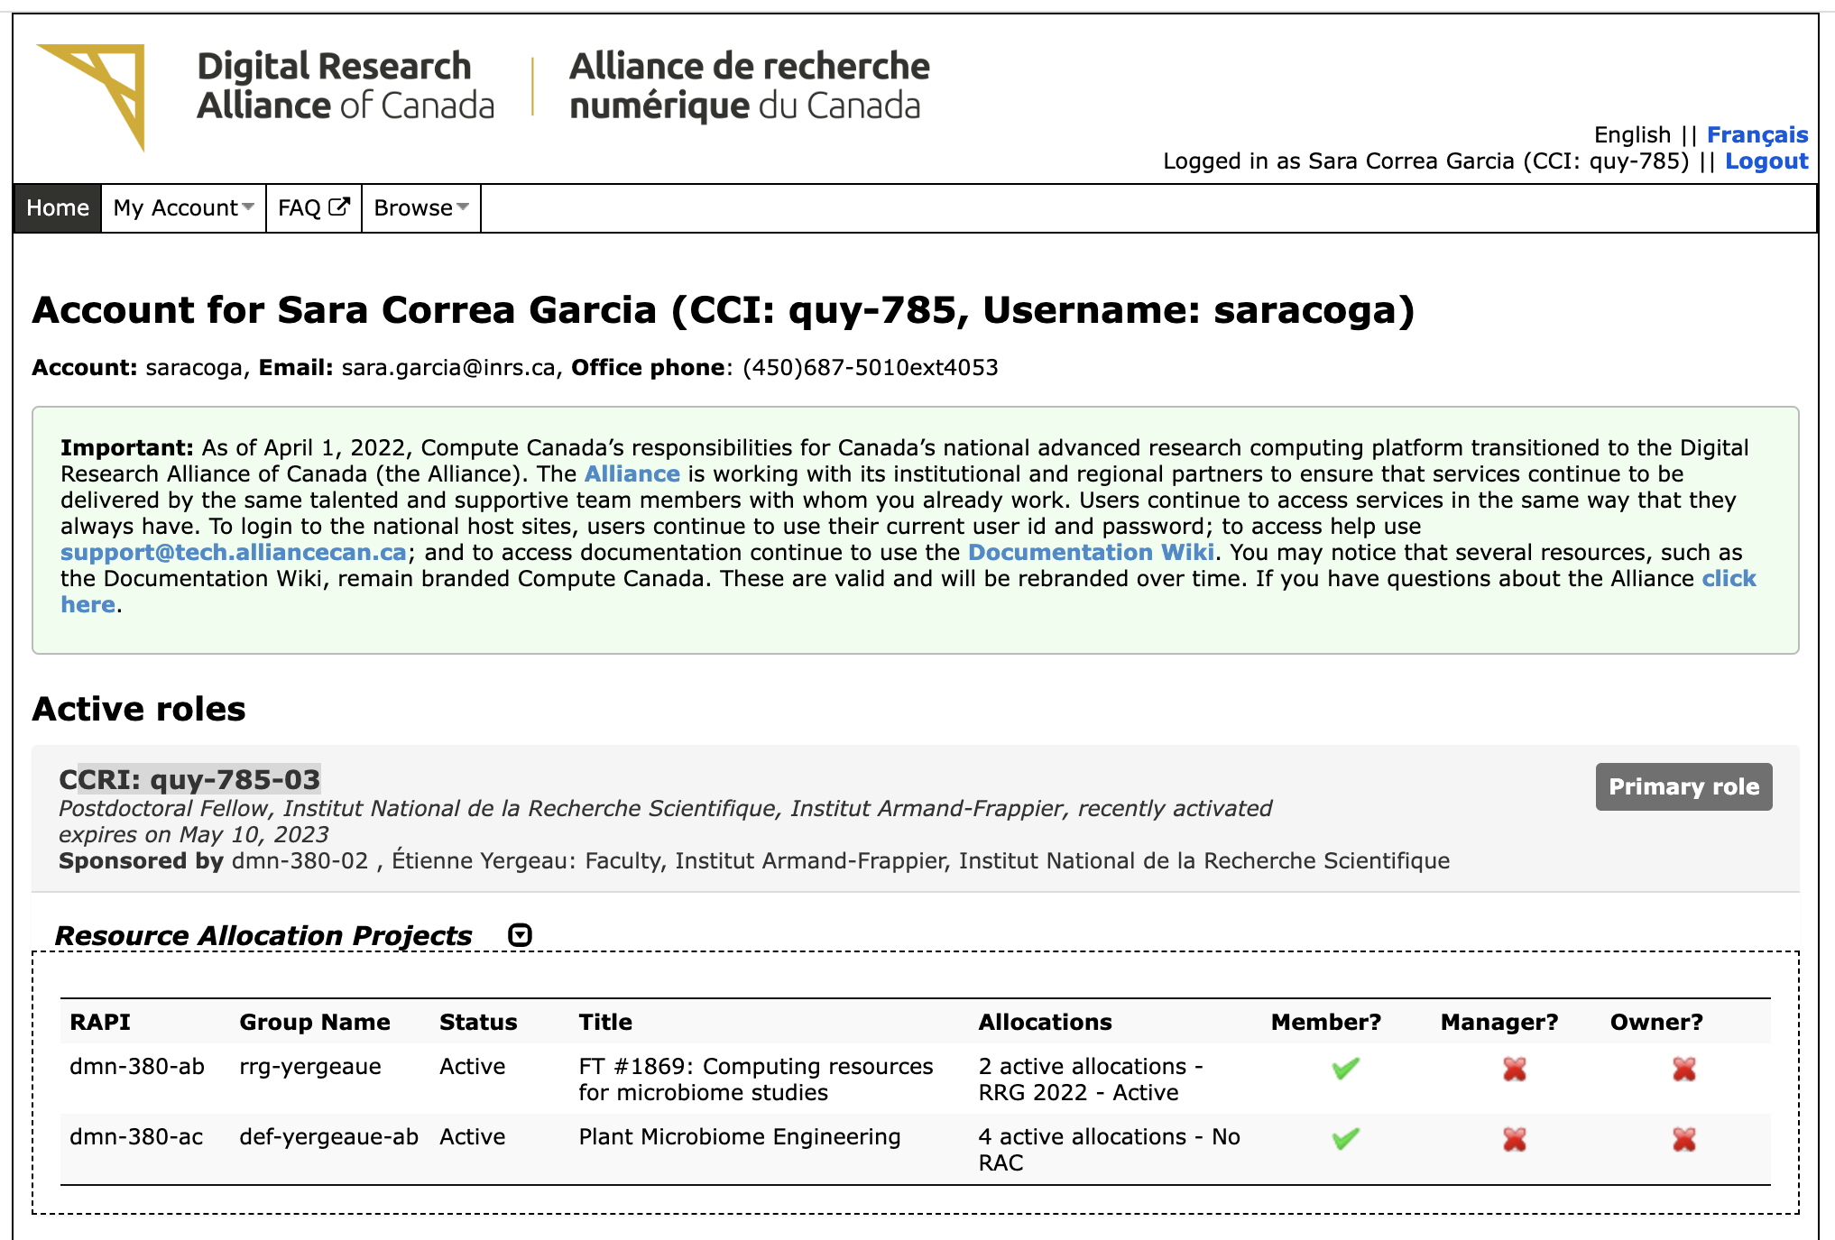
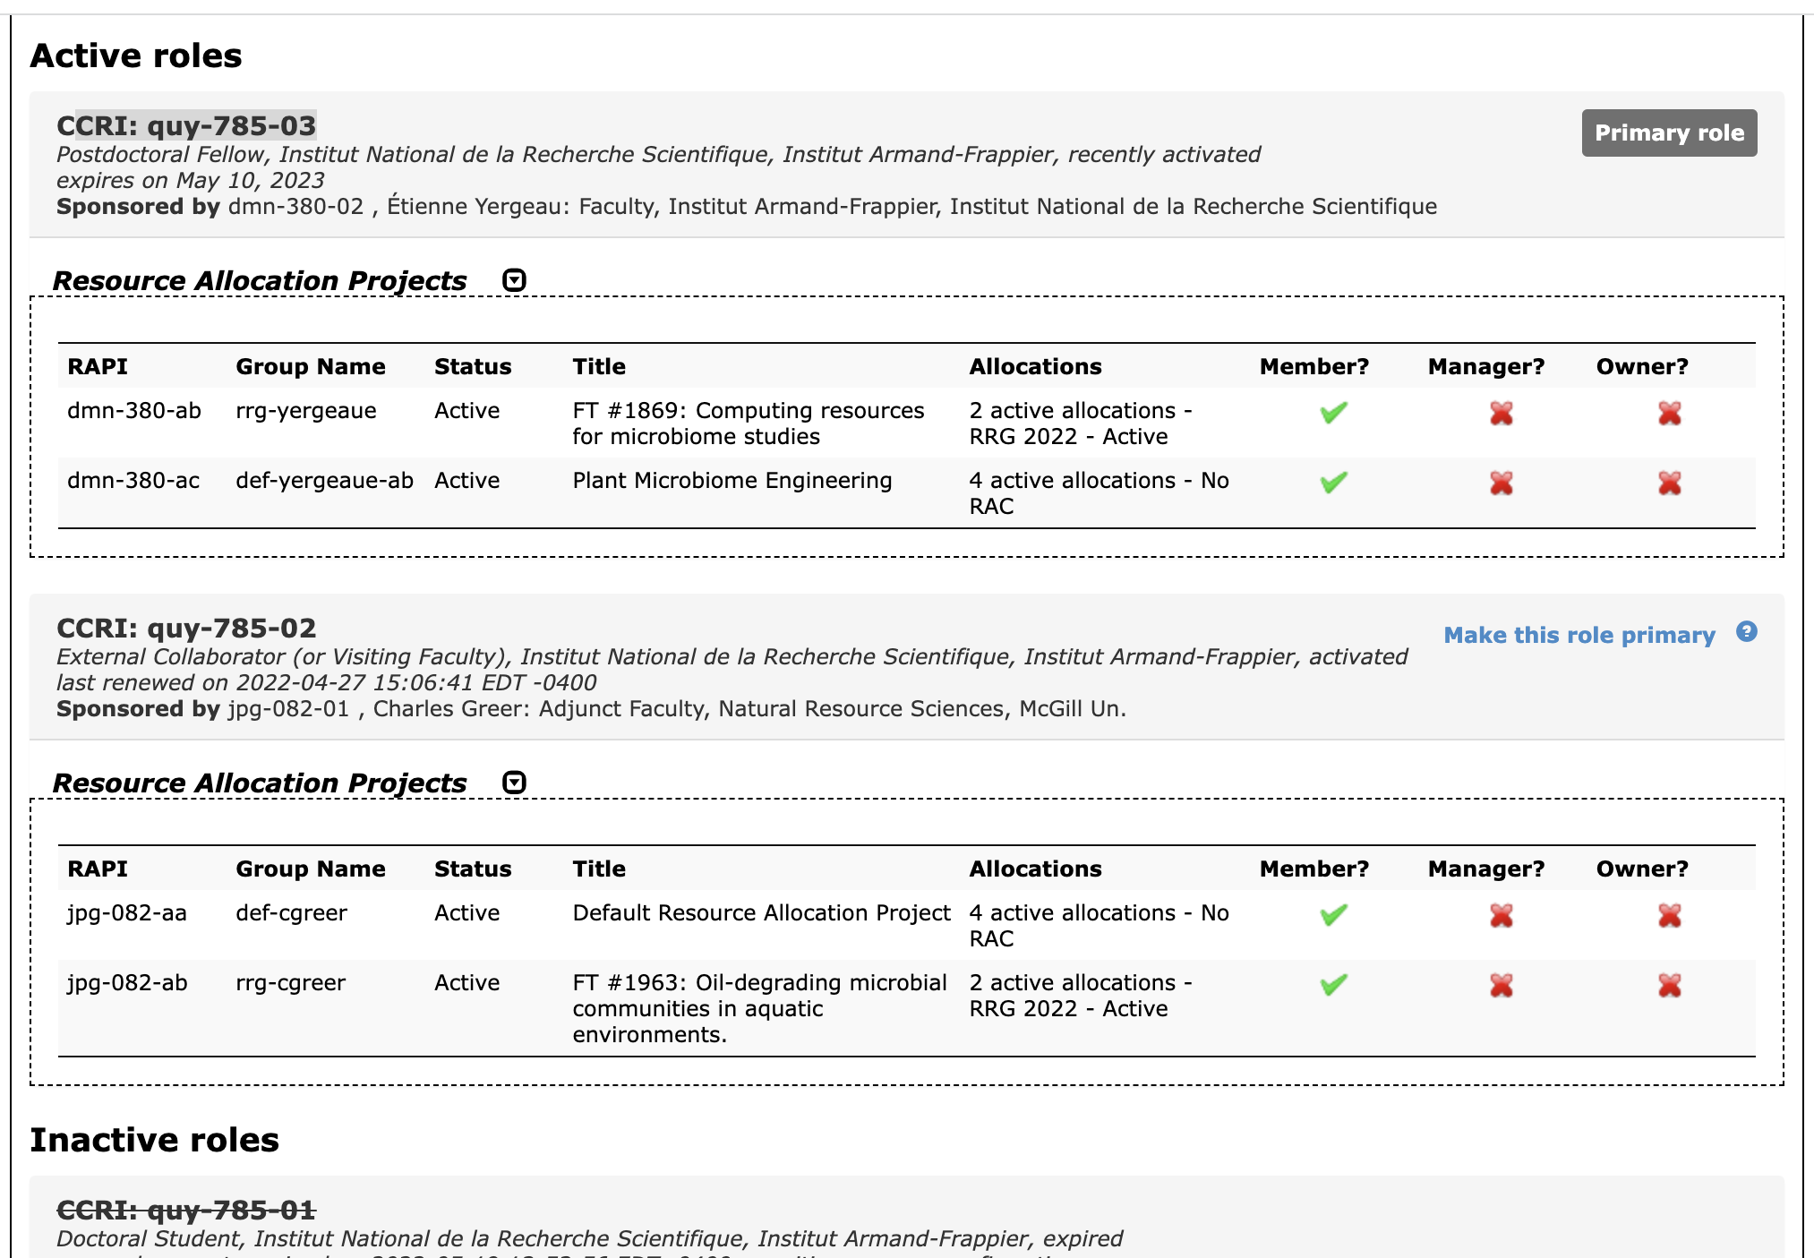
Compute Canada Identifier (CCI): a unique personal and national identifier. A CCI is created for you “once” when you register with CCDB. You must be a member of or be sponsored by a faculty member at a Canadian institution registered with CCDB.
Role: Identifier that represents a combination of a person’s position, institution, and sponsor. In order to access Compute Canada resources, you must have a valid and up-to-date role. A CCRI is associated with each role and uniquely identifies it. Some people may have more than one active role at a time. When changing institution, sponsor or position you need to apply for a new role
Compute Canada Role Identifier (CCRI): unique identifier for your role. One CCI may be associated with more than one CCRI. Every job that runs on a Compute Canada ARC system is attributed to a CCRI.

Slide 4
Resource Allocation Project : Compute Canada resources are made available to PIs and their research group (not to individuals) through RAP. Each RAP is identified by a RAPI and an associated group name. Researchers are usually working on at least one research project. In general, there are two main types of RAPs:
Default RAP: A default RAP is automatically created when a PI role is activated. Default and Rapid Access Service quotas for storage and cloud resources are managed via this default RAP. The Default RAP allows PIs and sponsored users to make opportunistic use of computing resources with the default (that is, the lowest) priority. On CCDB, it uses the convention def-profname.
RAC RAP: This RAP is created when the PI receives an award through any of the Resource Allocation Competitions. The RAC RAPI typically takes the form abc-123-ab, with an associated group name typically of the form of rrg-profname-xx or rpp-profname-xx for HPC allocations, and crg-profname-xx or cpp-profname-xx for Cloud allocations, depending on the competition.

Slide 5
Connect to the cluster via SSH
Before connecting to the clusters via the command line, you need to connect your computer via an ssh public key.
You probably have one already. If that is the case, instructions to link your current key start at slide (number)
If you do not have a key, you can generate one and then link it

Slide 6
Mac/Linux users: generate a public key to secure shell (ssh) connect to the clusters
In mac
https://docs.alliancecan.ca/wiki/SSH_Keys#Best_practices_for_key_pairs
https://docs.alliancecan.ca/wiki/SSH_Keys#Using_the_authorized_keys_file
https://docs.alliancecan.ca/wiki/Using_SSH_keys_in_Linux

Slide 7
Windows users: generate a public key to secure shell (ssh) connect to the clusters
In Windows

Slide 8
[name@server ~]$ ssh -Y username@machine_name
The first time that you connect to a remote machine you'll be asked to store a copy locally of its "host key", a unique identifier that allows the ssh client to verify, when connecting next time, that this is the same machine.
The option -Y shown above forwards X11 traffic which allows you to use graphical applications on the remote machine such as certain text editors. Note that to use graphical applications you also need to have an X11 server installed on your workstation. Under Linux an X11 server will normally already be installed, but users of macOS will typically need to install an external package such as such XQuartz. Under windows, MobaXterm comes with an X11 server, while for PuTTY users, there is VcXsrv.

