Slide 1
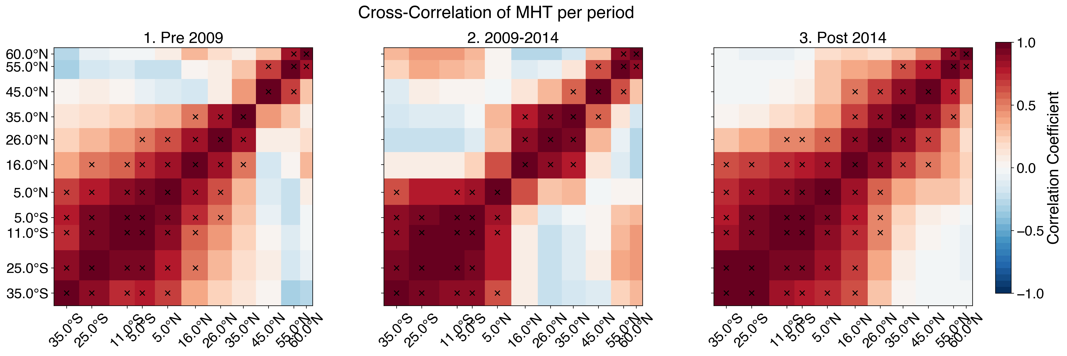
Cross correlation for periods shows break
By eye: 1 period: 2004-2008-11, 2. period: 2009-2014-11, 3. period: 2015-2020
break between 16°N and 5°N
$→$ validate / investigate timescales using wavelet coherence!

Slide 2
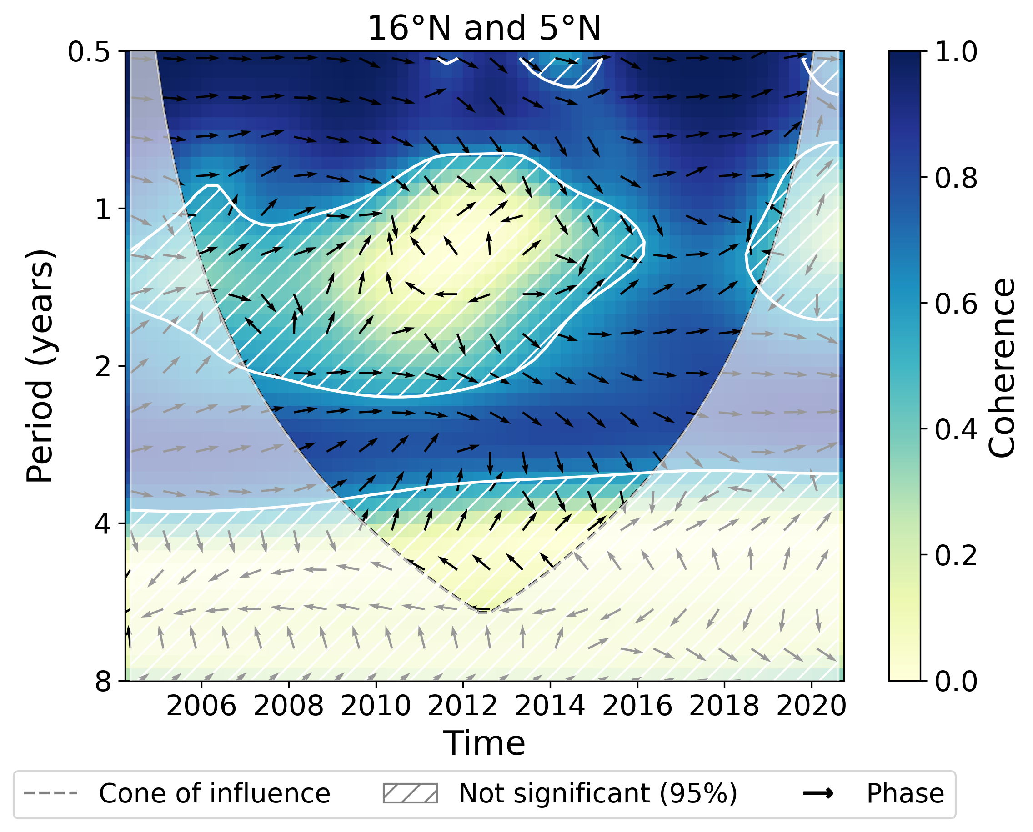
Wavelet coherence: 16°N and 5°N
Validate / investigate timescales using wavelet coherence (Cross correlation split by eye)
Interpretation of wavelet coherence plot:
On (bi-) annual scales:
Drop of coherence below 0.4 (not significant), strongly pronounced around 2009 - 2014 (including 2014)
Phase arrows are scattered around $→$ no stable relative phase relationship
Interannual:
Around 3 years again high coherence
Similar drop in coherence around 4-5 year period as on annual scales (not significant) , out of phase (i.e. anti-correlation?)
Around 2008 - 2010: 16°N leading by ~1 year, then around 2012 switch to 5°N leading by ~1 year
Wavelet coherence transform between 16°N and 5°N. Period in logarithmic scale.

Slide 3
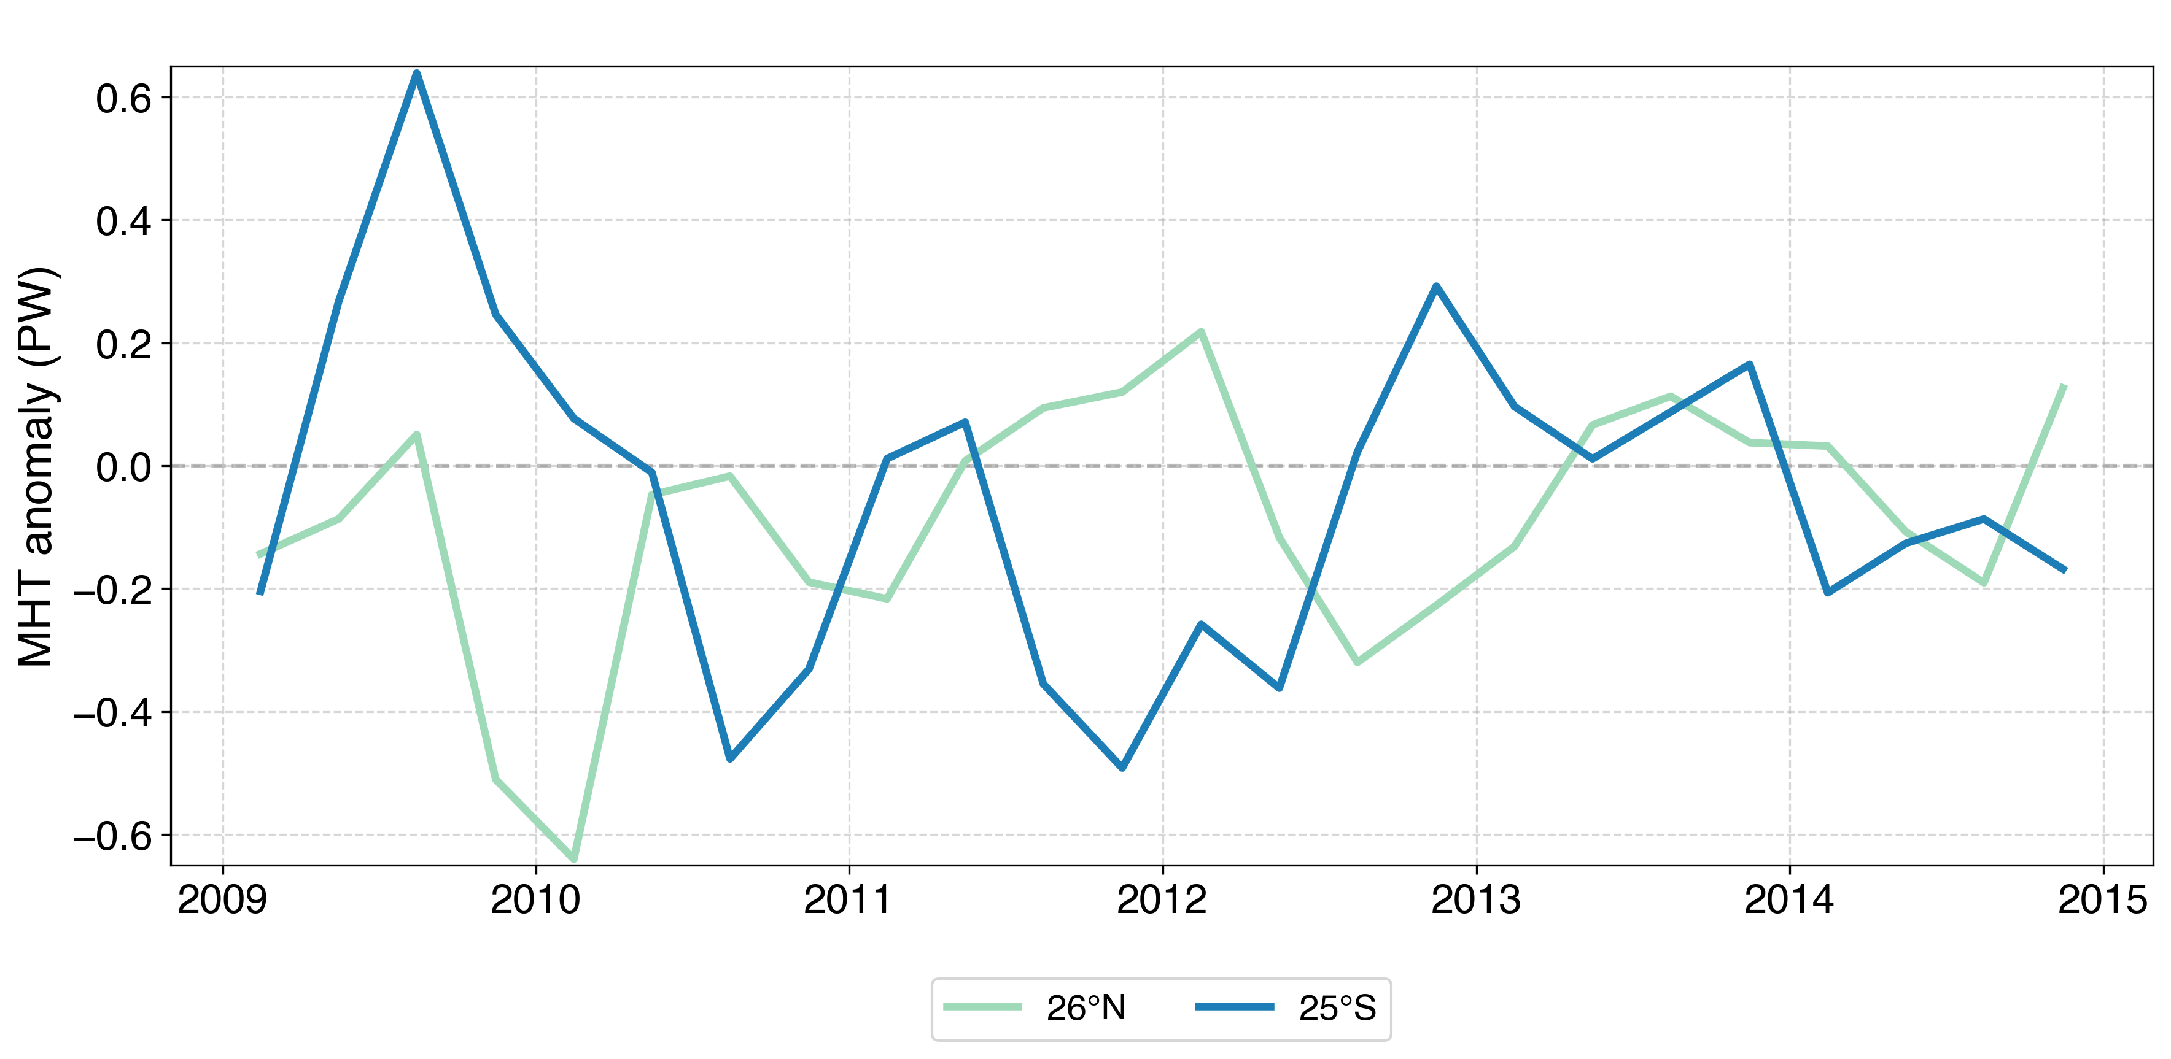
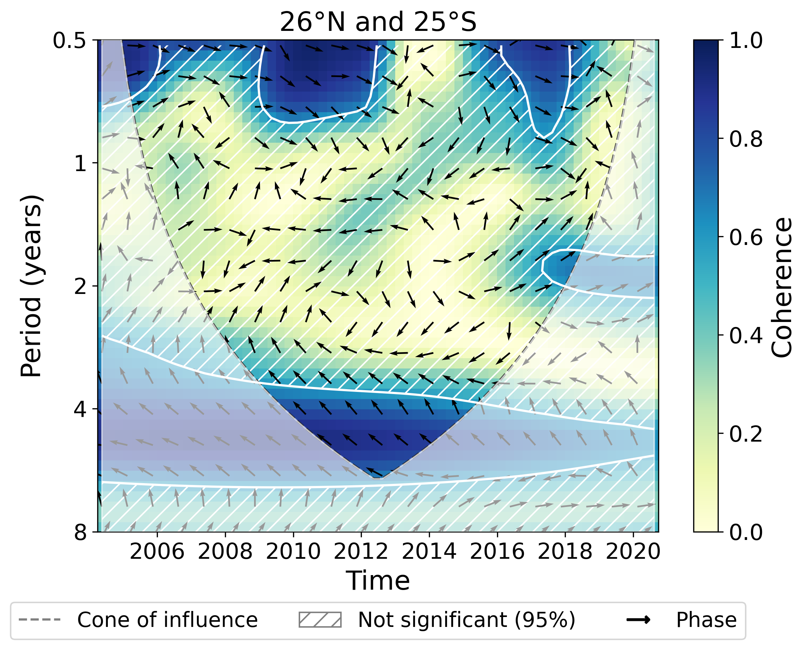
Wavelet coherence: 26°N and 25°S
Time series of MHT anomalies (PW) for 26°N and 25°S.
High coherence & out of phase around 2010-2013 (26°N leading slightly) for periods >4 years
Wavelet coherence transform between 26°N and 25°S. Period in logarithmic scale.

Slide 4
Cross correlation between blocks shows break
I can find the imprint of the coherence break already in the raw (and the detrended) data
Significance calculated for each period separately
$→$ perform correlation analysis using the unfiltered (only detrended) data ?
(as for wavelet coherence I should use unfiltered aswell)
Period | Corr ST & SA block | Significant (95%)
Pre 2009 | 0.53 | Yes
2009-2014 | 0.01 | No
Post 2014 | 0.47 | No (rcrit: 0.48)

