Slide 1
Hotel Survey
iOS App Design
Project member: Lea W. Leonard

Slide 2
Features
& Technology
Xcode, an Apple IDE, integrated development environment, for their mobile and desktop OS
Storyboard, used in Xcode to create user interface views and connect views
Core Data, persistent storage for saving, adding, and updating data used for login controllers

Slide 3
Survey App
Layout
Section: Login
Section: Survey Questions
Section: Overall Rating

Slide 4
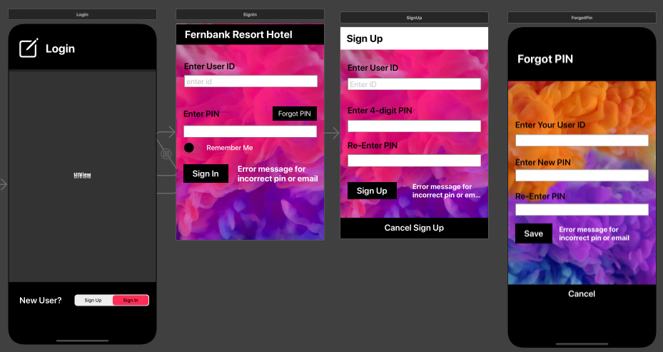
Login
UIContainerView - UISegmentControl - UISwitch - Swift obj: UIStoryboard

Slide 5
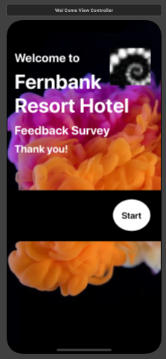
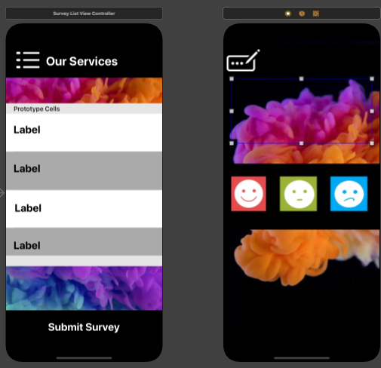
Survey Questions
UITableView - Swift obj: UIStoryboard

Slide 6
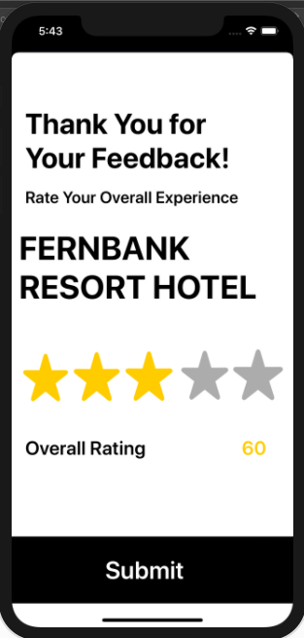
Overall Ratings
Swift obj: UIStoryboard

