Slide 1
Exome Sequencing QC
Lea Urpa
Postdoctoral researcher, FIMM, Ollila Lab
April 2024

Slide 2
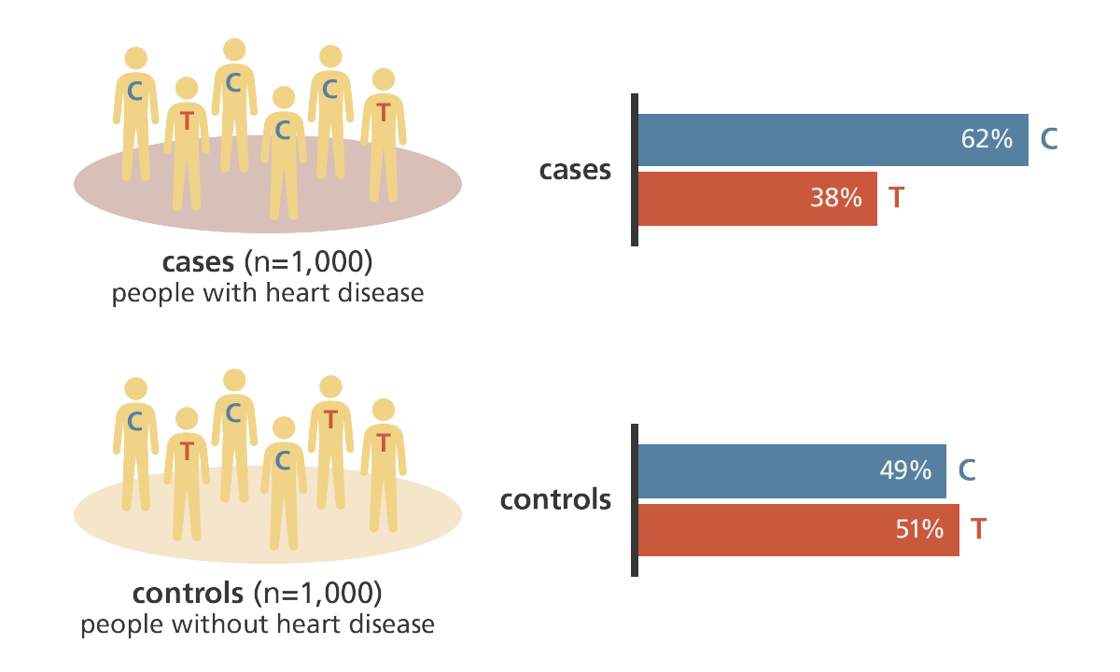
What kind of question are we asking?
Suspected mendelian inheritance-
Family data, single patients
Case-control comparison
→ More lenient QC, don’t want to miss anything.
Can sanger sequence poor quality variants to confirm.
→ More strict QC- infeasible to Sanger sequence whole cohort for many genes (that’s why we do high-throughput)
Especially important when cases + controls from different seq. center/
exome capture kit!

Slide 3
Exome QC for case/control comparisons
Focus on keeping variants that are well-captured and typed in ALL batches/centers/exome sequencing capture kits.
Begin with post-GATK, called variants in VCF file
Samples
Genotypes
Variants

Slide 4
Overview
VEP annotate
Low-pass variant QC
Samples QC
Final variant QC
Samples
Genotypes
Variants

Slide 5
VEP annotate
VEP annotate
Low-pass variant QC
Samples QC
Final variant QC
Variant Effect Predictor, annotates per transcript
Slow (in Hail), better to do first in pipeline
Samples
Genotypes
Variants

Slide 6
Low-pass variant QC
VEP annotate
Low-pass variant QC
Samples QC
Final variant QC
Before removing samples based on poorly sequenced data, good to remove variants that are poorly sequenced throughout all individuals
Filter out poor genotypes
Filter out poor variants
Samples
Genotypes
Variants

Slide 7
Low-pass variant QC
VEP annotate
Low-pass variant QC
Samples QC
Final variant QC
Filter out poor genotypes
Depth < 10
Genotype quality (GQ) or Phred Likelihood (PL) < 20
Ref read ratio (aka allelic balance) correct for called genotype
Filter out poor variants
Samples
Genotypes
Variants
Notes:
Depth is reads passing QC + uninformative reads, a single number, as opposed to allelic depth, a vector of length # alleles, which includes filtered reads but not reads considered uninformative.

Slide 8
Tangent- GQ vs PL
Each genotype has an array of Phred-scaled likelihoods (PL) for each genotype, “normalized” that the PL for the most likely genotype is always zero.
For variant A/G, [AA, AG, GG] -> [0, 38, 99]
Genotype quality is the difference between the most likely and second most likely genotype (e.g. 38). If this number is large we are confident about the call.
For homozygous reference genotypes, we use GQ > 20 as a threshold.
For heterozygous and homozygous alternate genotypes, we use PL[ref]. Why?
If GQ is small, it means we are not confident if the call is one genotype or another
If PL[ref] is large, we are confident the genotype is not ref- we’re just not sure if it is het or hom alt. We care about keeping these calls.

Slide 9
Ref read ratio (allelic balance): Genotypes
[#ref, #alt]
ID1
ID2
ID3
ID4
ID5
ID6
ID7
ID8
variant 1 [A,G]
A/G
A/A
A/G
G/G
A/A
A/G
A/G
G/G
variant 2 [T,G]
T/G
T/T
T/G
G/G
T/T
T/G
G/G
T/G
Goal: find if # ref and # alt reads really support a genotype call.
(Uses GATK AD, which is slightly different than DP. See this link for details: https://gatk.broadinstitute.org/hc/en-us/articles/360035532112-Coverage-Read-depth-metrics#:~:text=The%20key%20difference%20is%20that,by%20default%20for%20each%20tool)

Slide 10
Ref read ratio (allelic balance): Genotypes
[#ref, #alt]
ID1
ID2
ID3
ID4
ID5
ID6
ID7
ID8
variant 1 [A,G]
A/G
A/A
A/G
G/G
A/A
A/G
A/G
G/G
variant 2 [T,G]
T/G
T/T
T/G
G/G
T/T
T/G
G/G
T/G
Hom ref genotypes- % Ref reads > 90%

Slide 11
Ref read ratio (allelic balance): Genotypes
[#ref, #alt]
ID1
ID2
ID3
ID4
ID5
ID6
ID7
ID8
variant 1 [A,G]
A/G
A/A
A/G
G/G
A/A
A/G
A/G
G/G
variant 2 [T,G]
T/G
T/T
T/G
G/G
T/T
T/G
G/G
T/G
Het genotypes- % ref reads between 20-80%

Slide 12
Ref read ratio (allelic balance): Genotypes
[#ref, #alt]
ID1
ID2
ID3
ID4
ID5
ID6
ID7
ID8
variant 1 [A,G]
A/G
A/A
A/G
G/G
A/A
A/G
A/G
G/G
variant 2 [T,G]
T/G
T/T
T/G
G/G
T/T
T/G
G/G
T/G
Hom alt genotypes- % ref reads < 10%

Slide 13
Low-pass variant QC
VEP annotate
Low-pass variant QC
Samples QC
Final variant QC
Filter out poor genotypes
Filter out poor variants
Hardy-Weinberg Equilibrium p value (in controls) < 1e-9
Call rate (# genotypes non-missing per variant) < 80%
Quality by depth (QD) < 2 for SNPS, < 3 for indels
# het calls with incorrect ref read ratio < 20% of all het genotypes
Samples
Genotypes
Variants
Notes:
HWE- number of expected genotypes based on sample AF- can be a real biological reason to deviate (so we do it in controls only) but it’s usually technical problem
QD is the variant confidence QUAL score normalized by allele depth per variant.

Slide 14
Ref read ratio (allelic balance): Cases + controls separately
50% het GTs not passing -> variant discarded
ID1
ID2
ID3
ID4
ID5
ID6
ID7
ID8
variant 1 [A,G]
A/G
A/A
A/G
G/G
A/A
A/G
A/G
G/G
variant 2 [T,G]
T/G
T/T
T/G
G/G
T/T
T/G
G/G
T/G
Allelic balance per variant-
For het variants, what percentage of genotypes pass AB filters?
Typically 80% or more genotypes must pass

Slide 15
Samples QC
VEP annotate
Low-pass variant QC
Samples QC
Final variant QC
Find relatives
First filter out rare (<1% MAF) variants
Couple of ways- I use King in Hail (Exome QC pipeline does this)
PC relate in Hail also works (but sensitive to population outliers)
Find population outliers
Also a couple of ways to do this-
Calculate PCs jointly with your data + 1000 genomes Finns
Run PC on your data + remove those with >4 SD on the first two PCs, recalculate until there are no more outliers (Exome QC pipeline does this)
Samples
Genotypes
Variants
Notes:
HWE- number of expected genotypes based on sample AF- can be a real biological reason to deviate (so we do it in controls only) but it’s usually technical problem
QD is the variant confidence QUAL score normalized by allele depth per variant. #2 only works well with non-admixed data.

Slide 16
Samples QC
VEP annotate
Low-pass variant QC
Samples QC
Final variant QC
Remove samples with:
> 5% contamination
> 5% chimeric reads
Within each batch, calculate
Transition/transversion ratio
Insertion/deletion ratio
Heterozygote/homozygous reference ratio
number of singletons
and remove any samples deviating > 4 SD from the mean for each.
Samples
Genotypes
Variants
Notes:
Ti/Tv- should be about 2 genome-wide, and closer to 3 for protein coding regions. Known exome variants should be about 2.6.
excess heterozygosity for an individual can be contamination or poor sequencing
singletons (private variants not seen in anyone else in the cohort) are usually errors if there are a lot of them

Slide 17
Final variant QC
VEP annotate
Low-pass variant QC
Samples QC
Final variant QC
Filter out poor genotypes
Depth < 10
Genotype quality (GQ) or Phred Likelihood (PL) < 20
Ref read ratio (aka allelic balance) correct for called genotype
Filter out poor variants
Filter variants in cases and controls separately
Samples
Genotypes
Variants

Slide 18
Final variant QC
VEP annotate
Low-pass variant QC
Samples QC
Final variant QC
Filter out poor genotypes
Filter out poor variants
Hardy-Weinberg Equilibrium p value (in controls) < 1e-6 (more strict)
Call rate (# genotypes non-missing per variant) < 90% (more strict)
Quality by depth (QD) < 2 for SNPS, < 3 for indels
# het calls with incorrect ref read ratio < 20% of all het genotypes
Filter variants in cases and controls separately
Samples
Genotypes
Variants

Slide 19
Final variant QC
VEP annotate
Low-pass variant QC
Samples QC
Final variant QC
Filter out poor genotypes
Filter out poor variants
Filter variants in cases and controls separately
We especially want to remove variants that are poorly captured in either cases OR controls- can create false positive results in association analysis
Call rate
Calculate percentage of non-missing genotypes in cases and controls separately
Remove variant if call rate < 95% in cases or controls separately
Allelic balance
Remove variant if <20% of het genotypes have incorrect ref read ratio/allelic balance
in cases or controls separately
Samples
Genotypes
Variants

Slide 20
Ref read ratio (allelic balance): Cases + controls separately
cases
controls
ID1
ID2
ID3
ID4
ID5
ID6
ID7
ID8
variant 1 [A,G]
A/G
A/A
A/G
G/G
A/A
A/G
A/G
G/G
variant 2 [T,G]
T/G
T/T
T/G
G/G
T/T
T/G
G/G
T/G
variant 1 case call rate: 100%
variant 1 control call rate: 0%

