Slide 1
AI FOR HEALTHCARE · RESPONSIBLE AI PART
Who should the nurse call after discharge?
A readmission risk score for patients with diabetes, and what Microsoft's Responsible AI dashboard showed us about it
Data: 73,000 hospital stays of patients with diabetes, 130 US hospitals, 1999–2008
Notes:
Imagine you are a nurse and 1,000 patients with diabetes go home this month. You have time to phone about 200 of them. Who do you call? We built a score to answer that, and then used Microsoft's Responsible AI dashboard to check where it goes wrong and what a hospital should do with it. No background needed: we will explain every chart.

Slide 2
THE PROBLEM
Too many patients with diabetes come back too soon
1 in 10
~200
73,000
patients with diabetes are back in a hospital bed within 30 days of going home
follow-up calls nurses can realistically make per 1,000 patients sent home (about 20 minutes each)
hospital stays in our data, from 130 US hospitals
Why a phone call? A short call after discharge can catch problems early: a medicine mix-up, blood sugar out of control, a follow-up appointment that was never booked.
Our question: using only what is already in the chart on the day of discharge, who should the nurses call first?
Notes:
About one in ten patients with diabetes is back in hospital within a month. That is bad for them and expensive for the hospital. A short phone call after discharge can catch some of it early: a medicine mix-up, blood sugar out of control, a follow-up appointment that was never booked. But there is time for about 200 calls per 1,000 patients, about 20 minutes each. So the question is: from what is already in the chart on the day they leave, who should be called first?

Slide 3
OUR TOOL
A risk score built from the discharge chart
1 Read the chart
Words you will hear today
17 items already written down at discharge: age, sex, previous hospital stays, number of diagnoses and medicines, days in hospital, the HbA1c blood test, insulin changes.
(grey = the name the dashboard uses)
Readmission: back in hospital as an inpatient within 30 days of going home.
Previous stays: hospital stays in the year before this one. number_inpatient
Diagnoses: how many medical problems are written in the chart. number_diagnoses
HbA1c: a blood test showing average blood sugar over the last 2–3 months, the "diabetes report card". Recorded as not measured, normal, above 7 or above 8. Higher = worse control. A1Cresult
Insulin change: insulin dose raised, lowered, kept the same, or no insulin. insulin
2 Give a risk
A number from 0% to 100%: the chance this patient is back in hospital within 30 days.
3 Make the call list
Everyone above 11.6% goes on the list. That is about the riskiest 1 in 5 patients, which matches the ~200 calls per 1,000.
The list is only a suggestion. A nurse or doctor still decides who is actually called.
Notes:
Our tool is a simple statistical score. It reads 17 things already written in the chart at discharge, like age, previous hospital stays, number of diagnoses and the HbA1c blood test, and turns them into a risk between 0 and 100 percent. Everyone above 11.6 percent goes on the call list: roughly the riskiest one in five, which matches the 200 calls. The list is only a suggestion; a nurse still decides. Two words to remember. HbA1c is the diabetes report card: a blood test for average sugar over the last few months. And previous stays means hospital stays in the year before. The grey names are what the dashboard calls them.

Slide 4
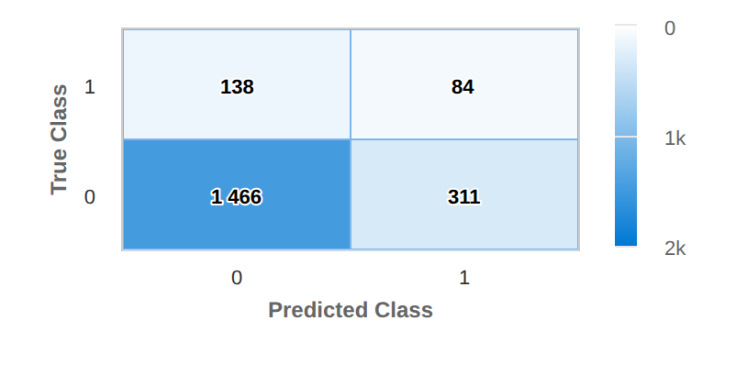
DASHBOARD · MODEL OVERVIEW · CONFUSION MATRIX
How good is the call list? Four boxes tell the story
1,999 patients the score had never seen. Each patient lands in exactly one box.
1
84: called, and they did come back. These are the calls that matter.
3
1
2
311: called, but they were fine. A call "for nothing": reassuring for the patient, but nurse time.
4
2
3
138: came back, but never called. These are the misses.
4
1,466: not called, and fine. Correctly left alone.
Rows (True Class): did the patient come back? 1 = yes, 0 = no
Columns (Predicted Class): did we put them on the call list? 1 = yes, 0 = no
In plain words: about 1 in 5 calls reaches someone who comes back, twice as good as calling at random. But 6 in 10 of the people who come back are never called. On brand-new patients (our final test) the picture was the same.
Notes:
First dashboard screen: the confusion matrix. It is just four boxes. Rows: did the patient really come back? Columns: did we put them on the list? [1] Top right: 84 patients were called and did come back. Those are the calls that matter. [2] Below it: 311 were called but were fine, a call for nothing. [3] Top left: 138 came back and were never called. Those are the misses. [4] And 1,466 were correctly left alone. So one call in five reaches someone who comes back, twice as good as picking at random. But six in ten of the people who come back are never called, and on brand-new patients it looked the same. Honest summary: the list tells you who to call first, not who is safe.

Slide 5
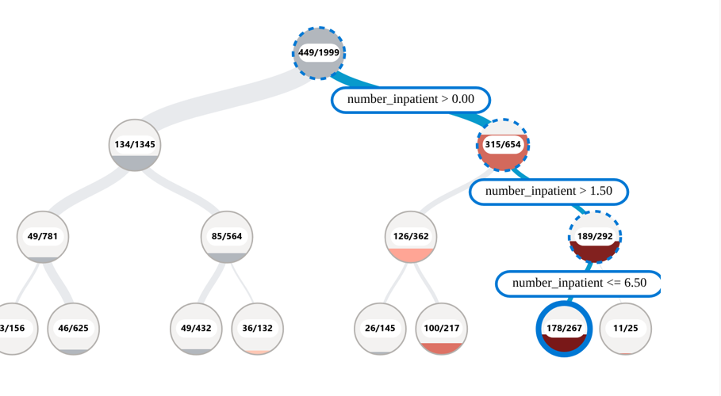
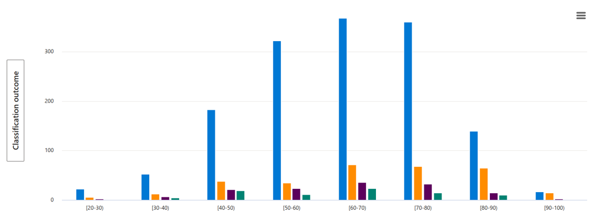
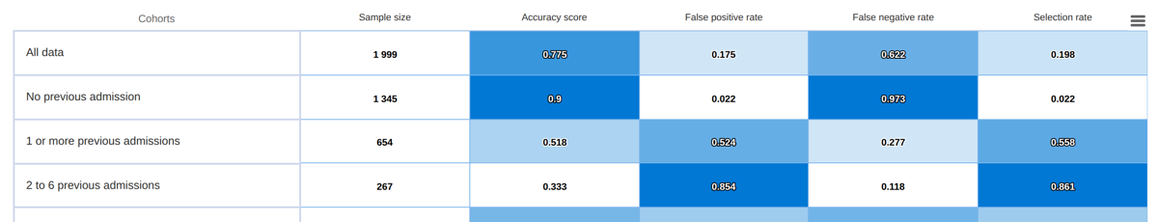
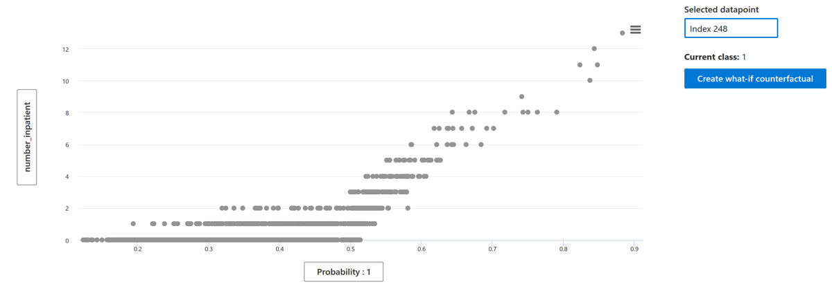
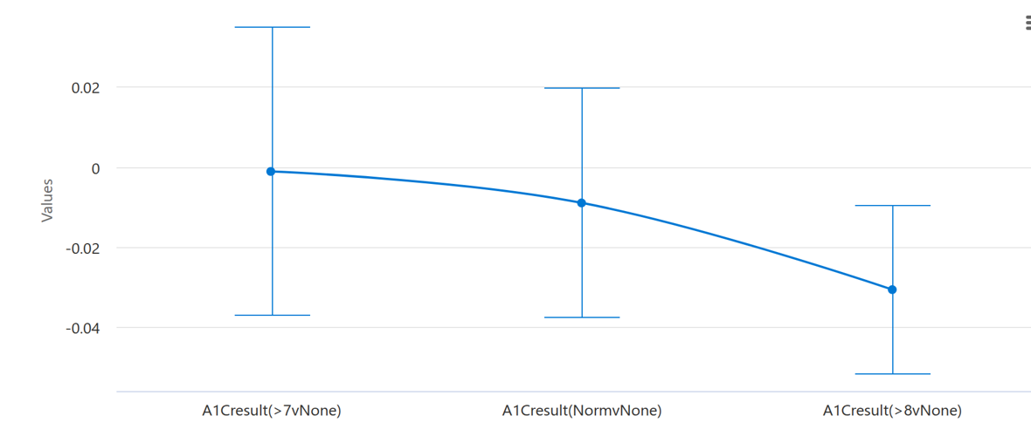
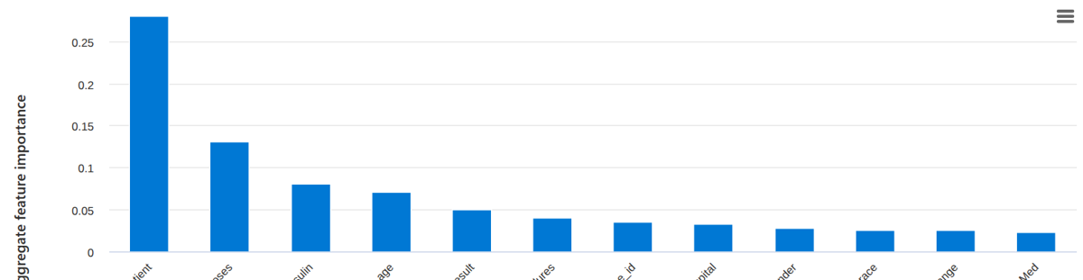
MICROSOFT RESPONSIBLE AI DASHBOARD
The dashboard: one web page, six panels
It does not build the score. It interrogates it. Each panel answers one question.
1
Error analysis
2
Model overview
3
Data analysis
Where does the score make mistakes?
How well does it work for each group of patients?
What does the data look like? (we used it to explore)
4
Feature importance
5
Counterfactuals (what-if)
6
Causal analysis
What does the score look at?
What would need to change to flip a decision?
Is it a cause, or just a coincidence?
One setting we had to change: the dashboard assumes a 50% cut-off. With only about 1 in 10 patients coming back, that puts almost nobody on the list, so we made every panel use our real 11.6% line.
Notes:
The dashboard itself is one web page with six panels. It does not build the score; it interrogates it. Where does the score make mistakes? Does it work equally well for different groups of patients? What does it look at? What would flip a decision? And is something a cause or just a coincidence? One setting mattered: the dashboard assumes a 50 percent cut-off. Almost nobody reaches that here, so it would show an empty call list. We set every panel to our real 11.6 percent line.

Slide 6
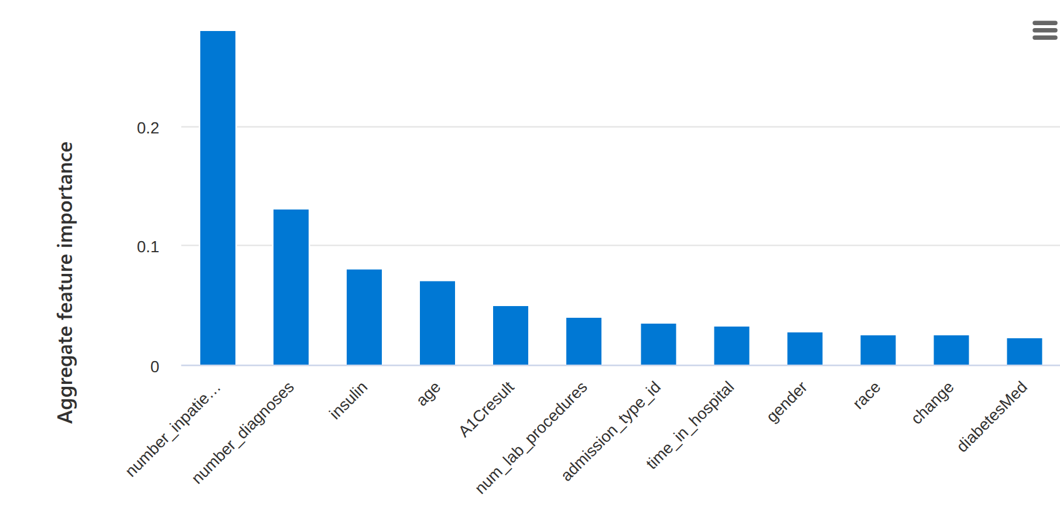
DASHBOARD · FEATURE IMPORTANCE
What does the score look at? Mostly one thing
Each bar is one item from the chart. Taller bar = the score's answer changes more when that item changes.
1
Previous hospital stays (number_inpatient, its label is cut short by the dashboard): twice as tall as anything else.
1
2
2
Then diagnoses, insulin change, age and the HbA1c test (A1Cresult).
3
3
Gender and race: small bars. Small, but not zero.
The other small bars hardly matter; no need to read every name.
Notes:
What does the score look at? Each bar is one item from the chart; the taller the bar, the more the score reacts to it. [1] One bar towers over everything: previous hospital stays. It counts twice as much as the next item. [2] Then come diagnoses, insulin changes and age. [3] Gender and race have small bars, which is good, but small is not zero, so we also checked groups separately. The other small bars hardly matter, so we will not read every name. Remember the first bar: most of what follows comes from it.

Slide 7
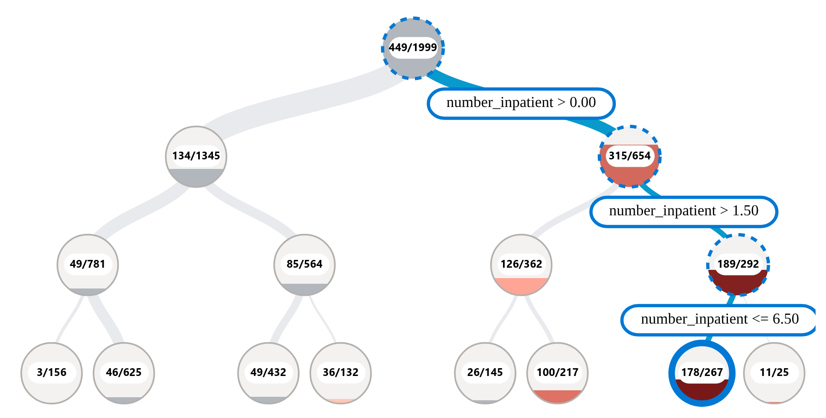
DASHBOARD · ERROR ANALYSIS · TREE MAP
Where does the score go wrong? The error tree
The tool keeps splitting patients into groups, hunting for groups where our decisions are often wrong.
1
Top circle = all 1,999 patients. 449/1999 = 449 wrong decisions: a call for nothing or a missed patient (22%).
1
2
2
Each branch is a yes/no question the tool picked itself. "number_inpatient > 0.00" = any previous stay.
3
3
Redder circle = wrong more often in that group. Fuller circle = more of all our mistakes sit there.
4
Worst group: 2 to 6 previous stays. 178 of 267 wrong (67% against 22%), 40% of all our mistakes.
4
In the dashboard, clicking a circle shows its numbers and the exact rule on the right: here 267 patients, 89 right, 178 wrong.
Notes:
The error tree hunts for groups of patients where our decisions are often wrong. [1] Start at the top: that circle is everyone. 449 over 1,999 means 449 wrong decisions, either a call for nothing or a miss: 22 percent. [2] From there the tool splits patients with yes-or-no questions it picked by itself, and it asks about previous stays three times in a row. [3] Read the circles by colour and fill: the redder the circle, the more often we are wrong in that group; the fuller it is, the more of all our mistakes sit there. [4] Follow it down to the darkest circle: patients with 2 to 6 previous stays. 178 wrong out of 267: 67 percent, three times the average, and 40 percent of all our mistakes.

Slide 8
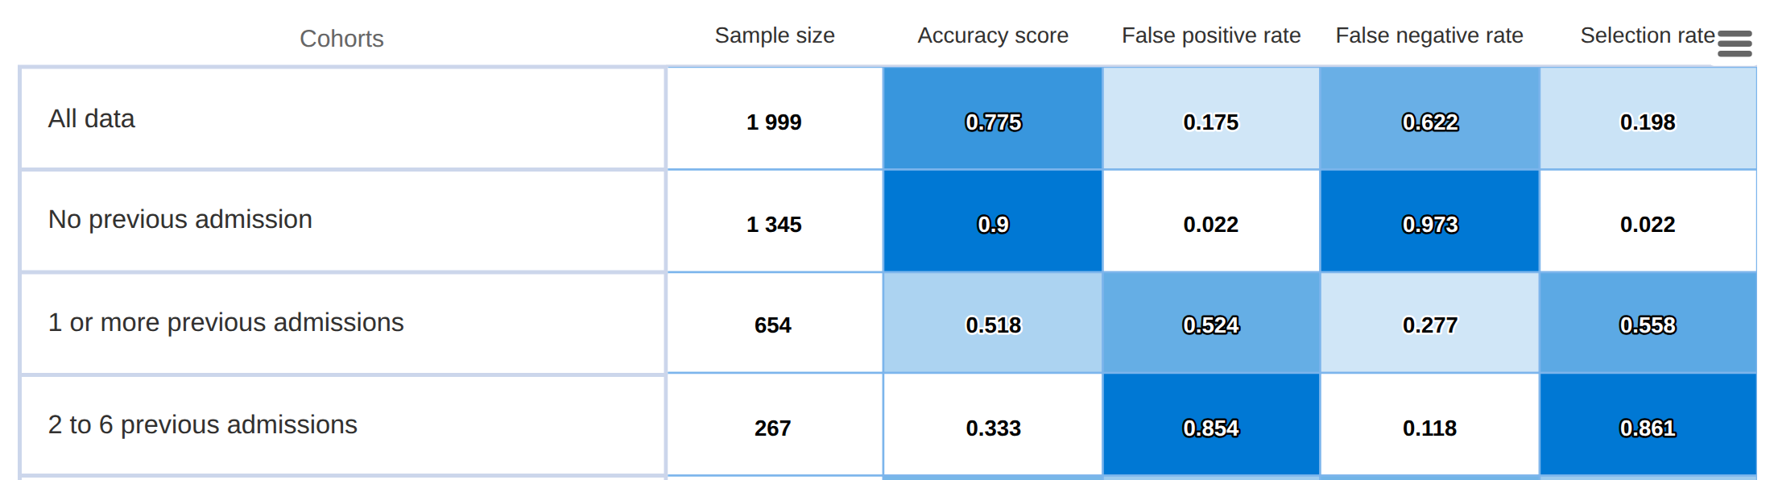
FINDING 1 · MODEL OVERVIEW · PATIENT GROUPS
Finding 1: regular patients get called on autopilot
2
3
1
Reading the columns
What it shows
What we tell the hospital
1 Selection rate: share of the group we put on the call list.
2 False positive rate: of those who did NOT come back, share we called anyway.
3 False negative rate: of those who DID come back, share we missed.
2 to 6 previous stays: 86% called (everyone: 20%).
3 in 4 of those calls are for nothing (170 of 230).
They do come back more (25% vs 11%), but the score can't tell which ones will.
For patients with 2 or more previous stays, a nurse decides whether to call, after reading why they were admitted.
Ask the data team to add the reason for admission to the next version of the score.
Notes:
Why are we wrong there? The model overview table compares groups of patients, one per row, and three columns matter. [1] Selection rate: how many of the group we call. [2] False positive rate: of those who were fine, how many we called anyway. [3] False negative rate: of those who came back, how many we missed. Now look at the orange row. Patients with 2 to 6 previous stays get a call 86 percent of the time, against 20 percent overall, and three out of four of those calls are for nothing. The score cannot tell which regulars will come back; it just thinks: been here before, will be back. So for regulars, a nurse should decide after reading why they were admitted, and the next version of the score should know the reason for admission.

Slide 9
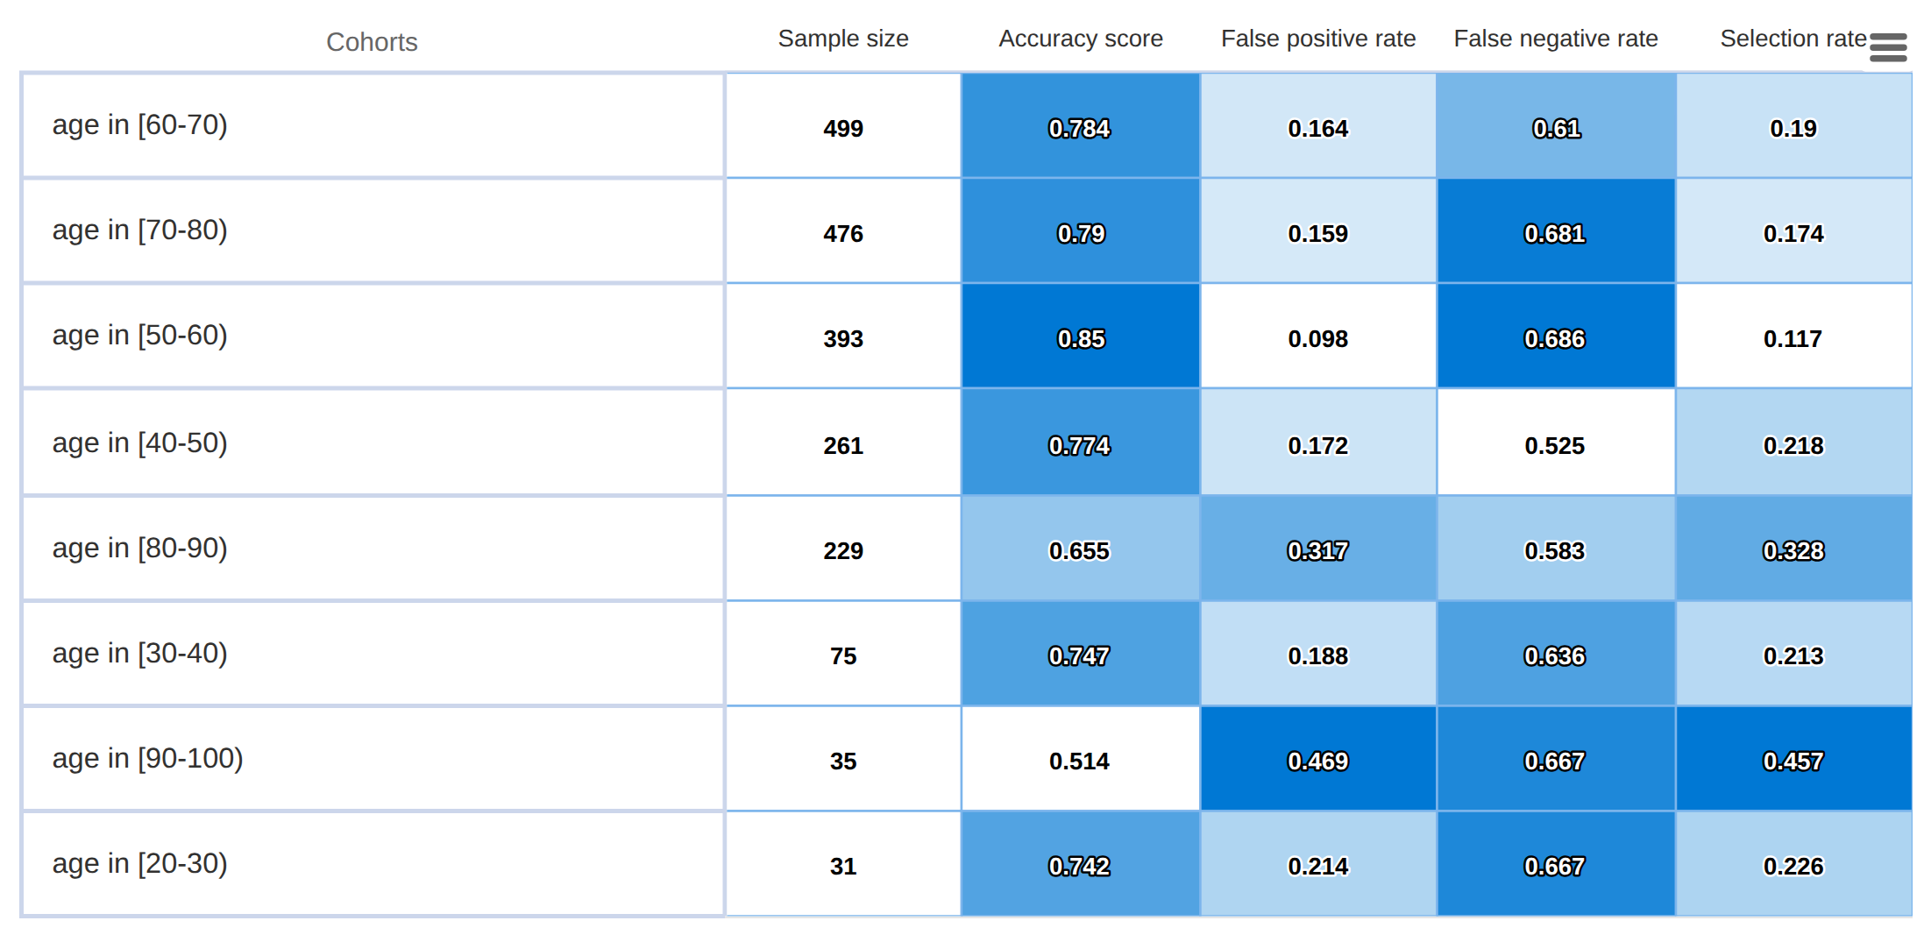
DASHBOARD · MODEL OVERVIEW · FEATURE COHORTS: AGE
Finding 2: the same table, split by age
3
1
Called: 33% of patients aged 80–89 and 46% of over-90s, against 12% of people in their 50s.
2
Called for nothing: of the 80–89s who were fine, 32% got a call anyway (50s: 10%).
3
Missed: about half to two-thirds of those who come back, at every age. Misses do not climb with age.
2
1
How to read: one row per age group, sorted by size, not by age. Same columns as before; darker blue = higher number in that column.
Notes:
Same table, now split by age. Careful: the rows are sorted by size, not by age. [1] People aged 80 to 89 are called 33 percent of the time and over-90s 46 percent, while people in their fifties are called 12 percent of the time. [2] Among the 80 to 89 year-olds who were fine, one in three got a call anyway; in the fifties, one in ten. [3] The misses do not climb with age the way the calls do: at every age we miss between about half and two-thirds of those who come back. So age mainly decides who gets the extra calls.

Slide 10
FINDING 2 · WHO GETS THE EXTRA CALLS
Finding 2: twice the calls for over-80s, same return rate
What it shows
Over 80: 35% called, 10% came back.
Age 50–79: 16% called, 10% came back.
Only 1 in 8 calls to an over-80 reaches someone who returns (1 in 5 for ages 50–79).
Why
The score adds a little risk for very old age and for every extra diagnosis, and over-80s have more diagnoses on file.
What we tell the hospital
Keep one rule for everyone, but a clinician checks the over-80 names before calls go out: is a call useful, or a burden for a frail patient and their carer? No separate age cut-off without an ethics review.
Dashboard sample of 1,999 patients. Under-40s left out (only 106 patients); over-90s are only 35 patients.
Notes:
Here is the same thing as a picture. Orange: how many we call. Teal: how many actually came back. From 50 to 79 the bars are close: 16 percent called, 10 percent back. Over 80, the orange bar doubles to 35 percent, but the teal bar stays at 10. So only one call in eight to an over-80 reaches someone who returns. Why? The score adds a little risk for very old age and for every extra diagnosis, and old patients have more diagnoses written down. What we would tell the hospital: keep one rule for everyone, because a special age rule needs an ethics review, but have a clinician look at the over-80 names first. For a frail 88-year-old, an unnecessary call is a burden, not a favour.

Slide 11
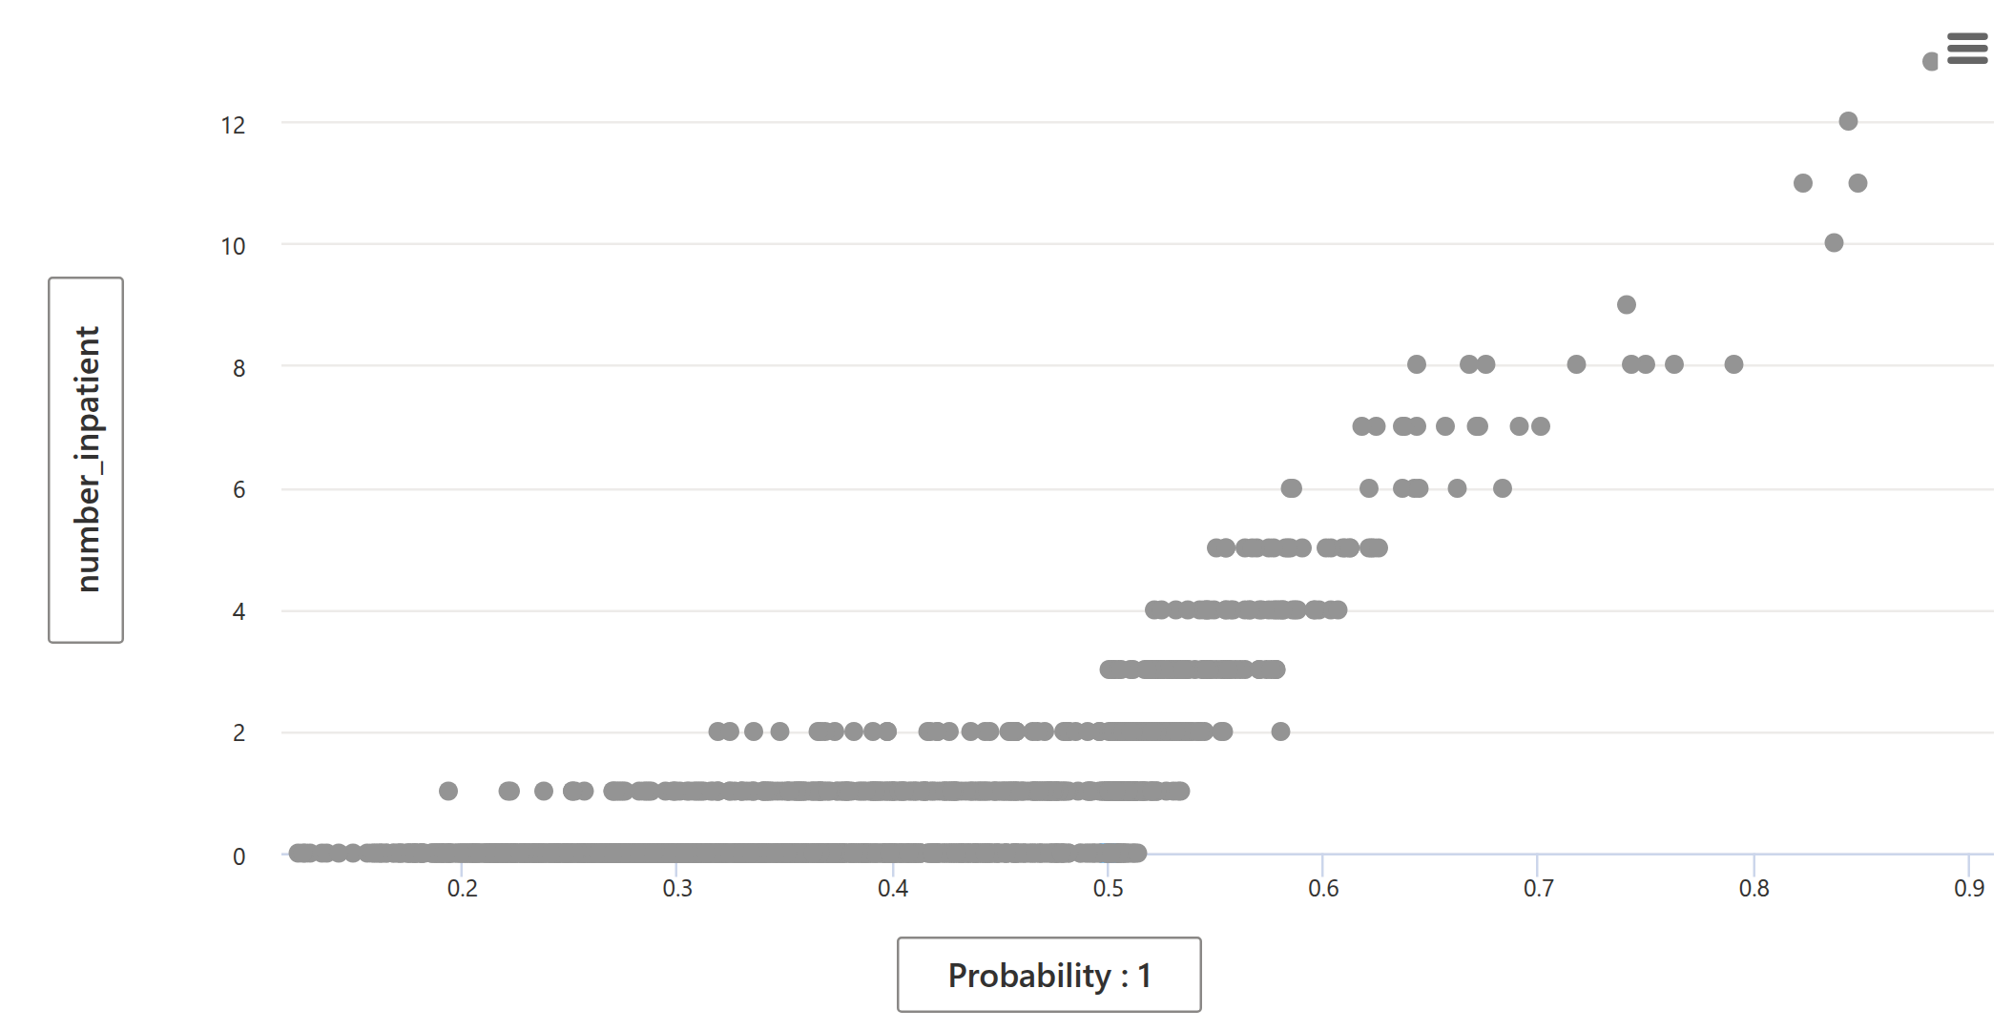
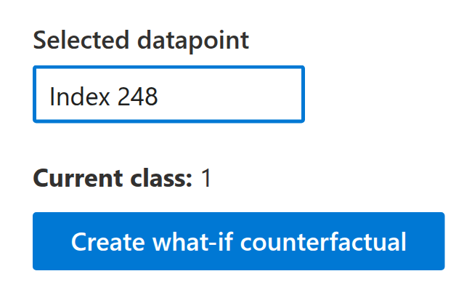
DASHBOARD · COUNTERFACTUALS (WHAT-IF)
What would have to change? The what-if tool
Pick one patient. The tool looks for the smallest change to the chart that moves them across the call line.
our call line
2
4
1
Left to right = risk. Scale stretched so 0.5 is exactly our call line. Right of it = on the list.
2
Up = more previous stays. One dot per patient. Notice the staircase.
3
3
Patient 248 sits right on the line.
1
4
This button asks for the smallest chart change that flips his decision.
Notes:
Next, the what-if tool. Each dot is a patient. [1] Left to right is risk, and we stretched the scale so that 0.5 is exactly our call line: right of it, you are on the list. [2] Up and down is the number of previous stays. See the staircase? Nobody with three or more previous stays is left of the line, and almost nobody with zero is right of it. [3] Now pick one patient, number 248, who sits right on the line, [4] and press this button. It asks: what is the smallest change to his chart that flips the decision? We only let it change what the ward writes down during the stay, the HbA1c result and the diabetes medicines. Age and history stayed fixed.

Slide 12
FINDING 3 · WHAT-IF RESULT
Finding 3: one line of paperwork can decide who gets a call
Patient 248, as recorded
Same patient, one change
36%
Man in his 70s
No previous hospital stays
8 diagnoses, 5 days in hospital
Insulin lowered during the stay
Man in his 70s
No previous hospital stays
8 diagnoses, 5 days in hospital
Insulin lowered during the stay
→
of patients (716 of 1,999) cross the call line when only the HbA1c result or the diabetes-medicine entries change.
HbA1c: not measured
HbA1c: measured, above 8
Risk 11.8% → ON the call list
Risk 9.6% → OFF the call list
What really happened: he was back in hospital within 30 days.
What we tell the hospital: the call list partly reflects how things were written down, not only how sick the patient is. Never change a test or a medicine to move a score. Record these items the same way on every ward, and re-check the list if recording habits change.
Notes:
Here is the answer for patient 248. A man in his seventies, never admitted before, insulin lowered during the stay, no HbA1c test. Risk 11.8 percent: just on the list. Same man, one change: the HbA1c test was done and came back above 8. Risk 9.6 percent: off the list. What really happened? He was back in hospital within 30 days. And he is not alone: for 36 percent of patients, changing only these paperwork items moves them across the line. So the list partly measures how things were written down. The message: never change a test or a medicine to move a score, and record these things the same way on every ward. You may wonder why a high sugar result would lower the risk. That is our next question.

Slide 13
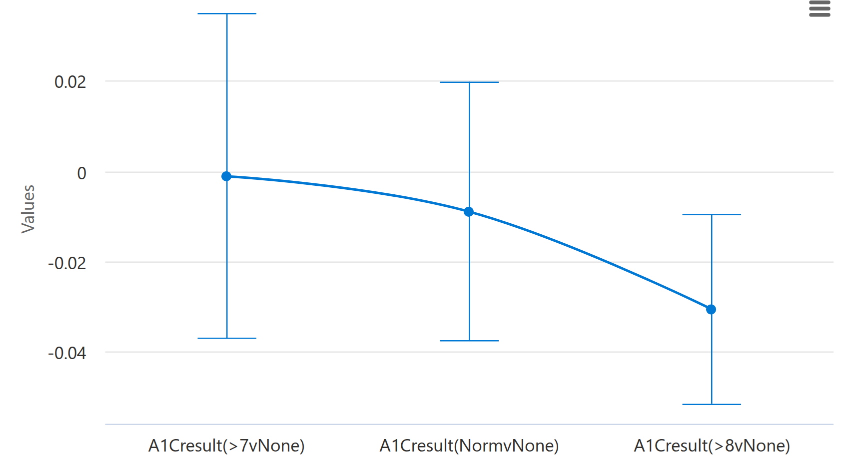
DASHBOARD · CAUSAL ANALYSIS
Cause or coincidence? Reading the causal chart
Our question: does having the HbA1c test, and its result, change the chance of coming back?
3
1
Each column compares patients with one HbA1c result to similar patients never tested. ">8vNone" = above 8 versus not measured.
2
The dot is the best estimate. −0.03 = 3 fewer readmissions per 100 patients.
2
3
Whiskers = uncertainty. If they cross the 0 line, we cannot tell it apart from no effect.
1
"Similar" = same age, previous stays, diagnoses and so on. The dashboard also lists these numbers in a table (next slide, in plain words).
Notes:
The causal panel asks a different question: does doing something change the outcome? We asked about the HbA1c test. [1] Each column compares patients with one test result to similar patients who were never tested; similar means the same age, previous stays, diagnoses and so on. [2] The dot is the best estimate: minus 0.03 means three fewer readmissions per 100 patients. [3] The whiskers show how unsure we are. If they cross the zero line, like the first two columns, we cannot tell the effect apart from nothing. Only one column sits clearly below zero: results above 8.

Slide 14
FINDING 4 · CAUSAL ANALYSIS
Finding 4: a high HbA1c result goes with fewer returns
HbA1c result (against never tested) | Change in readmissions per 100 patients | Could it be luck?
Above 8 | 3 fewer (range: 1 to 5 fewer) | Unlikely (p = 0.004)
Normal | 1 fewer (range: 4 fewer to 2 more) | Can't tell (p = 0.54)
7 to 8 | About 0 (range: 4 fewer to 3 more) | Can't tell (p = 0.95)
Two explanations the data cannot tell apart
Cause: a high result makes doctors adjust the diabetes treatment before the patient goes home.
Coincidence: wards that order the test may simply plan discharges more carefully, and that is what helps.
p-value: the chance of seeing a difference this big by luck alone. Under 0.05 is usually read as real.
Striking detail: 83% of the stays in our dashboard sample had no HbA1c test at all. That is also why recording a high result lowered patient 248's score.
What we tell the hospital: measuring HbA1c in patients with diabetes is cheap and already good practice, so keep doing it and act on high results. But do not promise fewer readmissions from it until a proper study tests it.
Notes:
The dashboard also lists these numbers in a table; here they are in plain words. Patients whose HbA1c was measured and above 8 came back about three times less per hundred than similar untested patients, and a p-value of 0.004 says that is unlikely to be luck. For normal results and 7 to 8 we cannot tell. Why would worse sugar mean fewer returns? Two stories. Cause: a high result makes doctors fix the diabetes treatment before the patient leaves. Coincidence: wards that bother to test also plan discharges more carefully. This data cannot tell them apart. A striking detail: 83 percent of stays had no HbA1c test at all, and this is also why a recorded high result lowered patient 248's score. For the hospital: keep testing and acting on high results, because it is cheap and good practice, but do not promise fewer readmissions until a proper study checks it.

Slide 15
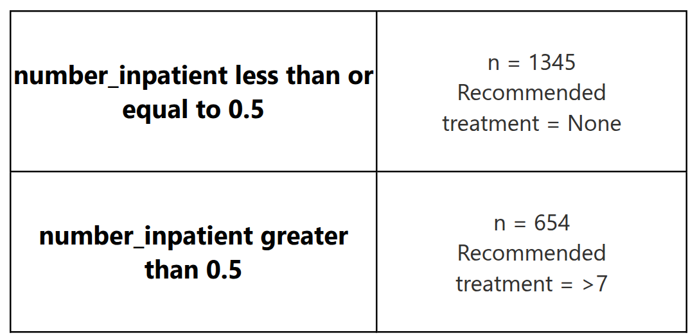
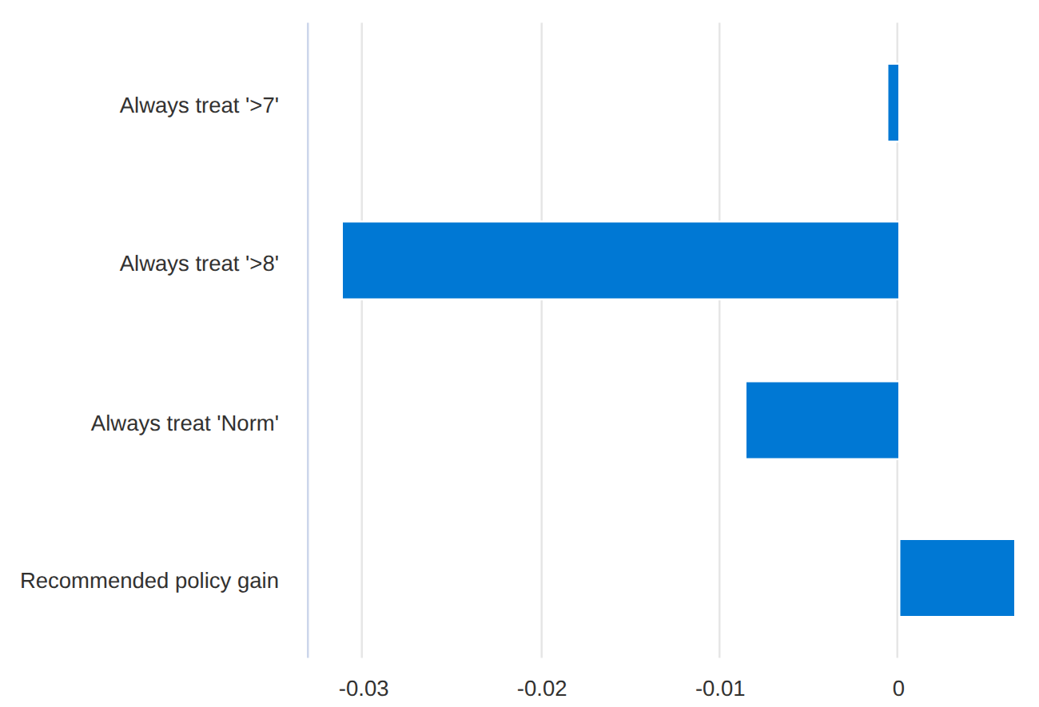
DASHBOARD · CAUSAL ANALYSIS · TREATMENT POLICY
Warning: the tool's recommended treatment is backwards
2
1
1
The rule it proposes: "patients with a previous stay should get an HbA1c above 7". You cannot give a patient a test result.
2
The bars: change in readmissions if everyone had that result. The long bar left (−0.031) is the best news.
3
3
The "gain": the tool assumes bigger is better, so its recommended plan raises readmissions (+0.7 per 100).
← fewer readmissions = better
worse →
Lesson: the tool does not know that readmission is bad. Check which direction is "good" before trusting any automatic recommendation.
Notes:
One more causal screen, and it is a warning. The dashboard offers a recommended treatment. [1] Its rule says patients with a previous stay should get an HbA1c above 7. But a test result is not a treatment; you cannot prescribe a lab value. [2] The bars show how readmissions would change if everyone had that result. Readmission is bad, so the long bar to the left is actually the best news. [3] But the tool assumes bigger is better, so the plan it recommends, and calls a gain, would raise readmissions. We checked the library's code to confirm this. The lesson: the tool does not know that readmission is bad, so always check which direction counts as good.

Slide 16
FINDING 5 · MODEL OVERVIEW · PATIENT GROUPS
Finding 5: the score only finds patients it already knows
1
2
3
What it shows
Why it matters
What we tell the hospital
1 First-timers who came back: we missed 97% (107 of 110).
2 Only 2% of first-timers are put on the list.
3 Patients with a previous stay who came back: we missed 28%.
Half of everyone who came back (110 of 222) had never been in hospital before. For them the score is almost blind.
Use the list for known frequent patients. It will not find first-timers, so normal discharge care (education, a follow-up appointment) stays for everyone. Not on the list never means safe.
Notes:
The last finding is the most important. Back to the groups table, and look at the orange row: patients never admitted before. [1] Of the first-timers who came back, we missed 97 percent, 107 out of 110, [2] because only 2 percent of first-timers make the list at all. [3] Compare the patients with previous stays: of those who came back, we missed 28 percent. And here is the problem: half of everyone who came back had never been in hospital before, so the score is almost blind to half of the problem. The message: use the list for the known frequent patients, keep normal discharge care for everyone, and never read "not on the list" as "safe".

Slide 17
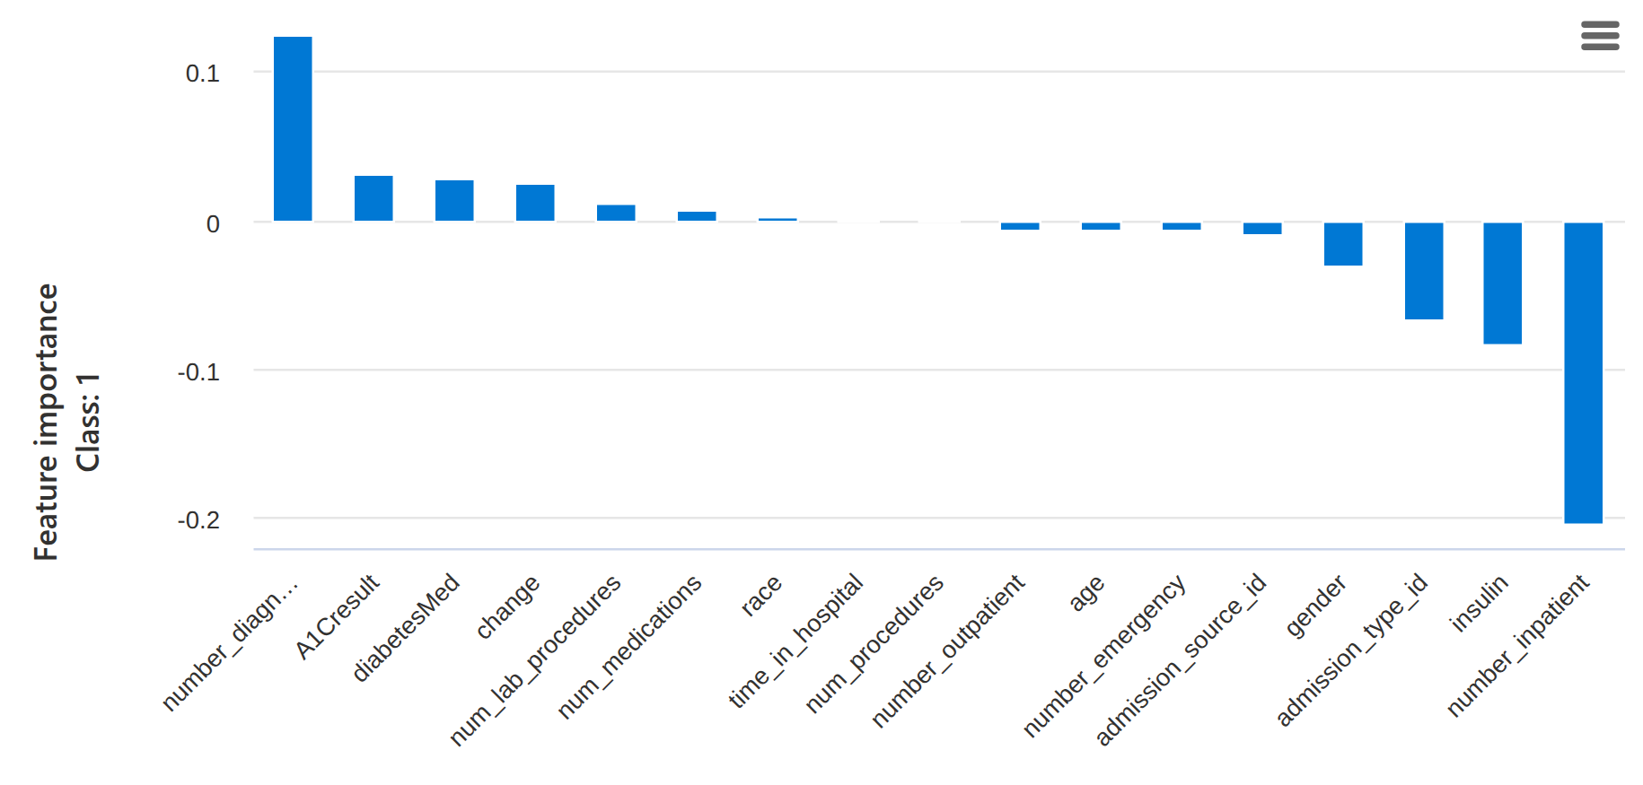
DASHBOARD · FEATURE IMPORTANCE · ONE PATIENT
Why was she missed? Meet patient 21
Woman in her 60s · 9 diagnoses · 4 days in hospital · no previous stays · HbA1c not measured · risk 7.5% (line: 11.6%), not called · back in hospital within 30 days
1
How to read: bars above 0 pushed her risk up, bars below 0 pushed it down.
1
9 diagnoses (number_diagnoses) pushed her risk up the most.
2
2
No previous stays (number_inpatient) pushed it down even more, so she stayed under the line.
Only these two bars matter here; the rest are small.
Notes:
To make it concrete, meet patient 21: a woman in her sixties with nine diagnoses, four days in hospital, never admitted before. Her score was 7.5 percent, under the line, so no call, and she was back within 30 days. The dashboard can explain one patient at a time: bars above zero pushed her risk up, bars below zero pushed it down. [1] Her nine diagnoses pushed it up, [2] but "no previous stays" pushed it down even harder. Her chart simply did not look risky.

Slide 18
SUMMARY
What we tell the hospital
DO
DON'T
NEXT
1
Use the list to decide who to call first, within ~200 calls per 1,000.
1
Change tests or medicines to move a score.
1
Add the reason for admission to the score.
2
Have a nurse review patients with 2+ previous stays and over-80s before calls go out.
2
Read "not on the list" as "safe".
2
Test the score on this year's patients.
3
Keep normal discharge care for everyone: first-timers are the score's blind spot.
3
Make special cut-offs per age group without an ethics review.
3
Run a proper trial: do the calls actually prevent readmissions? Nothing we did shows that yet.
4
Check every month: ~200 per 1,000 on the list, and at least 15% of those called come back (1 in 5 today).
4
Follow the dashboard's "recommended treatment" at face value.
Notes:
So what do we tell the hospital? Do: use the list to decide who to call first; have a nurse review the regulars and the over-80s; keep normal discharge care for everyone; and check every month that the list stays around 200 per 1,000 and that at least 15 percent of the people called do come back. Today it is one in five, so dropping below 15 percent is the early warning. Don't: change care to move a score, treat "not on the list" as safe, make age rules without an ethics review, or follow the dashboard's recommended treatment. Next: add the reason for admission, test the score on this year's patients, and run a proper trial, because nothing we did shows that the calls actually prevent readmissions.

Slide 19
The score is a good memory of who has been here before.
It is not a crystal ball.
Use it to put the calls in order. Keep people in charge of the decisions.
Thank you. Questions?
Notes:
If you remember one sentence: the score is a good memory of who has been here before, but it is not a crystal ball. Use it to put the calls in order, and keep people in charge of the decisions. Thank you. Questions?

