Slide 1

Price Takers

Slide 2
Game Instructions
Price Takers

Slide 3

You are one of ten potential drivers for a rideshare service in the area
Hourly Revenue depends on how many drivers choose to drive
Revenue depends on how many hours you choose to drive

Slide 4
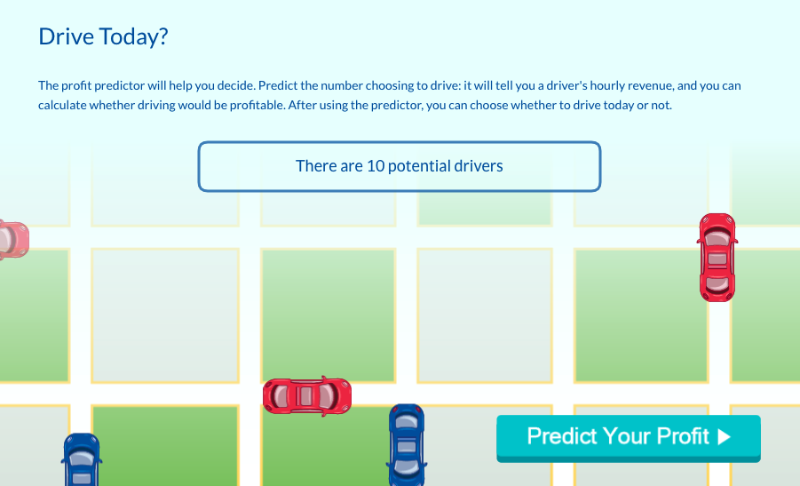
In the first round, you will be told how many drivers are in the market

Slide 5
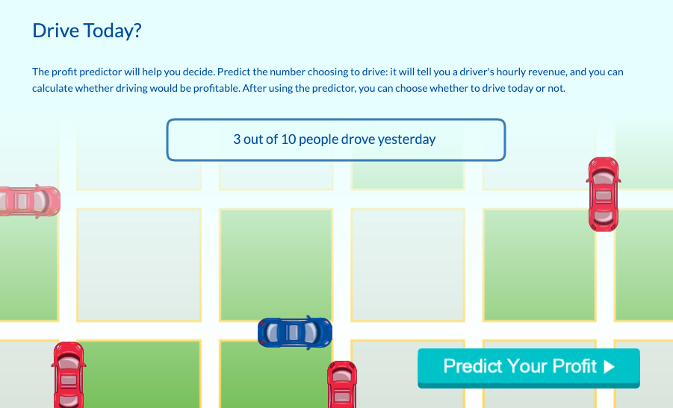
In the following rounds, you will be told how many drivers decided to drive yesterday

Slide 6
Use profit predictor to help you make the decision to drive or not

Slide 7
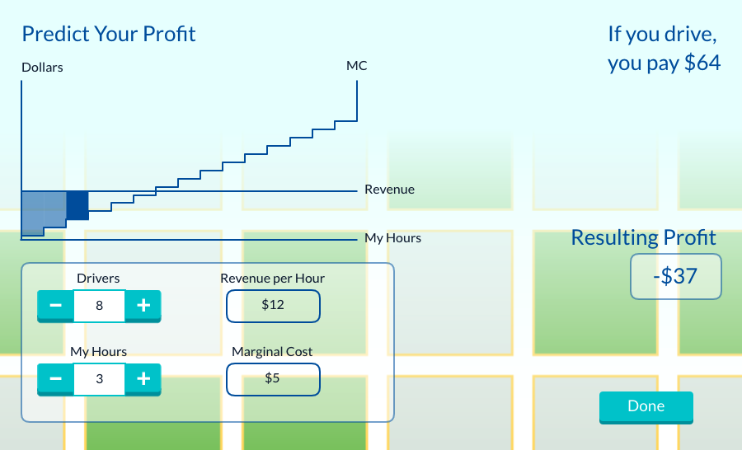
Explore how different numbers of drivers and hours affect your profit
Your fixed cost for driving
Your predicted profit
Number of drivers affects Revenue/Hr
Number of hours affects Marginal Cost

Slide 8
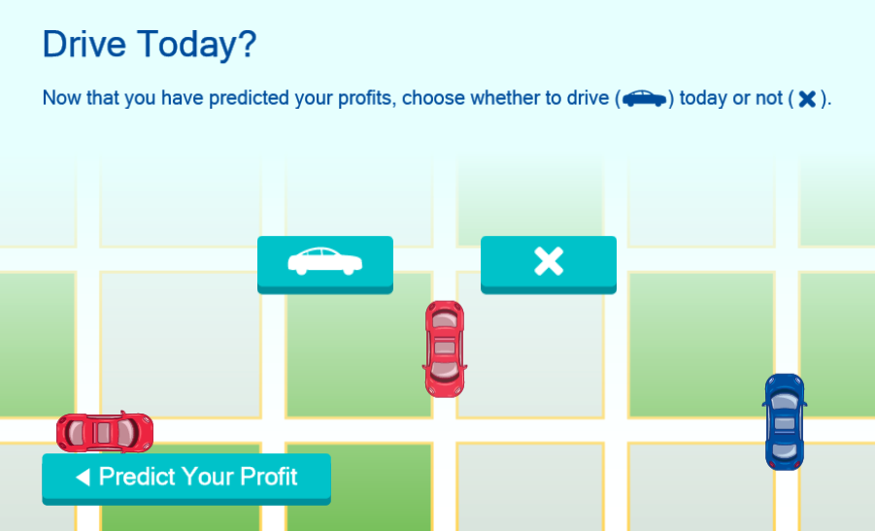
Decide whether or not you want to drive today
Drive today
Don’t drive today
Return to previous screen

Slide 9
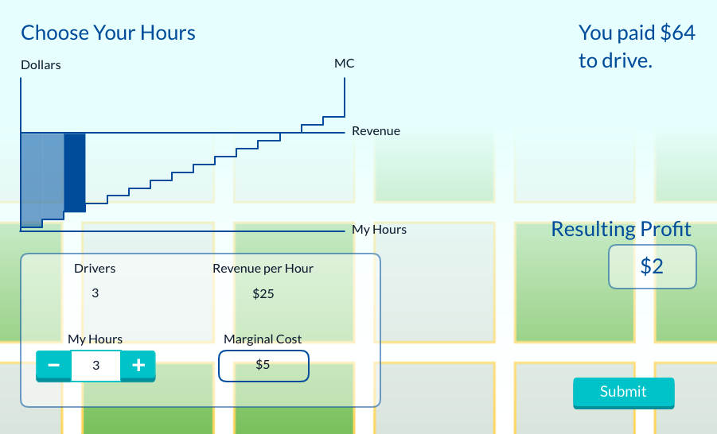
Choose how many hours to drive (If you didn’t drive, see what you could’ve made)
Your fixed cost for driving
Your actual profit
Number of drivers this round
Choose the number of hours to drive

Slide 10
Pre-Game Survey
Price Takers
Notes:
Run the survey Pre-Game Survey – Price Takers in your playlist
Question 1: If there are 3 drivers who enter the market, and you choose to drive 3 hours as in the following image, what is the resulting profit?
https://moblab-poll-images.s3.amazonaws.com/438f6eff-959e-4aa9-8550-9775183839cb-a96f7afe-8871-44ce-8209-31a6be286788/0.png?cacheBust=10LUv
$64
$2
$25
Impossible to tell
Question 2: If there are 10 potential drivers in the market, how many drivers will enter the market?
10
5
1
Impossible to tell

Slide 11
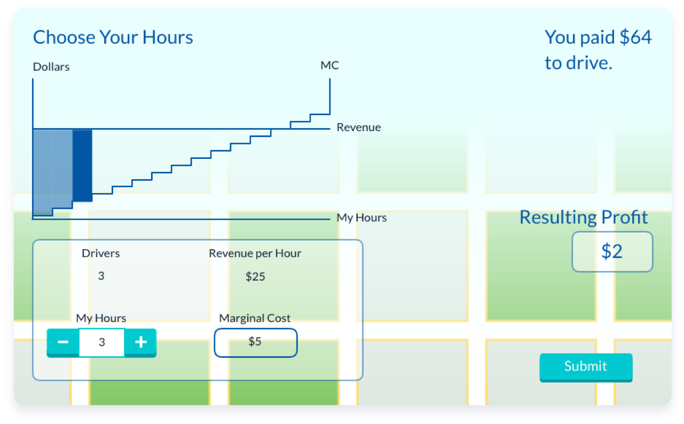
With the hours you choose, how much profit will you make?
Revenue – Fixed Cost – Variable cost = Profit
Revenue – Fixed Cost – Variable cost = Profit
(3 x $25)
$64
$9
$2
Notes:
Emphasize that the number of drivers is fixed at this stage, so profit maximization is down to the individual’s choice of hours.

Slide 12
How many drivers will enter the market?
Lets find out:
You’ve been told to maximize your profits (or minimize your losses!)
Theory predicts how many drivers there will be in a perfectly competitive market.
Everyone is a price taker in this market!
How accurate will the prediction be?

Slide 13
Game Time!
Price Takers
Notes:
Configure the game with the default options selected.
Run the game Price Takers in your playlist

Slide 14
Post-Game Survey
Price Takers
Notes:
Run the survey Post-Game Survey – Price Takers in your playlist.
Question 1: When maximizing profit, how did you decide how many hours to drive?
When marginal revenue equals marginal cost
When profit is zero
When variable cost is minimized
Gut feeling and intuition
Question 2: What do you think was the long run equilibrium number of drivers in the market?
10
0
3
6

Slide 15
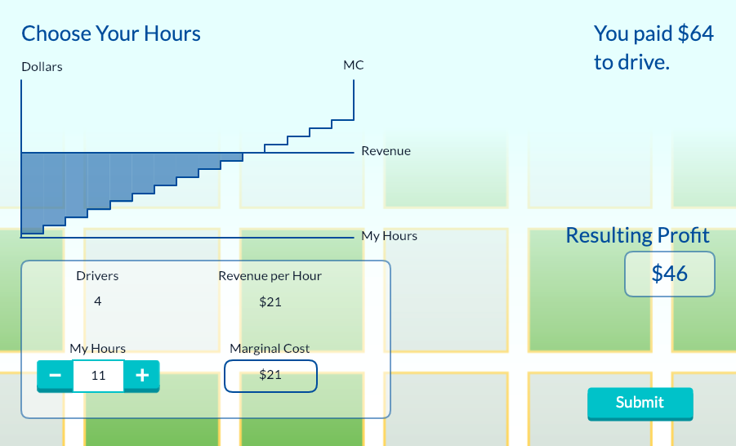
How many hours should you drive in order to maximize profit?
When marginal revenue equals marginal cost!

Slide 16
What was the long-run equilibrium number of drivers?
# of Drivers | Hours (MR = MC) | Profit
1 | 15 | $341
2 | 15 | $191
3 | 12 | $92
4 | 10 | $46
5 | 9 | $17
6 | 8 | $0
7 | 7 | -$15
8 | 6 | -$28
9 | 5 | -$34
10 | 5 | -$39
6
Notes:
You can begin to discuss how the market (in-game or real-life) would adjust to the equilibrium, and why the equilibrium would be stable.

Slide 17
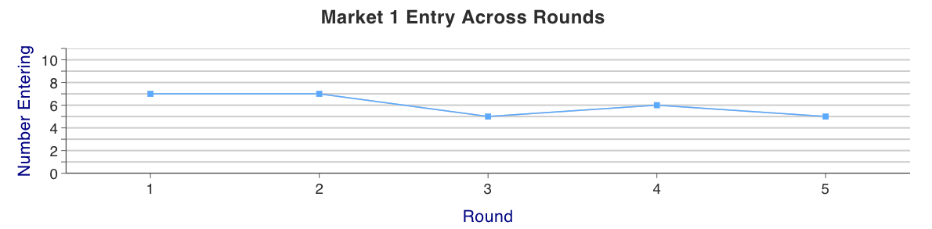
What was the long-run equilibrium number of drivers?
Equilibrium number of drivers: 6
6
Notes:
COMING SOON: A better graph

Slide 18
Results Discussion
Price Takers

Slide 19
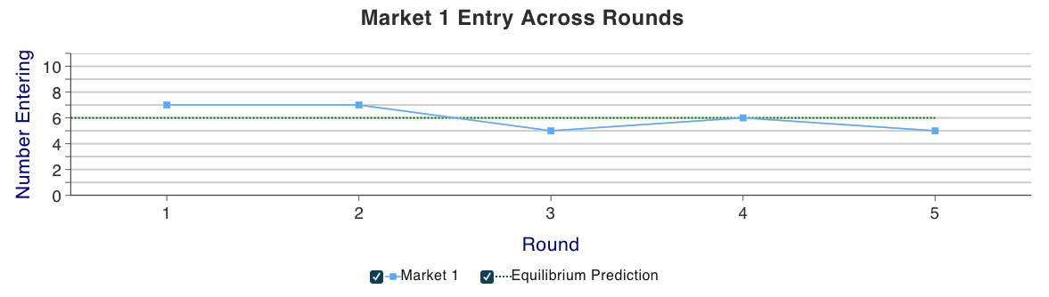
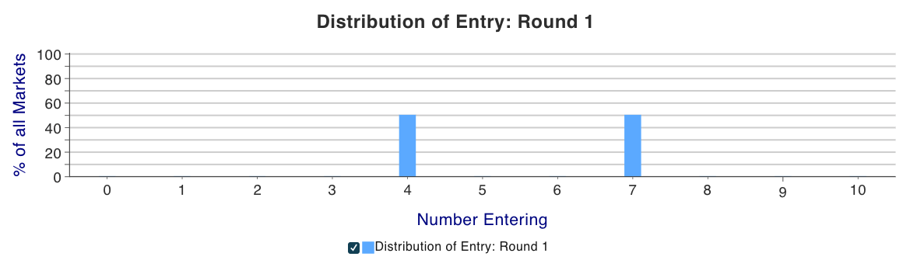
In the long-run the number of producers trend toward the equilibrium.

Slide 20
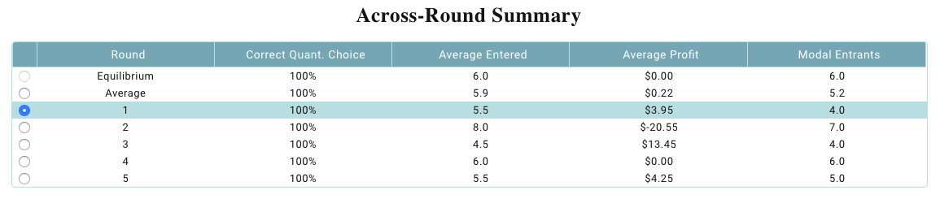
Look at the round by round summary to see the average producers, profit, correct short-run decisions.

Slide 21

Concept Review
Price Takers
Notes:
Run the survey Concept Review – Price Takers in your playlist
Question 1: Which of the following are true in the long-run at equilibrium?
Drivers will have an incentive to join the market due to its stability.
Drivers will have an incentive to leave the market due to low economic profits.
Drivers will not have an incentive to enter or exit the market.
Drivers will not make an accounting profit.
Question 2: What was the long-run equilibrium profit in this perfectly competitive market?
$64
Unlimited
$0
Impossible to know

Slide 22
What is the long-run equilibrium profit?
If there is positive economic profit:
Firms have incentive to enter the market
If there is negative economic profit:
Firms have incentive to leave the market
If there is zero economic profit:
Firms have neither incentive to enter nor exit the market, resulting in equilibrium
Drivers will still make an accounting profit, but make no economic profit
Notes:
This slide summarizes both concept review questions.

Slide 23
Key Takeaways
Price Takers accept the price that the market determines.
There are many buyers and sellers in the market.
Goods offered by producers are largely identical.
Producers may freely enter or exit the market
For a market to be considered a perfectly competitive market, it must consist of Price Takers and have low barriers to entry and exit.

Slide 24
Completed
Price Takers

