Slide 1
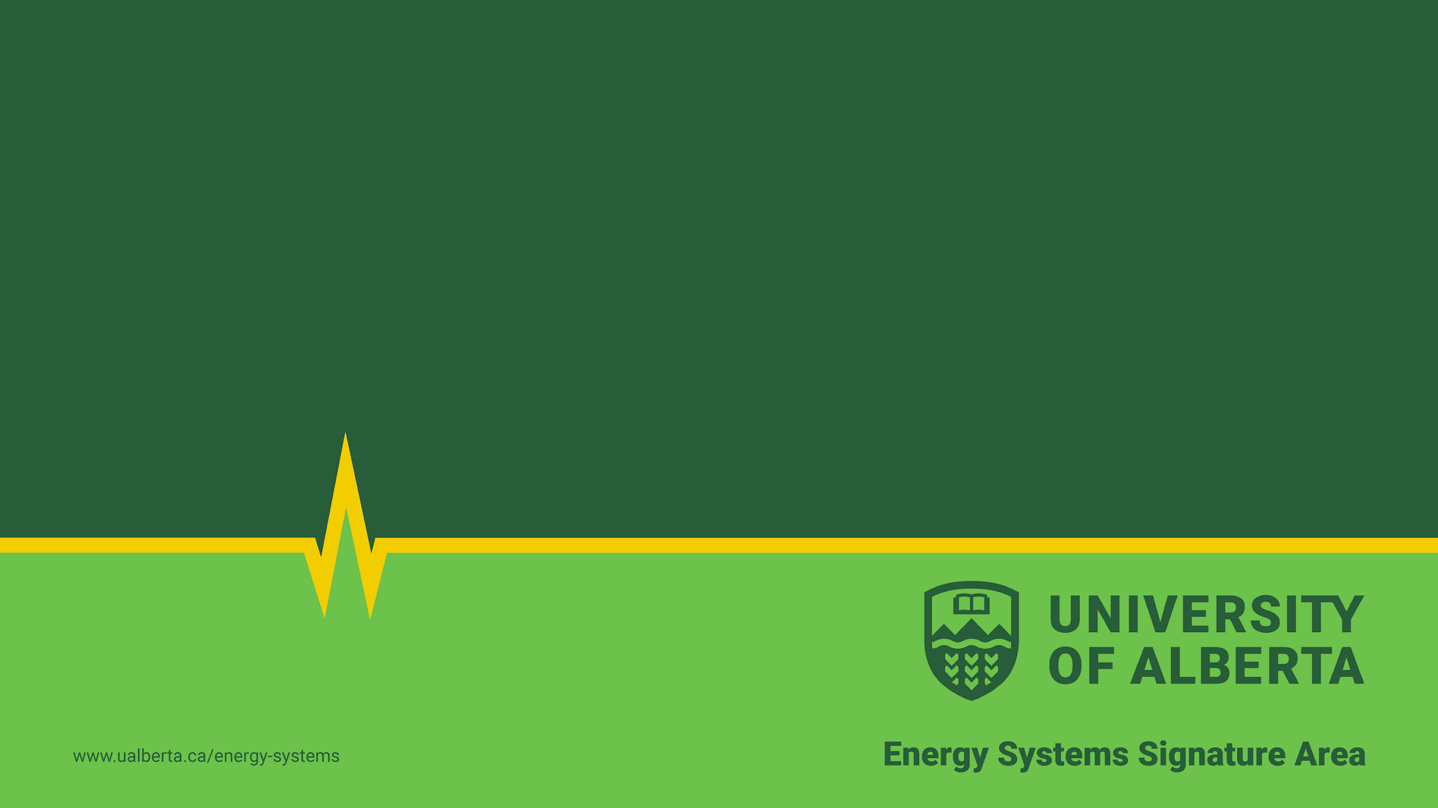
The nerd value of solar power
Our household energy system: how it works, and whether it will pay for itself
Andrew Leach, Alberta School of Business
Caption

Slide 2
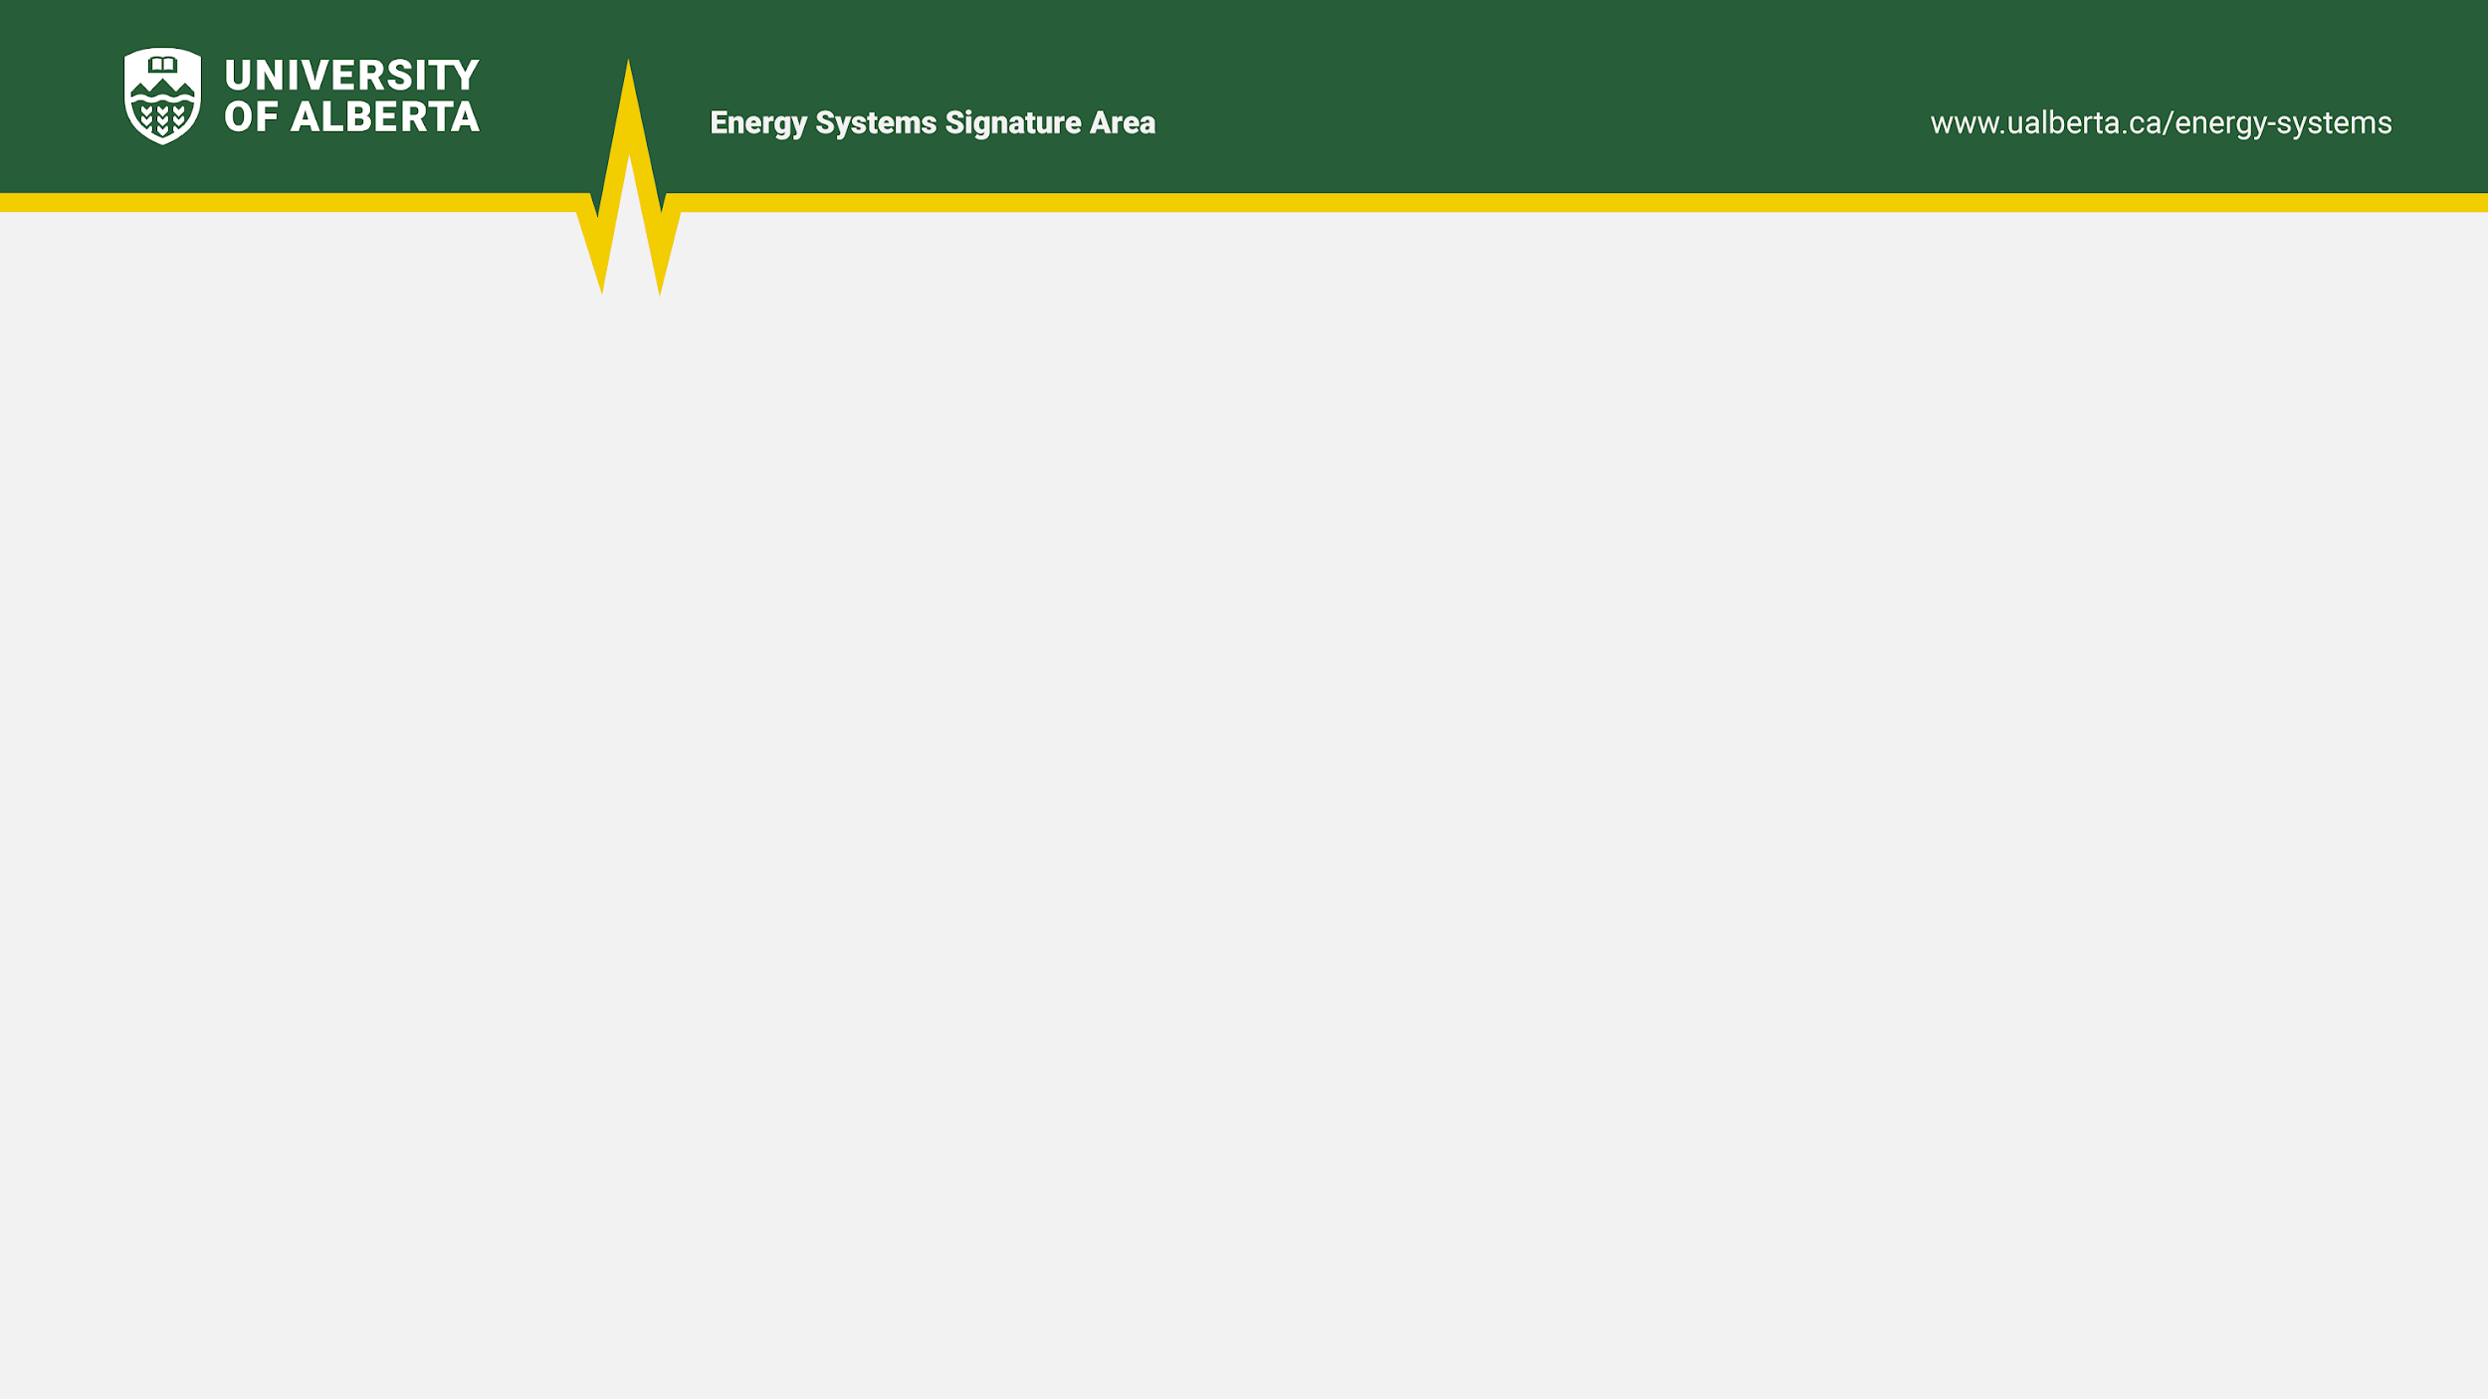
How did we end up with a solar power system?
Text
Caption

