Slide 1
DJ AFTER
Phone DJ System for
Home Parties
Before, During & After
Notes:
Security Analytics is a browser based toolkit that will allow the user to analyze their favorite financial securities and portfolio.
O

Slide 2
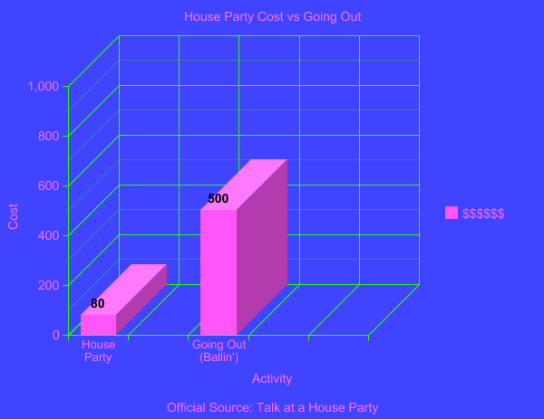
REAL GRAPH

Slide 3

Who Needs it?
People having a house Party with everyone having different music tastes. Switching phones, looking up the songs is time music is not playing.
The bar closes, you want to have an after party with your new friends and your music isn’t the vibe of the people. Your new friends can send you party music.
Your significant other is at home and is listening to music and you are out of country and want to send her a song that has a meaning.

Slide 5
What will it do?
DJ will log into the DJ Site and invite people to give access to view the playing music list.
The DJ kids will be able to search/ select songs and send to Main DJ’s Phone connected to the speaker.
The main Host DJ can set the music to play in the order that they want or people can suggest.

Slide 6
What we used
React
Spotify API
Socket.io
Express
Node.js
Mongo
MERN Login Security

Slide 7
The Future Home DJ
2019 – Being able to have more than one other DJ to hook up
2019 – Being able to get ahold of your own playlist
2020 - Being able to keep your favorite playlist from your favorite parties.
2021 – Same thing every 21 year old wants to do after a couple shots of Taquila Pinky. TRY TO TAKE OVER THE WORLD!!!

Slide 8
Questions?

